Slide 1
Rent A Car
Submitted to:
Lucas Brancatella
Soumaya Chaffar
Pargol Poshtareh
Submitted by:
Keerthana Nimmagadda 1893679
Durga priya Kalam 1892807
Sai Manasa Goka 1892793
Padma Prabhasa Inturi 1893686
Navya Damuluri 1892832
Kowkshitha idamakanti ranga 1893145
Rajwinder singh 1795544
Navdeep kaur 1795515

Slide 2

Introduction
Rent A Car Mobile Application was designed and implemented to Rent cars better than the traditional methods.
Android based mobile application will be helpful to the people who are looking for cars for rent in temporary bases.

Slide 3
Aims and Objectives
To produce a mobile based application that allow customer to register and reserve cars through this application
To provide the company to effectively manage their car rental business
To ease customers task whenever they need to rent a car

Slide 4
Why Rent A Car?
Helps the users to quickly rent a car without any hassle
Provides
Flexibility to users
User friendly
GUI
Provides 24 * 7 customer support

Slide 5
Functional Requirements
Users must login to use the application
Admin, clerk, and customers can login using their username and password
Users can search cars by the type of cars and by the year of manufacturing
Users can view detail description of vehicle based on his needs
Users can have access all history of their previous bookings
Customer Can make payments by using online payment
Personal information of the customer and payment card details are fully secured
Clerk can update information of the vehicle
Admin can create, update and delete the access for staff members

Slide 6
Non-Functional Requirements
User Friendly: System must be easy to use so that new user can use it without difficulties
Performance: Response time is short, and application can handle numerous users at the same time
Security: The system provides security to the customer by encrypting all their personal data.
Error handling: In case of system crash, application recovers the user data by maintaining backup of customer records in multiple databases.
Responsive View: Display accurately and efficiently on all devices

Slide 7
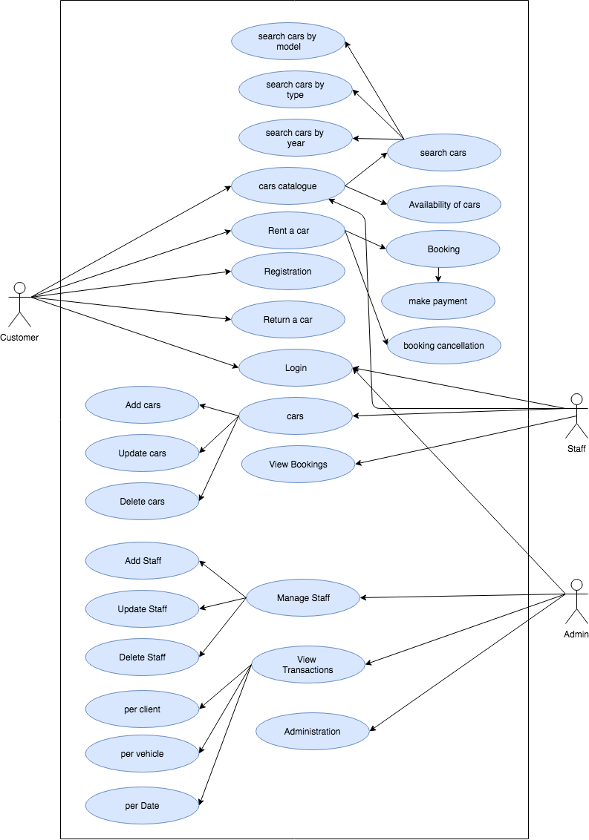
UseCase Diagram

Slide 8
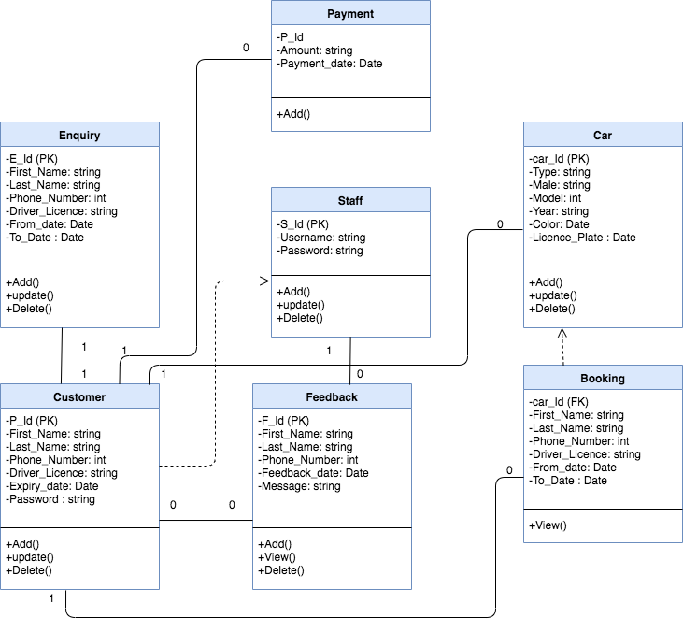
Class Diagram

Slide 9
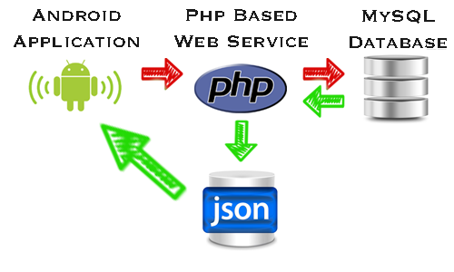
Database

Slide 10
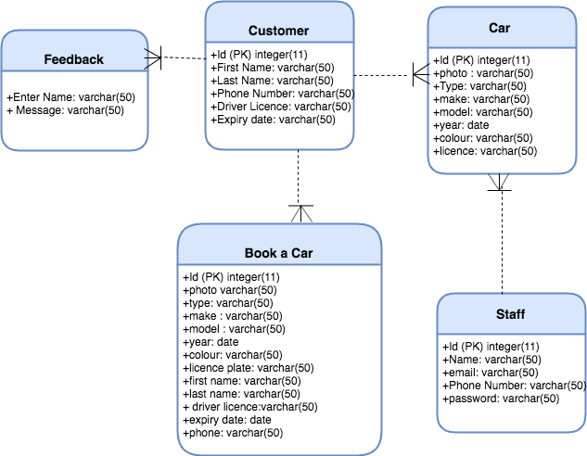
Database Schema

Slide 11
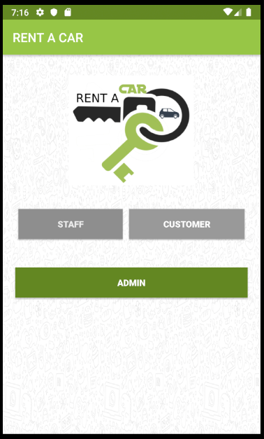
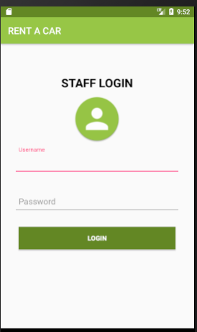
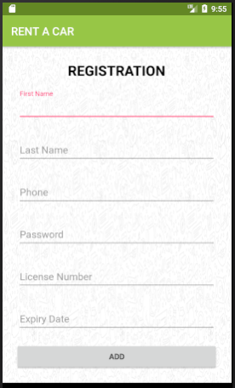
Login and register Screens:

Slide 12
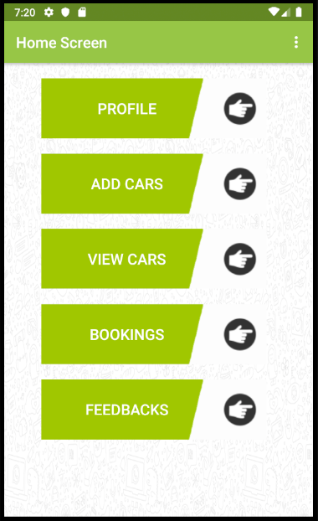
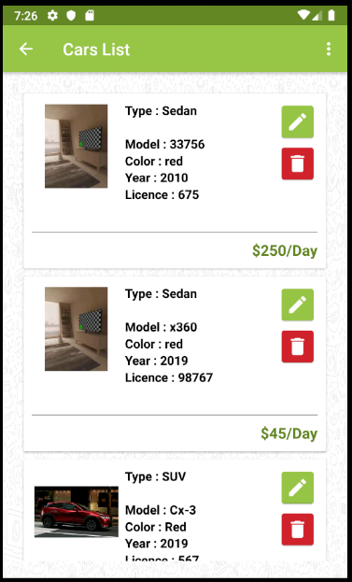
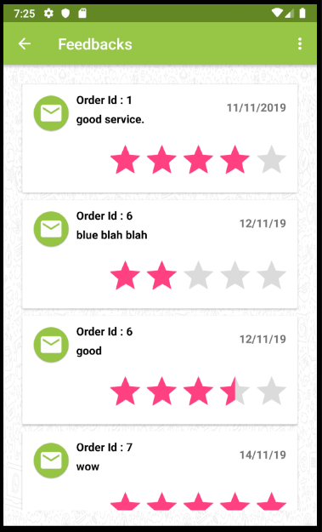
Staff Screens:

Slide 13
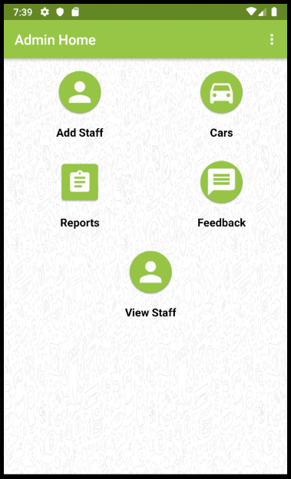
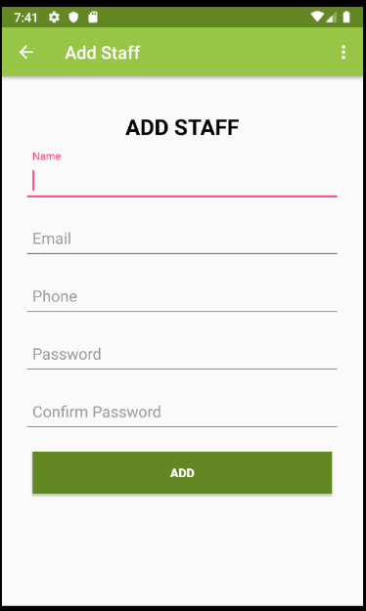
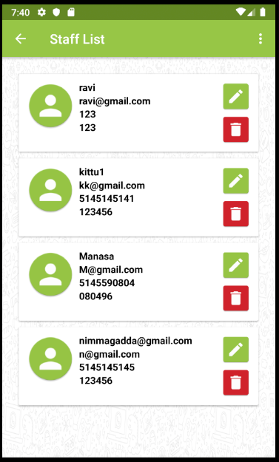
Admin screens:

Slide 14
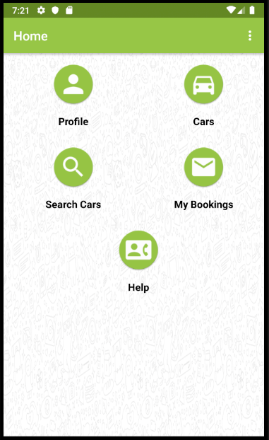
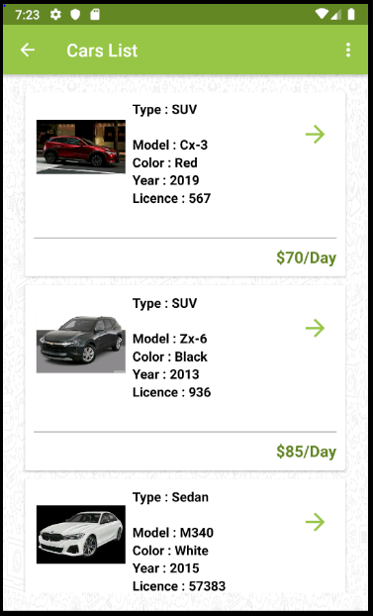
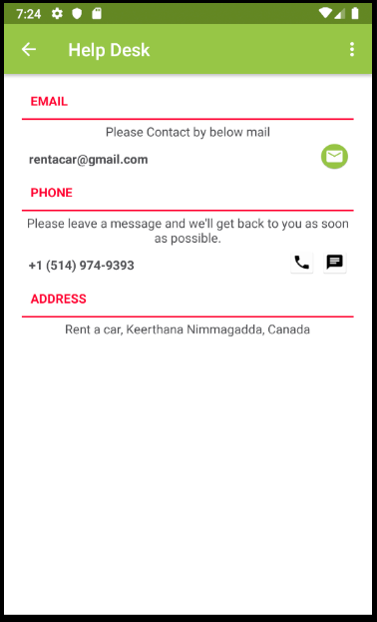
Customer Screens:

Slide 15
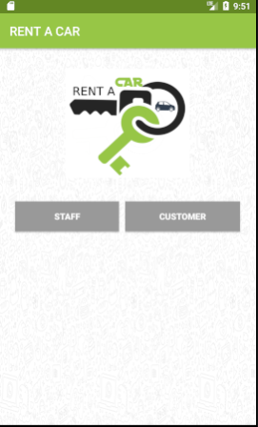
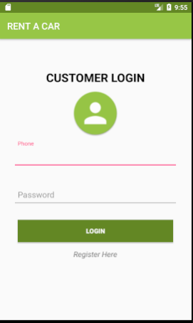
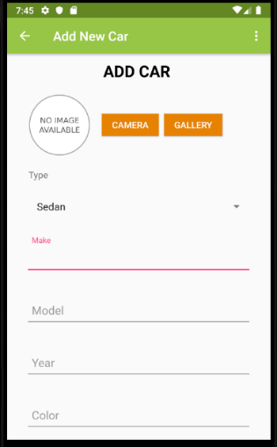
Screen Flow Diagram:

Slide 16
Conclusion:
The problem that undergo for Car Rentals was a lack of real time car renting for their customers.
In order to overcome this problem, we develop an android application that would allow for users to purchase their service with ease and admiration.
Customers will be able to rent and view vehicles by logging into the application
We came up with solution that was able to provide Car Rental with a user-friendly Android application that would allow for customers to access easily.

Slide 17

Questions?

Slide 18



