Slide 1
DashQuest Power BI Challenge
Amazon E-Commerce Sales Analysis
Keerthana R R

Slide 2
Objective & Dataset
- Analyze sales trends and business performance
- Dataset: Amazon Sales Report (2021–2023)
- Tools: Python (Colab) for cleaning, Power BI for dashboard
- Deliverables: Dashboard + Strategic Recommendations

Slide 3
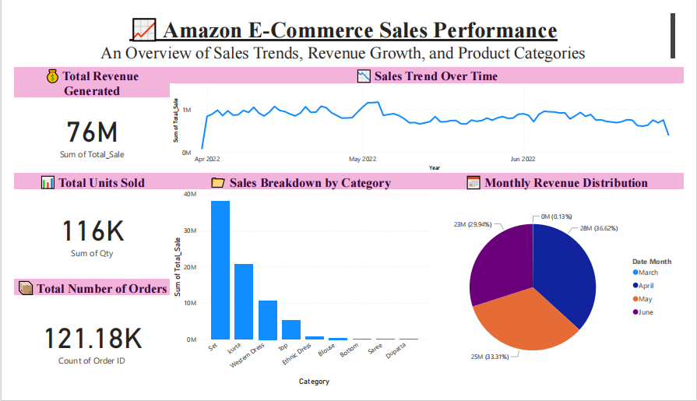
Page 1

Slide 4
Sales Performance Overview
- Total Revenue: ₹76M
- Total Orders: 121K
- Total Quantity Sold: 116K
- Healthy and consistent transaction volume observed

Slide 5
Sales Trends & Monthly Insights
- Line Chart: Sales Trend Over Time
- Bar Chart: Sales by Month
- Category-wise: Apparel leads consistently
- Q2 shows peak sales activity

Slide 6
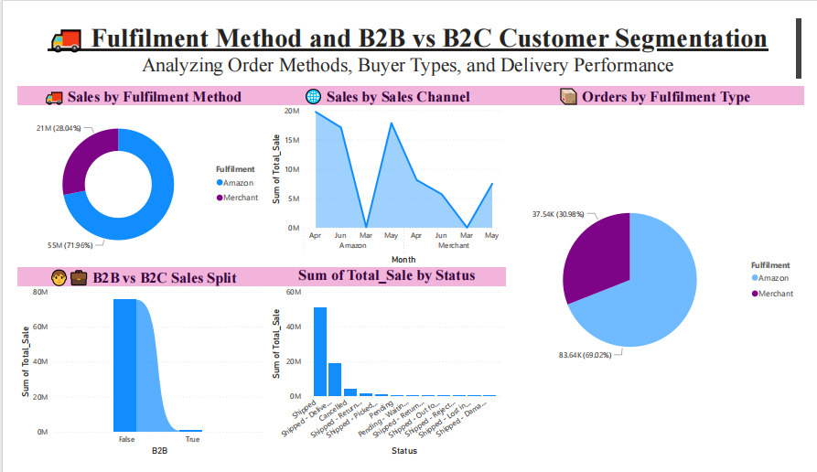
page2

Slide 7
Fulfillment & Delivery Overview
- Fulfilment Types: Amazon (72%) vs Merchant (28%)
- Courier Status: 66% Shipped, 4.95% Cancelled
- Unfulfilled orders suggest delivery challenges

Slide 8
Product-Level Insights
- Top SKUs: J0230, JNE3797
- High-performing Styles: SET268, J0341
- Best Sizes: M, L, XL
- Underperforming Sizes: 4XL, 5XL

Slide 9
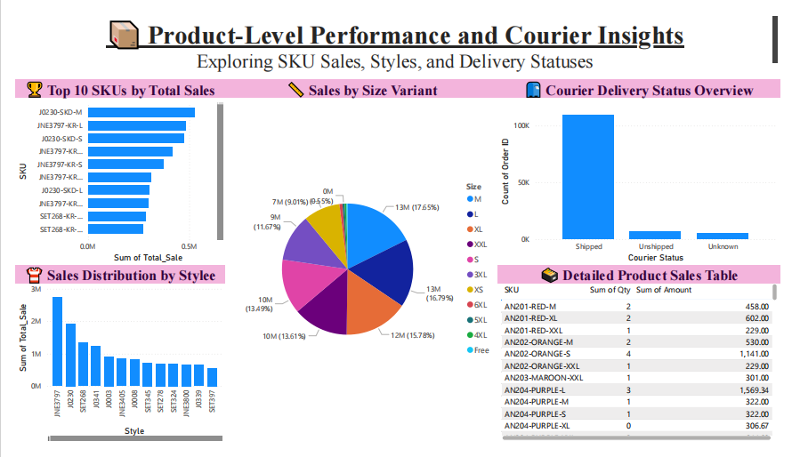
page3

Slide 10
Returns & Order Cancellations
- High cancellations observed Apr–Jun
- Status Funnel: Drop from shipped to delivered
- Sales impact due to returns

Slide 11
Profit Drivers & SKU Analysis
- Scatter Plot: High revenue, low quantity SKUs
- Zero/Low Sale SKUs identified
- Combo Chart: Sales velocity vs value
- B2B trendline growing steadily

Slide 12
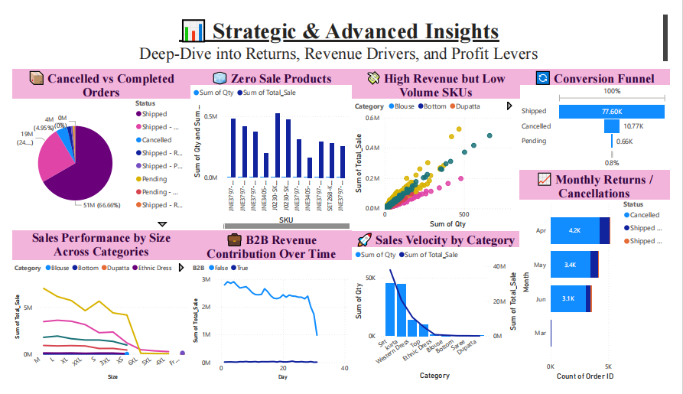
page4

Slide 13
Top Revenue Generating SKUs
- Horizontal Bar: Top 10 SKUs by Total Sales
- Ideal for promotions and inventory prioritization

Slide 14
Strategic Recommendations – CASEQUEST
- C: Focus on top categories (Apparel)
- A: Retarget high-sales cities (if available)
- S: Improve courier service reliability
- E: Bundle slow movers with bestsellers
- Q: Investigate product returns
- U: Upsell premium sizes and styles
- E: Reduce zero-sale SKUs
- T: Monitor B2B growth monthly

Slide 15
Summary of Key Insights
- Revenue peaks in Q2
- Category Apparel dominates
- Fulfillment delays impact CX
- Returns and cancellations cost revenue
- B2B is an emerging growth path

Slide 16
Thank You
Keerthana R R

