Slide 1
WELCOME !!! Local Food Wastage Management System Presentation
Skills: Python | SQL | Streamlit | Data Analysis

Slide 2
Introduction
The Local Food Wastage Management System connects surplus food providers with those in need to minimize waste and fight food insecurity. It utilizes technology to manage food listings, claims, and analyze data.

Slide 3
Technology Stack & Skills
Languages & Tools:
- Python
- SQL
- Streamlit
- Pandas/Matplotlib
Skills:
- Data Analysis
- CRUD Operations
- Database Integration

Slide 4
How It Works
1. Providers register and list surplus food.
2. Receivers browse and claim food.
3. System logs all activity in a SQLite database.
4. Streamlit app enables interaction and data visualization.

Slide 5
App Navigation & Pages
- Homepage: Overview, filtering, search
- Providers.py: Manage provider details
- Receivers.py: Manage receiver details
- Food Listings: View, update food
- Claims: Submit & manage claims
- Reports: Analytics & charts
- About: Project description

Slide 6
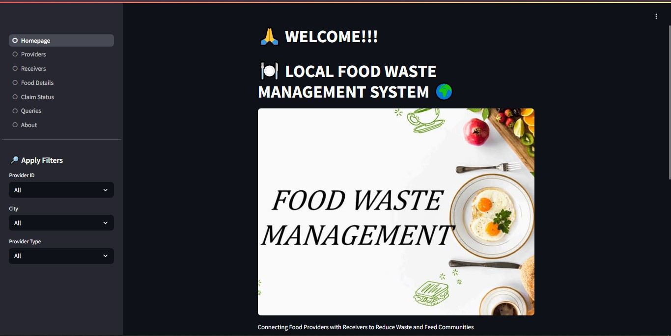

Slide 7
HOME PAGE VIEW

Slide 8
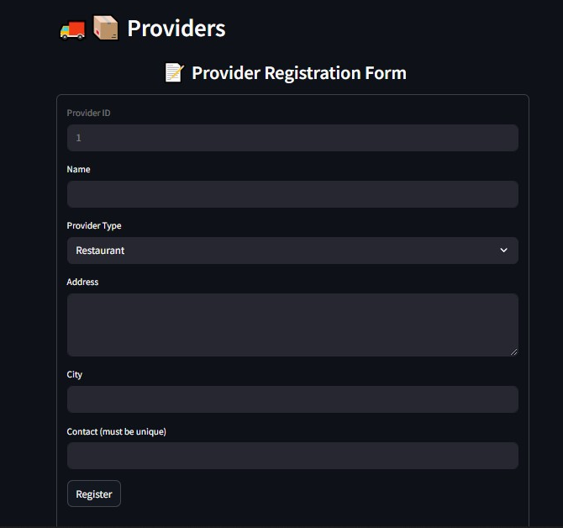
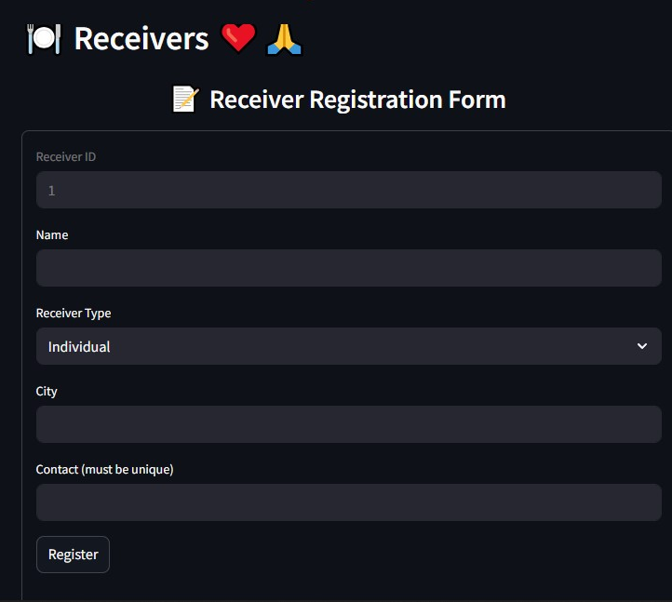
PROVIDER \ RECEIVER VIEW

Slide 9
Database & Dataset Description
Four Key Datasets:
1. Providers: ID, Name, Type, Address, City, Contact
2. Receivers: ID, Name, Type, City, Contact
3. Food Listings: ID, Name, Qty, Expiry Date,PID,PType, Location, Food Type,Meal Type
4. Claims: Claim ID, Food ID, Receiver ID, Status, Timestamp

Slide 10
CRUD Operations
Functionalities:
- Create new food/provider/receiver records
- Read all listings and filter them
- Update existing data entries
- Delete outdated or invalid entries

Slide 11
SQL Query Examples
1).Providers/receivers per city :
SELECT p.City,
COUNT(DISTINCT p.Provider_ID) AS Providers,
COUNT(DISTINCT r.Receiver_ID) AS Receivers
FROM providers p
LEFT JOIN receivers r ON p.City = r.City
GROUP BY p.City
2).Total food quantity available for providers:
SELECT SUM(Quantity) AS Total_Quantity FROM food_listings

Slide 12
3).Claims per food item :
SELECT f.Food_Name, COUNT(c.Claim_ID) AS Total_Claims FROM claims c
JOIN food_listings f ON c.Food_ID = f.Food_ID
GROUP BY f.Food_Name
ORDER BY Total_Claims DESC
4). meal type is claimed the most :
SELECT Meal_Type, COUNT(*) AS Claim_Count
FROM food_listings f
JOIN claims c ON f.Food_ID = c.Food_ID
GROUP BY Meal_Type
ORDER BY Claim_Count DESC LIMIT 1

Slide 13
Data Analysis & Insights
- Most frequent food providers
- Highest demand locations
- Food wastage over time (trend lines)

Slide 14
Thank You
Local Food Wastage Management System

