Slide 1


DIGITAL BOOKS
PROJECT BY KEERTHANA
GUIDED BY SURESH

Slide 2
INTRODUCTION Build digital solutions with best user experience
The primary goal of Digitalization is to provide people with all sort of technologies in fingertip
One of which is Digital Books Store
Digital Books provides user with wide range of different books available for purchase in the store to read
One can create book, buy and read it digitally.

Slide 3
PROBLEM STATEMENT
In Book Store, customer searches for required book and purchases it in person
This process requires every aspect – customer presence in book store, searching for book and buying it with money
To overcome all these aspects, proposing a online book store which can be used to buy, create and read book over online using electronic gadget.

Slide 4
FUNCTIONAL REQUIREMENTS

Slide 5
MAIN ROLES
Author
Reader
Guest

Slide 6
AUTHOR
Author should be able to do following actions in digital book app
Create author account
Sign in
Create books
Edit books
Block or Unblock book

Slide 7
READER
Reader should be able to do following actions in digital book app
Create account
Sign in
Search Books
Buy Books
Read Purchased Books
View payment history using email id
View Invoice using payment id
Ask for Refund within 24 hrs of payment

Slide 8
GUEST
Guest should be able to do following actions in digital book app
Search books without login
Buy book with email id
Read purchased book
View payment history using email id
View Invoice using payment id
Ask for Refund within 24 hrs of payment

Slide 9
TECHNICAL REQUIREMENT
Asp.Net Core Web api – Back end
Angular – Front End
SQL server - Database

Slide 10
SOFTWARE REQUIREMENTS
Visual Studio
Visual Studio Code
Sql Server Management Studio
Azure
Rabbitmq
Postman
Swagger

Slide 11
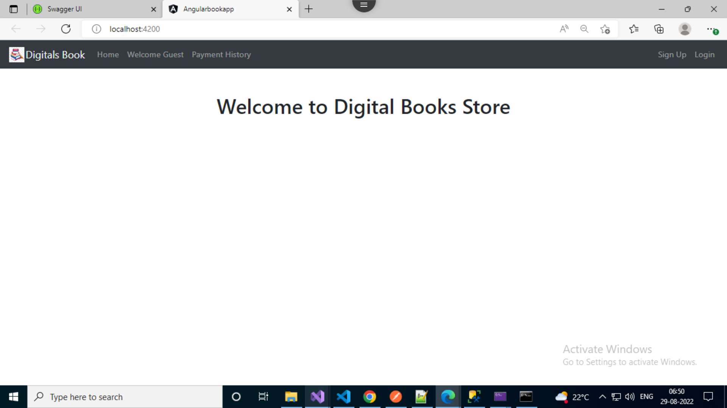
Landing Page

Slide 12
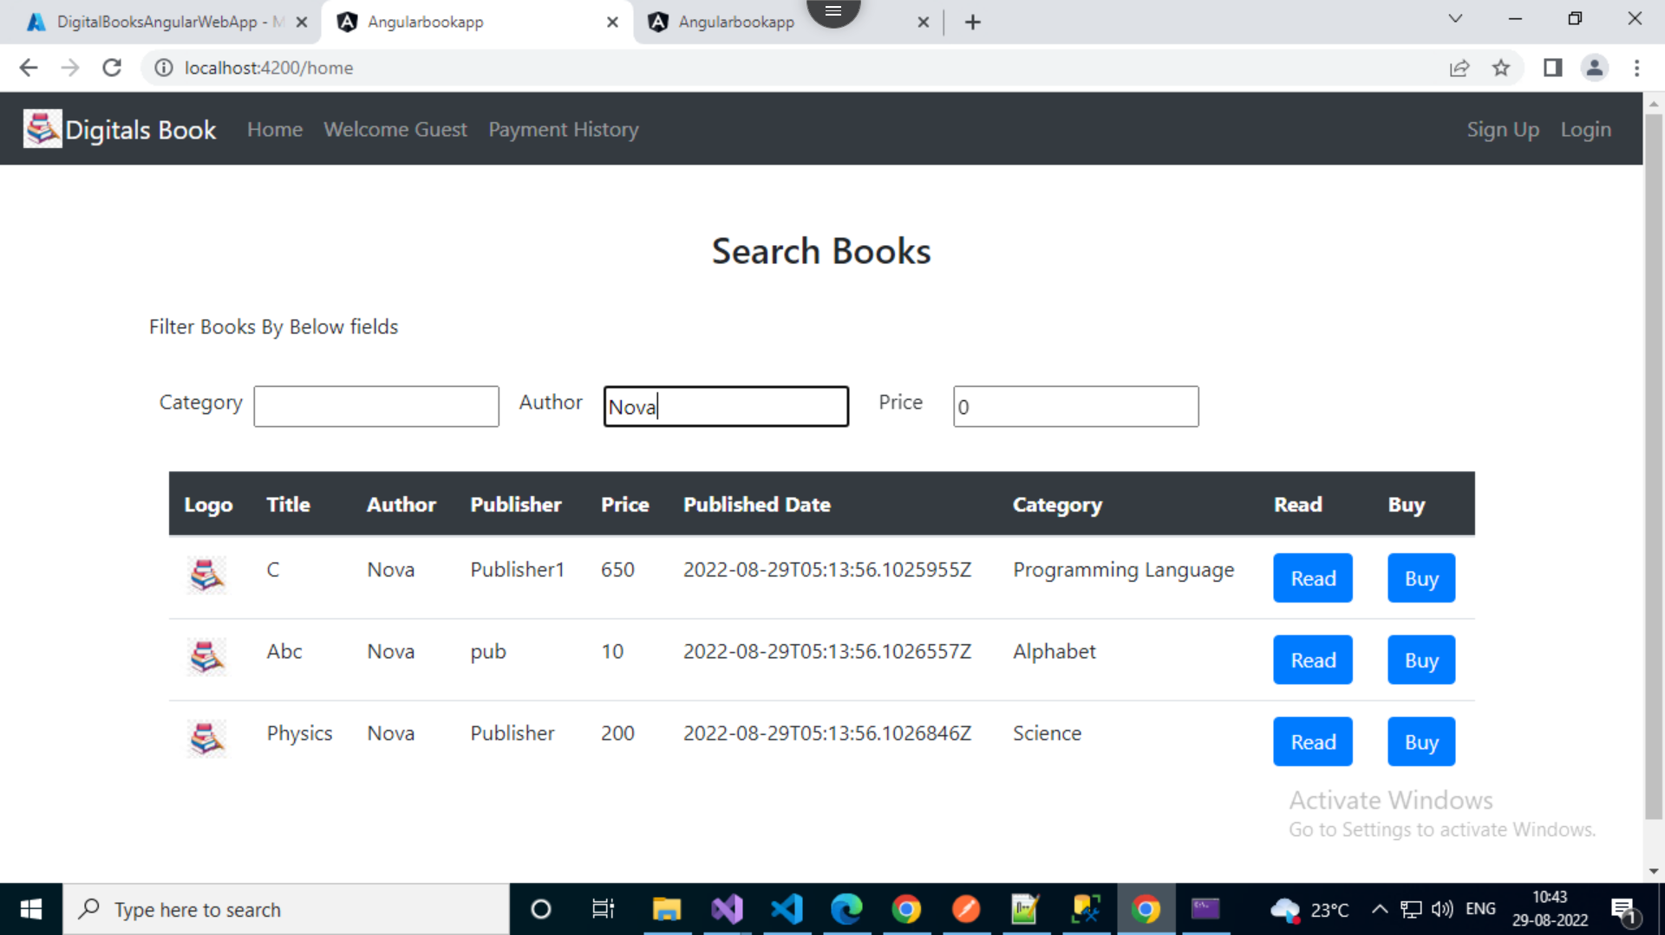
Home Page

Slide 13
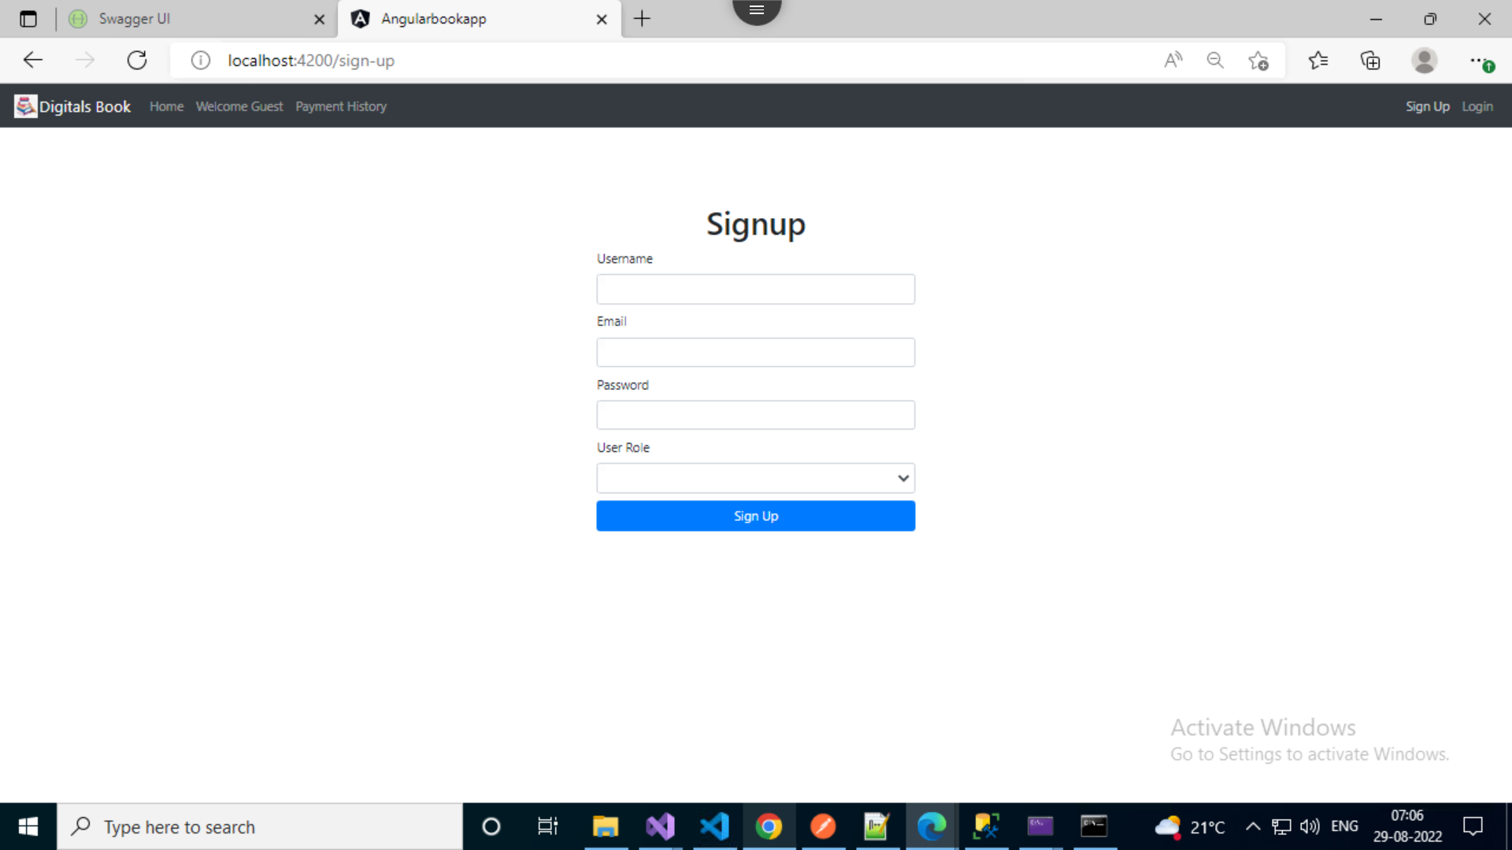

Slide 14
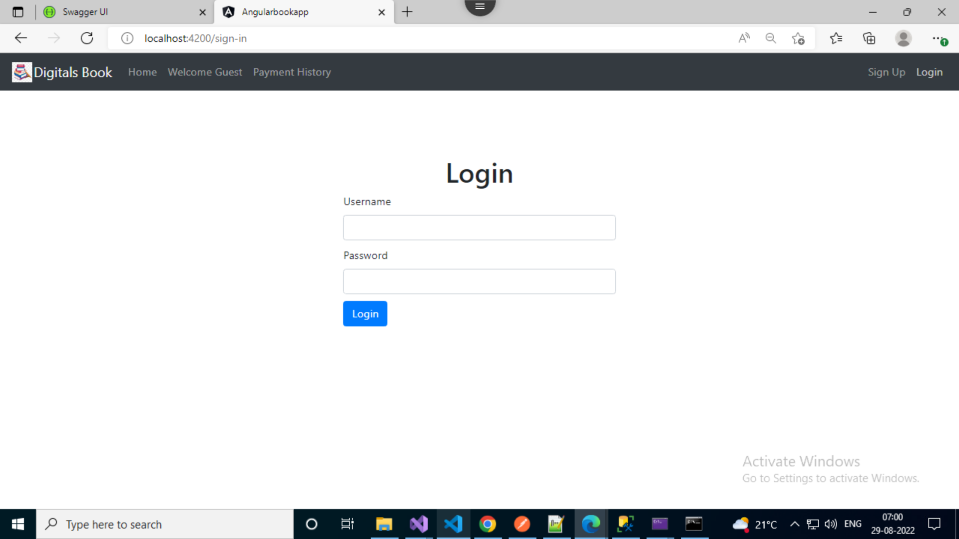

Slide 15
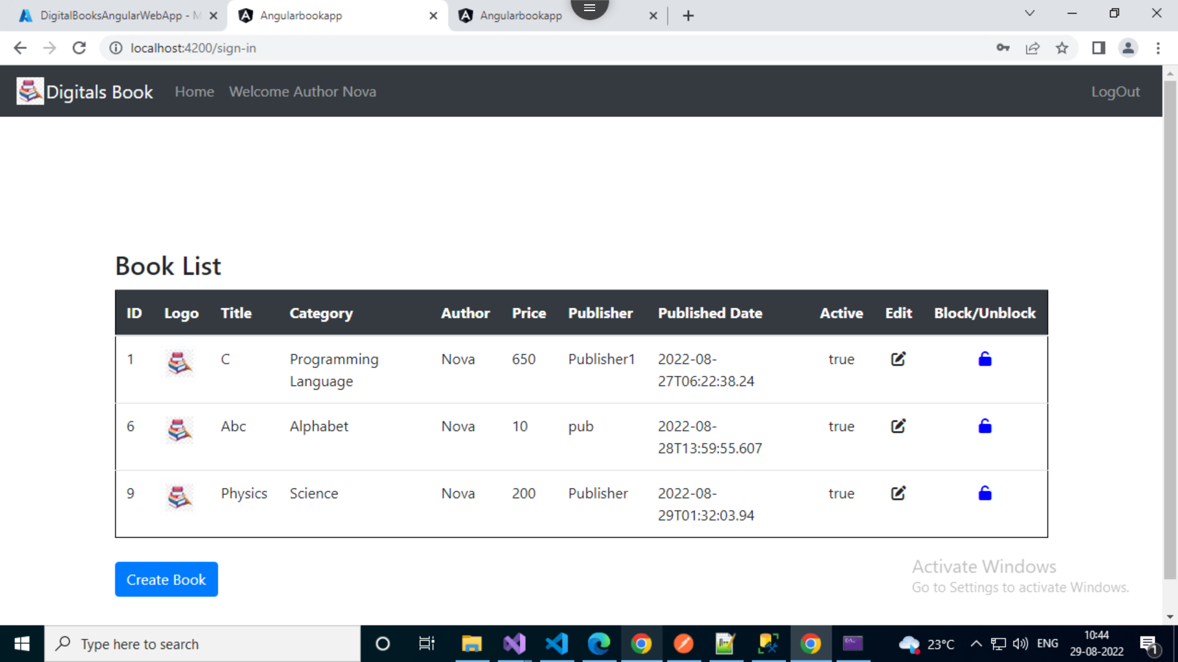
Author Login

Slide 16
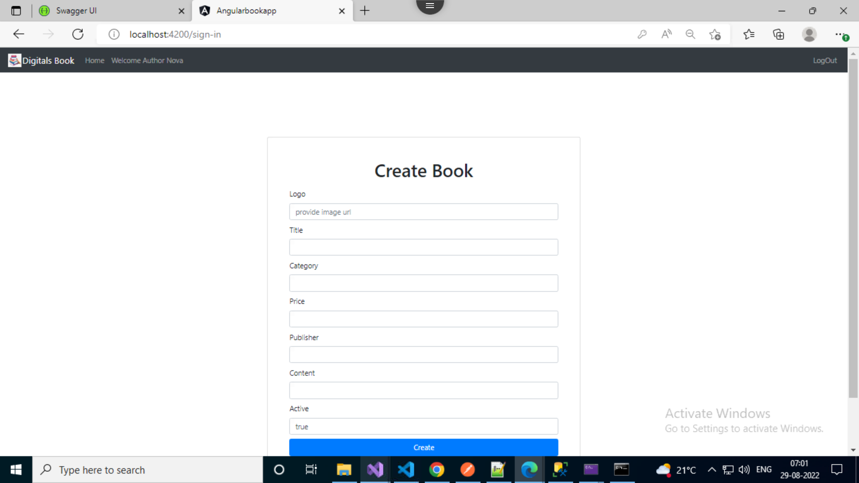

Slide 18
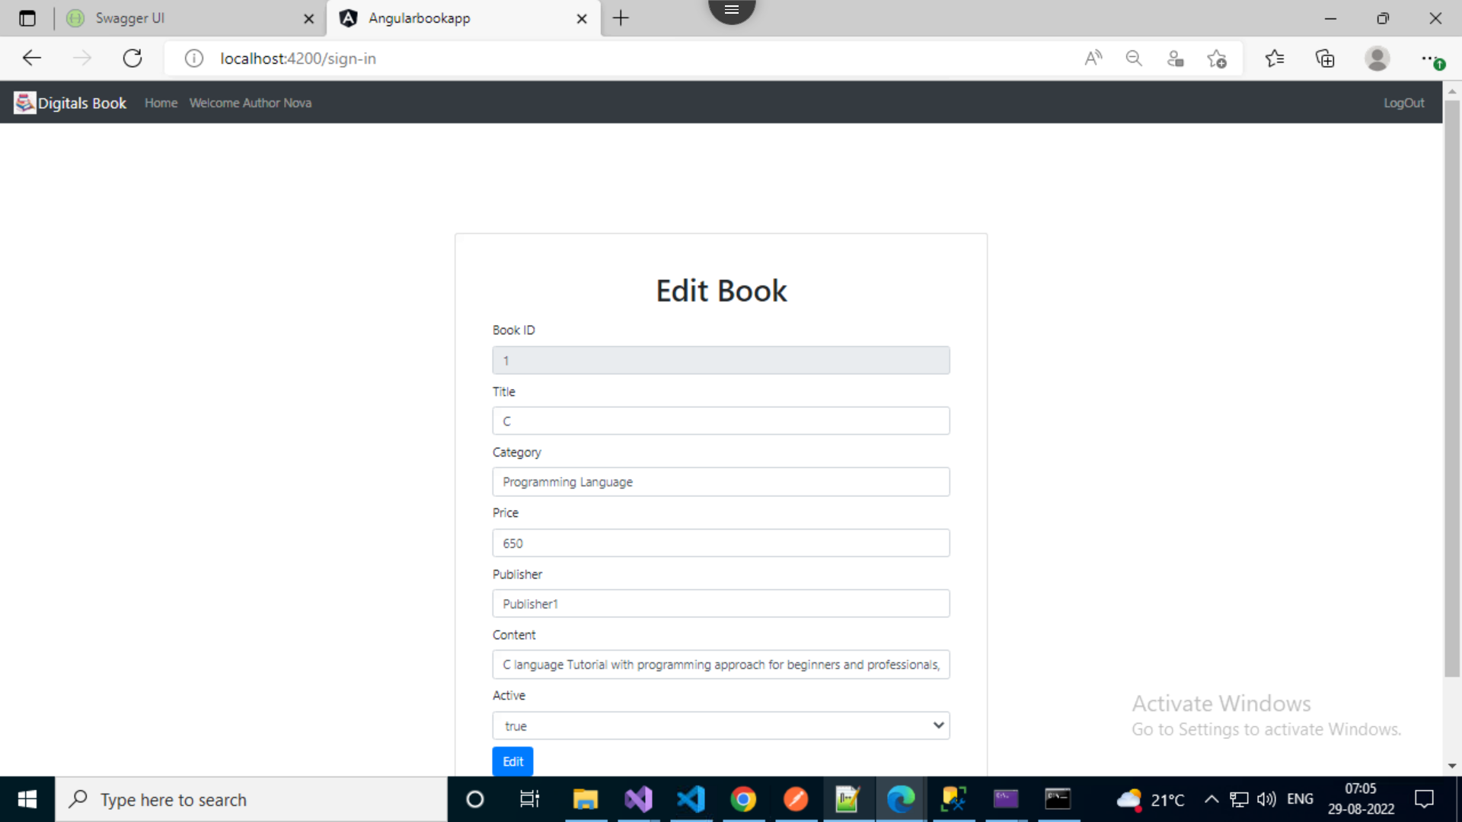

Slide 19
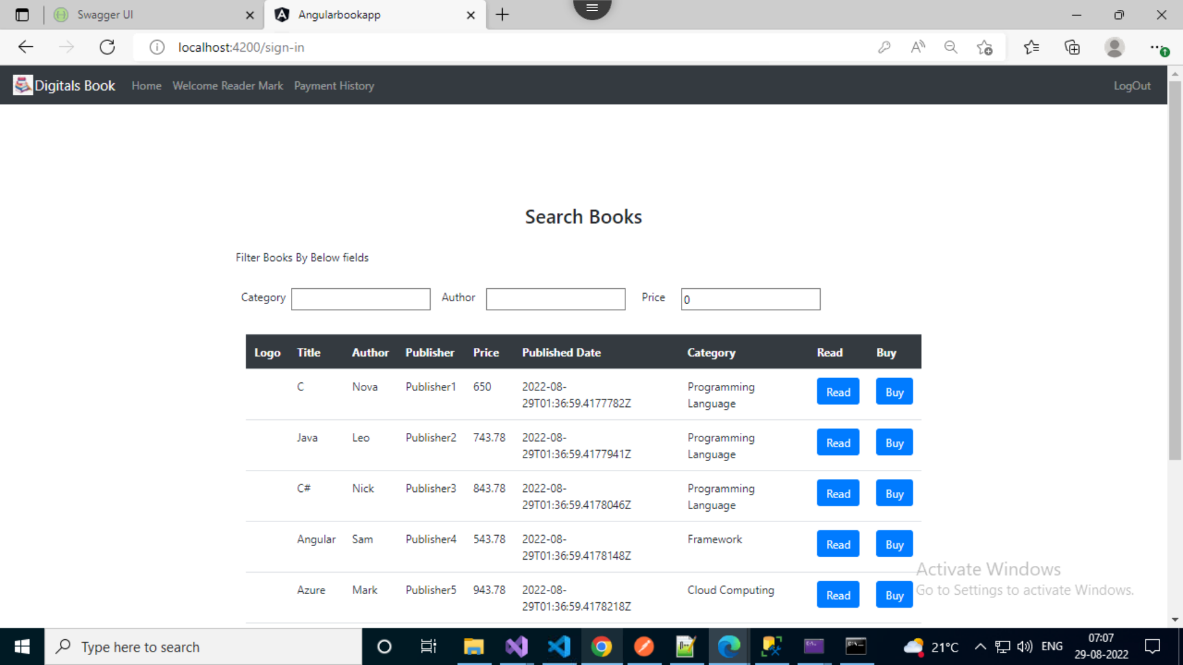
Reader Home

Slide 20
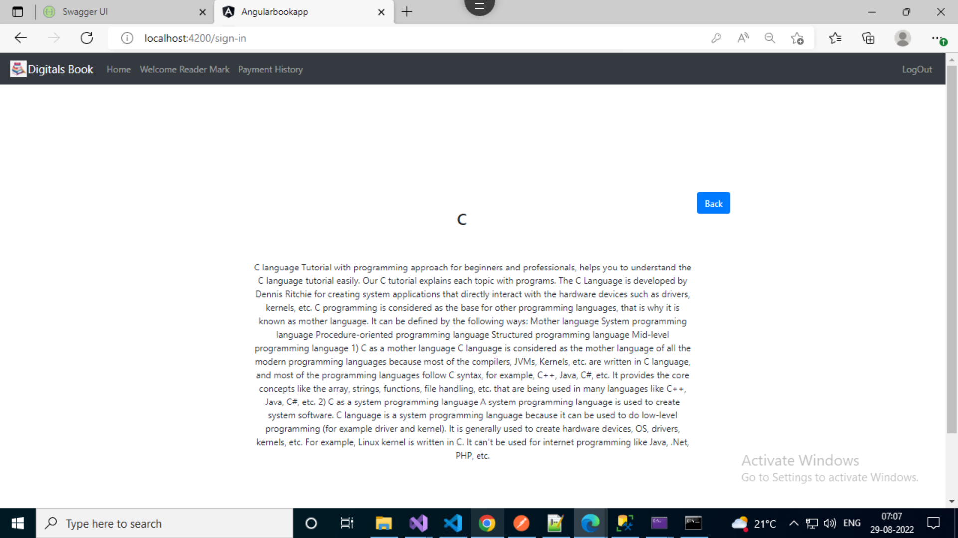
Read Book

Slide 21
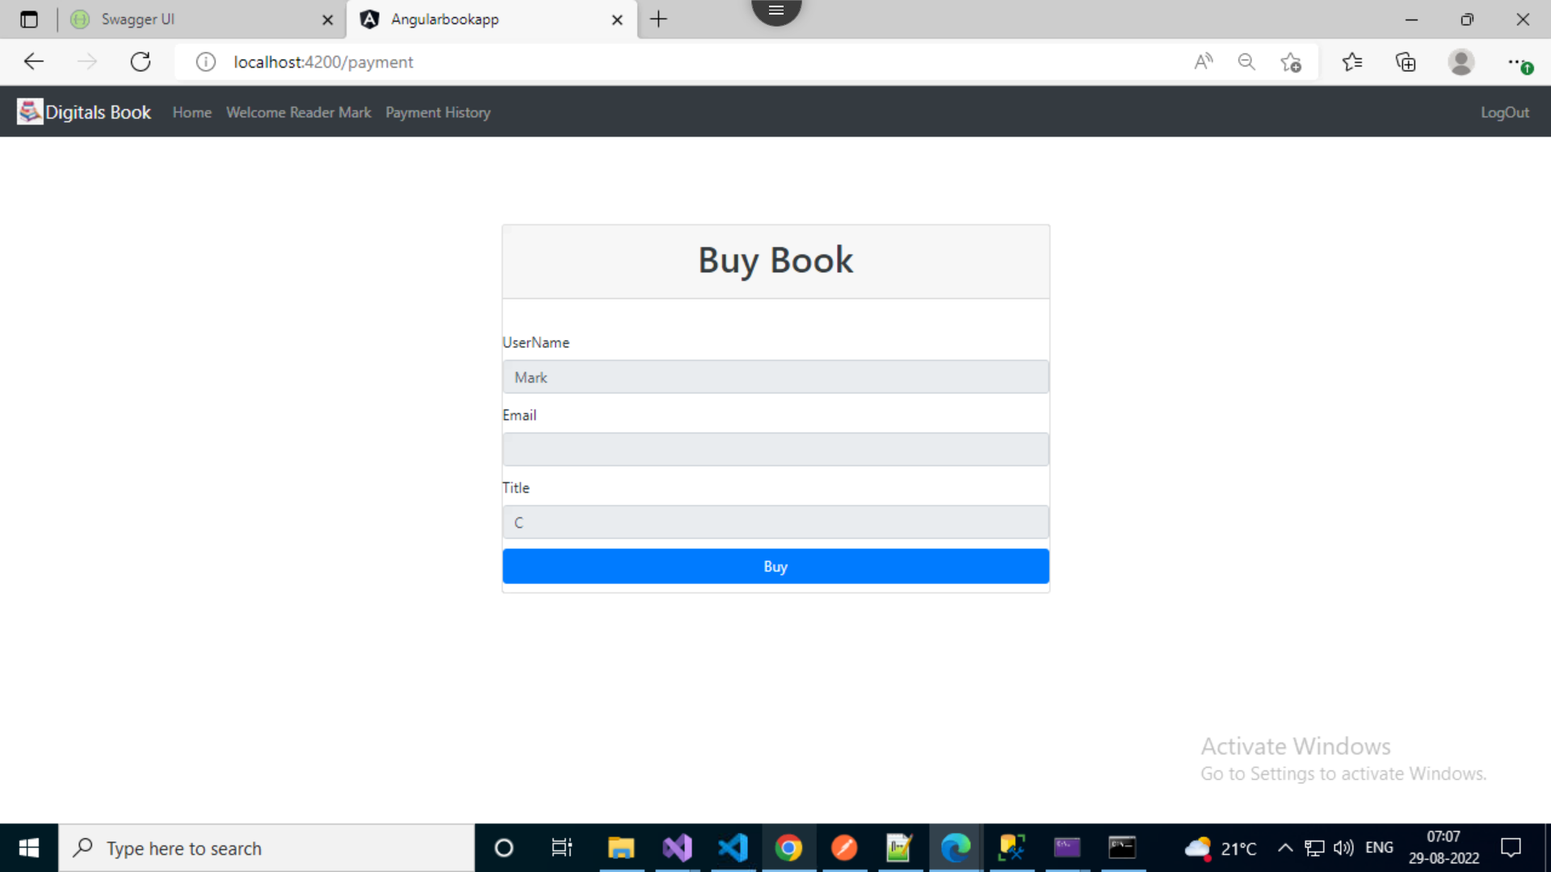

Slide 22
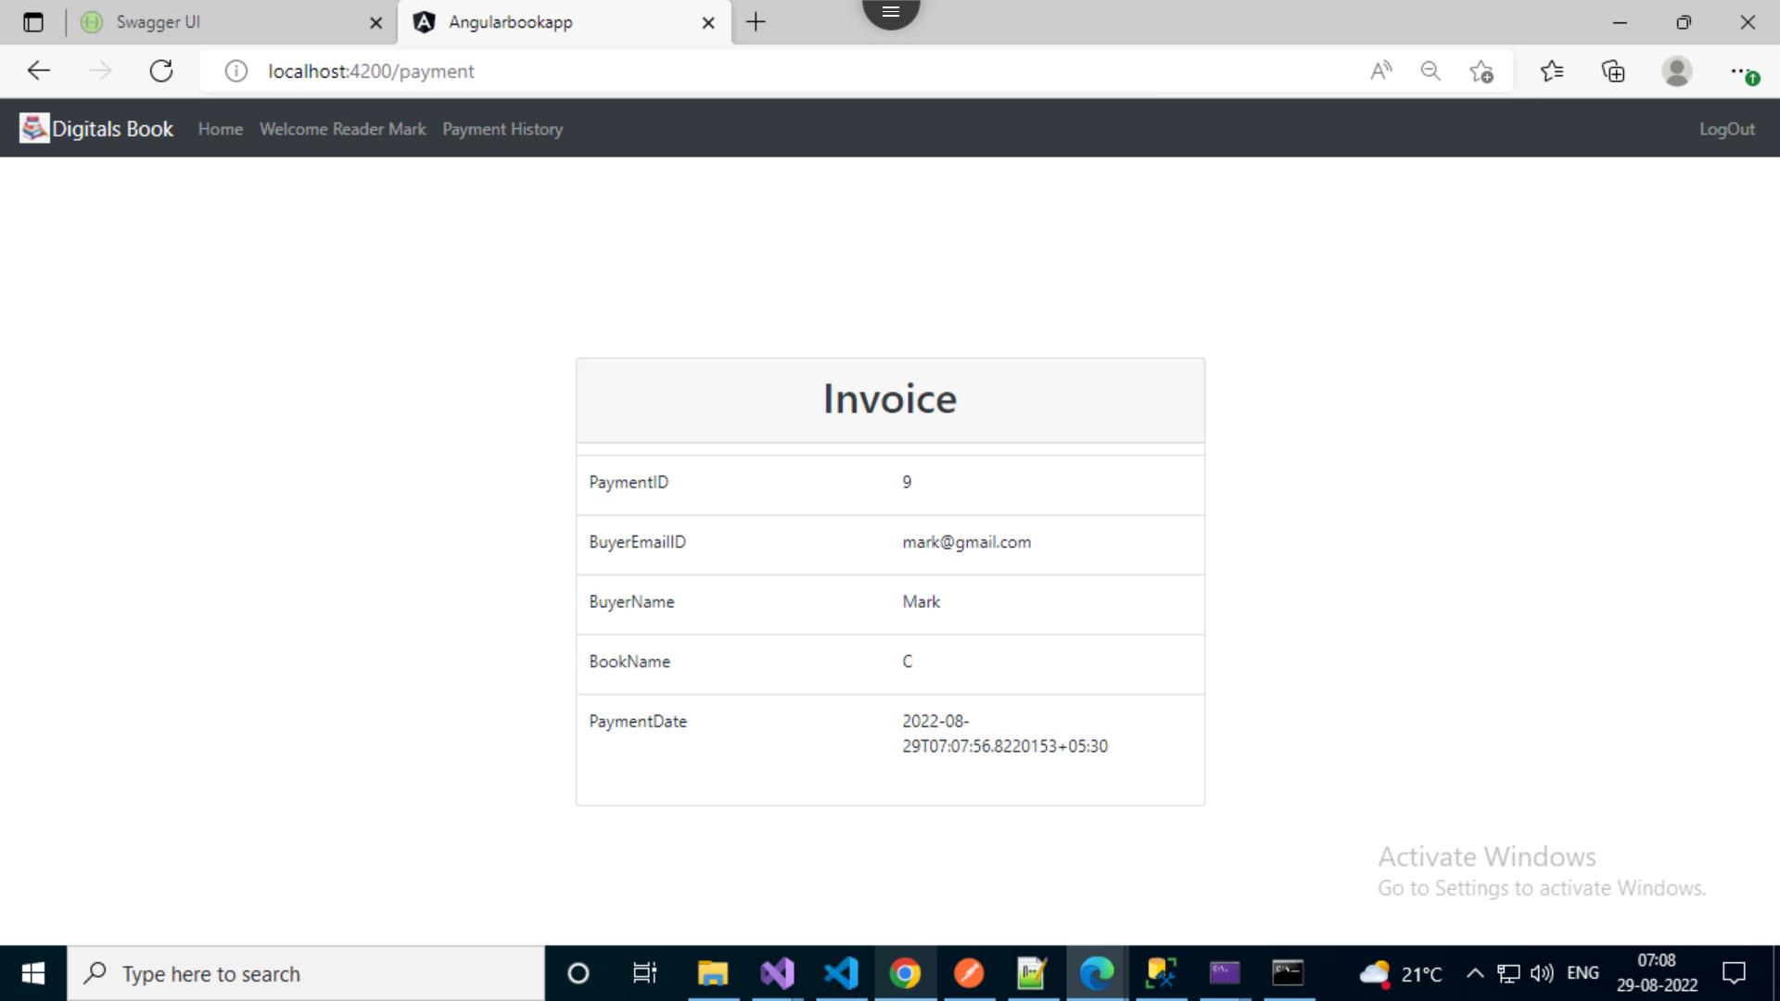

Slide 23
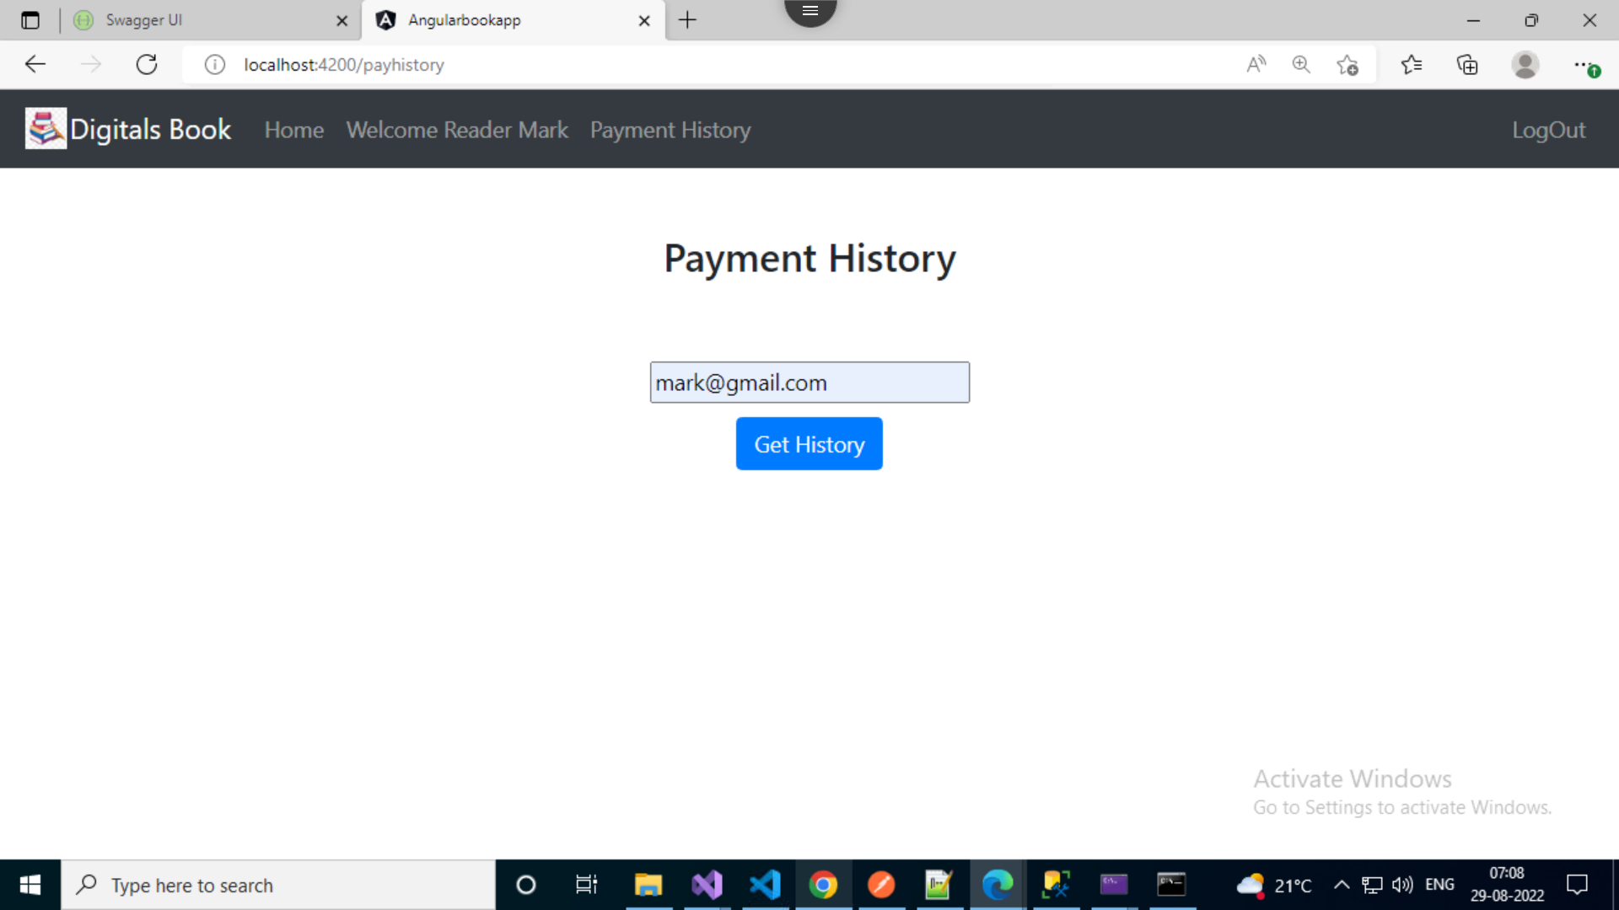

Slide 24
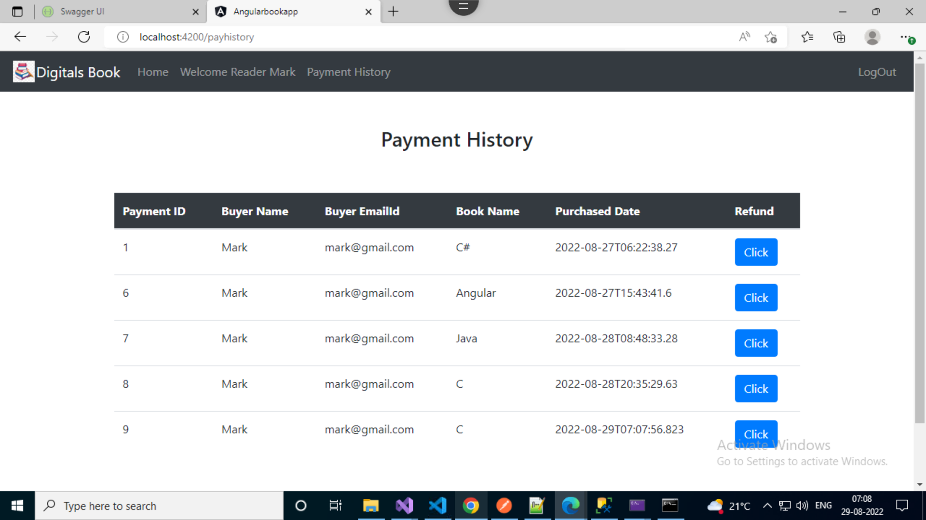

Slide 25
Explore and utilize the facilities of Digital Books Web application
Thank You!!!

Slide 26
Any Questions?

