Slide 1

Cuisine recommendation
Keerthana Sharon Kannan

Slide 2
Objective
To identify the different cuisine restaurants that are frequently visited in the Manhattan city and its neighborhood using Machine Learning models.
With the help of this analysis, we can give recommendations to people who are looking to open a new restaurant.

Slide 3
Data
New York data set is in JSON formatting.
Dataset has a total of 5 boroughs and 306 neighborhoods.
Dataset is converted to Pandas data frame using python.
Geopy library is used to get the latitude and longitude values of New York city by using a module called Nominatim.
FoursquareAPI was utilized for getting the neighborhood venues of the coordinates identified by geopy.

Slide 4
Data Analysis
As the primary focus of the analysis is restaurants, I filteres the categories of the venues that had only restaurants
One-hot encoding technique is used to turn the categorical values into binary representation
Data is grouped based on the mean to find the frequency
Machine learning technique like K-Means clustering is implemented for analysis purpose.
Folium maps are used to visualize the data that has been manipulated in Python on an interactive leaflet map.

Slide 5
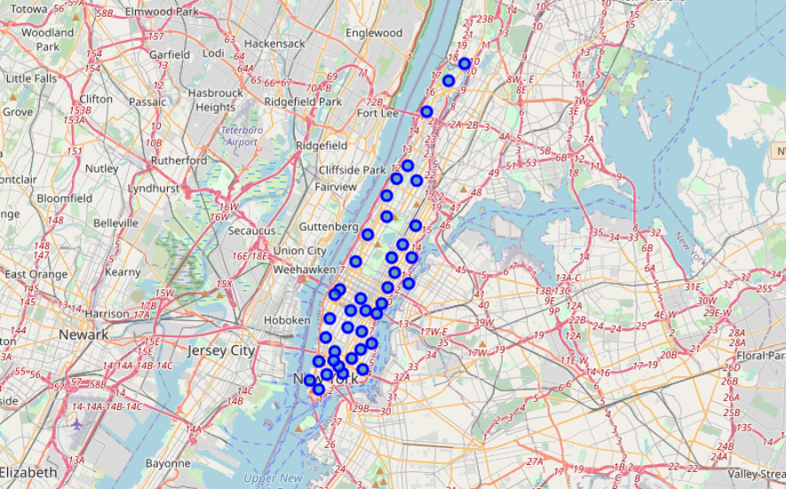
Results
Folium map of the neighborhood in Manhattan city

Slide 6
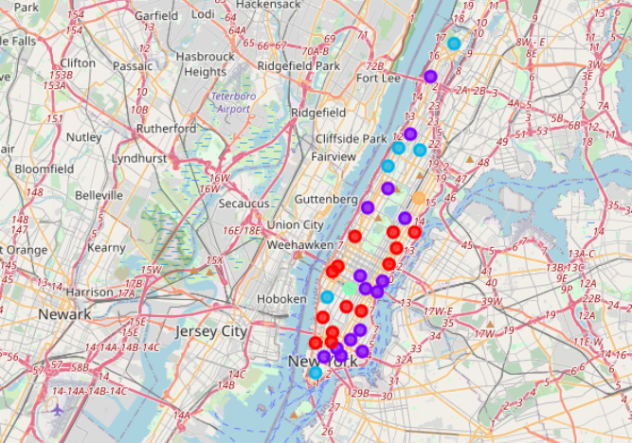
Results
Clustered map after Analysis

Slide 7
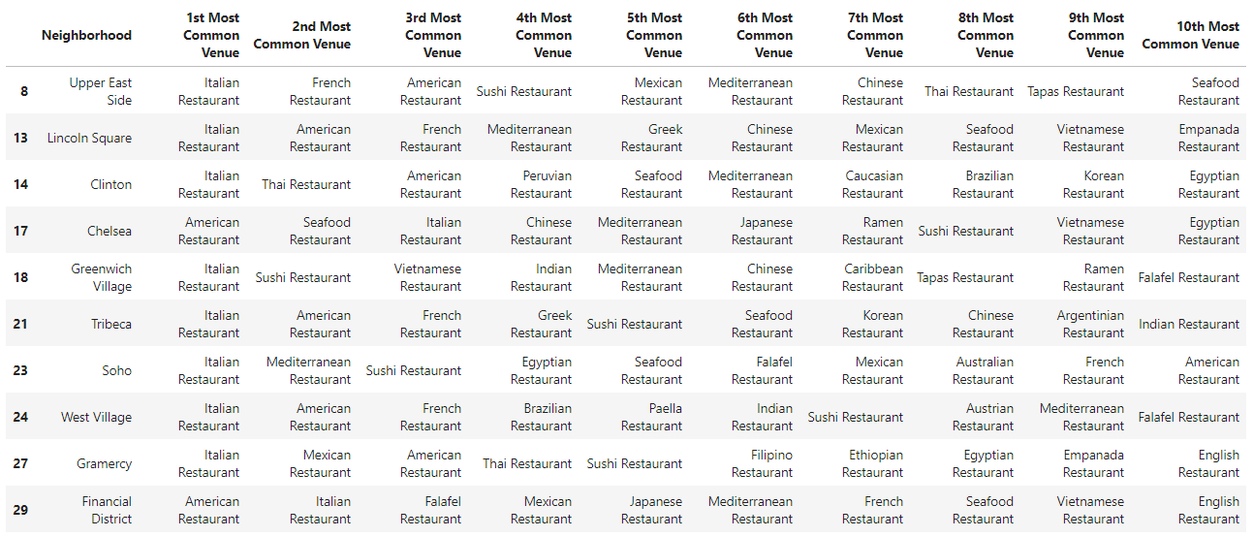
Results
Screenshot of the resulting Cluster1 data

Slide 8
References
https://en.wikipedia.org/wiki/K-means_clustering
https://geopy.readthedocs.io/en/stable/
https://pandas.pydata.org/docs/
https://developer.foursquare.com/
https://python-visualization.github.io/folium/

