Slide 1
CASE STUDY 1
Data Profiling & Quality Assessment
Agency Performance Insurance Dataset
213,656 rows across 49 columns | 29 columns contain a hidden 99999 sentinel value
Python | pandas | numpy | seaborn | matplotlib

Slide 2
OBJECTIVE & APPROACH
Understanding the Dataset Before Any Analysis
1
2
3
4
Load & Validate Schema
Build a Data Dictionary
Detect Hidden Missingness
Clean & Visualize
Print shape, dtypes, and column names. Never assume — every column is inspected before use.
Reusable function computing dtype, % missing, unique values, and a sample value per column.
Identify the 99999 sentinel code used in place of true NULLs across numeric fields.
Standardize categorical text, check duplicates, and chart the real data quality picture.
Agency Performance Dataset | Case Study 1: Data Profiling & Quality Assessment
2

Slide 3
SCHEMA DISCOVERY
Dataset Structure at a Glance
213,656
49
37
Total Rows
Total Columns
Numeric Fields
5
1,623
11
Categorical Fields
Unique Agencies
Years Covered
(2005-2015)
Schema spans policy identifiers, premium/loss amounts, retention & growth ratios, producer counts, and channel-level quote/bind activity across five external vendor systems (MDS, SBZ, eQT, ELINKS, PLRANK, eQTte, APPLIED, TRANSACTNOW).
Agency Performance Dataset | Case Study 1: Data Profiling & Quality Assessment
3

Slide 4
KEY FINDING
The 99999 Sentinel Problem
This dataset encodes missing/not-applicable values as the number 99999 instead of true NULLs — a pattern that silently breaks naive analysis.
Where it appears
Why it matters
RETENTION_RATIO, LOSS_RATIO, LOSS_RATIO_3YR, GROWTH_RATE_3YR
PL/CL/COMMISIONS/ACTIVITY_NOTES _START_YEAR & _END_YEAR fields
Vendor quote/bind counts (CL_BOUND_CT_*, PL_QUO_CT_*)
PRIMARY_AGENCY_ID and PREV_* prior-period fields
Averages and totals computed before cleanup are catastrophically wrong (99999 dwarfs any real premium or ratio value)
Missing-value counts under-report true gaps if 99999 isn't replaced first
Year-based fields (e.g. PL_START_YEAR) would compute nonsensical date ranges
Agency Performance Dataset | Case Study 1: Data Profiling & Quality Assessment
4

Slide 5
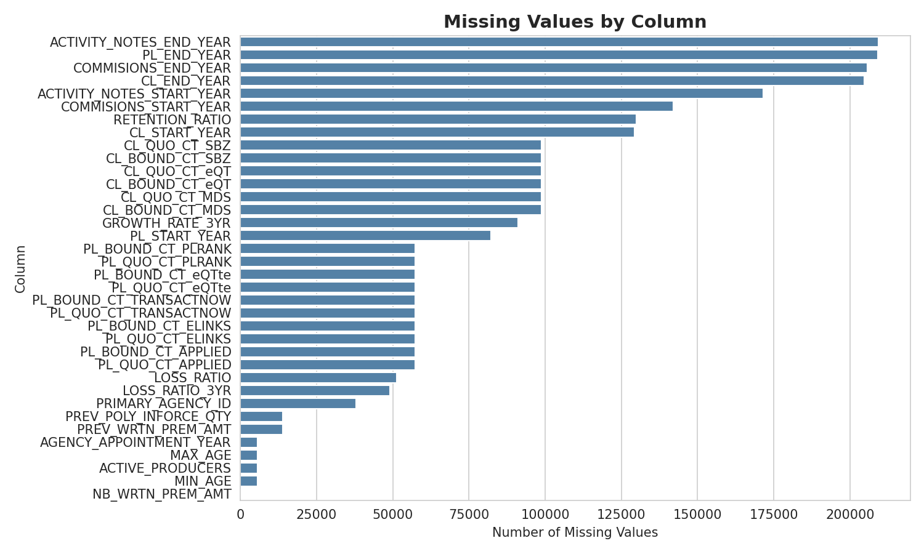
MISSING VALUE ANALYSIS
Where the Gaps Are Concentrated
Top risk fields
ACTIVITY_NOTES_END_YEAR: 98.1% missing
PL_END_YEAR: 98.1% missing
COMMISIONS_END_YEAR: 96.4% missing
CL_END_YEAR: 96.0% missing
RETENTION_RATIO: 60.9% missing
Agency Performance Dataset | Case Study 1: Data Profiling & Quality Assessment
5

Slide 6
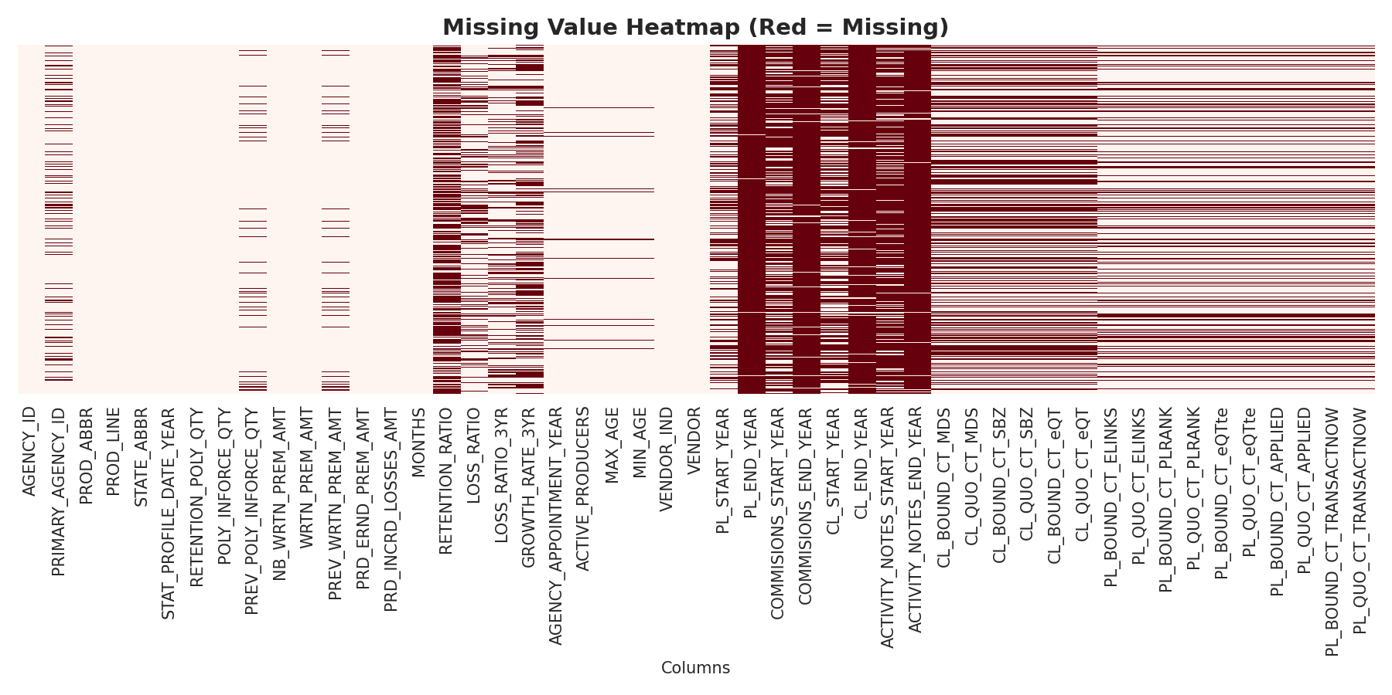
MISSING VALUE ANALYSIS
A Structural, Not Random, Pattern
The dense red block on the right (vendor activity & commission-period columns) shows missingness clusters by data source rather than scattering randomly — consistent with several vendor feeds only being active for part of the agency's history.
Agency Performance Dataset | Case Study 1: Data Profiling & Quality Assessment
6

Slide 7
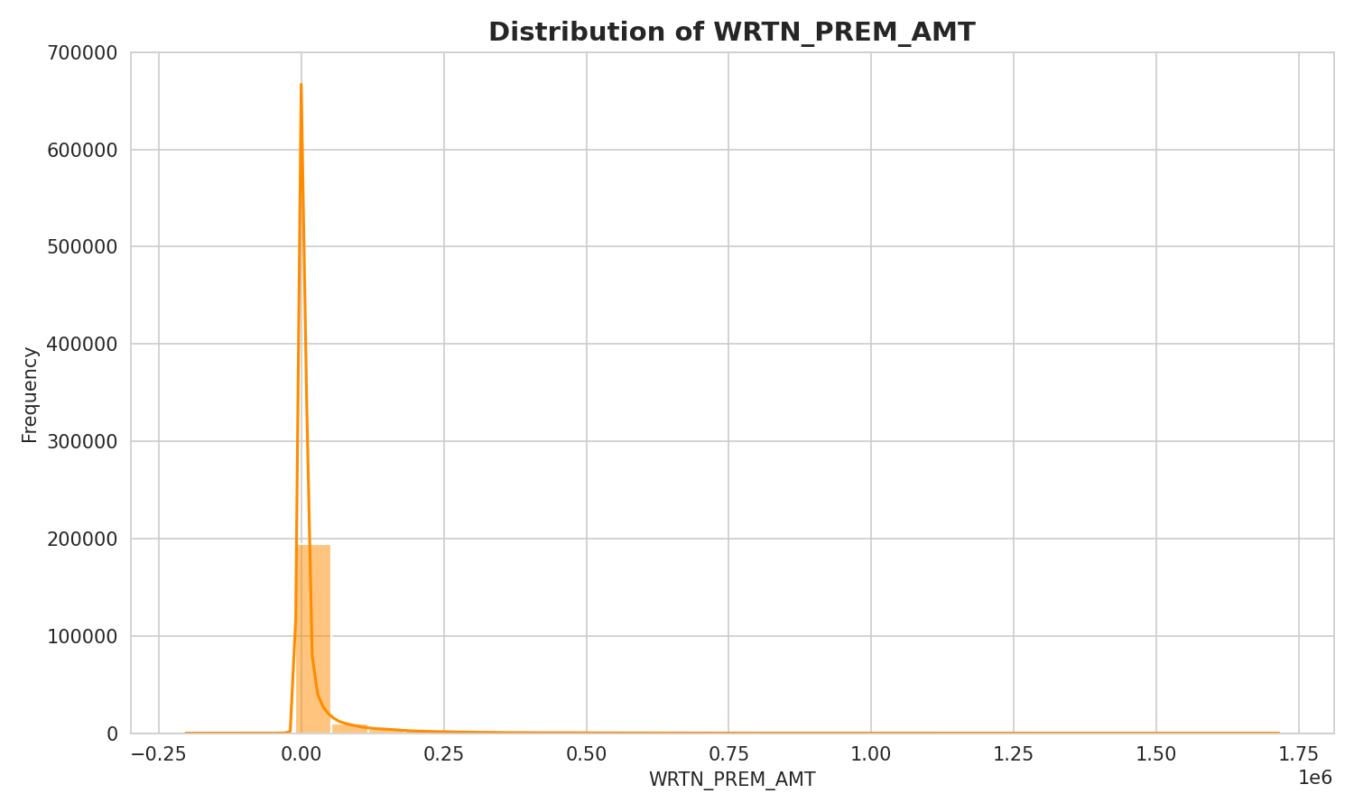
NUMERIC DISTRIBUTION
Written Premium Is Heavily Right-Skewed
117,534
unique premium amounts
The vast majority of policies carry small written premiums, with a long tail of large commercial accounts stretching past $1.7M.
Implication: use median / log-scale or trimmed views for summary statistics — a simple mean would be dominated by outlier policies.
Agency Performance Dataset | Case Study 1: Data Profiling & Quality Assessment
7

Slide 8
DATA DICTIONARY
Highest-Risk Columns by Missingness
Column | Dtype | % Missing | Unique | Sample
ACTIVITY_NOTES_END_YEAR | float64 | 98.09% | 2 | 2015
PL_END_YEAR | float64 | 98.05% | 9 | 2009
COMMISIONS_END_YEAR | float64 | 96.38% | 10 | 2012
CL_END_YEAR | float64 | 95.98% | 5 | 2011
ACTIVITY_NOTES_START_YEAR | float64 | 80.41% | 3 | 2013
RETENTION_RATIO | float64 | 60.93% | 21,376 | 0.923
GROWTH_RATE_3YR | float64 | 42.69% | 11,049 | -0.083
LOSS_RATIO | float64 | 24.02% | 53,125 | 0
PRIMARY_AGENCY_ID | float64 | 17.75% | 587 | 3
All %-missing figures reflect TRUE missingness after replacing the 99999 sentinel with NaN. Full 49-column dictionary exported to data_dictionary.csv.
Agency Performance Dataset | Case Study 1: Data Profiling & Quality Assessment
8

Slide 9
RISK SUMMARY
Key Data Quality Risks
1
Sentinel values mask true missingness
29 of 49 columns use 99999 as a placeholder; any analysis run before replacement silently corrupts averages and date logic.
2
Concentrated, structural missing data
Vendor- and commission-period fields are missing 60-98% of the time, clustered by source rather than random.
3
Heavily skewed monetary fields
WRTN_PREM_AMT spans from near-zero to $1.7M+; naive means will be distorted by outlier commercial policies.
4
PRIMARY_AGENCY_ID gaps (17.75%)
A near-key identifier with meaningful missingness — needs validation before being used to join or de-duplicate.
Agency Performance Dataset | Case Study 1: Data Profiling & Quality Assessment
9

Slide 10
CONCLUSIONS & NEXT STEPS
The Dataset Is Usable - With Guardrails
Schema was validated, not assumed: 49 columns profiled across 213,656 rows.
The 99999 sentinel was the most consequential finding - it must be replaced with NaN before any other step.
Categorical fields needed trimming/casing fixes to prevent silent group fragmentation.
Vendor- and commission-period fields carry the highest genuine missingness and need an explicit handling strategy.
Recommended next steps for downstream analysts:
Decide impute-vs-drop policy for columns above the 30% missing threshold
Confirm whether AGENCY_ID + PRIMARY_AGENCY_ID combinations should be unique per year/state/product
Re-validate column semantics (ratio vs. amount vs. count) before building performance KPIs
Agency Performance Dataset | Case Study 1: Data Profiling & Quality Assessment
10

