Slide 1

FreshMart Sales Analysis
Turning retail transactions into business decisions — an Excel dashboard built to the FreshMart BRD.
Presented by Keerthana
Problem → Solution → Recommendations
Notes:
Good afternoon everyone. Today I am presenting the FreshMart Sales Analysis Dashboard, built against the FreshMart Business Requirements Document. FreshMart is a multi-location retail business with different products, customers, stores, regions and sales channels. The flow is: the business problem, the dashboard solution, and recommendations.

Slide 2







The Business Problem
Areas Investigated
No Single View of Business Performance
Data sits in separate datasets, so management cannot see what drives profit. High sales alone do not mean strong performance — discounts, costs and returns erode margin.
Monthly Sales Trend
Membership Performance
Sales Channel Split
“Which stores, products, customer segments and sales channels are driving profitable growth — and which areas need management attention?”
Category Performance
Weekday vs Weekend
Regional Sales
₹28.95L
₹7.37L
25.47%
2,500
649
Total Sales
Total Profit
Profit Margin
Orders
Buying Customers
Notes:
The BRD states the problem clearly: management has no single consolidated view of performance, so it cannot easily tell which stores, products, customer segments and channels are driving profitable growth, and which need attention. High sales alone do not mean strong performance, because discounts, costs and returns can reduce profit. These KPI cards give the overview: about Rs 28.95 lakh in sales, Rs 7.37 lakh profit, a 25.47% margin, 2,500 transactions, and 649 of the 700 registered customers actually purchased. The six areas on the right are the views the dashboard uses to answer the problem.

Slide 3
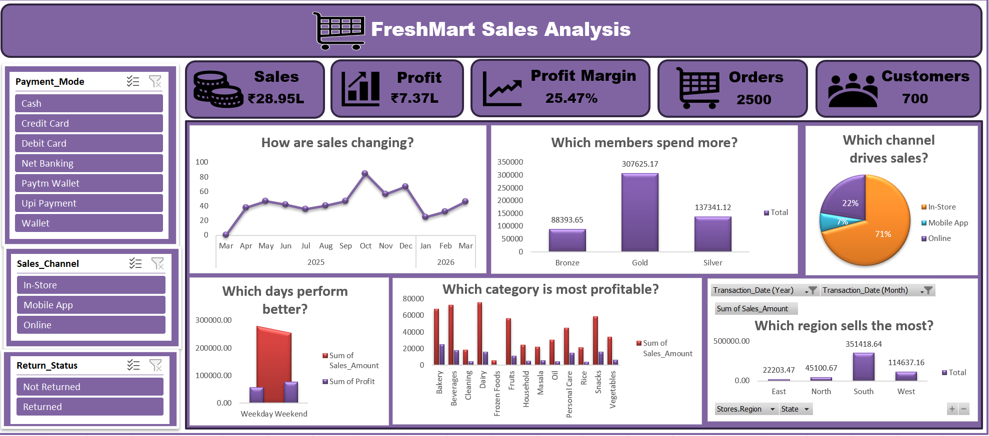
The Solution: Interactive Excel Dashboard
Built With
Data cleaning + calculated columns (Profit, Margin, Day Type)
PivotTables & PivotCharts across 7 dimensions
KPI cards with connected slicers for live filtering
Key Insights Uncovered
Gold members: 23% of buyers, 60% of sales and 65% of profit
In-Store drives 69% of sales; Online + Mobile add 31% at similar margins
Live dashboard — charts shown for Jan–Mar 2026; KPI cards cover the full period
Weekends earn 60% of profit from 50% of sales (margin 31% vs 20%)
South delivers 65% of sales; East and North lag far behind
Notes:
The solution is an interactive Excel dashboard: cleaned data with calculated columns, PivotTables and PivotCharts, and KPI cards with slicers for Payment Mode, Sales Channel and Return Status. Key insights over the full period: Gold members are under a quarter of buyers but generate about 60% of sales. In-Store is about 69% of sales and digital about 31%, at similar margins. Weekends earn about 60% of profit from about half the sales. South delivers about 65% of sales. NOTE: the charts in the screenshot are filtered to Jan-Mar 2026, so the pie shows 71% In-Store; the full-period figure is 69%. The dashboard shows the pattern; the reason behind it needs further investigation.

Slide 4




Recommendations
Areas for management to act on and investigate — patterns in the data, not proven causes
Set Discount Guardrails
Gold Loyalty Rewards
Evaluate Digital Channels
Margins fall from 31% to 14% at a 20% discount.
Gold is 23% of buyers but 60% of sales — retain them with tailored perks.
Online + Mobile are 31% of sales at similar margins; study behaviour first.
Promote High-Margin Items
Lift Weekday Margin
Replicate the South Playbook
Bakery earns 20% of profit from 13% of sales; cross-sell Personal Care and Snacks.
Weekday margin is 20% vs 31% at weekends; investigate pricing and costs.
South sells ~₹20.5k per store vs ₹4.2k in East; learn from South.
Notes:
These are areas for management to act on or investigate, not proven causes. Deeper discounts reduce margin from about 31% to 14%. Retain Gold members. Evaluate the digital channels before investing. Bakery earns about 20% of profit from 13% of sales. Weekday margin is about 20% against 31% at weekends. East and North stores sell far less per store than South. Key takeaway: sales alone should not be used to measure performance; profitability, customers, channels, categories and regions must be read together. Thank you, I am happy to take questions.

