Slide 1

TrendMart: Are We Really Making Money?
TrendMart is a busy fashion retailer. This is a simple look at where it makes money — and where it quietly loses it.
Presented by Keerthana
The Problem → What We Built → What To Do
Notes:
Good morning everyone. This project is about one simple question: where does TrendMart make money, and where does it quietly lose it? I will show you the problem, the dashboard I built to answer it, and what management can do next.

Slide 2







The Business Problem
What We Looked At
Selling a lot is not the same as earning a lot
TrendMart sells across many stores and products, but nobody can easily see where the money is really made or lost. Price cuts (discounts), product costs and returned items can quietly eat the profit.
Sales and profit, month by month
Price cuts (discounts)
Types of products
Online vs in-store sales
“Where are we losing profit even though we are selling well — and which areas need attention?”
Sales by state and city
The question this project answers
Our 10 best-selling stores
₹92.27L
₹18.01L
19.52%
12.57%
Total Sales
Total Profit
Profit Margin
Average Discount
Money customers paid us
Money left after costs
Profit kept from every ₹100 sold
Average price cut we give
Notes:
Here is the problem in simple words. TrendMart sells a lot across many stores and products. But management cannot easily see where the money is really made and where it is lost. High sales do not automatically mean high profit. Price cuts, product costs and returned items can quietly reduce profit. So the question is: where are we losing profit even though we are selling well, and which areas need attention? The four cards are the same as on the dashboard. Sales are Rs 92.27 lakh. Profit is Rs 18.01 lakh. The profit margin is 19.52%, which simply means we keep about Rs 19.50 out of every Rs 100 sold. And the average discount, or price cut, is 12.57%. The six items on the right are the views the dashboard uses to look for the answer.

Slide 3
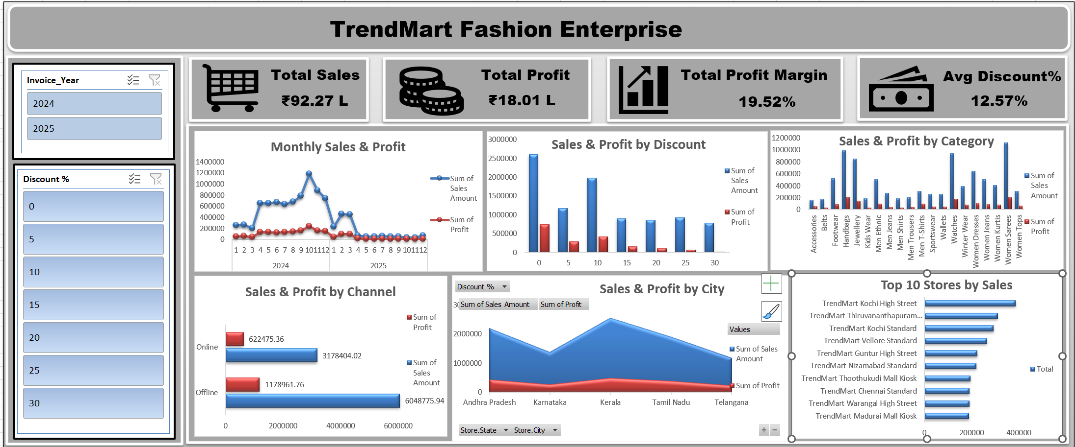
The Solution: A Simple Excel Dashboard
What We Found
Bigger discounts, smaller profit
With no discount we keep about ₹28 from every ₹100 sold. With 30% off, we keep less than ₹2.
Popular is not always profitable
Sarees sell the most (₹11.2L), but Handbags make the most profit (₹2.1L).
Online and in-store earn the same
In-store brings 66% of sales and online 34%. Both keep about ₹19.50 per ₹100.
Our live dashboard — click the Year or Discount filters to explore
How We Built It
Cleaned the raw sales data (duplicates, blanks, spelling mistakes)
Kerala and top stores lead
Kerala sells the most (₹25.6L). Our top 10 stores bring 27% of all sales.
Worked out the profit and profit % of every sale
Turned the numbers into charts anyone can read at a glance
Next step: add returns, costs and customers to the dashboard
Notes:
To answer the question, I built an interactive Excel dashboard. First I cleaned the raw sales data, fixing duplicates, blanks and spelling mistakes. Then I worked out the profit and profit percentage of every sale, and turned the numbers into charts. The dashboard has two filters, Year and Discount, so anyone can click and explore. What did we find? First, bigger discounts mean smaller profit. With no discount we keep about Rs 28 from every Rs 100 sold. With 30% off, we keep less than Rs 2. This is a pattern we see in the data; it does not prove that discount alone causes it. Second, popular is not always profitable. Sarees sell the most, but Handbags make the most profit. Third, online and in-store earn about the same profit per sale. In-store is about Rs 60.49 lakh of sales and Rs 11.79 lakh profit. Online is about Rs 31.78 lakh of sales and Rs 6.22 lakh profit. Fourth, Kerala sells the most, and our top 10 stores bring about 27% of all sales. Two things to note. The monthly chart shows very few records after March 2025 (173 in March, 18 in April), so we should confirm whether that is a real slowdown or missing data. And returns, costs and customers are not yet on the dashboard; that is the next step.

Slide 4






What We Recommend
Ideas for management to act on or look into — these are patterns in the data, not proven causes
Limit Big Discounts
Check Handbag Returns
Sell More High-Profit Items
Orders with 25–30% off are nearly 1 in 4, yet bring only 4.5% of profit. Most sales made at a loss (168 of 179) happen here.
Nearly 3 in 10 handbags come back, against about 3 in 100 for other items. One sling bag alone has 51 of 81 sales returned.
Accessories and Men’s T-Shirts keep about ₹30–33 from every ₹100 sold, but they are only 5% of our sales.
Fix Low-Profit Products
Cut Discounts at Outlet Stores
Grow Online, Carefully
Sarees sell the most but keep a bit less than average (18.5%). Men’s Jeans keep only 14.8%. Review prices and buying costs.
Outlets give the biggest discounts and keep the least profit (18.2%), compared with 20.9% at flagship stores.
Online earns as much profit per sale as our stores. Grow it, but keep the same limits on discounts.
Notes:
These are ideas for management to act on or look into. They are patterns in the data, not proven causes. One: limit big discounts. Orders with 25 to 30 percent off are nearly one in four, but bring only about 4.5% of profit. And 168 of the 179 sales made at a loss happen at these discount levels. Two: check handbag returns. Nearly 3 in 10 handbags are returned, against about 3 in 100 for other items. One sling bag, product PRD0043, has 51 of its 81 sales returned. The brand on that product is a jewellery brand, so the product record should also be checked. Returned orders are still counted in the headline sales and profit. Three: sell more high-profit items. Accessories and Men's T-Shirts keep about Rs 30 to 33 from every Rs 100 sold, but are only about 5% of sales. Four: fix low-profit products. Sarees sell the most but keep a little less than average. Men's Jeans keep only 14.8%. Five: cut discounts at Outlet stores, which give the biggest discounts and keep the least profit. Six: grow online carefully, with the same discount limits. The key message: do not judge the business by sales alone. Look at sales and profit together. Thank you, I am happy to take questions.

