Slide 1

TrendMart: Are We Really Making Money?
TrendMart is a busy fashion retailer. This is a simple look at where it makes money — and where it quietly loses it.
Presented by Keerthana
The Problem → What We Built → What To Do
Notes:
Good morning everyone. This project is about one simple question: where does TrendMart make money, and where does it quietly lose it? I will show you the problem, the dashboard I built to answer it, and what management can do next.

Slide 2







The Business Problem
What We Looked At
Selling a lot is not the same as earning a lot
TrendMart sells across many stores and products, but nobody can easily see where the money is really made or lost. Price cuts (discounts), product costs and returned items can quietly eat the profit.
Why sales and profit went down
Which discount works best
How many orders were returned
Online or in-store: who wins
“Where are we losing profit even though we are selling well — and which areas need attention?”
Which cities perform best
The question this project answers
How each product type performs
₹92.27L
₹18.01L
19.52%
12.57%
Total Sales
Total Profit
Profit Margin
Average Discount
Money customers paid us
Money left after costs
Profit kept from every ₹100 sold
Average price cut we give
Notes:
Here is the problem in simple words. TrendMart sells a lot across many stores and products. But management cannot easily see where the money is really made and where it is lost. High sales do not automatically mean high profit. Price cuts, product costs and returned items can quietly reduce profit. So the question is: where are we losing profit even though we are selling well, and which areas need attention? The four cards are the same as on the dashboard. Sales are Rs 92.27 lakh. Profit is Rs 18.01 lakh. The profit margin is 19.52%, which simply means we keep about Rs 19.50 out of every Rs 100 sold. And the average discount, or price cut, is 12.57%. The six items on the right are the six questions the dashboard answers, one chart for each.

Slide 3
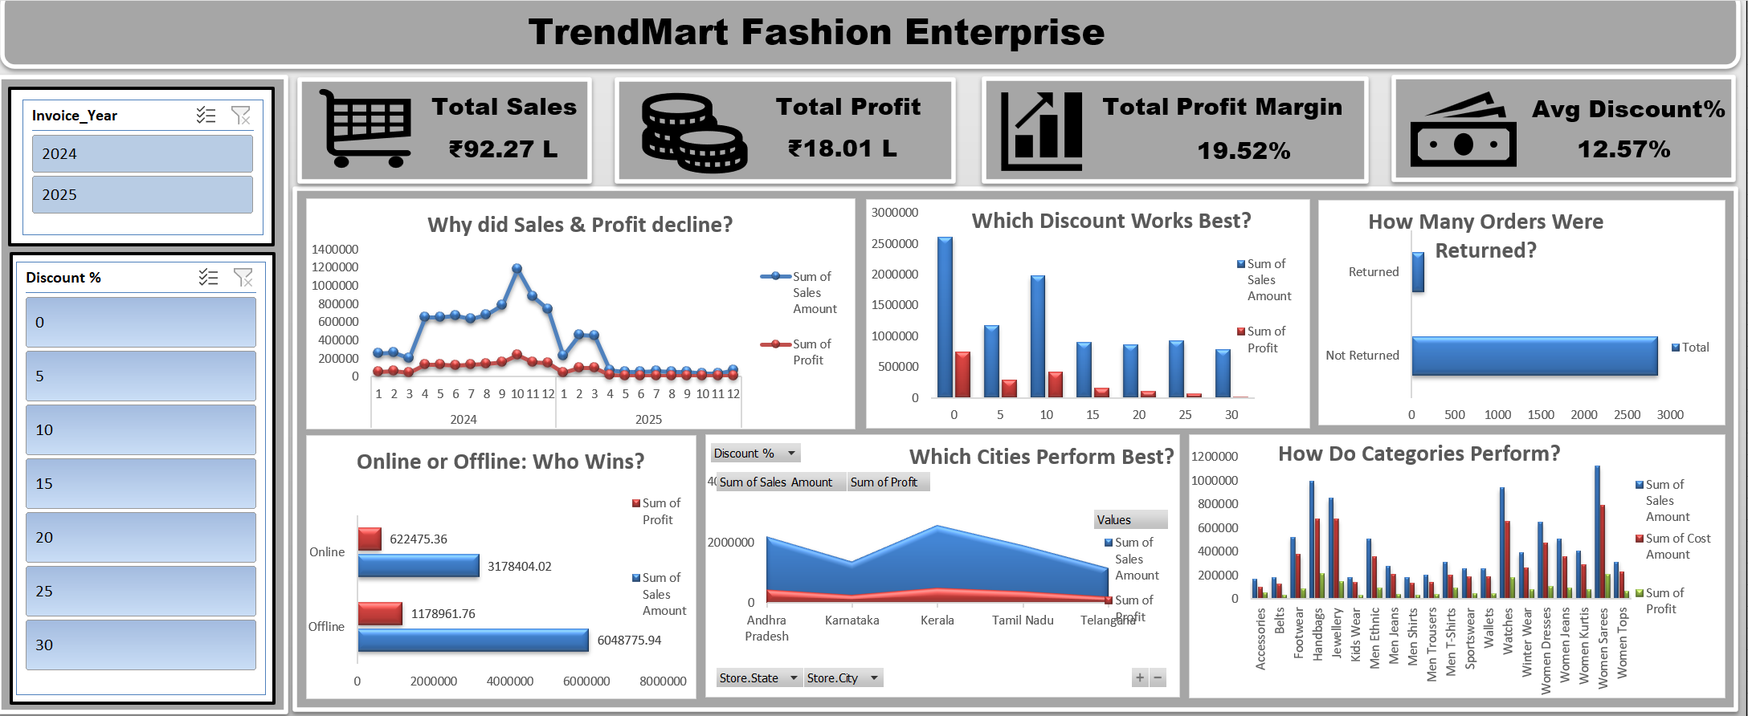
The Solution: A Simple Excel Dashboard
What We Found
Smaller discounts work best
With no discount we keep about ₹28 from every ₹100 sold. With 30% off, we keep less than ₹2.
Fewer orders, not smaller ones
Sales peaked in Oct 2024 (₹11.8L). Since Apr 2025 there are under 25 orders a month, yet each order is still about ₹3,000.
Few orders come back, except handbags
Only 146 of 3,000 orders (about 5%) were returned. Nearly 3 in 10 handbags come back.
Our live dashboard — click the Year or Discount filters to explore
How We Built It
Cleaned the raw sales data (duplicates, blanks, spelling mistakes)
Popular is not always profitable
Sarees sell the most (₹11.2L), but Handbags make the most profit (₹2.1L). Costs take about ₹71 of every ₹100 sold.
Worked out the profit and profit % of every sale
Built six charts, each answering one simple question
Next step: add customer and store-level views
Notes:
To answer the question, I built an interactive Excel dashboard. First I cleaned the raw sales data, fixing duplicates, blanks and spelling mistakes. Then I worked out the profit and profit percentage of every sale. The dashboard has six charts, and each one answers one simple question. It also has two filters, Year and Discount, so anyone can click and explore. What did we find? First, smaller discounts work best. With no discount we keep about Rs 28 from every Rs 100 sold. With 30% off, we keep less than Rs 2. This is a pattern in the data; it does not prove that discount alone causes it. Second, why did sales and profit go down? Sales peaked in October 2024 at about Rs 11.8 lakh. From April 2025 there are only 11 to 22 orders a month, compared with 173 in March 2025. But the average order value stayed near Rs 3,000 and the average discount did not change. So the drop is about the number of orders, not the size of each order. The data cannot tell us why, so we should check whether it is a real slowdown or missing records. Third, returns. Only 146 of 3,000 orders, about 5%, were returned. But nearly 3 in 10 handbags come back. Returned orders are still counted in the sales and profit totals. Fourth, popular is not always profitable. Sarees sell the most, but Handbags make the most profit, and costs take about Rs 71 of every Rs 100 sold. Online and in-store earn almost the same profit per sale: online is about Rs 31.78 lakh of sales and in-store about Rs 60.49 lakh. Kerala is the biggest state at about Rs 25.6 lakh. The next step is to add customer and store-level views.

Slide 4




What We Recommend
Ideas for management to act on or look into — these are patterns in the data, not proven causes
Limit Big Discounts
Check Handbag Returns
Focus on Profitable Categories
Orders with 25–30% off are nearly 1 in 4, yet bring only 4.5% of profit. Most sales made at a loss (168 of 179) happen here.
Nearly 3 in 10 handbags come back, against about 3 in 100 for other items. One sling bag alone has 51 of 81 sales returned.
Accessories and Men’s T-Shirts keep ₹30–33 per ₹100 sold but are just 5% of sales. Men’s Jeans keep only ₹14.8.
Confirm the Drop in Orders
Grow Online, Carefully
Look Closer at Kerala
Orders fell from 173 (Mar 2025) to 18 (Apr 2025), yet each order stayed near ₹3,000. Check if records are missing.
Online brings 34% of sales and keeps about ₹19.60 per ₹100, the same as in-store. Grow it, with the same discount limits.
Kerala sells the most (₹25.6L) and gives the biggest discounts (13.2%), yet keeps about ₹19 per ₹100. Andhra Pradesh keeps ₹20.
Notes:
These are ideas for management to act on or look into. They are patterns in the data, not proven causes. One: limit big discounts. Orders with 25 to 30 percent off are nearly one in four, but bring only about 4.5% of profit. And 168 of the 179 sales made at a loss happen at these discount levels. Two: check handbag returns. Nearly 3 in 10 handbags are returned, against about 3 in 100 for other items. One sling bag, product PRD0043, has 51 of its 81 sales returned. The brand on that product is a jewellery brand, so the product record should also be checked. Three: focus on profitable categories. Accessories and Men's T-Shirts keep about Rs 30 to 33 from every Rs 100 sold, but are only about 5% of sales. Sarees, our biggest seller, keep Rs 18.50, and Men's Jeans keep only Rs 14.80. Four: confirm the drop in orders. Orders fell from 173 in March 2025 to 18 in April 2025, while the average order stayed near Rs 3,000. We need to check whether this is a real slowdown or missing records. Note that the data ends on 3 December 2025, so December is only a partial month. Five: grow online carefully. Online earns the same profit per sale as in-store, so it can grow under the same discount limits. Six: look closer at Kerala. It sells the most and gives the biggest discounts, and keeps slightly less profit per Rs 100 than Andhra Pradesh. The gap is small, so treat it as something to look into, not a conclusion. The key message: do not judge the business by sales alone. Look at sales and profit together. Thank you, I am happy to take questions.

