Slide 1

Calendar App
Capgemini Programming Assignment
Keerthana Vemuganti

Slide 2
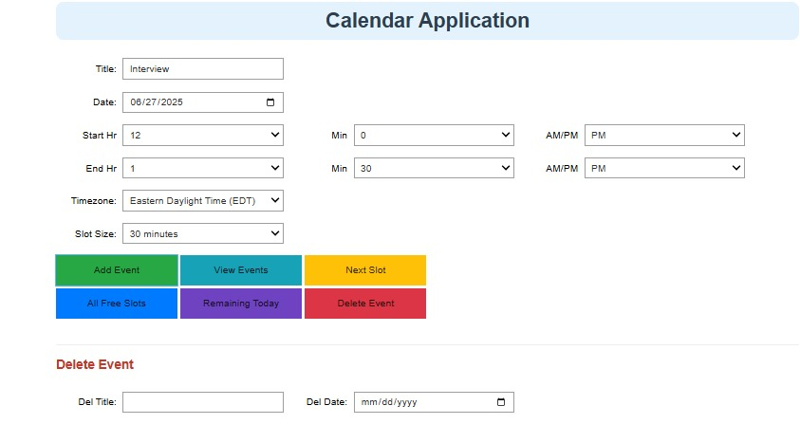
Problem Statement
Build a calendar and appointment scheduling tool using Python.
The application should allow users to: Add events with title, start time, and end timePrevent overlapping events.
View all events for a specific dayView remaining events for todayFind next available time slot.
Show all available free slots of a specific duration.
Delete events to free memory and update the data fileNo database is required; events are stored in a .json file.
Output:

Slide 3
Requirements
App must support:
Listing all remaining events for today
Listing all events for any specified date
Suggesting the next available time slot of a given duration
Listing all events for the current day

Slide 4


Key Python Libraries
These libraries help:
Create an interactive calendar input system
Maintain and display events chronologically
Provide time zone and AM/PM support

Slide 5
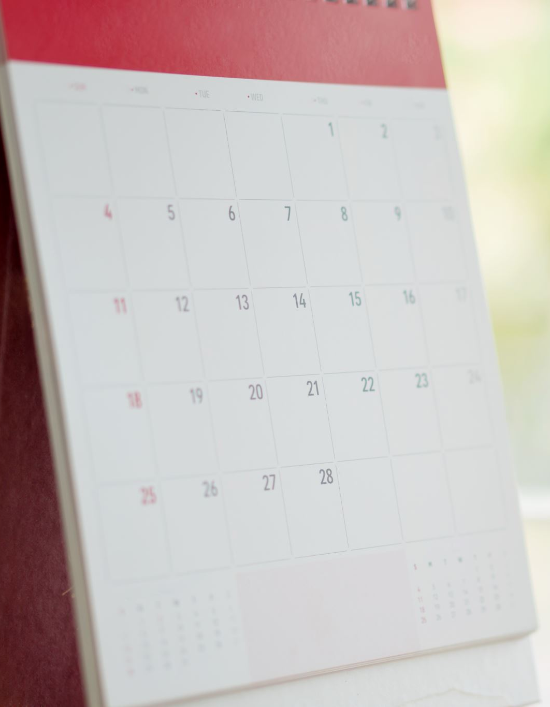
Project Structure
Notebook Used: Calendar.ipynb Data File: calendar.json (stores added events) Classes and Functions:
CalendarApp class with methods:
add_event()
list_all_events()
list_remaining_events()
list_events_by_day()
find_next_available_slot()

Slide 6
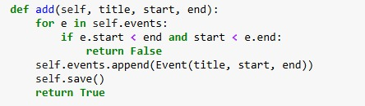
Key Features Implemented
Feature – Add EventPurpose: Add a new event if it doesn't overlap with existing events
Code Snippet :
Description :Checks for time conflict. If there's no overlap, adds the event and saves the updated list to calendar.json.

Slide 7

Key Features Implemented
Feature – View Events for Selected Day
Purpose: Display all events scheduled on a given day
Code Snippet:
Description: Filters events stored in memory based on the selected date and returns only those matching the day.

Slide 8
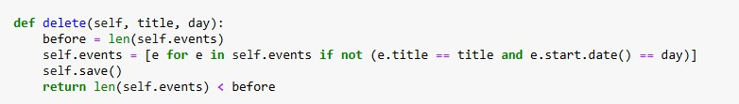
Key Features Implemented
Feature – Delete Event
Purpose: Delete an event by title and date from memory and JSON file
Code Snippet:
Description: Deletes events that match the given title and date, then rewrites the updated list back to the file.

Slide 9
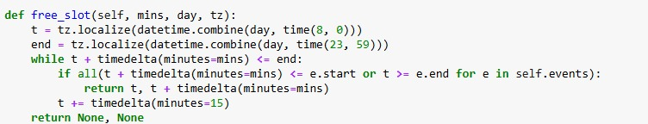
Key Features Implemented
Feature – View Next Available Slot
Purpose: Return the next available slot of given duration
Code Snippet:
Description:Iterates through the day from 8:00 AM to 11:59 PM and returns the first available time range that doesn’t overlap with existing events.

Slide 10
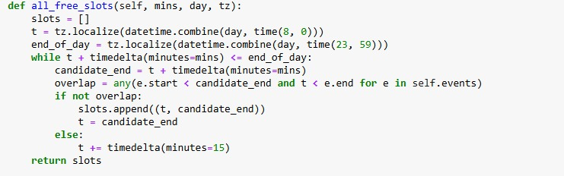
Key Features Implemented
Feature – View All Free SlotsPurpose: List all free time slots of the selected duration
Code Snippet:
Description:Finds all non-overlapping intervals of the selected duration throughout the day and returns them in a list.

Slide 11
Key Features Implemented
Feature – Convert AM/PM to 24-Hour Time
Purpose: Convert user input time into 24-hour format
Code Snippet:
Description: Used to convert user selections for hour and AM/PM into 24-hour time format for consistent processing.

Slide 12
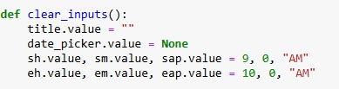
Key Features Implemented
Feature – Clear Input Fields
Purpose: Reset the form after adding an event
Code Snippet:
Description: Clears all inputs to default values so the user can add a new event without manually resetting fields.

Slide 13
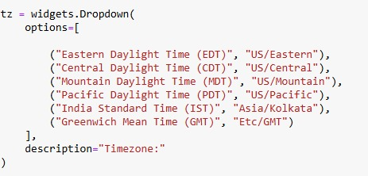
Key Features Implemented
Feature – Time Zone Selection
Purpose: Ensure all events are scheduled and displayed in the user’s selected time zone.
Code Snippet (exact from your code):
Description:The dropdown widget allows the user to choose a timezone from predefined options.This selected timezone is used when creating or viewing events, ensuring times are localized.It works together with pytz.timezone(tz.value) to convert the selected date and time into a proper timezone-aware datetime object.

Slide 14
UI/UX Design Choices
Widgets used:
DatePicker for selecting date
Dropdowns for hour, minute, and AM/PMButtons to trigger actions
Other Design Choices:
Form clears after adding an event
Events are shown in chronological order
Supports readable, minimal UI with labels like “Add Event,” “View Events,” etc.

Slide 15
Conclusion & Improvements
Fully functional basic calendar app built All assignment features completed Future Improvements:
Add event editing and deletion
Integrate with real calendars (Google Calendar API)
Support recurring events
Build responsive web UI using Streamlit

Slide 16


