Slide 1

Calendar App
Capgemini Programming Assignment
Keerthana Vemuganti

Slide 2
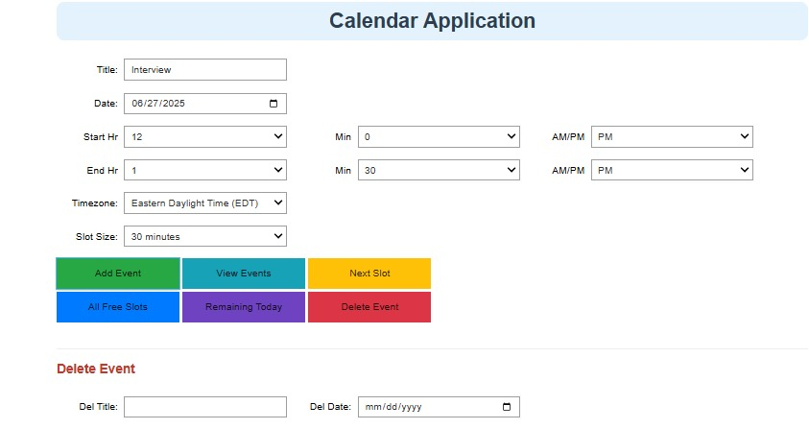
Problem Statement
Build a calendar and appointment scheduling tool using Python.
The application should allow users to: Add events with title, start time, and end timePrevent overlapping events.
View all events for a specific dayView remaining events for todayFind next available time slot.
Show all available free slots of a specific duration.
Delete events to free memory and update the data fileNo database is required; events are stored in a .json file.
Output:

Slide 3
Requirements
App must support:
Listing all remaining events for today
Listing all events for any specified date
Suggesting the next available time slot of a given duration
Listing all events for the current day

Slide 4


Key Python Libraries
These libraries help:
Create an interactive calendar input system
Maintain and display events chronologically
Provide time zone and AM/PM support

Slide 5
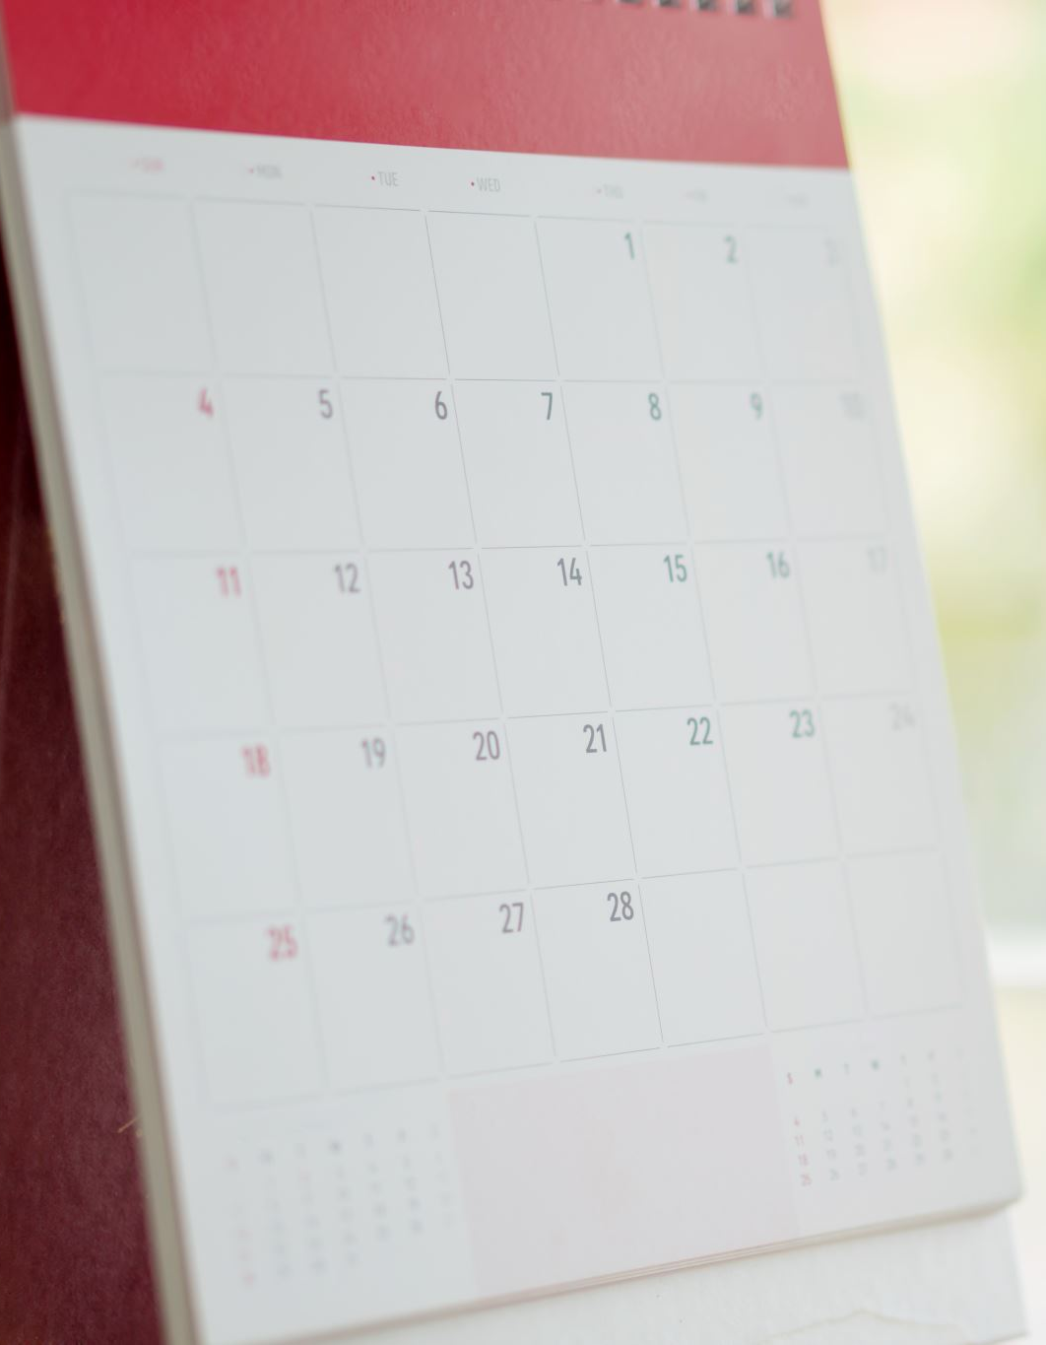
Project Structure
Notebook Used: Calendar.ipynb Data File: calendar.json (stores added events) Classes and Functions:
CalendarApp class with methods:
add_event()
list_all_events()
list_remaining_events()
list_events_by_day()
find_next_available_slot()

Slide 6
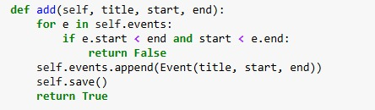
Key Features Implemented
Feature – Add EventPurpose: Add a new event if it doesn't overlap with existing events
Code Snippet :
Description :Checks for time conflict. If there's no overlap, adds the event and saves the updated list to calendar.json.

Slide 7

Key Features Implemented
Feature – View Events for Selected Day
Purpose: Display all events scheduled on a given day
Code Snippet:
Description: Filters events stored in memory based on the selected date and returns only those matching the day.

Slide 8
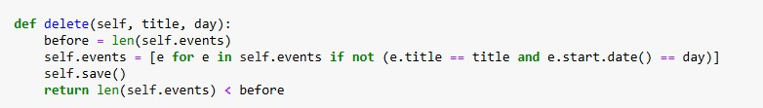
Key Features Implemented
Feature – Delete Event
Purpose: Delete an event by title and date from memory and JSON file
Code Snippet:
Description: Deletes events that match the given title and date, then rewrites the updated list back to the file.

Slide 9
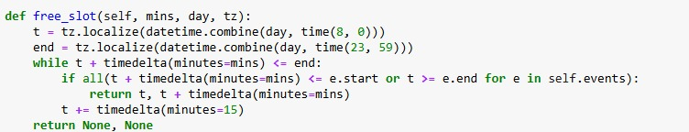
Key Features Implemented
Feature – View Next Available Slot
Purpose: Return the next available slot of given duration
Code Snippet:
Description:Iterates through the day from 8:00 AM to 11:59 PM and returns the first available time range that doesn’t overlap with existing events.

Slide 10
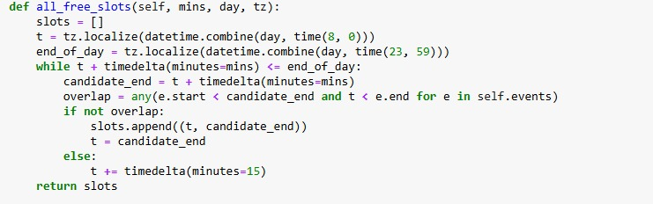
Key Features Implemented
Feature – View All Free SlotsPurpose: List all free time slots of the selected duration
Code Snippet:
Description:Finds all non-overlapping intervals of the selected duration throughout the day and returns them in a list.

Slide 11
Key Features Implemented
Feature – Convert AM/PM to 24-Hour Time
Purpose: Convert user input time into 24-hour format
Code Snippet:
Description: Used to convert user selections for hour and AM/PM into 24-hour time format for consistent processing.

Slide 12
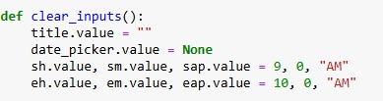
Key Features Implemented
Feature – Clear Input Fields
Purpose: Reset the form after adding an event
Code Snippet:
Description: Clears all inputs to default values so the user can add a new event without manually resetting fields.

Slide 13
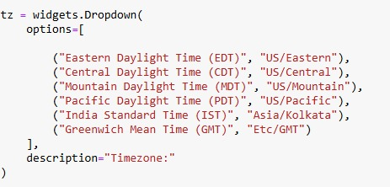
Key Features Implemented
Feature – Time Zone Selection
Purpose: Ensure all events are scheduled and displayed in the user’s selected time zone.
Code Snippet (exact from your code):
Description:The dropdown widget allows the user to choose a timezone from predefined options.This selected timezone is used when creating or viewing events, ensuring times are localized.It works together with pytz.timezone(tz.value) to convert the selected date and time into a proper timezone-aware datetime object.

Slide 14
UI/UX Design Choices
Widgets used:
DatePicker for selecting date
Dropdowns for hour, minute, and AM/PMButtons to trigger actions
Other Design Choices:
Form clears after adding an event
Events are shown in chronological order
Supports readable, minimal UI with labels like “Add Event,” “View Events,” etc.

Slide 15
How to Run the App
Open Calendar.ipynb in Jupyter Notebook
Run all cells to launch the widgetsSelect date, time, title and click “Add Event”Use other buttons to list or find available slots
All data saved in calendar.json for persistence

Slide 16
Testing and Validation
Manual testing using multiple event scenarios
Edge cases covered:
Overlapping events
Midnight to midnight coverage
Multiple events per day
Sample test data included in .json file

Slide 17
Conclusion & Improvements
Fully functional basic calendar app built All assignment features completed Future Improvements:
Add event editing and deletion
Integrate with real calendars (Google Calendar API)
Support recurring events
Build responsive web UI using Streamlit

Slide 18


