Slide 1

AI Investments
Riding the Wave or Riding a Bubble?
Keerthanaa Chidella Aditya Pawar Thanush Boyapati

Slide 2
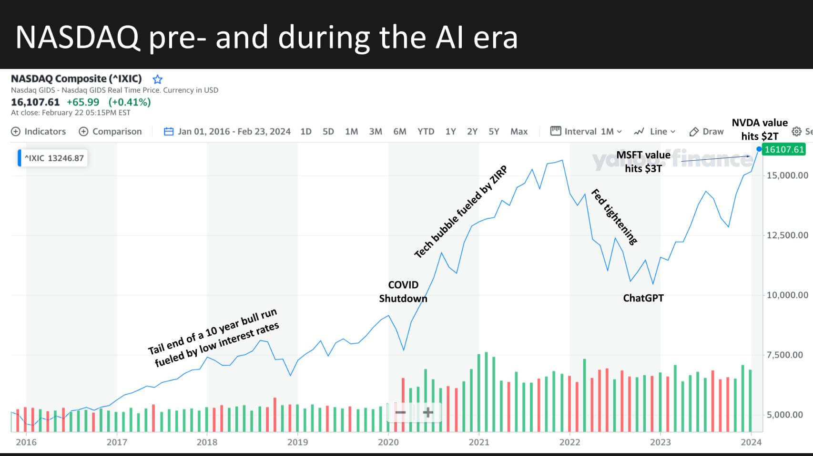
Trajectory of AI Valuations
Artificial Intelligence: Enables machines to learn from experience, adapt to new inputs and perform human-like tasks.
In 2022, GPT became widely recognized, bringing AI into the mainstream through its extensive applications.
AI era succeeded a decade-long bull market fueled by low interest rates.

Slide 3
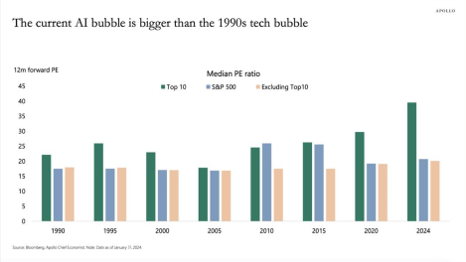
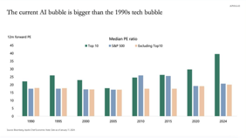
The “AHA” MOMENT
AI’s Enormous Potential and Universal Applicability but at what cost?
Nvidia sells tons of its H100 AI GPU chip, designed for AI applications.
Each chip consumes 700W of power which is MORE THAN that of average American household.
Their aggregated power consumption is anticipated to be as high as a major American city.
As we delve deeper into researching AI companies, we come across an article featuring a graph illustrating the PE ratio trends.

Slide 4
Hallmarks of a Bubble
⁠Lack of direct revenue generation
Round tripping funds to boost sales
Behind the Buzzword
⁠Investment Herd Mentality
Valuations skyrocket
Lack of killer apps

Slide 5
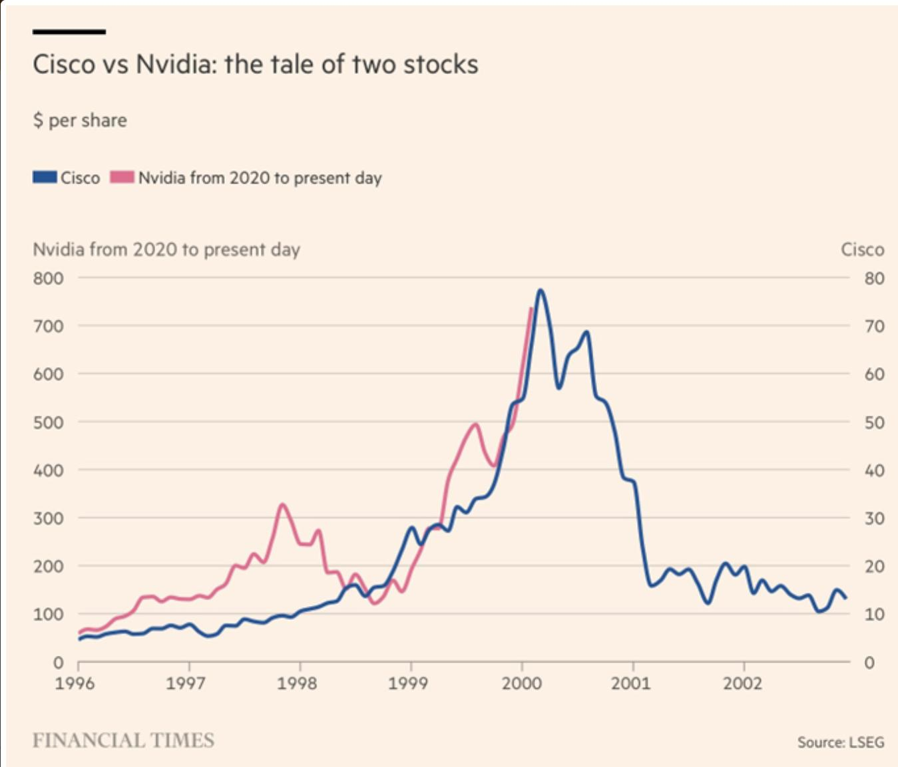
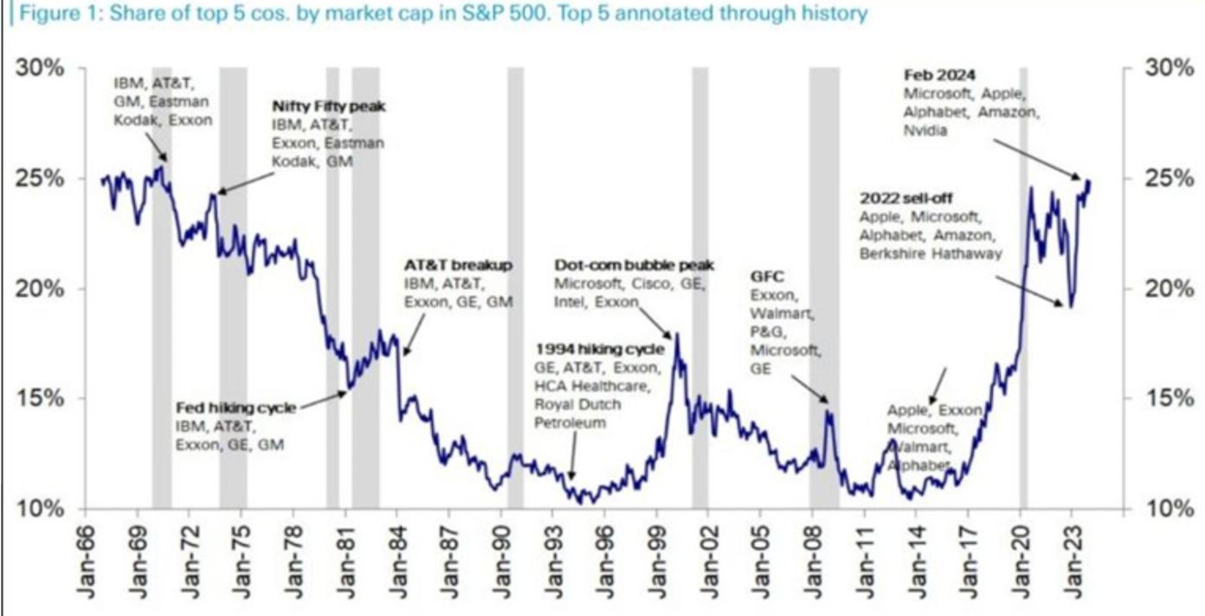
RIDING A BUBBLE

Slide 6
SIMILARITIES BETWEEN aI bubble & DOTCOM BUBBLE
Netscape & Open Al as the catalyst innovators
Web was funded by telco CAPEX as hyperscalers are funding AI CAPEX
Companies being highly valued
Investor FOMO
Completely new user experiences
Virtually unlimited and incalculable TAM
Embryonic markets have similar patterns 1.0 gets better & better leads to innovation

Slide 7
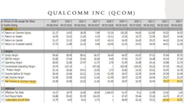
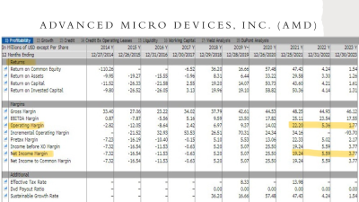
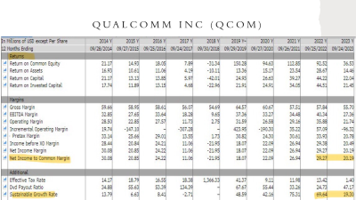
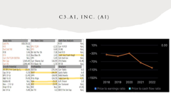
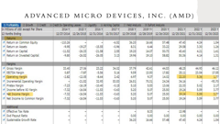

3 stocks to short
C3.ai, Inc. (AI)
Qualcomm Inc (QCOM)
Advanced Micro Devices, Inc. (AMD)

Slide 8

Thank you

Slide 9
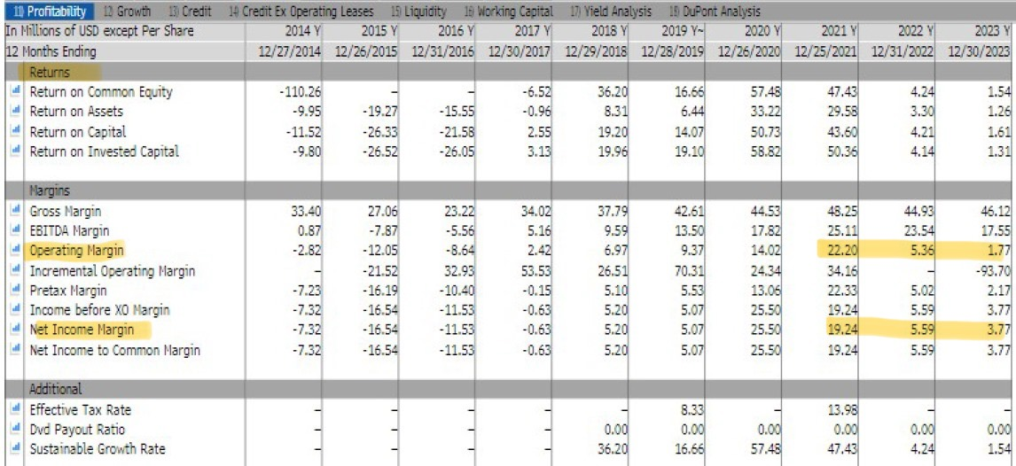
Advanced Micro Devices, Inc. (AMD)

Slide 10
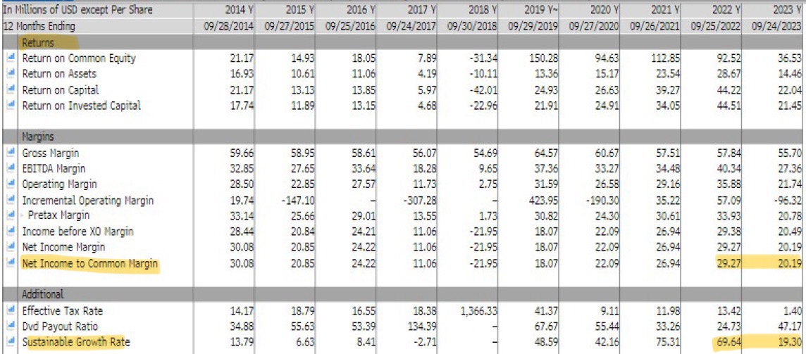
Qualcomm Inc (QCOM)

Slide 11
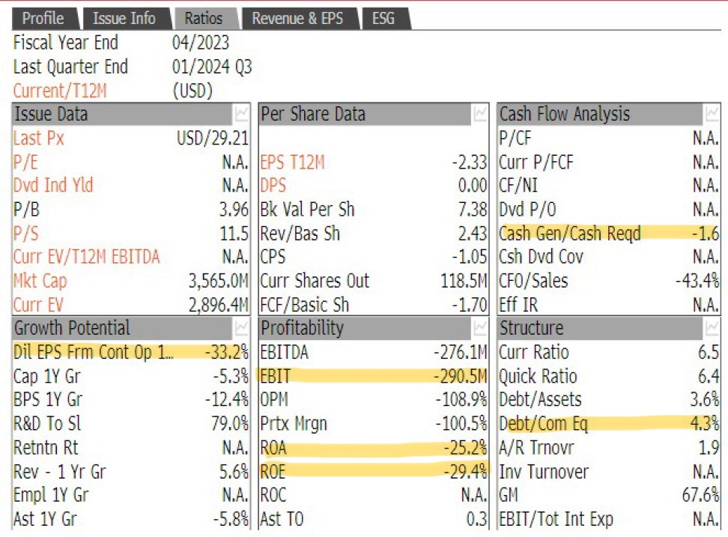
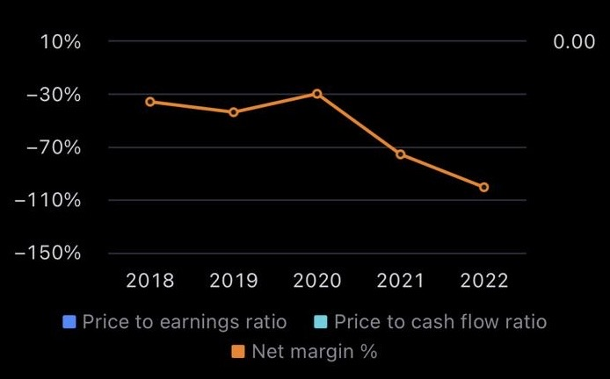
C3.ai, Inc. (AI)

Slide 12
