Slide 1


Title page option 2 with solid color background
Formal Verification of AHB – APB Bridge Model
TEAM - 14
Sai Rohith Reddy Yerram
Suhail Ahamed Subairudeen
Nikhitha Vadnala
Keerthanaa Bhoopathy

Slide 2
Section page with headline and two columns for copy
INTRODUCTION
The goal of this project is to develop a comprehensive Verification Plan for the AHB-APB bridge, ensuring its functionality and performance meet design requirements.
This bridge plays a vital role in connecting the AHB and APB, enabling efficient communication between the high-performance system and low-power peripherals.
The plan will detail the verification strategy, methodologies, and tools used to validate the bridge's operation.
Our verification approach involves formulating specific assertions, assumptions to cover all aspects of the bridge design in order to meet the functional specification.
‹#›

Slide 3
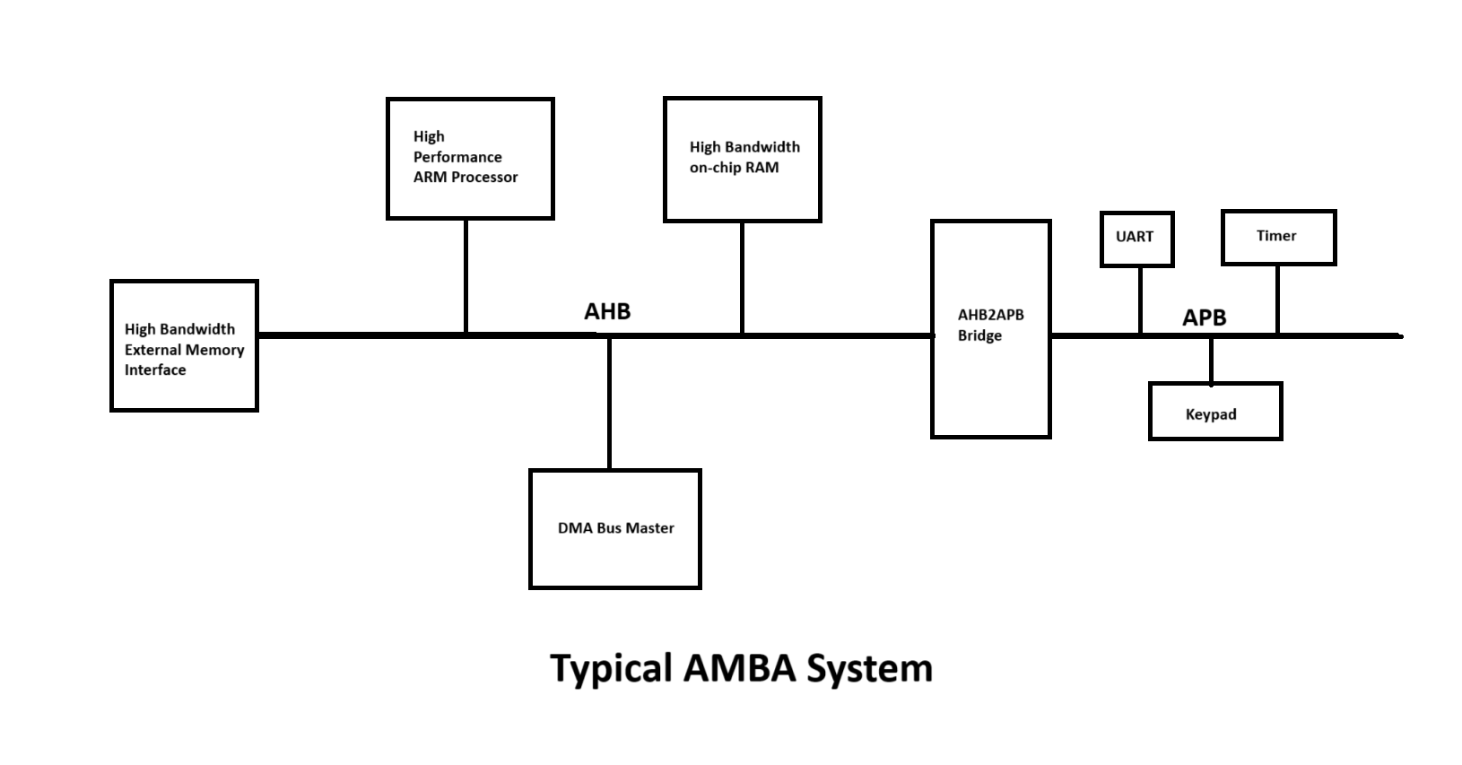
Section page with headline and two columns for copy
‹#›

Slide 4
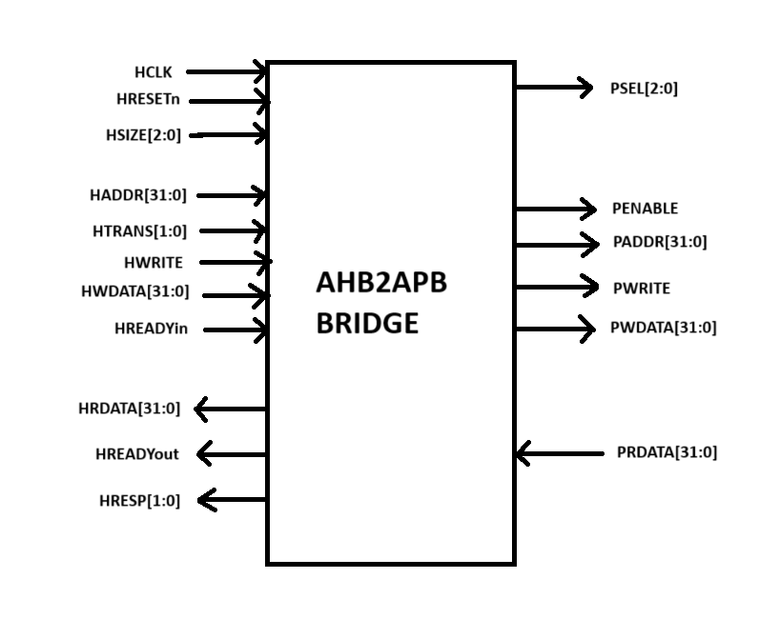
Section page with headline and two columns for copy
Block Diagram
‹#›

Slide 5
Section page with headline and two columns for copy
DESIGN DESCRIPTION
The AHB to APB Bridge is an AHB slave, providing an interface between the high-speed AHB and the low-power APB.
Read and write transfers on the AHB are converted into equivalent transfers on the APB.
As the APB is not pipelined, then wait states are added during transfers to and from the APB when the AHB is required to wait for the APB.
The bridge is designed to handle both sequential and non-sequential transfers of varying sizes (defined by HSIZE). This adaptability ensures compatibility with a wide range of peripherals, regardless of their specific data transfer requirements
‹#›

Slide 6
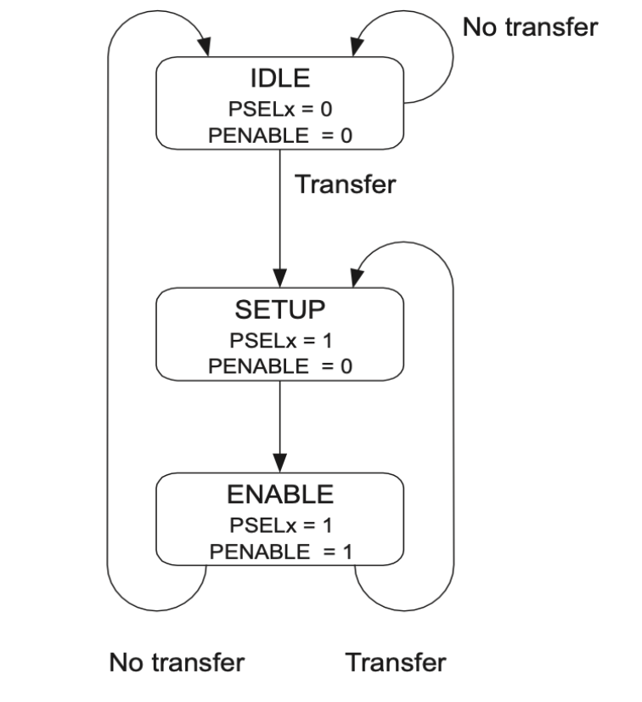
Section page with headline and two columns for copy
APB STATE DIAGRAM
‹#›

Slide 7
Section page with headline and two columns for copy
DESIGN DESCRIPTION
The bridge unit converts system bus transfers into APB transfers and performs the following functions:
Latches the address and holds it valid throughout the transfer.
Decodes the address and generates a peripheral select, PSELx. Only one select signal can be active during a transfer.
Drives the data onto the APB for a write transfer.
Drives the APB data onto the system bus for a read transfer.
Generates a timing strobe, PENABLE, for the transfer.
The AHB2APB bridge bridges the gap between high-speed and low-speed buses, providing a versatile and efficient communication pathway.
‹#›

Slide 8
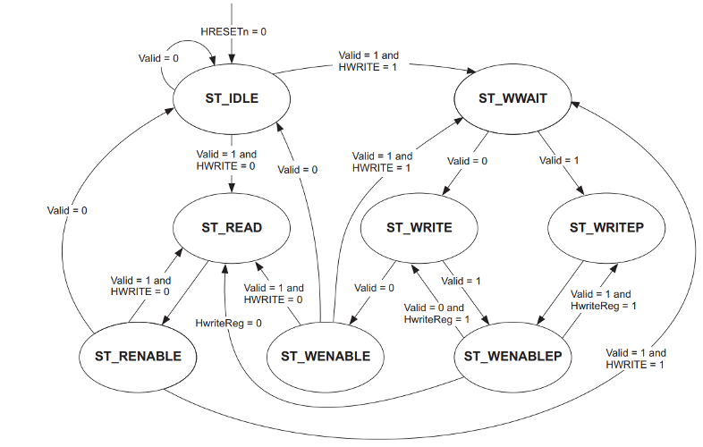
Section page with headline and two columns for copy
FSM Diagram
‹#›

Slide 9
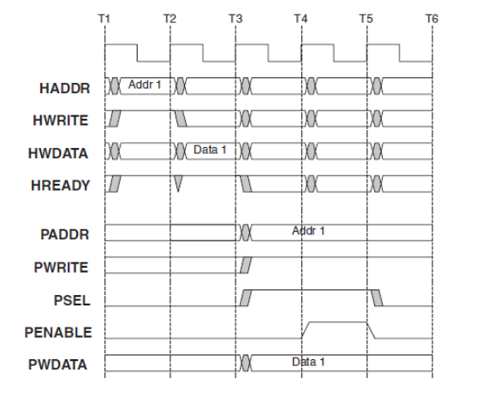
Section page with headline and two columns for copy
Timing Diagram - Write Transfer
‹#›

Slide 10
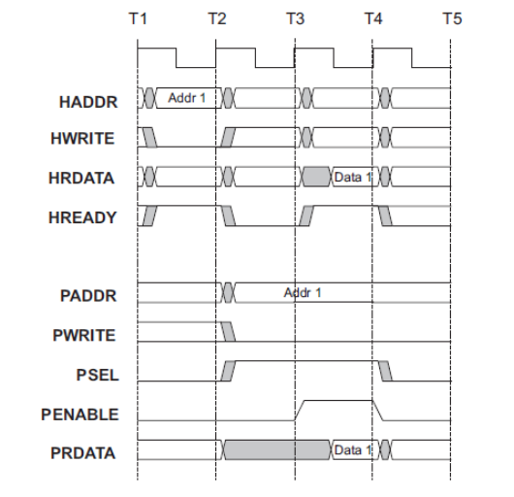
Section page with headline and two columns for copy
Read Transfer
‹#›

Slide 11
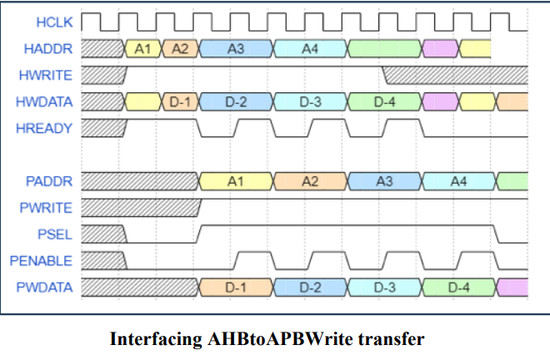
Section page with headline and two columns for copy
Burst of Write Transfer
‹#›

Slide 12
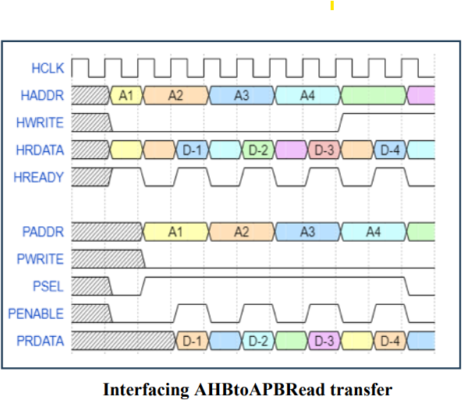
Section page with headline and two columns for copy
Burst of Read Transfer
‹#›

Slide 13
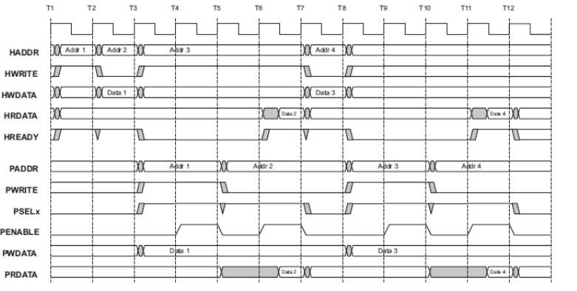
Section page with headline and two columns for copy
Read after Write
‹#›

Slide 14
Section page with headline and two columns for copy
Modes
We have Verified the design in using three modes.
Automatically Extracted Properties (AEP) : We used AEP to check for the deadlock conditions in the FSM. We encountered few deadlock states after which we avoided them by using fsm_fairness in the tcl file.
Formal X-Propagation (FXP) : We used FXP to check, if there is any X-Propogation occuring in any of the signals. We found few signals in which X-Prop is triggered, we updated the RTL to fix this issue.
Formal Property Verification (FPV) : We wrote the assertions and assumptions for all the modules at different levels of hierarchy, to verify the individual functionalities of these modules and their behavior in the top module.
‹#›

Slide 15
Section page with headline and two columns for copy
Verification Strategies
What are we Verifying ?
We are verifying the functionality of each individual modules.
AHB Slave Interface:
verified the reset signal functionality and its influence on other dependent signals.
Address decoding for the tempselx signal logic based on the Haddr.
resetting tempselx signal to 0, when Invalid address is called.
APB Controller:
FSM State Transitions
Verified Present State - Next State Logic
‹#›

Slide 16
Section page with headline and two columns for copy
Verification Strategies
3. Bridge Top-Level Module:
PSEL logic behavior based on the address range.
Data Transfer between AHB and APB modules.
Handling back to back transactions, reset behavior.
ASSUMPTIONS: We have defined assumptions to check the following Specificaions
Valid address ranges
Valid Data
Htrans to support only sequential and non- sequential Data Transfers.
Hreadyin to be high for two consecutive cycles.
‹#›

Slide 17
Section page with headline and two columns for copy
Error Injection
● Two Bugs were intentionally injected in APB_FSM_Controller module and those bugs were captured by the assertions we wrote.
● Bug1: In ST_WRITEP state, next state should be ST_WENABLEP but we made next state as ST_WRITE
● Bug2 : From ST_WENABLE state, it should move to ST_WWAIT state only if valid and Hwrite is high. No need of Hwritereg signal to be included in the condition.
‹#›

Slide 18
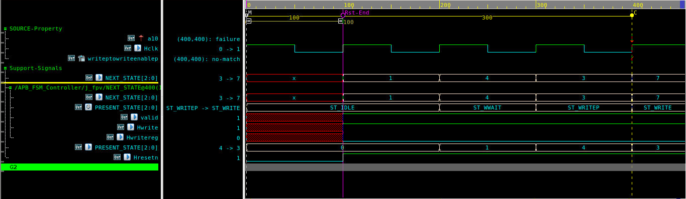
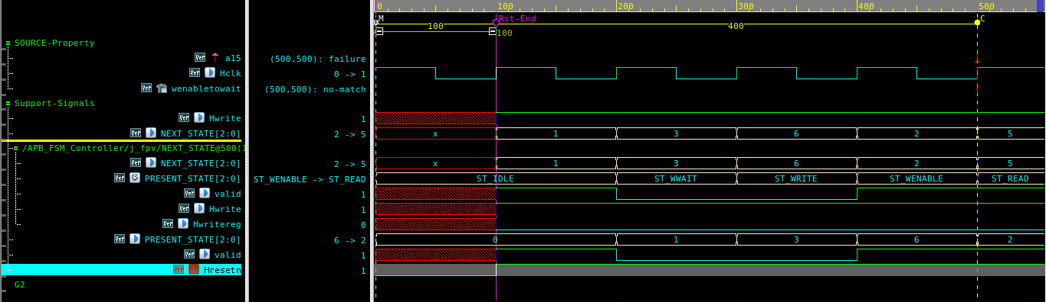
Section page with headline and two columns for copy
Counter Examples CEX
‹#›

Slide 19
Section page with headline and two columns for copy
Challenges
● Understanding the protocol is a bit challenging as it includes different requirements for AHB and APB buses, including handling different signal sets, burst transfers on AHB, and the simpler, non-pipelined nature of APB.
● Getting familiar with APB FSM controller module is quite difficult as it involves more state transitions.
● While integrating design modules with the assertion and assumption files we faced some errors and we rectified it.
‹#›

Slide 20
Section page with headline and two columns for copy
Conclusion
● The verification of the AHB-APB bridge ensures seamless communication between the high-speed AHB and the power-efficient APB, meeting the requirements set by the ARM AMBA specifications.
● Understanding the AHB2APB bridge protocol and verifying it using System Verilog assertions and assumptions has gave us the insights to understand the use of formal verification which includes FPV , FXP and AEP.
● This project helped us to understand the protocols in a better way and understand the formal way of verifying the designs.
‹#›

Slide 21
Section page with headline and two columns for copy
Referrences
1. Github .
2. ChatGPT
3. Lecture Slides by Professor Venkatesh Patil
Links:
https://github.com/prajwalgekkouga/AHB-to-APB-Bridge
‹#›

Slide 22
Section page with headline and two columns for copy
Thank You
‹#›

