Slide 1
Project Objective
Build a SQL-driven Logistics analytics system to analyze delays, optimize routes, and enhance shipment efficiency by leveraging queries, aggregations.

Slide 2
TASK1: Data Cleaning & Preparation
Task 1.1 : Identify and delete duplicate Order_ID records.
Syntax : select order_id, count(*) as duplicate_id from orders group by order_id having count(*)>1;
Task 1.2 : Replace null Traffic_Delay_Min with the average delay for that route.
select * from routes where traffic_delay_min is null;
update routes r join(select Route_ID,avg(traffic_delay_min) as Average_delay from routes where traffic_delay_min is not null group by Route_ID) t on r.Route_ID = t.Route_ID set r.traffic_delay_min = t.Average_delay where r.traffic_delay_min is null;

Slide 3
Task 1.3 : Convert all date columns into YYYY-MM-DD format
alter table orders MODIFY column Order_Date DATE,
MODIFY column Expected_Delivery_Date DATE,
MODIFY column Actual_Delivery_Date DATE;
alter table shipmenttracking MODIFY column Checkpoint_Time DATE;
Task 1.4 : Ensure that no Actual_Delivery_Date is before Order_Date (flag such records).
alter table orders add column Deliver_flag varchar(10);
update orders set deliver_flag = CASE when actual_delivery_date <order_date then 'Invalid’ else 'valid’ end;

Slide 4
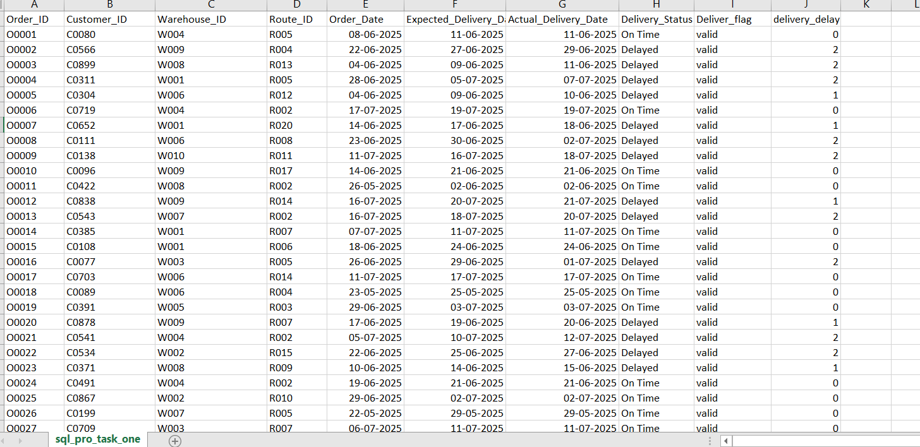

Slide 5
TASK 2 : Delivery Delay Analysis
TASK 2.1 : Calculate delivery delay (in days) for each order
alter table orders add column delivery_delay int;update orders set delivery_delay = datediff(actual_delivery_date,expected_delivery_date);
TASK 2 .2 : Top 10 delayed routes based on average delay days.
select Route_ID, avg(delivery_delay) Avg_delivery_delay from ordersgroup by route_id order by Avg_delivery_delay desc limit 10;
TASK 2 .3 : Rank all orders by delay within each warehouse using windows function
select order_id,warehouse_id,delivery_delay,RANK() OVER(partition by warehouse_id order by delivery_delay desc)AS ranking from orders;

Slide 6
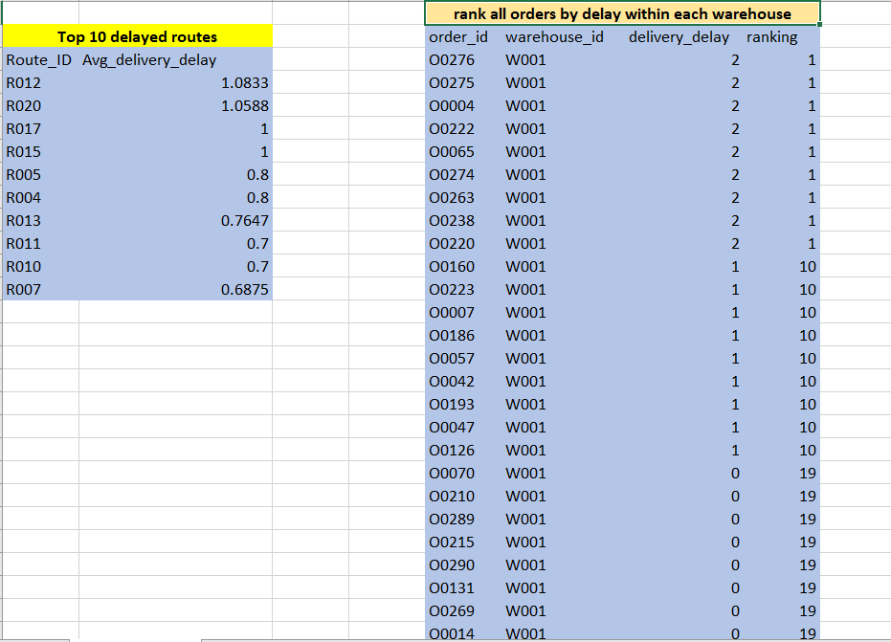

Slide 7
Task 3: Route Optimization Insights
Task 3 .1.1 : Calculate Average delivery time (in days).
select route_id, AVG(Average_Travel_Time_Min)/(60*24) as Average_Travel_Time_days from routes group by route_id;
Task 3 .1.2 : Calculate Average traffic delay.
select route_id, AVG(Traffic_Delay_Min) AS avg_traffic_delay_min from routes group by route_id;
Task 3 .1.3 : Distance-to-time efficiency ratio
alter table routes add column Distance_time_efficiency float;
update routes set Distance_time_efficiency=Distance_KM/Average_Travel_Time_Min;
Task 3 .2 : Identify 3 routes with the worst efficiency ratio.
select route_id, Distance_time_efficiency from routes order by Distance_time_efficiency asc limit 3;

Slide 8
Task 3.3 : Find routes with >20% delayed shipments.
select route_id,Average_Travel_Time_Min,Traffic_Delay_Min,Distance_time_efficiency, (traffic_delay_min/Average_Travel_time_min)*100 AS delay_percentage from routes where (Traffic_delay_min/Average_travel_time_min)*100 > 20;
task 3.4 : Recommend potential routes for optimization.
Increase the avg travel time.
Improve the transport fecility

Slide 9
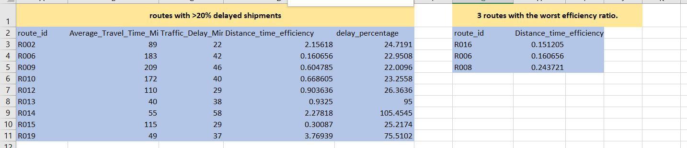

Slide 10
Task 4: Warehouse Performance
Task 4.1 : Find the top 3 warehouses with the highest average processing time.
select o.warehouse_id, avg(w.processing_time_min) As avg_processing_time from orders oleft join warehouses w on w.warehouse_id=o.warehouse_id group by o.warehouse_id order by avg_processing_time desc limit 3;
Task 4.2 : Calculate total vs. delayed shipments for each warehouse.
select o.warehouse_id, count(o.order_id) as total_shipment, sum(case when o.delivery_status='delayed' then 1 else 0 end) as delayed_shipment from orders o left join warehouses w on w.warehouse_id=o.warehouse_id group by o.warehouse_id;

Slide 11
Task 4.3 : bottleneck warehouses where processing time > global average
with Avg_processing as (select avg (processing_time_min) as Global_avg from warehouses) select w.warehouse_id, w.processing_time_min from warehouses w, Avg_processing a where w.processing_time_min > a.Global_avg;
Task 4.4 : Rank warehouses based on on-time delivery percentage
select w.warehouse_id, (sum(case when o.delivery_status='on time'then 1 else 0 end)/count(o.order_id))*100 AS on_time_percentage, RANK()OVER(order by (sum(case when o.delivery_status='on time'then 1 else 0 end)/count(o.order_id)) desc ) AS Rank_positionfrom warehouses w join orders o on w.warehouse_id=o.warehouse_id group by w.warehouse_id;

Slide 12
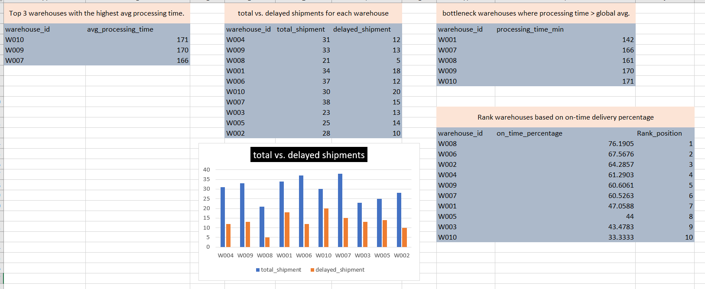

Slide 13
Task 5: Delivery Agent Performance
Task 5.1 : Rank agents (per route) by on-time delivery percentage
select agent_id,route_id, on_time_percentage, dense_rank() over( partition by route_id order by on_time_percentage desc) as rank_per_route from deliveryagents;
Task 5.2 : Find agents with on-time % < 80%.
select * from deliveryagents where on_time_percentage < 80;
Task 5.3 : Compare average speed of top 5 vs bottom 5 agents using subqueries.
select (select avg(Avg_Speed_KM_HR) from deliveryagents order by on_time_percentage desc limit 5 ) as top_5avg_speed,(select avg(Avg_Speed_KM_HR) from deliveryagents order by on_time_percentage asc limit 5) as bottom_5avg_speed;

Slide 14
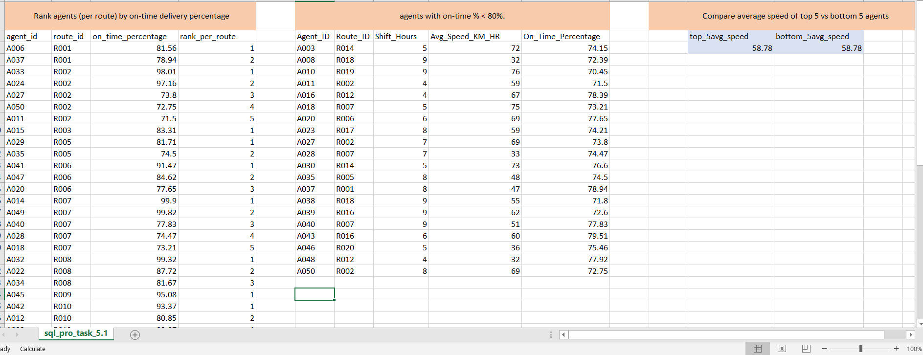

Slide 15
Task 6: Shipment Tracking Analytics
Task 6.1 : For each order, list the last checkpoint and time
select o.order_id, s.checkpoint,s.checkpoint_time from orders o left join shipmenttracking s on o.order_id=s.order_id order by o.order_id,checkpoint asc;
Task 6.2 : Find the most common delay reasons (excluding None).
select delay_reason, count(*) as reason_count from shipmenttracking where delay_reason is not null and delay_reason <> 'none’ group by delay_reason order by reason_count desc;
task 6.3: Identify orders with >2 delayed checkpoints
select order_id, count(*) as delayed_checkpoint from shipmenttracking where delay_reason is not null and delay_reason <> 'none’ group by order_id having count(*)>2;

Slide 16
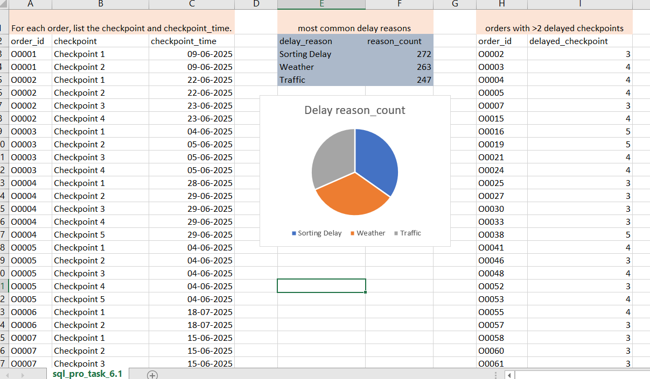

Slide 17
Task 7: Advanced KPI Reporting
Task 7.1 : Average Delivery Delay per Region (Start_Location).
select r.start_Location AS Region, avg(o.delivery_delay) AS Avg_delivery_delay from orders o join routes r on o.route_id=r.route_id group by r.start_location order by Avg_delivery_delay desc;
Task 7.2 : calculate On-Time Delivery % = (Total On-Time Deliveries / Total Deliveries) * 100.
select (sum(case when delivery_status = 'On Time'then 1 else 0 end)*100/count(*)) AS Ontime_delivery_percentage from orders;
Task : 7.3 Average Traffic Delay per Route
select r.route_id, avg(r.traffic_delay_min) AS Avg_traffic_delay_min from orders o join routes r on o.route_id=r.route_id group by r.route_id order by Avg_traffic_delay_min desc;

Slide 18
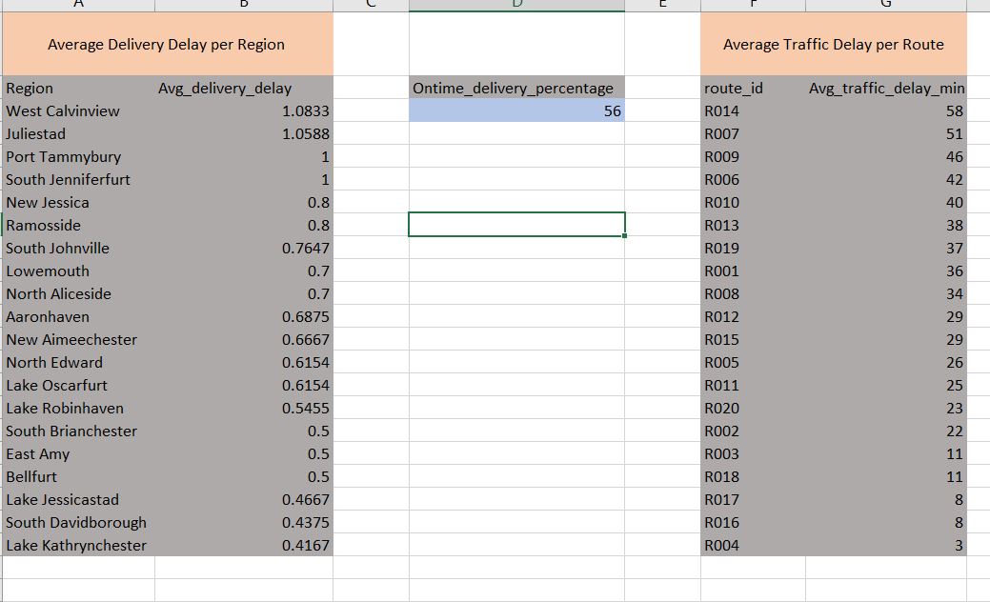

Slide 19
Thank you
Video link: :https://www.loom.com/share/6258bdaf54614c5da64099ba23e1fd51

