Slide 1

Helmet Detection
Amrutha Varshini (2010030009)
Bellam Keerthana (2010030017)
Mallyala Nissie (2010030095)
Under the Guidance of
Mr. G Madhukar Rao
Associate Professor
Computer Science and Engineering Department
KL Hyderabad Off Campus, Aziz Nagar Hyderabad

Slide 2
OVERVIEW
Introduction
Literature Review
Problem Statement
Objectives of the Project
Proposed Methodology
Methodology
Approach
Implementation Details
References

Slide 3
Introduction
Road safety is a key concern in today's world, and wearing helmets is a vital feature of it, particularly for motorcyclists and bicycle riders. To address this worry and contribute to safer road situations, the "Helmet Detection using Convolutional Neural Networks" project has been conducted. This project amalgamates powerful computer vision and deep learning techniques to produce a system that can identify whether persons are wearing helmets while on the road.
In summary, the "Helmet Detection using Convolutional Neural Networks" project goes on a path to increase road safety by automating the process of helmet compliance detection. By merging the power of deep learning with real-world applications, this research holds the potential to greatly enhance road safety, streamline traffic enforcement, and contribute to a safer and more secure transportation ecosystem

Slide 4
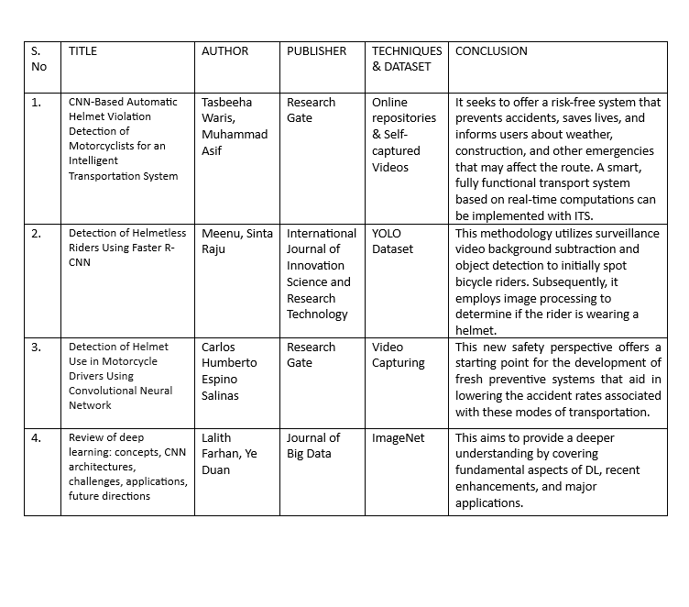
Literature Review

Slide 5
Problem Statement
The "Helmet Detection" project aims to address the pressing issue of road safety by leveraging computer vision and deep learning techniques. The primary problem being tackled is the need to enhance compliance with helmet-wearing regulations among individuals on the road. By developing a model capable of identifying humans with and without helmets in real-world scenarios, the project seeks to provide a systematic and versatile solution to improve overall traffic safety and support traffic enforcement efforts.

Slide 6
Objectives of the Project
Safety Improvement:
Preventing Accidents Utilizing CNNs for helmet detection can help reduce accidents by guaranteeing that people participating in risky activities or locations are wearing the proper safety gear. Decreased Risk of Injuries: It encourages the wearing of helmets, which considerably lowers the chance of brain damage in the event of falls or accidents.
Monitoring Compliance:
Enforcing Safety standards: By determining if employees are wearing helmets, businesses like manufacturing and construction may ensure compliance with safety standards, hence lowering workplace accidents. Sports and Recreation: In sports, encouraging athletes to wear helmets whether cycling, skateboarding, or skiing might help athletes adhere to safety precautions.

Slide 7
Automating Monitoring Systems:
Effective Surveillance: To achieve automated monitoring in real-time and effective surveillance in congested or remote regions, a CNN-based helmet detection system can be implemented. Fast Response to Violations: When people are seen not wearing helmets, automated detection systems can send out alerts or messages, allowing for quick actions or interventions.
IoT and wearables integration:
IoT Integration: Smarter safety solutions can be created by integrating helmet detection via CNNs with IoT devices. For example, in smart helmets that have sensors to track environmental factors or impacts. Wearable Tech: Improving wearable technology by making sure that safety gear—helmets—is worn in order to gather data or offer quick support in an emergency

Slide 8
Proposed Methodology
The proposed methodology in the accompanying Python script attempts to execute the following actions on a video stream:
1.Video Input: The script takes a video file as input, supplied by the video_path variable.
2.Object Detection with YOLO: It employs the YOLO (You Only Look Once) object detection model to detect items in each video frame. The YOLO model is loaded from the weights and settings files given in the cv2.dnn.readNet call.
3. Helmet Classification: For each detected bike in the frame, it defines a zone of interest (ROI) to focus on the helmet area. A proprietary Convolutional Neural Network (CNN) model (loaded using TensorFlow) is used to classify whether a helmet is worn or not. The classification results are displayed on the frame.

Slide 9
.
4. Number Plate Detection and OCR: For each detected number plate, it defines a region of interest (ROI) to extract the number plate area. The script performs Optical Character Recognition (OCR) on the recovered number plate region using Tesseract (PyTesseract). The identified text is saved in the number_plates list.
5. Output Visualization and Saving: The script annotates each frame with helmet status (wearing or not) and number plate text (if found) and presents it in a video window. It stores frames where no helmet is identified in the no_helmet_frames output folder. The annotated frames are written to an output video file. The recognized number plates are saved in the number_plates list.
6. Cleanup and Resources Release: Once the video has been processed frame by frame, the script releases the video resources and closes the video window.
7. Result Storage: The script can save the detected number plates to a text file supplied by the output_file variable.

Slide 10
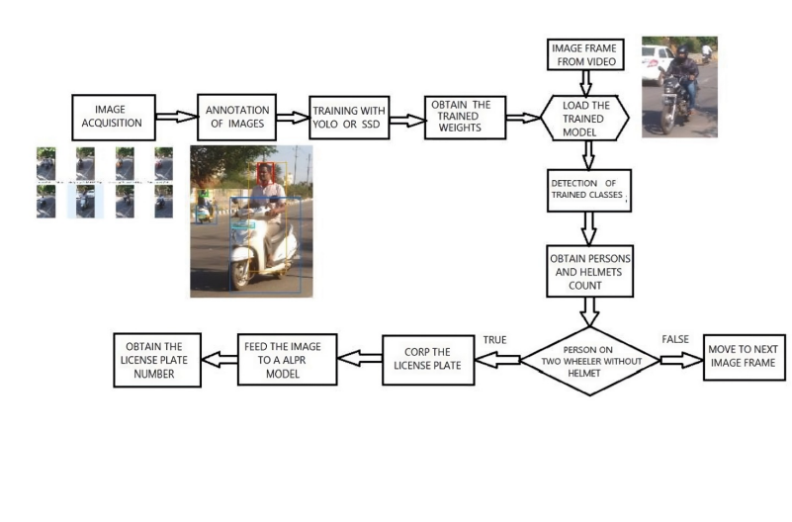
Methodology

Slide 11
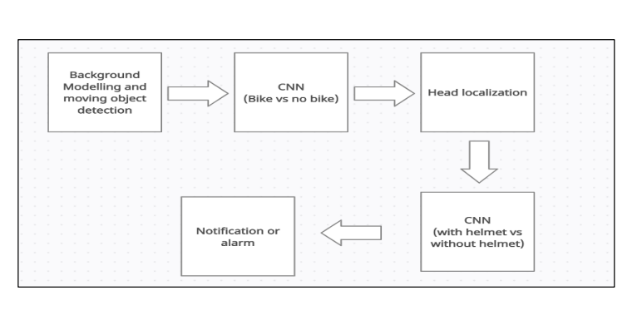
Approach

Slide 12
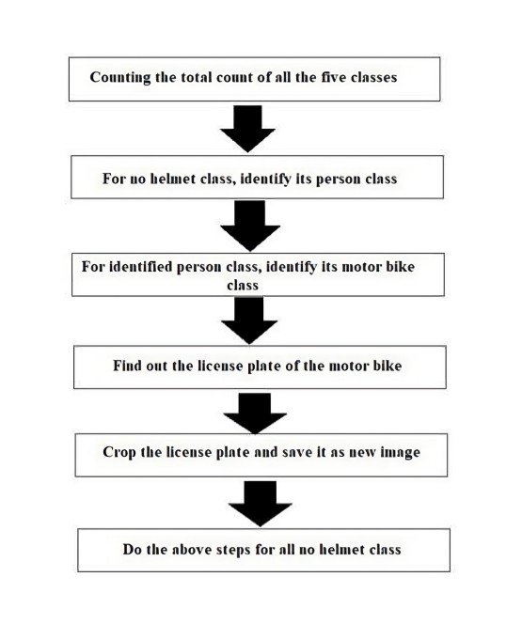
Implementation Details

Slide 13
References
https://journalofbigdata.springeropen.com/articles/10.1186/s40537-021-00444-8
https://ijisrt.com/assets/upload/files/IJISRT20MAY841.pdf
https://www.researchgate.net/publication/370697127_Detection_of_Helmet_Use_in_Motorcycle_Drivers_Using_Convolutional_Neural_Network

Slide 14
THANK YOU !

