Slide 1
DATA ANALYST
Task Presentation
By:
Keerthana V
HKBK College of Engineering
Data Analyst Intern
August Batch 1 / October 2026

Slide 2
CONTENTS
1. ACKNOWLEDGEMENT — Formal recognition of ShadowFox, coordinators, and declaration of independence.
2. BEGINNER LEVEL — Small Business Sales Performance Analysis & Automated Excel Dashboard.
3. INTERMEDIATE LEVEL — Customer Behaviour, RFM Segmentation, Cohort Retention & Relational SQL.
4. ADVANCED LEVEL — Executive Business Intelligence Dashboard & Logistics SLAs in Power BI.
5. CONCLUSION & RECOMMENDATIONS — Consolidated business insights, operational strategy, and learning outcomes.
2

Slide 3
ACKNOWLEDGEMENT
I would like to express my gratitude to ShadowFox for giving me the opportunity to present the comprehensive data analytics tasks I have completed during this internship.
I would also like to extend my thanks to my coordinator, Mr. Aakash, for guiding me throughout this experience. I acknowledge that all three capstone projects, automated Python pipelines, relational SQL queries, spreadsheet models, and Power BI dashboards were completed independently by me. Additionally, I utilized official technical documentation for research and developer tooling for validating code quality and generating reference ideas.
3

Slide 4
BEGINNER LEVEL: Overview & Methodology
Task: Small Business Sales Performance Analysis & Spreadsheet Dashboard
• Business Problem: A retail small business lacked visibility into category margins, seasonal demand spikes, and regional product profitability across 1,270 raw transaction records with real-world flaws.
• Data Cleaning Pipeline: Automated Python cleaning script (data_cleaning.py) removed 20 duplicate orders, imputed 37 missing payment methods, normalized casing, parsed mixed date formats, and verified 1,250 clean records.
• Core Verified KPIs: Gross Revenue: $180,936.50 | Net Profit: $87,709.30 | Margin: 48.48% | Orders: 1,250 | Units: 2,662 | Average Order Value (AOV): $144.75.
• Spreadsheet Dashboard: Constructed an automated 4-tab Excel workbook (Small_Business_Sales_Dashboard.xlsx) using dynamic formulas (=SUM, =SUMIFS, =AVERAGE), KPI summary cards, and embedded charts.
• Technical Stack: Python 3.12 (Pandas, NumPy, Matplotlib, Seaborn), Microsoft Excel (openpyxl), Git.
4

Slide 5
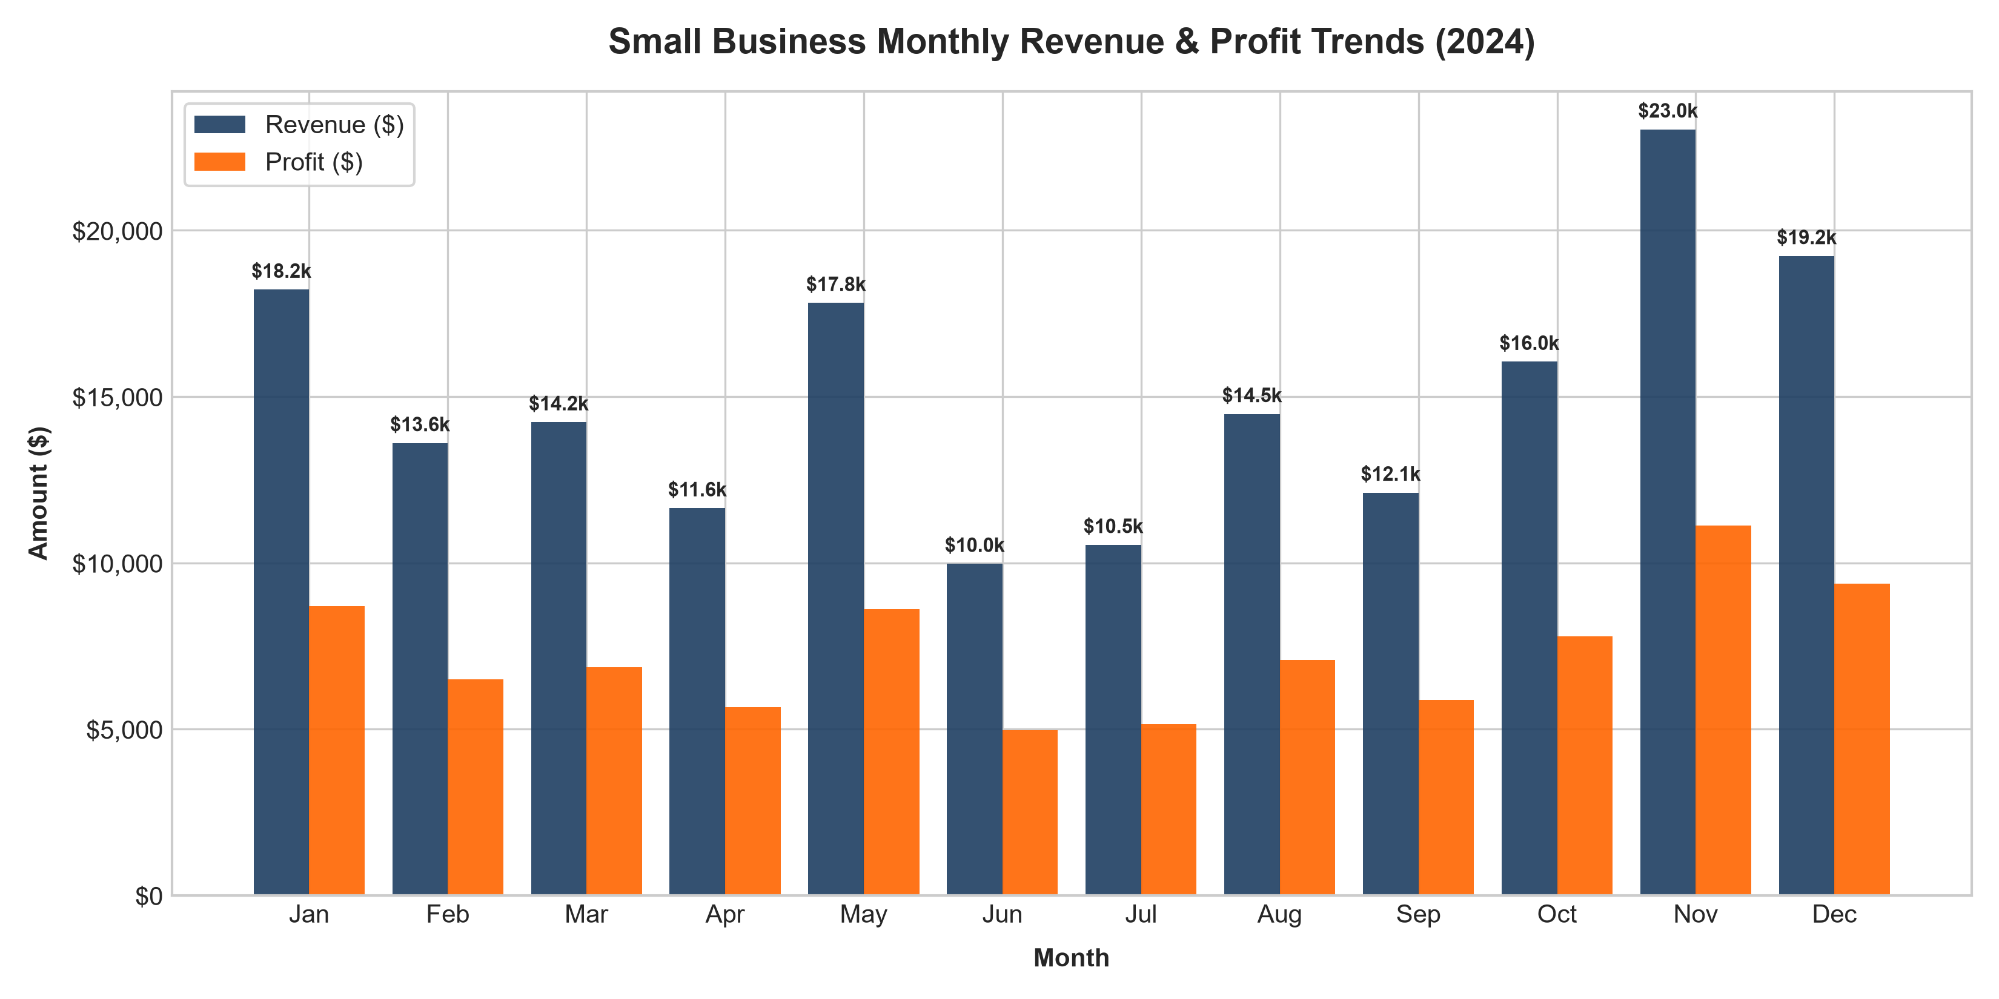
Monthly Sales Trend & Seasonality Analysis
• Description: Time-series line chart tracking monthly Gross Revenue and Net Profit across Fiscal Year 2024.
• Key Peak: November surge reached $23,036.00 in sales ($11,363.50 profit) with an AOV of $213.30, driven by Black Friday and Q4 holiday promotions.
• Low Season: June represented the lowest revenue month ($9,972.00; AOV $124.65), revealing a distinct summer purchasing lull.
• Strategic Action: Launch targeted early-bird campaigns starting in September to extend the seasonal peak and smooth mid-year dips.
5

Slide 6
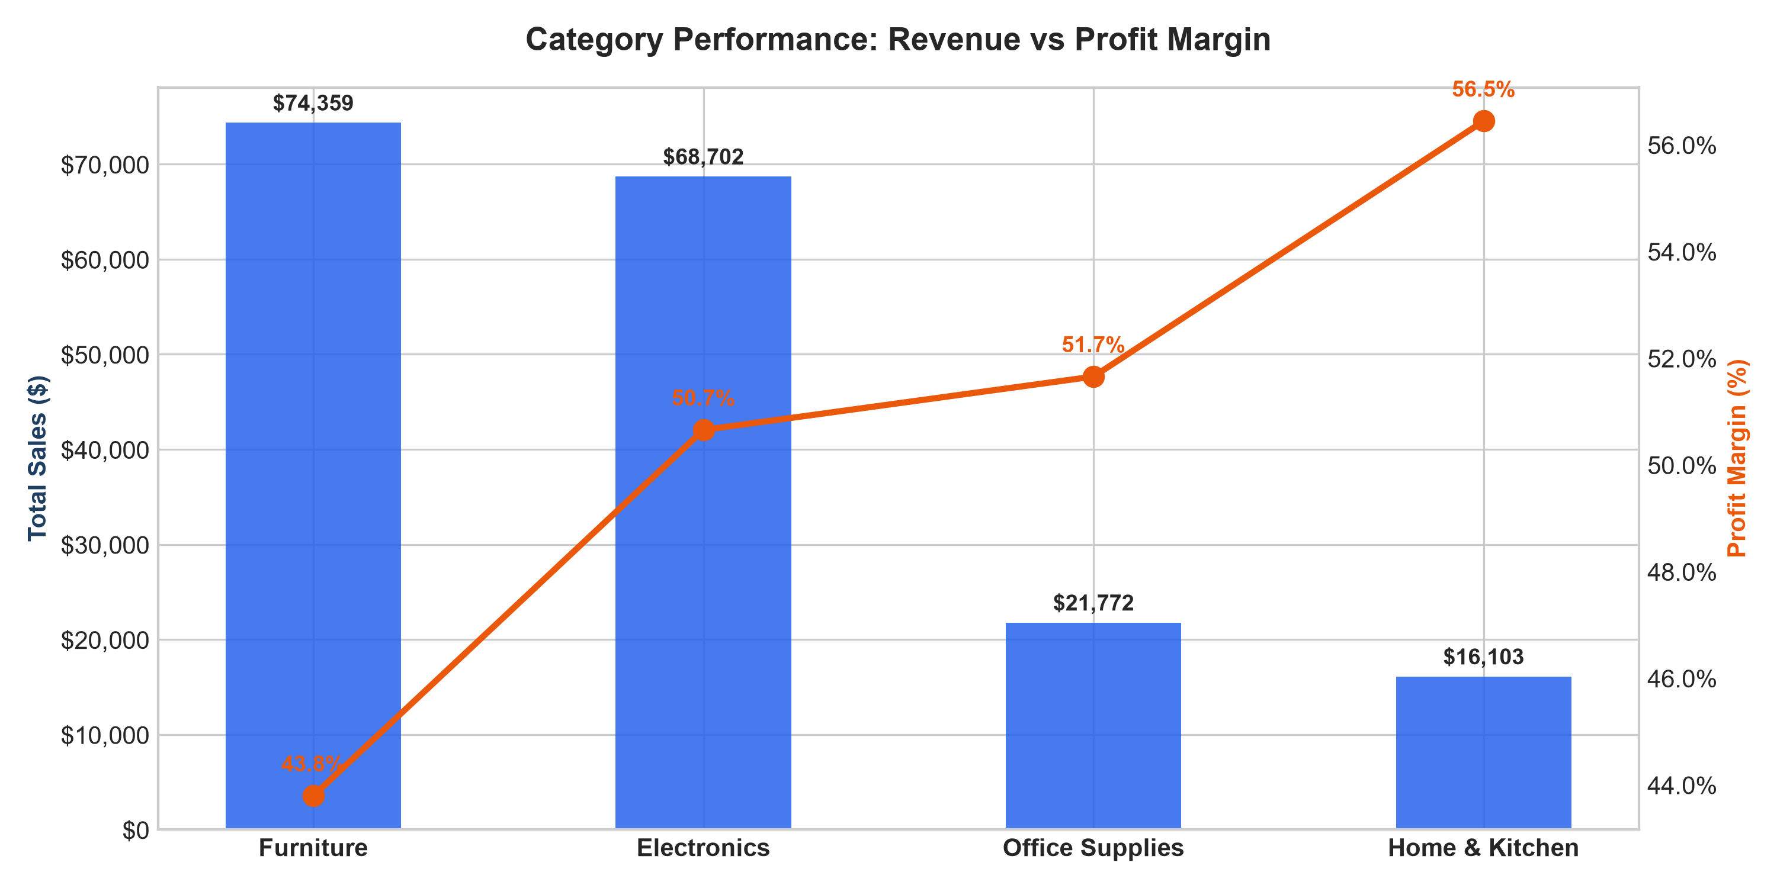
Category Sales & Profitability Breakdown
• Description: Dual-axis bar and line visualization comparing total gross revenue against net profit margin across 4 retail verticals.
• Volume Dominance: Furniture ($74,359.00) and Electronics ($68,702.50) generate 79.07% of consolidated gross company revenue.
• Margin Leaders: Office Supplies yield the highest margin percentage (49.95%), led by Gel Ink Pens at an extraordinary 67.72% net profit margin.
• Merchandising Strategy: Bundle high-volume furniture with high-margin desk accessories to lift consolidated order profitability.
6

Slide 7
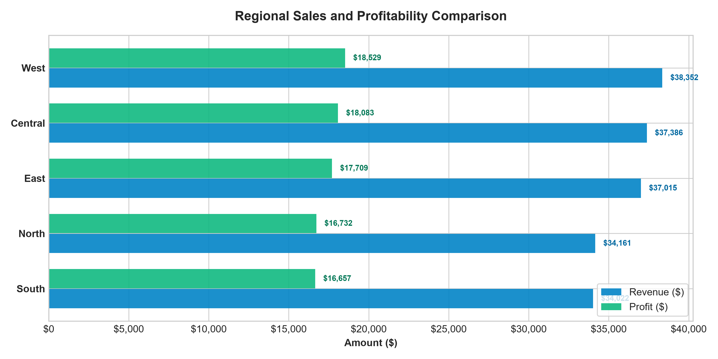
Regional Performance & Spreadsheet Automation
• Description: Geographic performance analysis across 5 sales territories alongside dynamic Excel dashboard architecture.
• Regional Lead: West Region leads overall performance with $42,306.00 in revenue and $20,443.00 in profit, closely followed by Central ($38,685.00).
• Excel Architecture: 4-tab workbook (Raw Data, Cleaned Data, Formula Analysis, Dashboard) using dynamic formulas (=SUMIFS, =AVERAGE).
• Non-Technical Usability: Empowers executive decision-makers with interactive KPI tiles and real-time summary calculations.
7

Slide 8
INTERMEDIATE LEVEL: Customer Analytics Overview
Task: Customer Behaviour, Revenue, and Retention Analytics
• Business Problem: A direct-to-consumer e-commerce brand needed to quantify customer persistence, repeat purchase velocity, and RFM spend concentration across 24 months of transactional data.
• Dataset & Cleaning: Evaluated 2,336 raw records across 850 customer accounts spanning 2023–2024. Cleaned 30 duplicates, standardized schemas, and engineered Cohort_Month and Cohort_Index tags.
• Behavioral Segmentation: Implemented an 8-cluster RFM framework (Champions, Loyal Customers, At Risk, etc.) binned via Recency, Frequency, and Monetary quintile scoring.
• Relational Database & SQL: Established an SQLite database (customer_analytics.db) and authored 10 production SQL queries utilizing Common Table Expressions (CTEs) and Window Functions (DENSE_RANK, LAG, NTILE).
• Key Outcome: Uncovered that repeat buyers generate 80.88% of total revenue and formulated an automated Day 3-10-21 retention sequence.
8

Slide 9
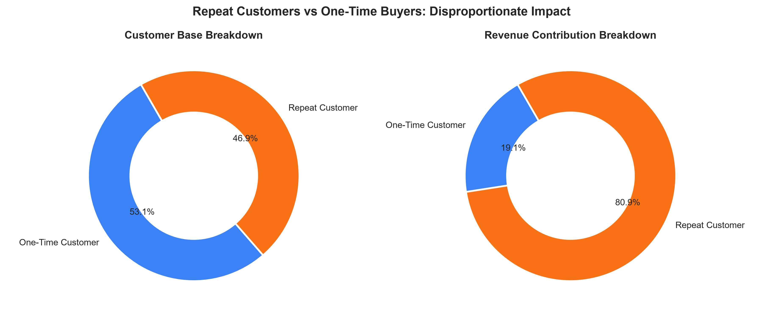
Customer Spend Dynamics: Repeat vs One-Time Buyers
• Description: Spend share distribution comparing repeat purchasers against single-order buyers across 850 accounts.
• Massive Asymmetry: Repeat buyers make up only 46.94% of the customer base (399 accounts) but drive 80.88% of total revenue ($264,508.51).
• Lifetime Value Gap: Average LTV for repeat buyers is $662.93, representing a 4.8x multiplier over one-time buyers ($138.07).
• Strategic Focus: Allocating marketing budget toward post-purchase reactivation yields dramatically higher ROI than top-of-funnel acquisition alone.
9

Slide 10
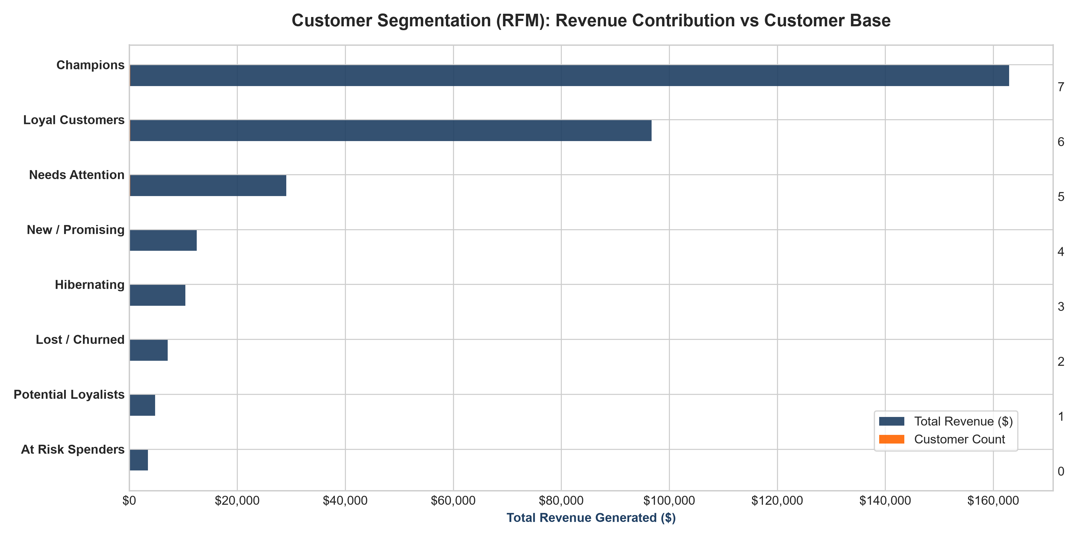
RFM Customer Segmentation & Spend Concentration
• Description: Customer segmentation framework categorizing 850 accounts across Recency, Frequency, and Monetary quintiles.
• Champions Dominate: 200 Champions alone account for $162,963.95 (49.83% of total brand sales) with an average of 5.7 purchases per account.
• Pareto Rule Confirmed: The top 20% of customers deliver 56.04% of cumulative revenue; top two segments account for 69.51%.
• Targeted Action: Deploy automated VIP concierge perks for Champions while launching win-back incentives for the $19.5k 'At Risk' segment.
10

Slide 11
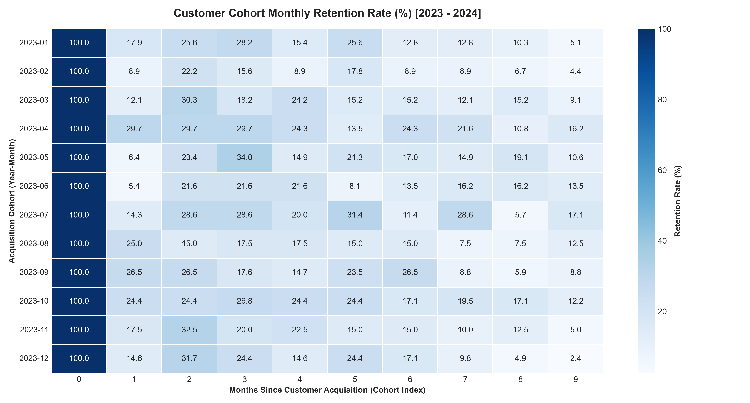
24-Month Cohort Retention Heatmap & Churn Dynamics
• Description: Seaborn retention heatmap tracking customer persistence percentage across 24 monthly acquisition cohorts.
• Steep Drop-Off: The primary attrition bottleneck occurs between Month 0 and Month 1, where retention drops from 100% to ~20%.
• Stabilized Loyalty Core: From Month 3 through Month 12, retention stabilizes at a resilient 12% to 16% long-term baseline.
• Intervention Strategy: Implement an automated Day 3-10-21 email sequence to guide first-time buyers toward their critical second purchase.
11

Slide 12
Relational Database & Advanced SQL Analytics
Production SQL Query Engine (SQLite & ANSI SQL-99)
• Database Architecture: Normalized 2,306 transactions into relational customers, products, and transactions tables with foreign key constraints in customer_analytics.db.
• Ranking Functions: Query 5 implemented DENSE_RANK() OVER (PARTITION BY Customer_Region ORDER BY Total_Spend DESC) to identify top 3 VIP accounts in each geographic territory.
• Time-Series Analytics: Query 6 utilized LAG(Monthly_Revenue, 1) OVER (ORDER BY Year_Month) to compute exact Month-over-Month (MoM) revenue growth percentages.
• Cumulative Aggregations: Query 7 computed running total revenue across 24 months using SUM(Monthly_Revenue) OVER (ORDER BY Year_Month ROWS UNBOUNDED PRECEDING).
• Spend Quintile Binning: Query 9 applied NTILE(5) OVER (ORDER BY Total_Spend DESC) to group the customer base into mathematical spend quintiles.
• Verification: All 10 queries executed via Python automation script (execute_sql_queries.py) with zero errors, exporting verified CSV reports.
12

Slide 13
ADVANCED LEVEL: Executive Power BI Dashboard
Task: Enterprise BI Architecture, Star Schema & Logistics SLAs
• Business Objective: Architect an enterprise reporting system for a global distributor (FY 2022–2024) to monitor revenue velocity, budget targets, and supply chain delivery compliance.
• Dimensional Star Schema: Engineered 6 relational tables: Fact_Orders (4,200 rows), Fact_Targets (1,080 rows), Dim_Date (1,096 days), Dim_Products (1,241 SKUs), Dim_Customers (600 accounts), Dim_Geography (10 hubs).
• DAX Measures Library: Authored 28 production DAX measures covering Core Financials, Time Intelligence (TOTALYTD, SAMEPERIODLASTYEAR), Target Variances, and Logistics SLAs.
• Verified 3-Year Metrics: Total Sales: $2,929,341.17 | Net Profit: $1,124,915.67 | Operating Margin: 38.40% | Annual YoY Growth: +96.4% in 2023, +24.5% in 2024.
• Supply Chain Discovery: Identified a critical logistics bottleneck where overall SLA compliance is 68.83% against an 85.00% target, driven by Standard Class ground shipping delays.
13

Slide 14
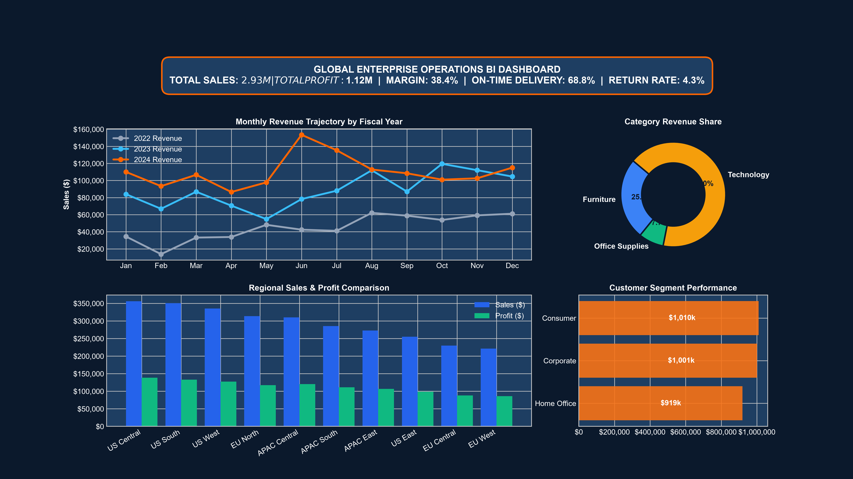
Executive Financial Scorecard & Growth Velocity
• Description: High-resolution Power BI dashboard mockups displaying multi-year sales velocity, operating profit, and product vertical distribution.
• Consolidated Revenue: 3-Year Gross Sales reached $2,929,341.17 with $1,124,915.67 in Net Operating Profit at an exceptional 38.40% margin.
• YoY Velocity: Annual revenue expanded from $541.6k (FY22) to $1,063.8k in FY23 (+96.40%) and reached $1,323.9k in FY24 (+24.46%).
• UI Design System: Engineered modern dark-mode palette (#0B192C, #1E3E62, #FF6500) with visual hierarchy, KPI summary cards, and drill-down paths.
14

Slide 15
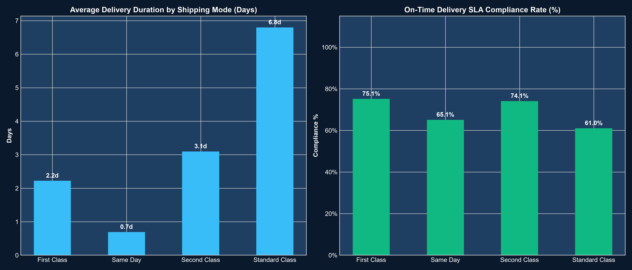
Supply Chain & On-Time Delivery SLA Compliance
• Description: Evaluation of fulfillment transit duration and On-Time Delivery SLA compliance across fulfillment tiers.
• Severe SLA Shortfall: Overall On-Time Delivery SLA sits at 68.83%, failing to meet the executive target benchmark of 85.00%.
• Fulfillment Disparity: Same Day (92.42%) and First Class (81.75%) shipping perform strongly, but Standard Class ground shipping achieves only 59.20% on-time delivery.
• Executive Action: Renegotiate 3PL regional carrier contracts and introduce ground hub transit tracking to remediate the 40.8% failure rate.
15

Slide 16
Conclusion & Strategic Business Recommendations
Data-Backed Action Plan Across Beginner, Intermediate & Advanced Levels
1. Merchandising Bundles (Sales): Capitalize on Furniture/Electronics volume ($143k) by bundling them with high-margin Office Supplies (Gel Ink Pens at 67.7% margin) to elevate overall gross margin.
2. Automated Lifecycle Marketing (Retention): Deploy an automated Day 3-10-21 post-purchase email onboarding flow to bridge the steep 80% Month 1 drop-off and nurture repeat buyers (who drive 80.88% of revenue).
3. Carrier Contract Restructuring (Logistics): Restructure Standard Class 3PL logistics agreements to eliminate ground fulfillment bottlenecks and elevate On-Time Delivery SLA compliance from 68.83% back above 85.00%.
4. Technical Competency & Tool Mastery: Successfully demonstrated end-to-end data analyst proficiency across Python, SQLite, Relational SQL, Microsoft Excel, and Microsoft Power BI.
16

Slide 17
THANK YOU
ShadowFox Data Analyst Internship Capstone Portfolio
GitHub: https://github.com/Keerthanagowda42/ShadowFox_Data_Analyst_Internship

