Slide 1
EMPLOYEE DATASET ANALYSIS USING EXCEL
STUDENT NAME: KEERTHANA.Y
REGISTER NO: 422200493 NAAN MUDHALVAN ID :
DEPARTMENT: B.COM(INFORMATION SYSTEM MANAGEMENT)
COLLEGE: VALLIAMMAL COLLEGE FOR WOMEN.

Slide 2
PROJECT TITLE
Employee Salary analysis using Excel

Slide 3
AGENDA
PROBLEM STATEMENT
PROJECT OVERVIEW
WHO ARE THE END USERS
OUR SOLUTION AND IT’S VALUE PROPOSITION
DATASET DESCRIPTION
THE “WOW” IN OUR SOLUTION
MODELLING
RESULT
CONCLUSION

Slide 4
PROBLEM STATEMENT
This salary analysis is used to find out whether the salary of the employee is increased or not

Slide 5
PROJECT OVERVIEW
Analyse the salary of the employee by considering various factors of
Like gender , Employee ID , Start data , Employee type,
Department,ect…… we use these in order to identify the trends,
Patterns of different categories of employee salary like very high,
high, medium and low

Slide 6
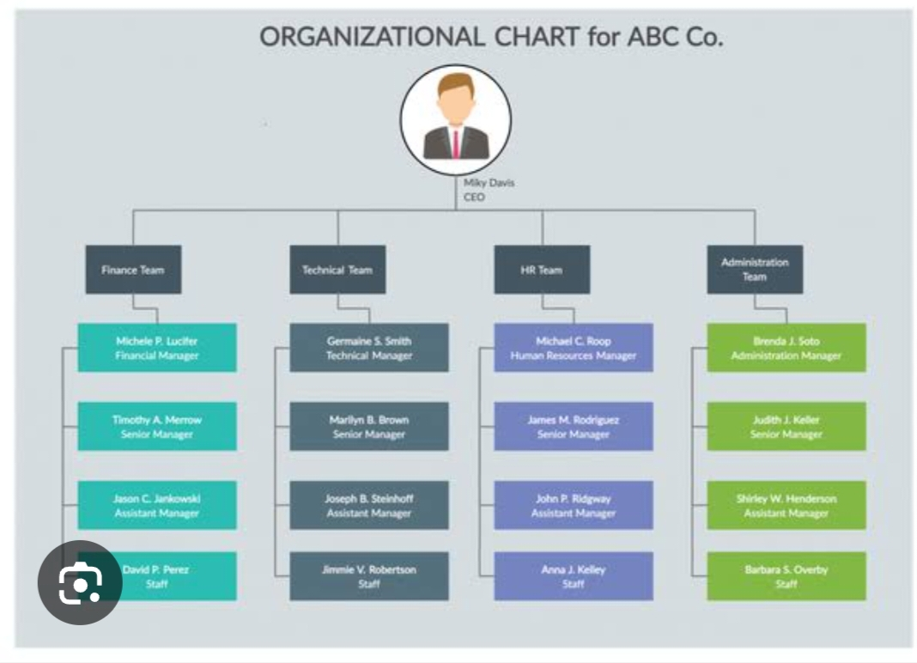
HOW ARE THE USERS

Slide 7
OUR SOLUTION AND IT’S VALUE PROPOSITION
Conditional formatting – Blank values
Sort &Filter –Filter – Remove Bank values
Formula –salary
Pivot Table –Summary
Graph –Data visualization

Slide 8
DATASET DESCRIPTION
Employee Dataset – Edunet Dashboard
11 features
5 Features
Employee ID – Number Values
Name – Text
Gender – Text
Salary – Numerical values
Start Data – Numerical values

Slide 9
THE “WOW” IN OUR SOLUTION
We use this formula
=IFS ( Z8>=5,” VERYHIGH” ,Z8>=4,” HIGH”,Z8>=3,”MED,” TRUE,”LOW”)
To find the salary level of the employee

Slide 10
MODELLING
DATA COLLECTION:
Naan mudhalvan:
Edunet Dashboard.
FEATURED SELECTION:
11 Features .
5 Features.
DATA CLEANING:
Colour blank values
Filter –Remove Blank values

Slide 11
SALARY LEVEL:
Very high.
High.
Medium.
Low.
PIVOT TABLE:
Employee ID .
Name.
Gender.
Salary.
Salary level.

Slide 12
Start date.
Employee Type.
CHART :
Employee ID.
Name.
Gender.
Salary.
Salary level.
Start date.
Employee Type.
Data visualization.

Slide 13
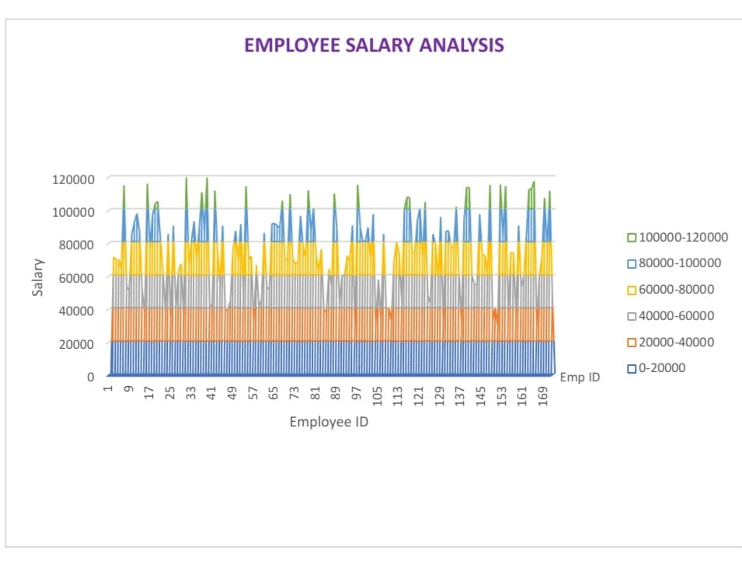
RESULTS

Slide 14
CONCLUSION
While comparing the salary level of the employee, the employee’s
are getting their salary according to their employee type and start
data

Slide 15

Thank you
someone@example.com

