Slide 1
₹251.51M
99K
CUSTOMER
SHOPPING BEHAVIOR
Total Revenue
Transactions
ANALYSIS
USING POWER BI
₹2.53K
299K
Avg Order Value
Units Sold
Revenue by Age Group
18-25
26-35
36-45
46-55
56+
Customer Shopping Behavior Analysis
1

Slide 2
PROJECT OVERVIEW
OBJECTIVE
TOOLS USED
Analyze customer shopping behavior based on:
Power BI
Gender
Data Visualization & Dashboard
Age Group
Revenue
Power Query
Product Categories
Data Transformation & Cleaning
Payment Methods
DAX
Data Analysis Expressions
Customer Shopping Behavior Analysis
2

Slide 3
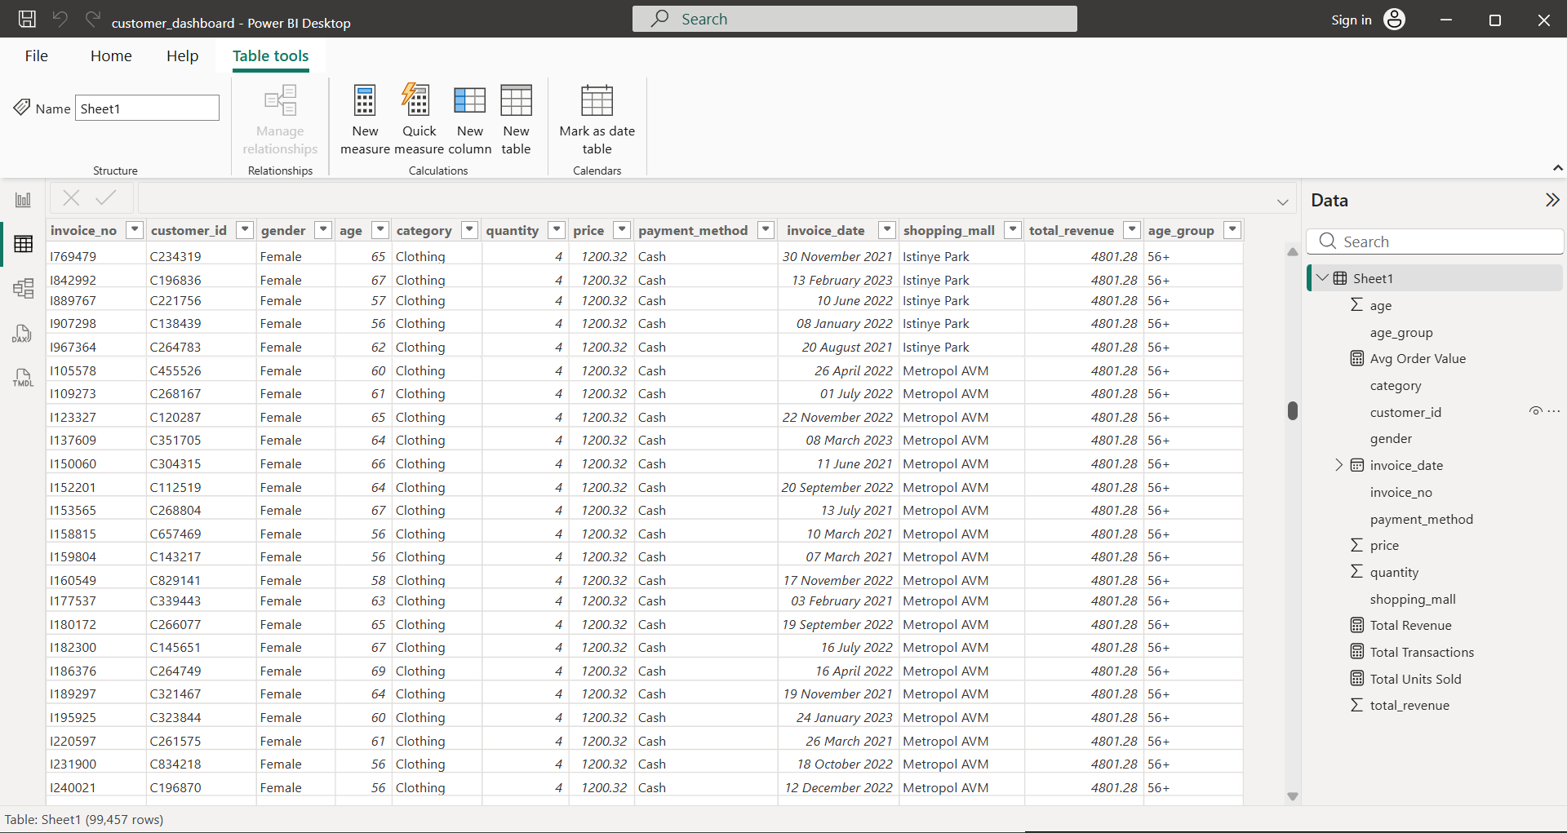
DATASET OVERVIEW
DATASET DETAILS
Records
99,457
Customer Demographics
Gender, Age
Product Categories
8 Categories
Transactions
Customer Purchase Records
Payment Methods
3 Methods
Shopping Malls
Multiple Locations
Customer Shopping Behavior Analysis
3

Slide 4
DATA PREPARATION & KPI MEASURES
The dataset was imported into Power BI and prepared for analysis. Data cleaning, transformations, and DAX measures were created to generate meaningful insights.
DATA PREPARATION STEPS
KEY PERFORMANCE INDICATORS (KPIs)
🗄️
Total Transactions
1. DATA IMPORT
₹
🛒
📊
📦
Imported customer shopping dataset into Power BI.
₹251.51M
99K
₹2.53K
299K
🧹
2. DATA CLEANING
Verified data types and checked dataset consistency before analysis.
Total Revenue
Total Transactions
Avg Order Value
Units Sold
DAX MEASURES CREATED
📋
3. DATA TRANSFORMATION
MEASURE NAME
DAX FORMULA
DESCRIPTION
Formatted the Invoice Date column, created the Age Group column, and calculated the Total Revenue column.
₹
Total Revenue
Total Revenue =
SUM(‘Sheet1'[total_revenue])
Calculates total revenue
generated.
⚙️
4.DAX MEASURES
Total Transactions =
DISTINCTCOUNT(‘Sheet1'[invoice_no])
Counts the total number
of transactions.
Created KPI measures including Total Revenue, Total Transactions, Average Order Value, and Total Units Sold.
🛒
Total Transactions
📊
Average Order Value
Avg Order Value =
DIVIDE([Total Revenue], [Total Transactions])
Calculates the average
revenue per transaction.
✅
5. DATA VALIDATION
Designed interactive dashboards using KPI cards, charts, slicers, and filters for customer behavior analysis.
📦
Units Sold
Units Sold =
SUM(‘Sheet1'[quantity])
Calculates the total
quantity of products sold.
Customer Shopping Behavior Analysis
4
🛒 Customer Shopping Behavior Analysis
04

Slide 5
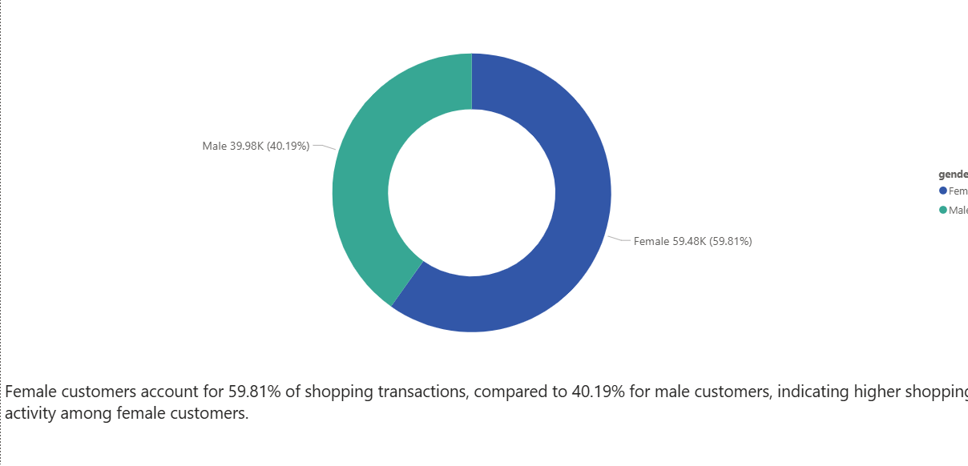
Q1. SHOPPING DISTRIBUTION BY GENDER
Customer Shopping Behavior Analysis
5

Slide 6
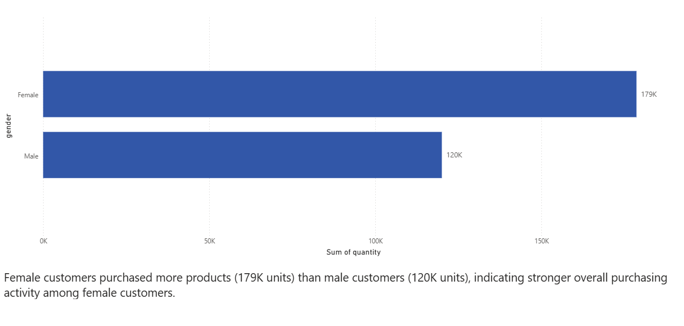
Q2. PRODUCTS SOLD BY GENDER
Customer Shopping Behavior Analysis
6

Slide 7
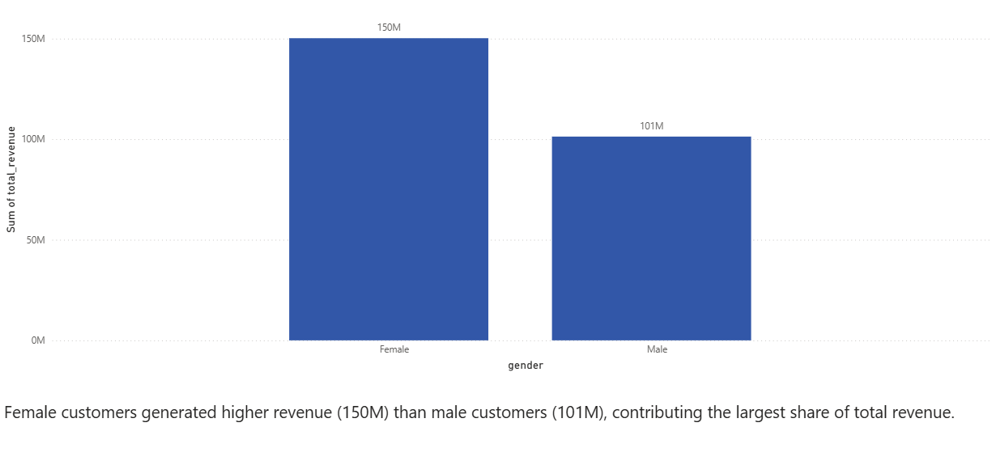
Q3. REVENUE GENERATED BY GENDER
Customer Shopping Behavior Analysis
7

Slide 8
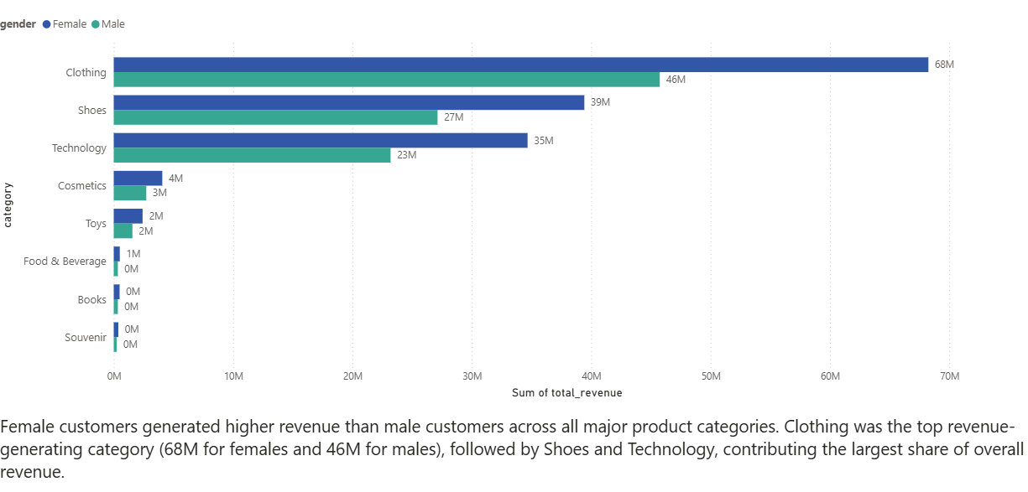
Q4. REVENUE BY CATEGORY AND GENDER
Customer Shopping Behavior Analysis
8

Slide 9
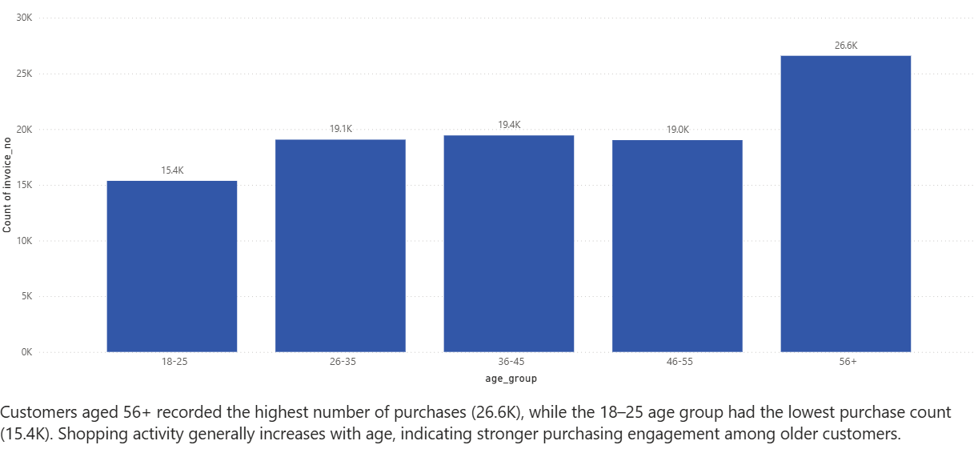
Q5. SHOPPING DISTRIBUTION BY AGE GROUP
Customer Shopping Behavior Analysis
9

Slide 10
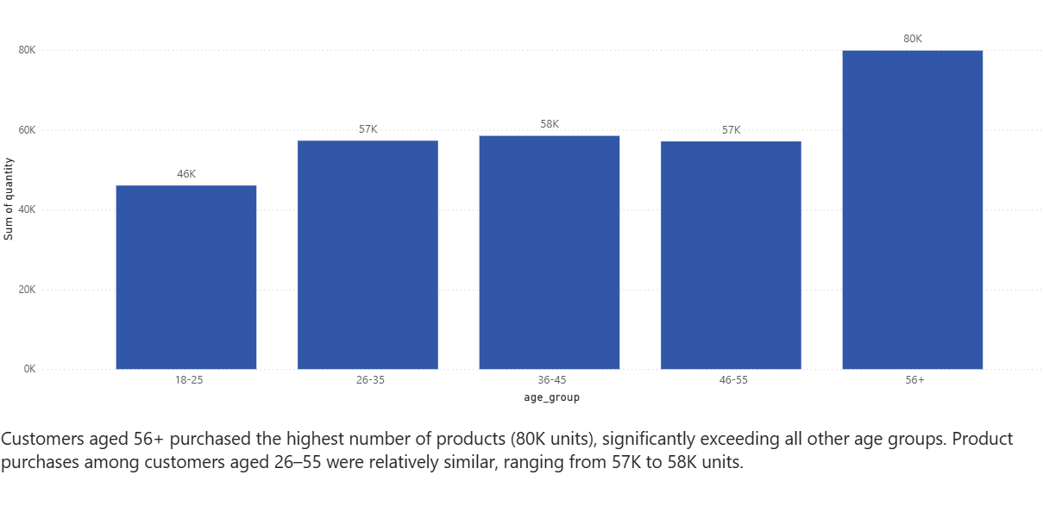
Q6. PRODUCTS SOLD BY AGE GROUP
Customer Shopping Behavior Analysis
10

Slide 11
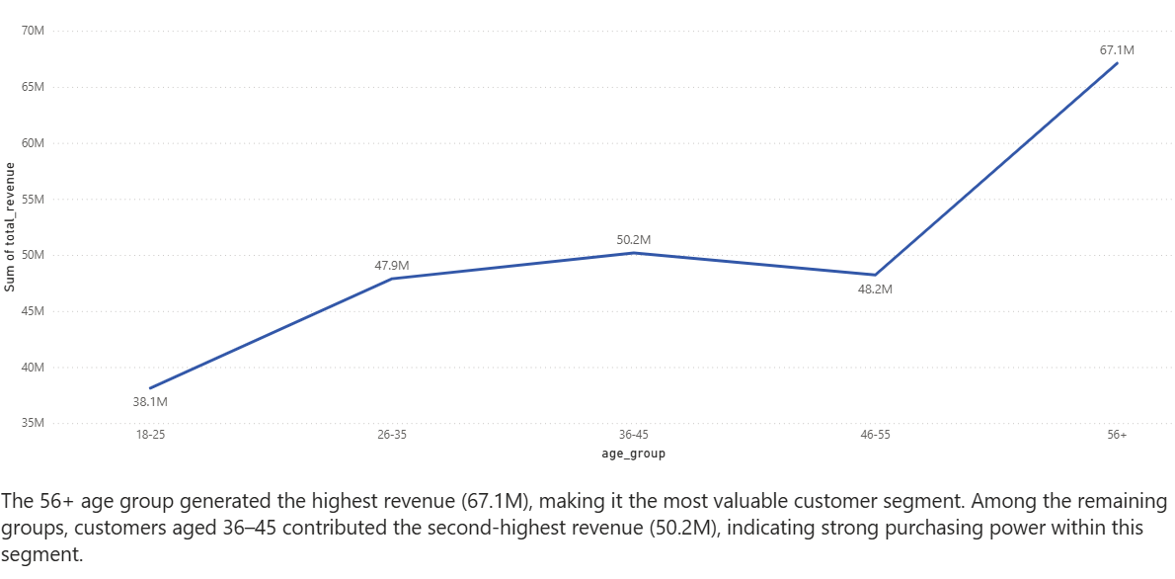
Q7. REVENUE BY AGE GROUP
Customer Shopping Behavior Analysis
11

Slide 12
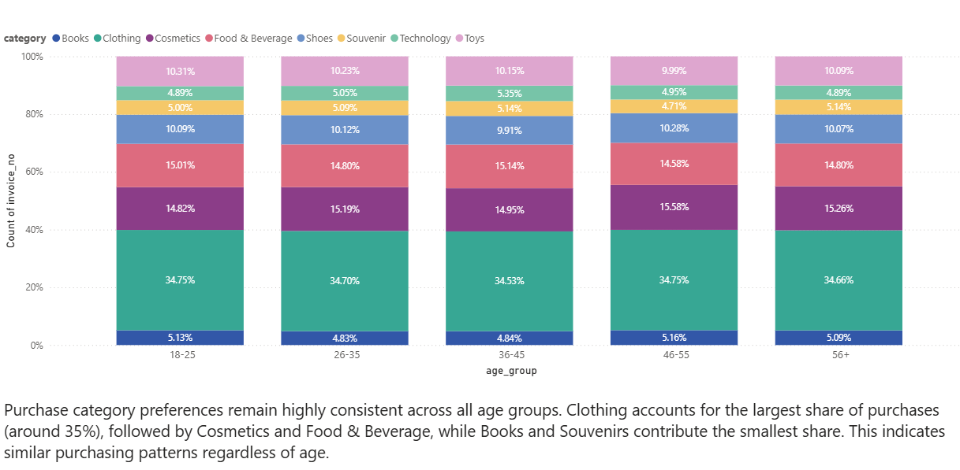
Q8. CATEGORY DISTRIBUTION BY AGE GROUP
Customer Shopping Behavior Analysis
12

Slide 13
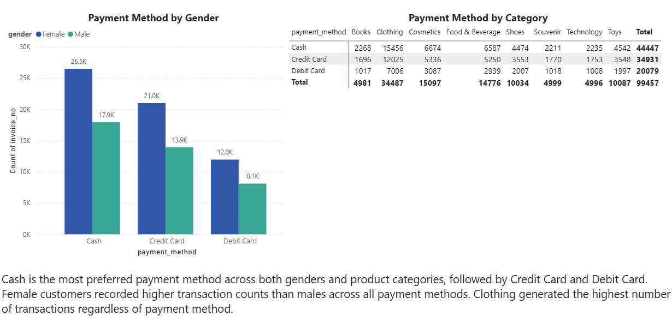
Q9. PAYMENT METHOD RELATIONSHIP ANALYSIS
Customer Shopping Behavior Analysis
13

Slide 14
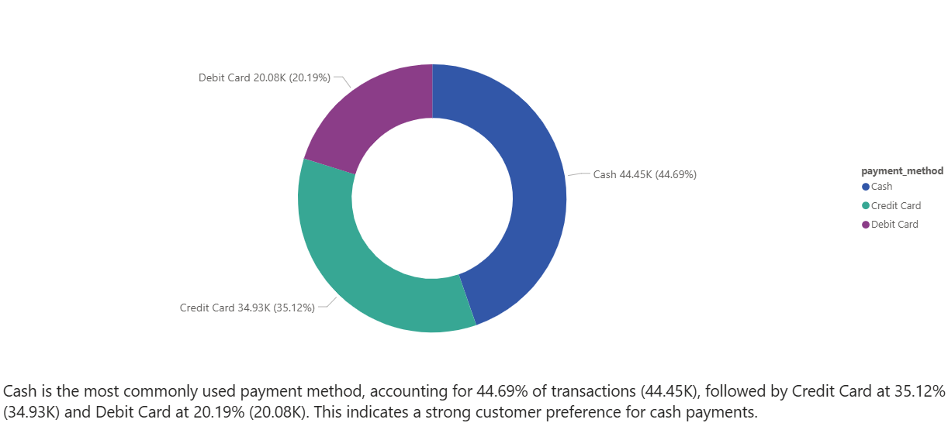
Q10. PAYMENT METHOD DISTRIBUTION
Customer Shopping Behavior Analysis
14

Slide 15
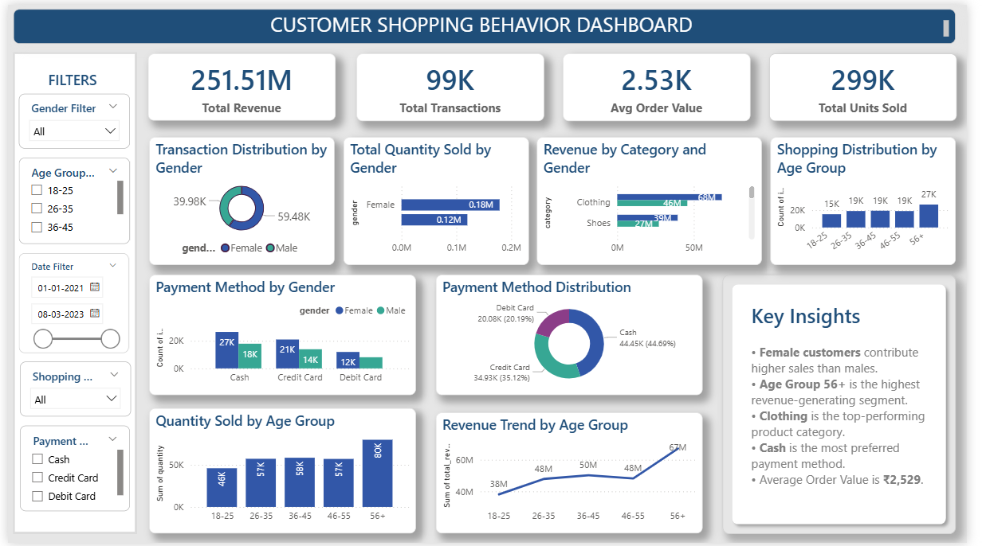
EXECUTIVE DASHBOARD
DASHBOARD HIGHLIGHTS
📊 Gender Trends
💰 Revenue Analysis
🛍️ Category Performance
👥 Age Group Analysis
💳 Payment Preferences
The dashboard provides a consolidated view of customer behavior, revenue performance, and payment preferences across all demographics.
Customer Shopping Behavior Analysis
15

Slide 16




MAJOR FINDINGS
59.81%
₹67.1M
#1
44.69%
of Transactions
Highest Revenue
Top Category
of All Transactions
Female Customers
56+ Age Group
Clothing Category
Cash Payments
Female customers drive the majority of sales, contributing ₹150M in revenue — significantly more than male customers.
The 56+ segment leads in both revenue and purchase volume (80K units), far outperforming all other age groups.
Clothing is the highest revenue-generating product category for both female and male customers.
Cash is the most preferred payment method consistently across all categories, genders, and age groups.
Customer Shopping Behavior Analysis
17

Slide 17




BUSINESS RECOMMENDATIONS
Target Senior Customers
Increase Clothing Focus
Develop loyalty programs and exclusive senior-specific promotions to leverage the 56+ segment's outstanding purchasing power and revenue contribution.
Expand clothing inventory and introduce seasonal collections to capitalize on the top-performing product category across both genders.
Encourage Digital Payment Adoption
Personalized Marketing
Offer incentives, cashback offers, and seamless UPI integration to encourage adoption of digital payment methods beyond cash.
Use demographic segmentation by gender, age group, and product preference to deliver highly targeted campaigns that drive repeat purchases.
Customer Shopping Behavior Analysis
18

Slide 18



CONCLUSION
The analysis reveals clear patterns in customer purchasing behavior
1
Female Customers Lead Sales
Focusing on senior customers, expanding clothing products, and encouraging digital payments can improve customer engagement and business growth.
2
Senior Segment Dominates Revenue
The 56+ age group generates ₹67.1M in revenue and buys 80K units — the highest of any age segment — indicating stronger purchasing power with age.
3
Clothing & Cash Drive the Business
Clothing is the top-performing product category (₹68M female, ₹46M male). Cash remains the #1 payment method at 44.69% of all transactions.
4
Strategic Focus for Growth
Targeting senior customers, expanding clothing lines, and promoting digital payment adoption will maximize revenue and modernize the customer experience.
Customer Shopping Behavior Analysis
19

Slide 19
THANK YOU
Name : Keerthaveni R
Project Team ID : PTID-CDA-JUN-26-11195
Project ID : PRDA-05: Customer Data Analysis
20

