Slide 1

SIMPLE STEPS
How to upload a project on GitHub?
00
A beginner-friendly step-by-step guide
Repository: github.com/Keerthi-2025
Source visual retained from the original guide
GitHub • MCA Bridge Course
01

Slide 2

STEP 1
Open your GitHub account
01
Open GitHub and sign in to your account.
Source visual retained from the original guide
GitHub • MCA Bridge Course
02

Slide 3
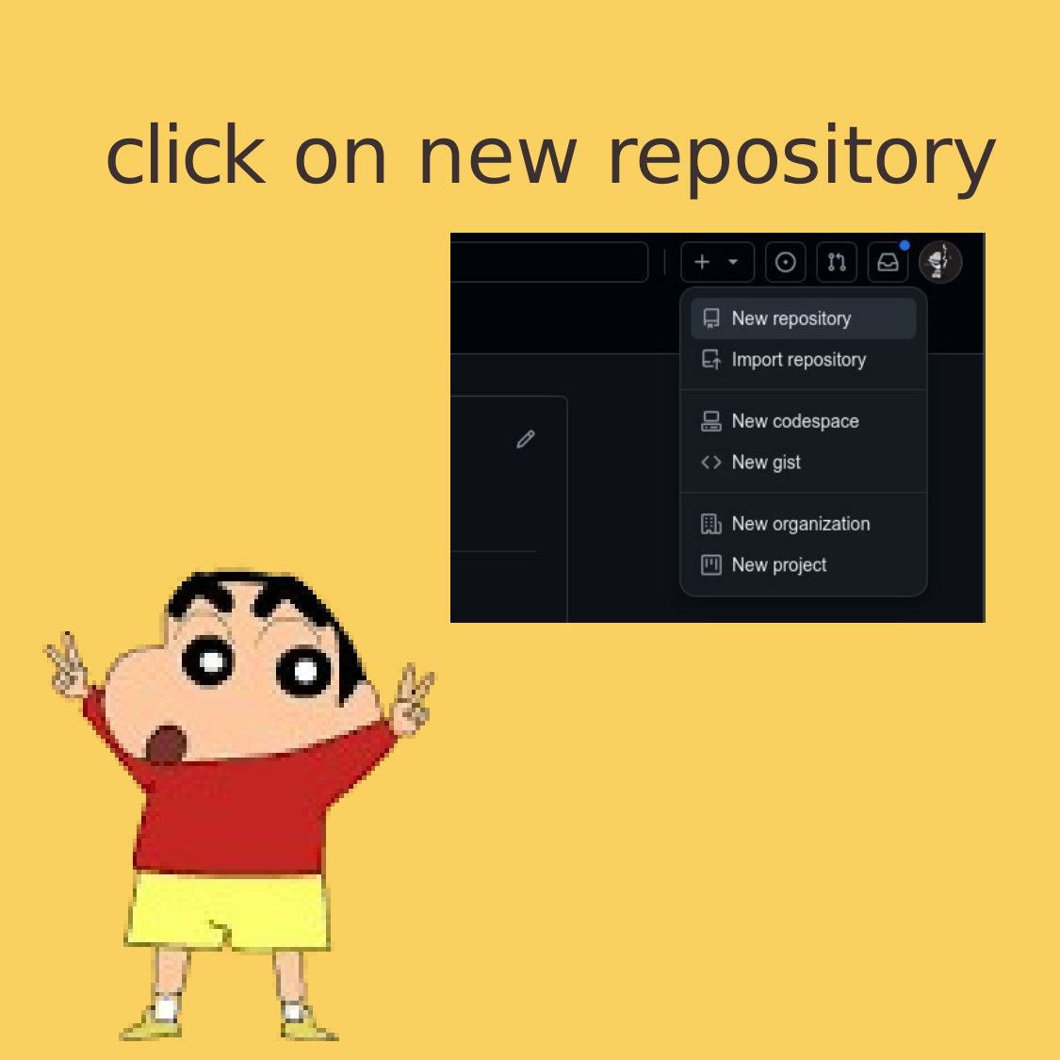
STEP 2
Click on New repository
02
Create a new repository from your GitHub account.
Source visual retained from the original guide
GitHub • MCA Bridge Course
03

Slide 4
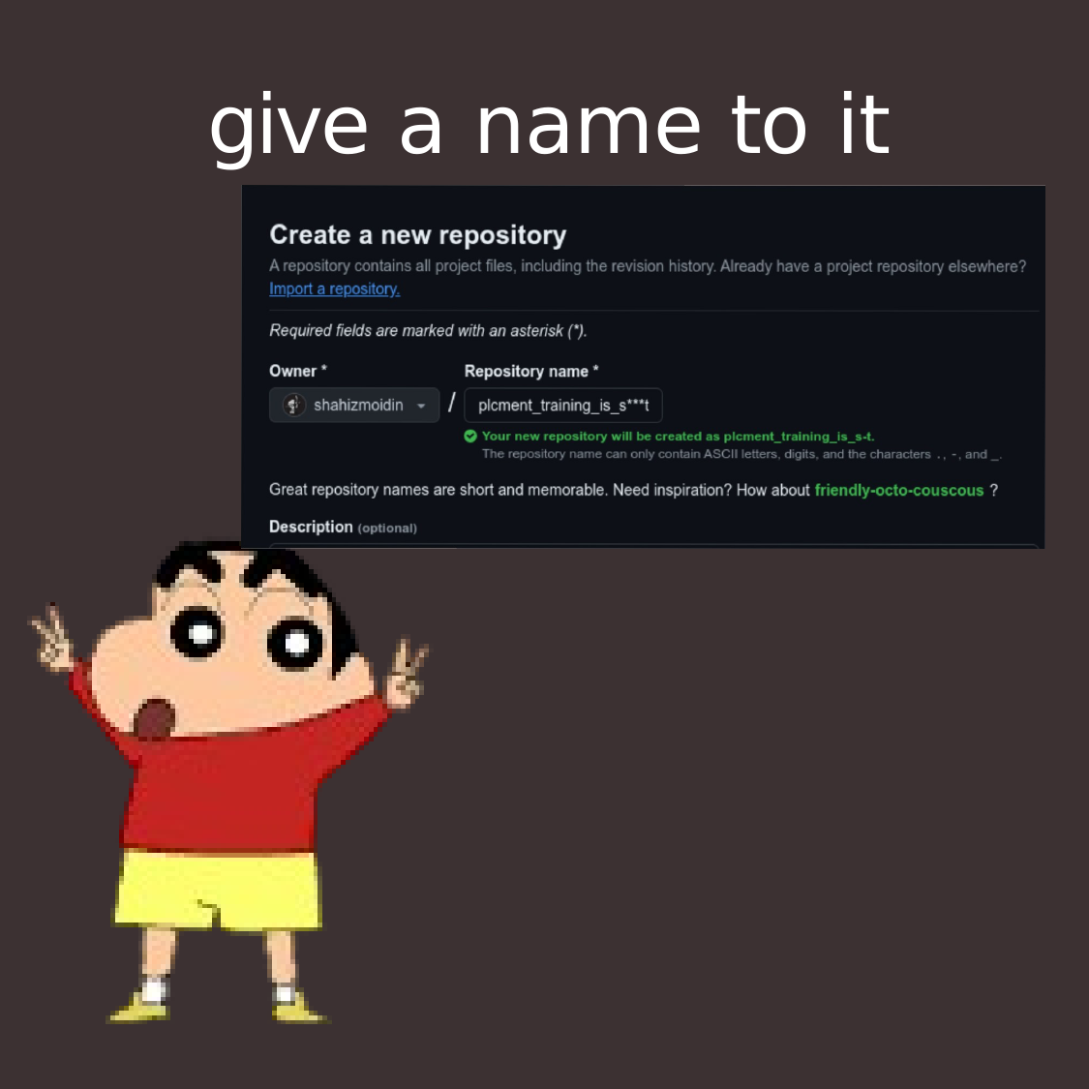
STEP 3
Give a name to it
03
Enter a name for the repository.
Source visual retained from the original guide
GitHub • MCA Bridge Course
04

Slide 5
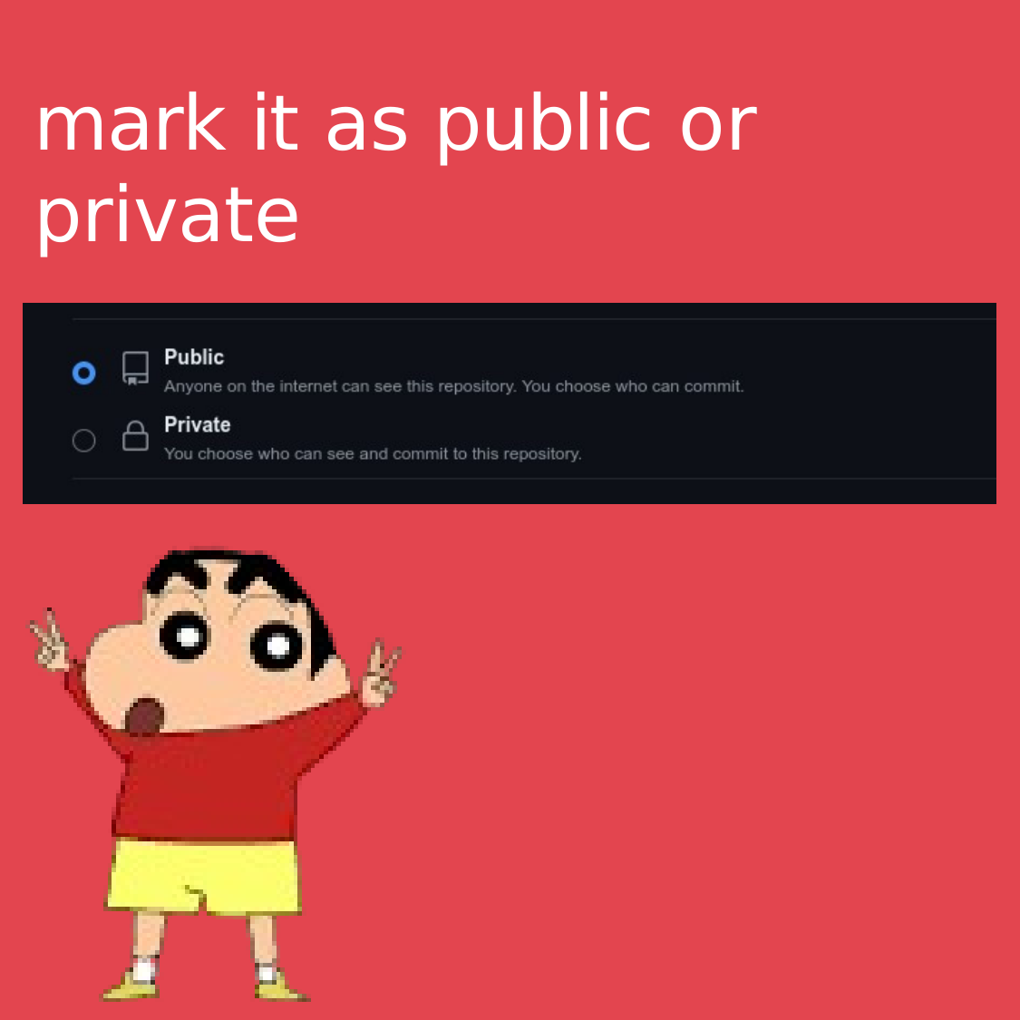
STEP 4
Mark it as Public or Private
04
Choose whether the repository should be Public or Private.
Source visual retained from the original guide
GitHub • MCA Bridge Course
05

Slide 6
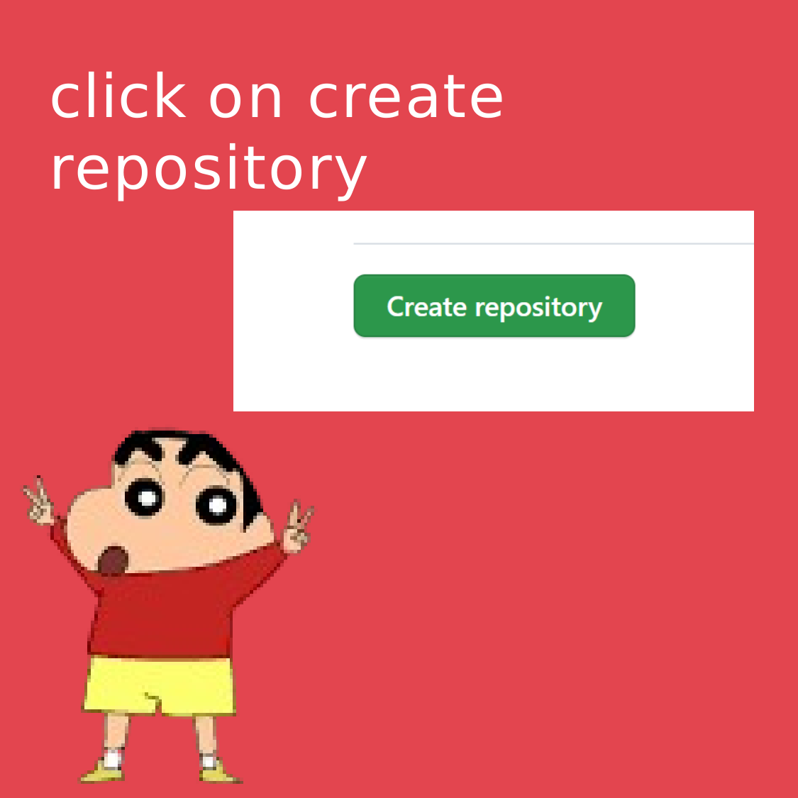
STEP 5
Click on Create repository
05
Create the repository after selecting the required options.
Source visual retained from the original guide
GitHub • MCA Bridge Course
06

Slide 7

STEP 6
Open VS Code
06
Open Visual Studio Code and open your project folder.
Source visual retained from the original guide
GitHub • MCA Bridge Course
07

Slide 8
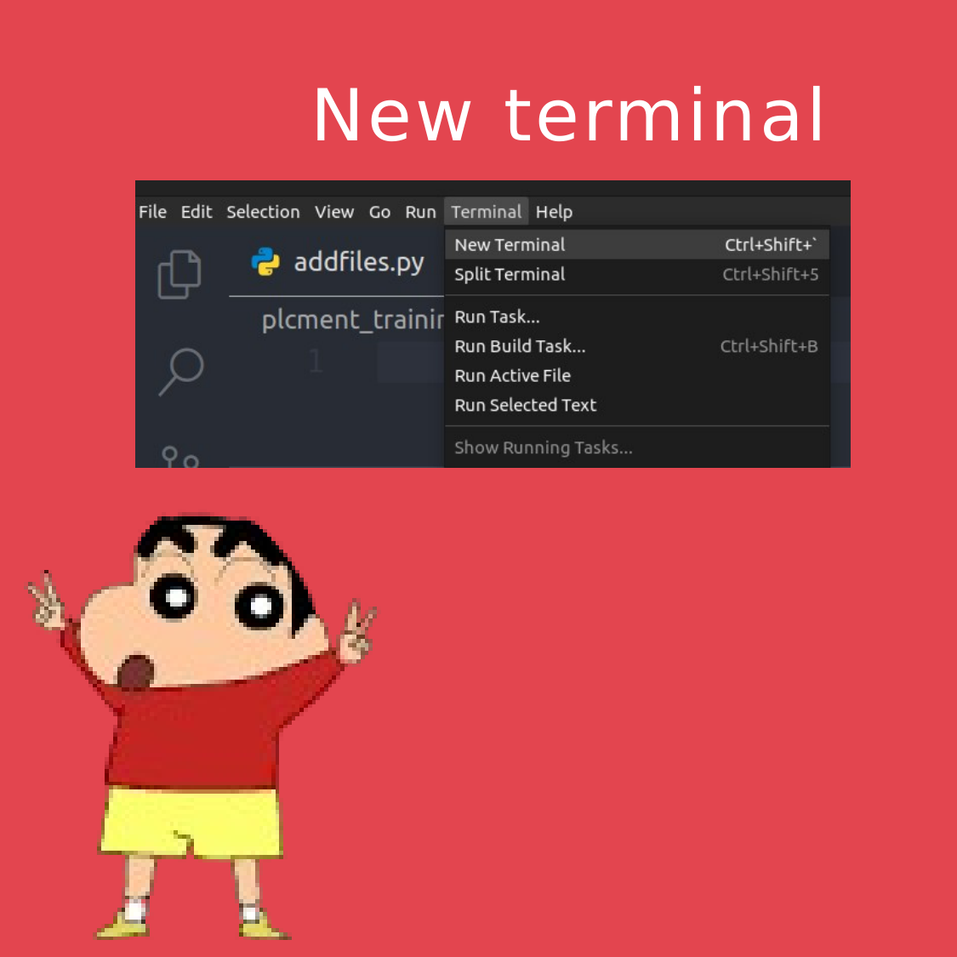
STEP 7
Open a New Terminal
07
Use the integrated terminal in VS Code.
Source visual retained from the original guide
GitHub • MCA Bridge Course
08

Slide 9

STEP 8
Type git init and hit Enter
08
Initialize Git in the current project folder.
Command: git init
Source visual retained from the original guide
GitHub • MCA Bridge Course
09

Slide 10
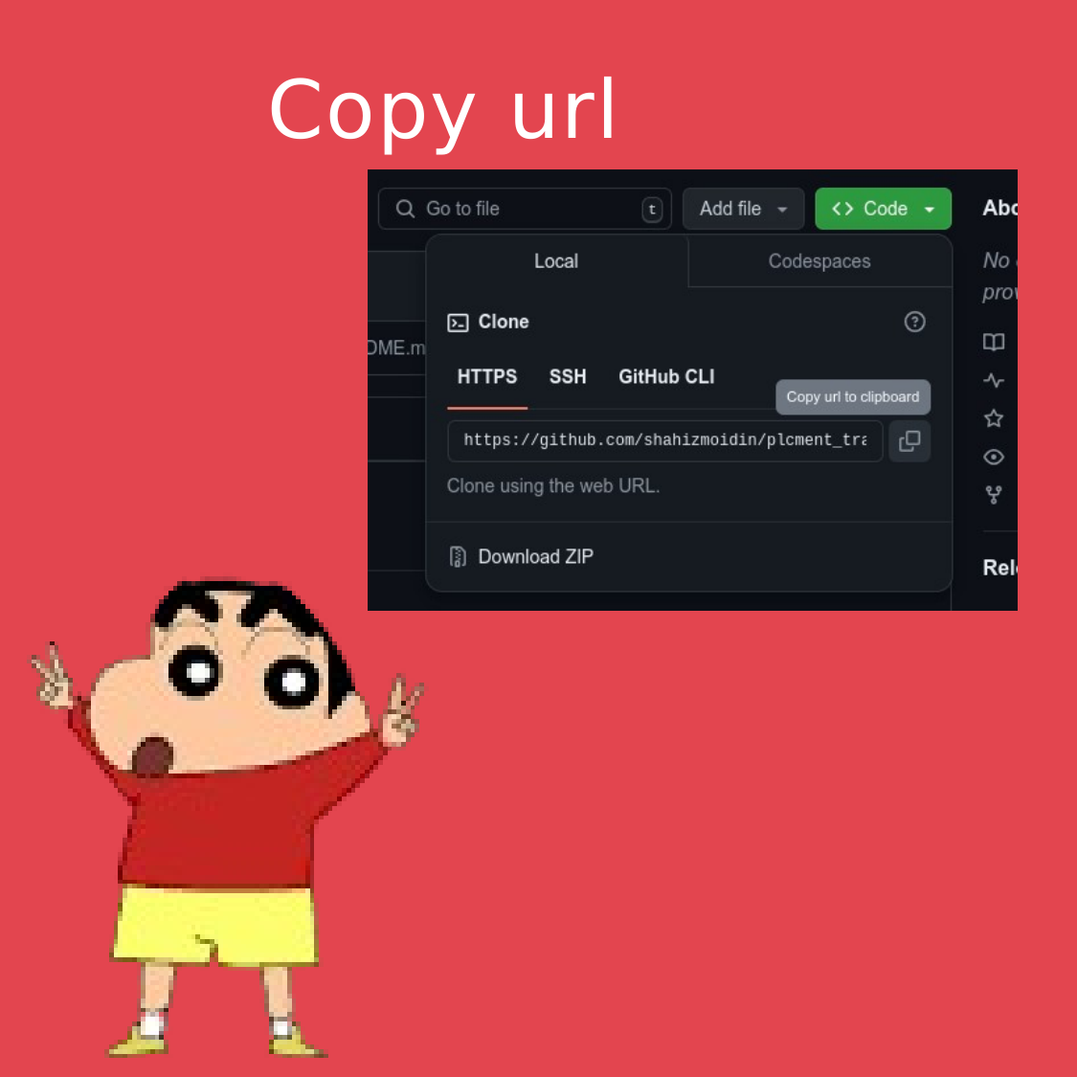
STEP 9
Copy the repository URL
09
Use your GitHub repository URL.
GitHub profile: https://github.com/Keerthi-2025
For a specific repository, use: https://github.com/Keerthi-2025/<repository-name>.git
Source visual retained from the original guide
GitHub • MCA Bridge Course
10

Slide 11
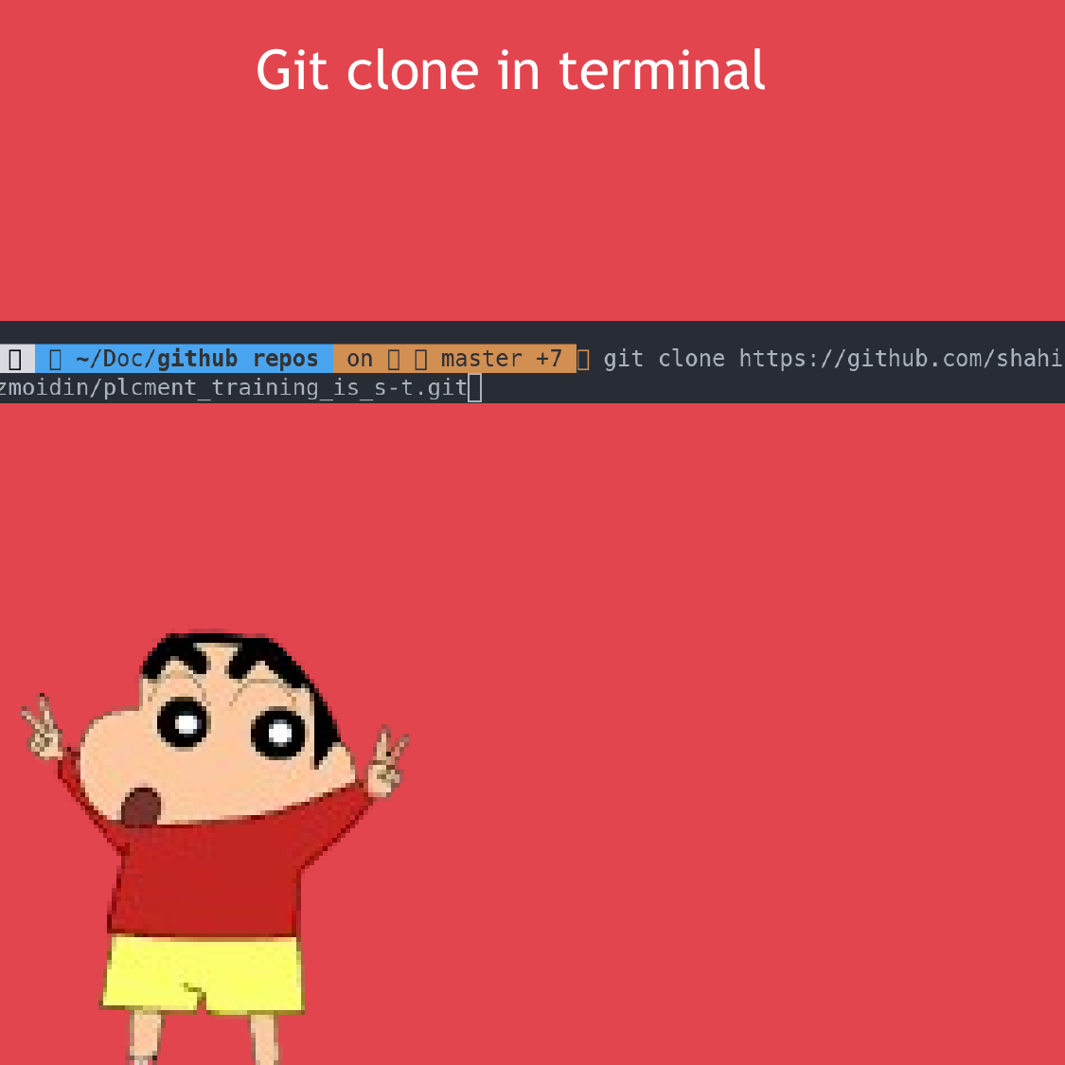
STEP 10
Git clone in terminal
10
Clone an existing repository to your computer.
Command: git clone <repository-url>
Note: git clone needs a specific repository URL, not only a profile URL.
Source visual retained from the original guide
GitHub • MCA Bridge Course
11

Slide 12
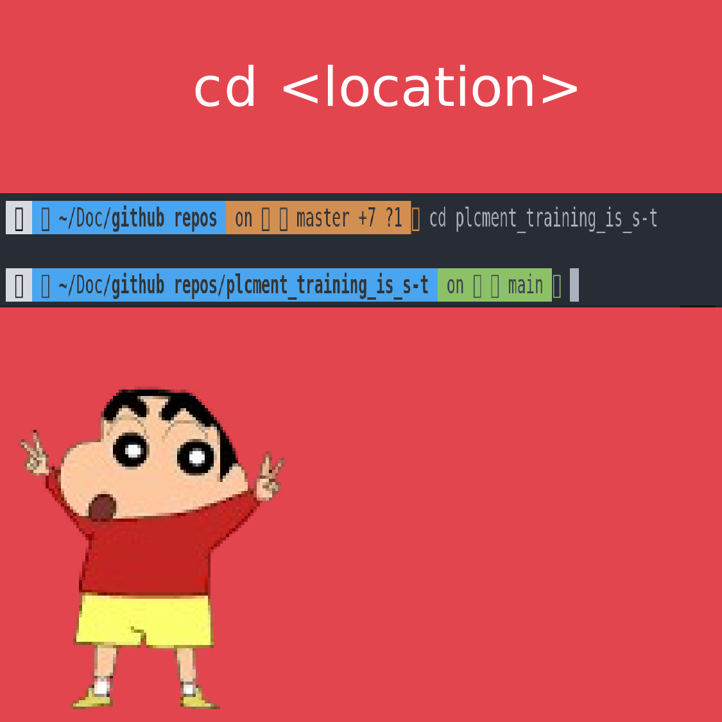
STEP 11
cd <location>
11
Move into the project/repository folder.
Command: cd <location>
Source visual retained from the original guide
GitHub • MCA Bridge Course
12

Slide 13
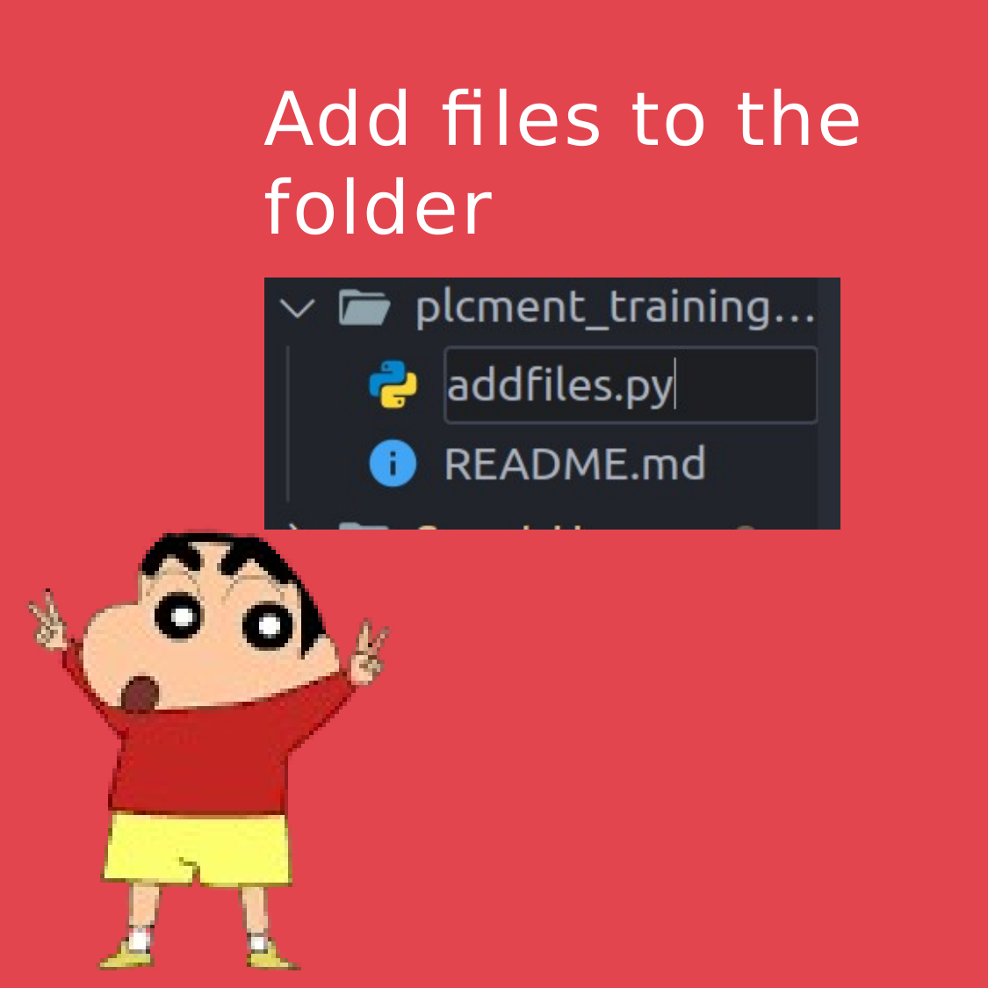
STEP 12
Add files to the folder
12
Add your project files to the repository folder.
Source visual retained from the original guide
GitHub • MCA Bridge Course
13

Slide 14
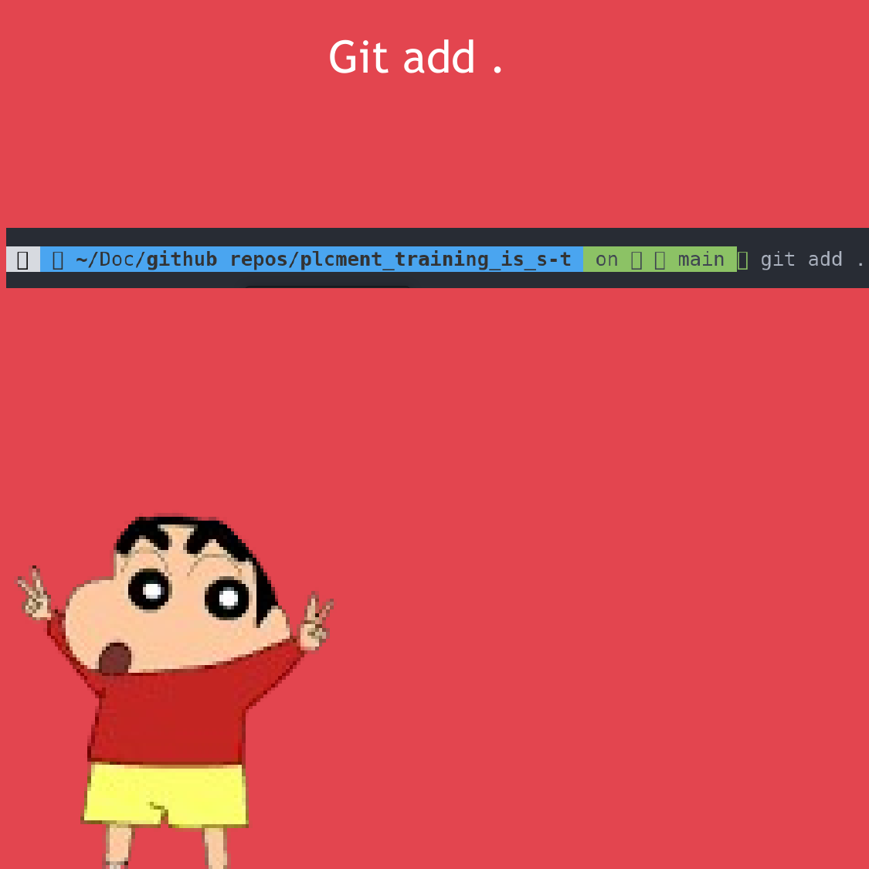
STEP 13
Git add .
13
Stage all changes in the current folder.
Command: git add .
Source visual retained from the original guide
GitHub • MCA Bridge Course
14

Slide 15
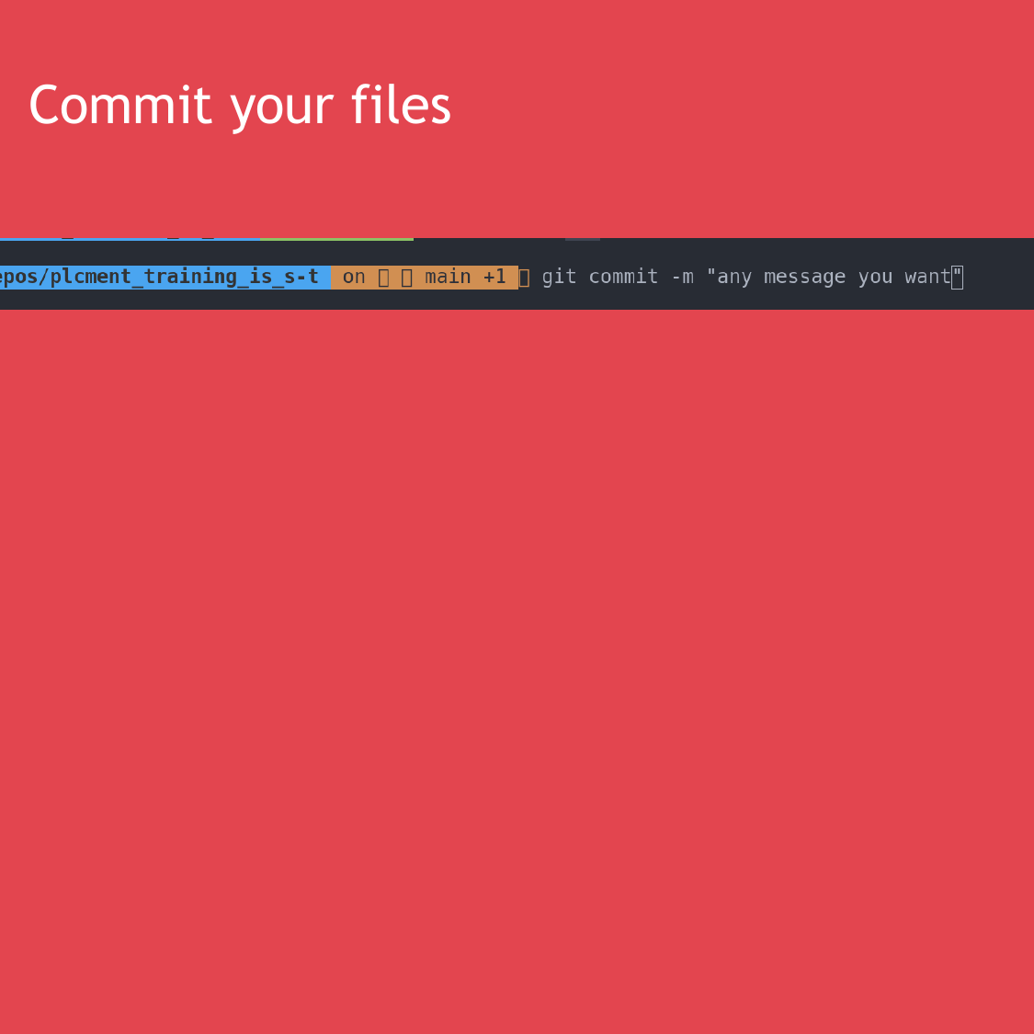
STEP 14
Commit your files
14
Save the staged changes in Git history.
Command: git commit -m "Your message"
Source visual retained from the original guide
GitHub • MCA Bridge Course
15

Slide 16
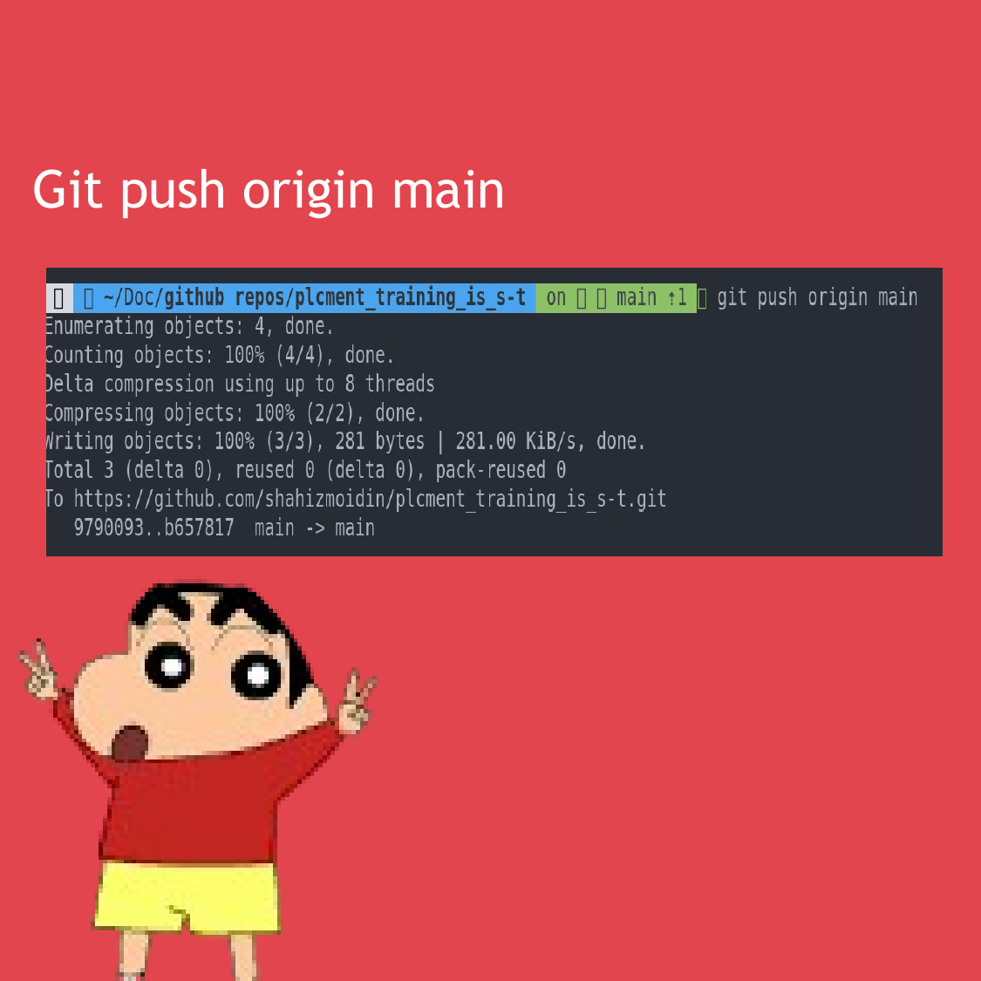
STEP 15
Git push origin main
15
Upload your local commits to GitHub.
Command: git push origin main
Target profile: https://github.com/Keerthi-2025
Source visual retained from the original guide
GitHub • MCA Bridge Course
16

Slide 17
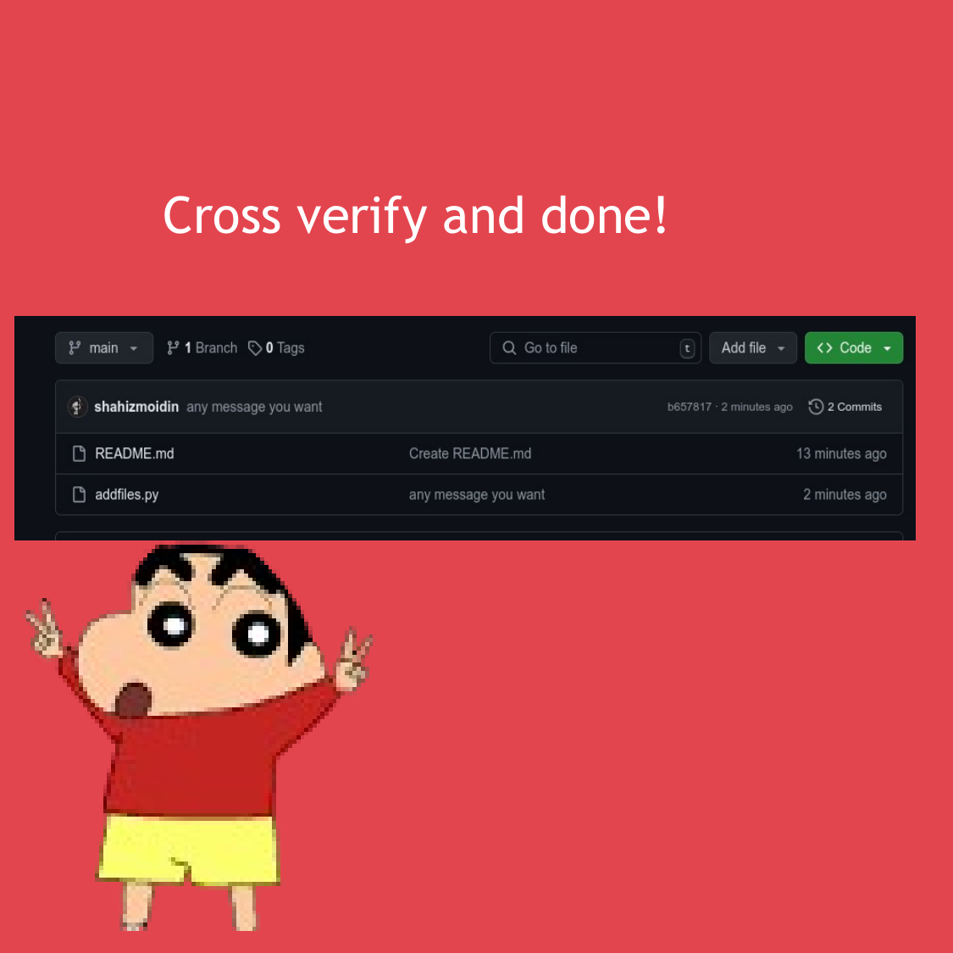
STEP 16
Cross verify and done!
16
Open GitHub and verify that your files are visible.
https://github.com/Keerthi-2025
Source visual retained from the original guide
GitHub • MCA Bridge Course
17

