Slide 1

IBM Data Analyst Capstone Project
Keerthi Katakam
12th August 2024

Slide 2

OUTLINE
Executive Summary
Introduction
Methodology
Results
Visualization – Charts
Dashboard
Discussion
Findings & Implications
Conclusion
Appendix

Slide 3

EXECUTIVE SUMMARY
Data contextualization and analysis goal.
Methodology Description
Data gathering
Data analysis
Data visualizations
Results presentation supported with graphs and trends
Discussion of overall findings and implications regarding the results previously exposed
Final conclusions of the carried out research

Slide 4

INTRODUCTION
This presentation report uses data analytics to highlight current and projected trends in the need for skills related to programming languages, databases, platforms and web frames.
The target audience for this research are IT professionals, HR managers, and anybody else with an interest in the IT sector who wants to learn about the top on-demand IT skills in their respective sectors that will also still be relevant in the future
The following inquiries were investigated using the data:
Which programming languages are most in demand today?
What are the most in-demand database skills?
What popular IDEs or Web frames are there?

Slide 5

METHODOLOGY
Collect survey data & explore its content by
Web Scraping
API
Request Library
Data Wrangling
Exploratory data analysis
Analyzing data distribution
Handling outliers
Correlations
Data Visualization
Create visualizations using the developer survey data
Highlight the distribution of data, relationships between data, the composition of data, and comparison of data.

Slide 6
RESULTS

Slide 7
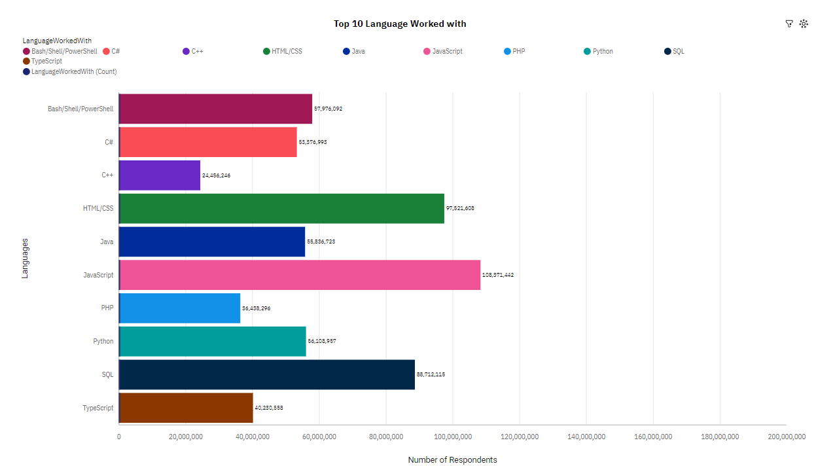
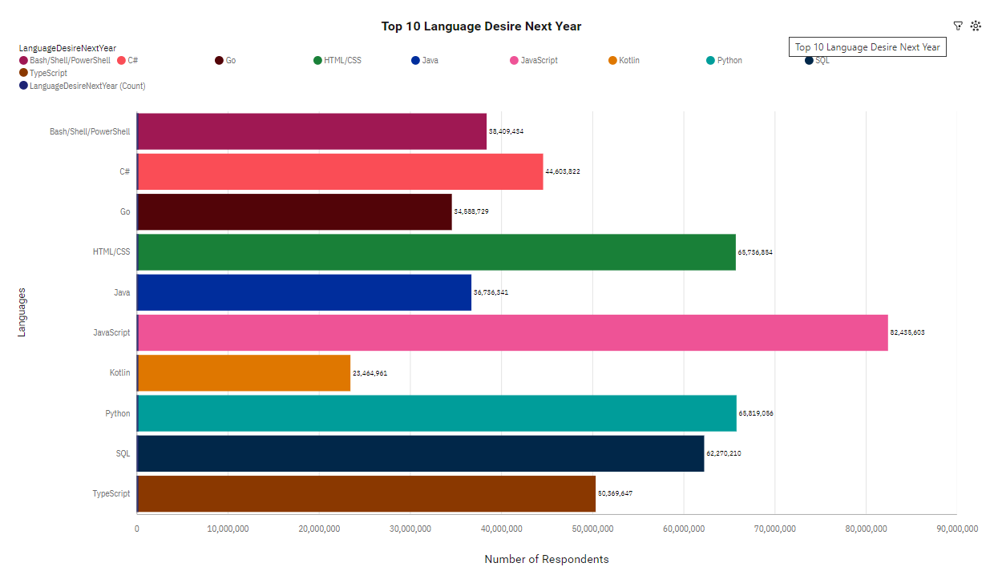
PROGRAMMING LANGUAGE TRENDS
Current Year
Next Year

Slide 8
PROGRAMMING LANGUAGE TRENDS - FINDINGS & IMPLICATIONS
Findings
Javascript,HTML/CSS,SQL,Shell languages and Python are the most used languages currently. JavaScript seems to keep as leading language.
Javascript, HTML/CSS, Python, SQL, and Typescript will be the most used languages next year and future years. Great interest in Typescript
Python will have more demand than SQL for next year.
Implications
Javascript and HTML are used for web development as a tech skill has the highest demand, especially as Typescript is getting viral. Possible developers migration from JavaScript to Typescript
Python is gaining more and more traction due to the increase in demand for AI and ML skills.
SQL is the still the most relevant language for data professionals. It is important for aspiring data analysts, scientists, business analysts etc to have SQL skills.

Slide 9
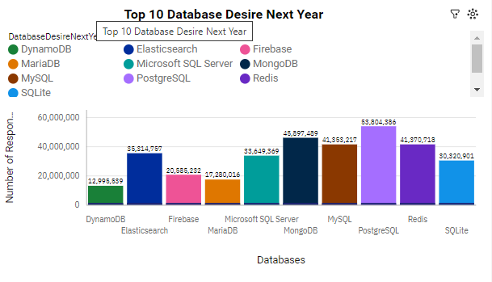
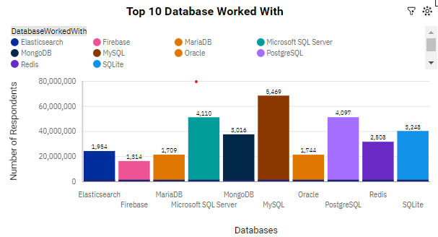
DATABASE TRENDS
Next Year
Current Year

Slide 10
DATABASE TRENDS - FINDINGS & IMPLICATIONS
Findings
MySQL, Microsoft SQL server, PostgreSQL SQL, SQLite and MongoDB are the top 5 most used databases at the moment. MySQL as most used database
However, PostgreSQL SQL, MongoDB, Redis, MySQL and Elastic sense are projected to become more popular in the future.
Redis and Elastic sense are relatively new tools and are set to gain more traction in the IT space.
Implications
SQL is still a top tool to watch out for in data specialists.
Companies still prefer Open source databases.
Oracle SQL was not among the top 5. It is losing relevance as time passes.
PostgreSQL and MongoDB establishment in the market

Slide 11

DASHBOARD
link IBM Cognos Analytics Dashboard Module:
https://us3.ca.analytics.ibm.com/bi/?perspective=dashboard&pathRef=.my_folders%2Fm5_survey_tech%2Bdashboard&action=view&mode=dashboard&subView=model0000019133ec2664_00000002
Git Hub link for cognos analystics dashboard pdf graphs
https://github.com/Keerthi-KataKam/IBM-Data-Analyst-Capstone-Project/blob/main/m5_survey_tech%20dashboard.pdf

Slide 12
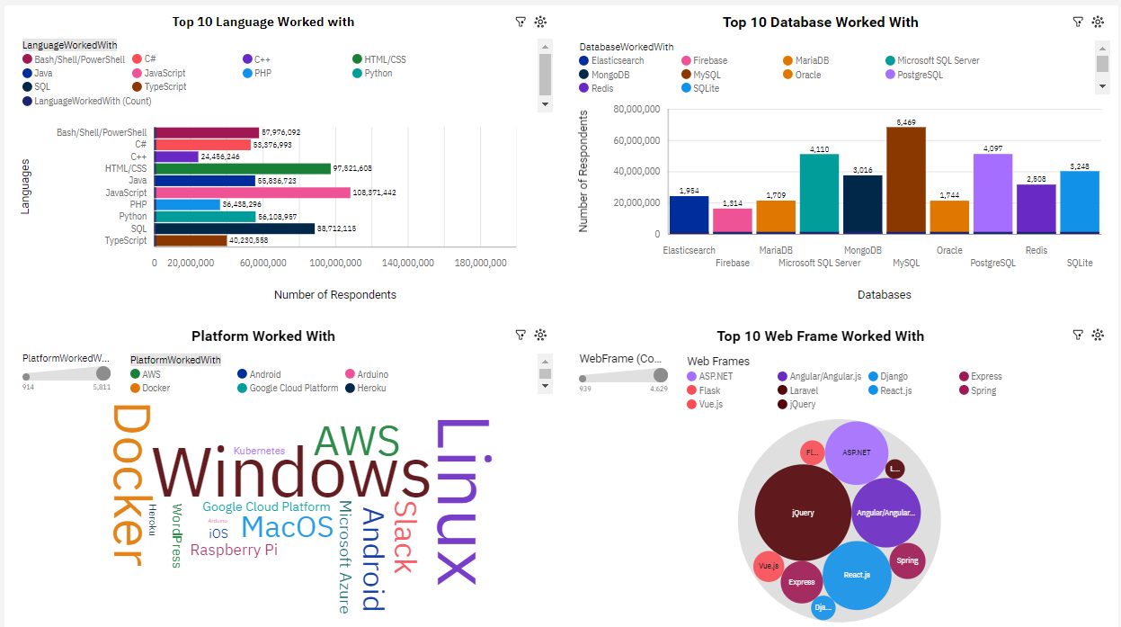
DASHBOARD TAB 1

Slide 13
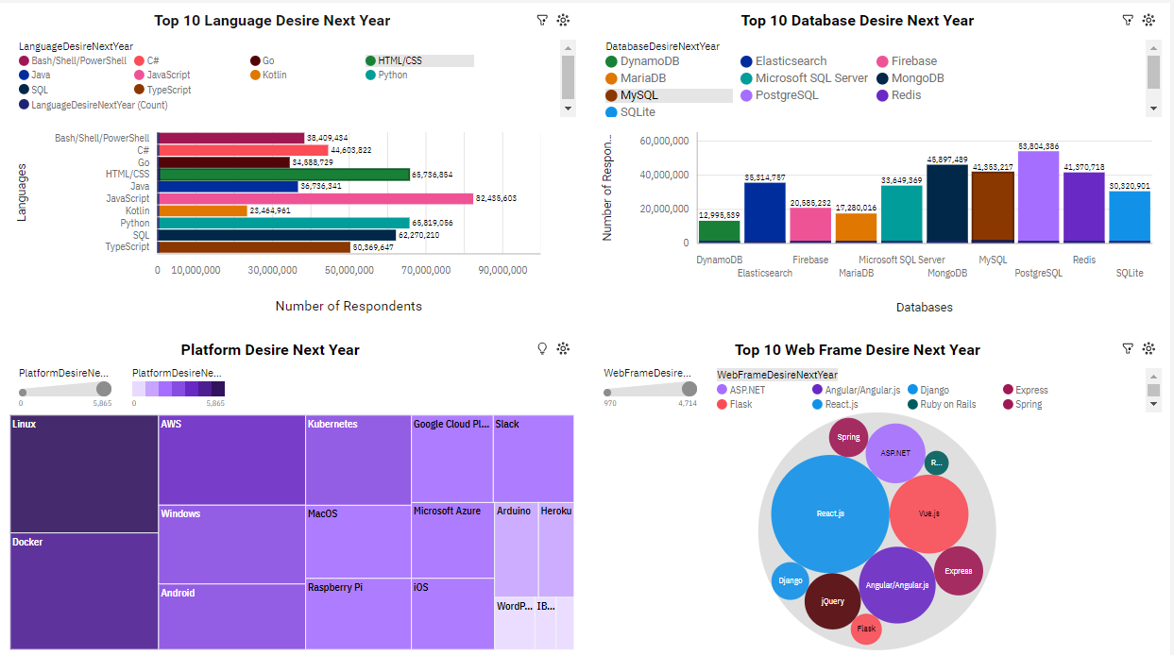
DASHBOARD TAB 2

Slide 14
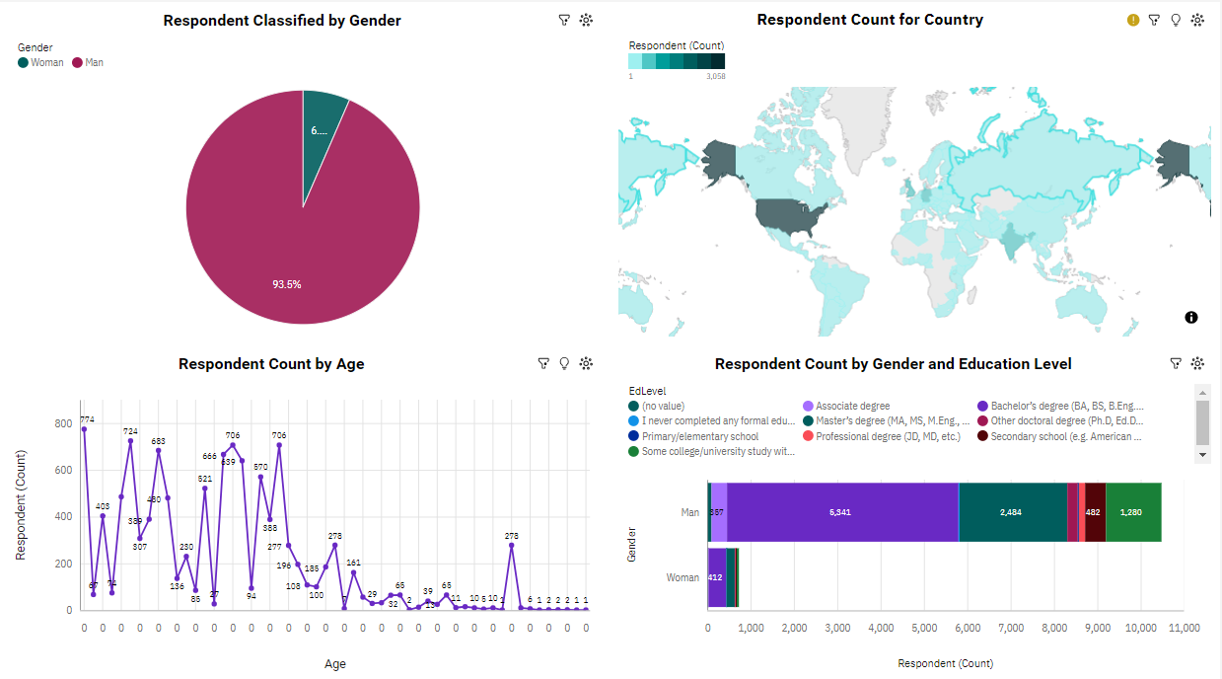
DASHBOARD TAB 3

Slide 15
DISCUSSION
Up skilling in the Technology sector.
How do we close the wide gender gap in the Technology sector?
Is completing a masters or doctorate degree really a requirement?
The increasing demand for mobile development as Kotlin is getting popular.
More tech education, access and development in less developed regions in South east Asia, South America, Africa and some parts of Europe.
How relevant will Oracle SQL still be in the future?

Slide 16
OVERALL FINDINGS & IMPLICATIONS
Findings
Web development languages are the most popular and on-demand tools in the IT field currently
Over 90% young male Developers. The Tech sector is filled with majorly young people under 40 years of age.
Developers mostly located in developed countries
Most people in the IT field have a Bachelors' degree.
Implications
It is important for data professionals to develop proficiency in NoSQL in addition to SQL databases.
Web development is still a very lucrative skill.
Young developers without postgrad studies are there
Less developed countries need more access to tech training and education

Slide 17

CONCLUSION
Developers are people with very marked characteristics.
A good idea of popularity trends of different tools, platforms and languages can be obtained.
It is expedient to stay updated in the Tech sector as the trends keep changing over time.
There is a job to be done to spread accessibility of this labor market to countries in development

Slide 18
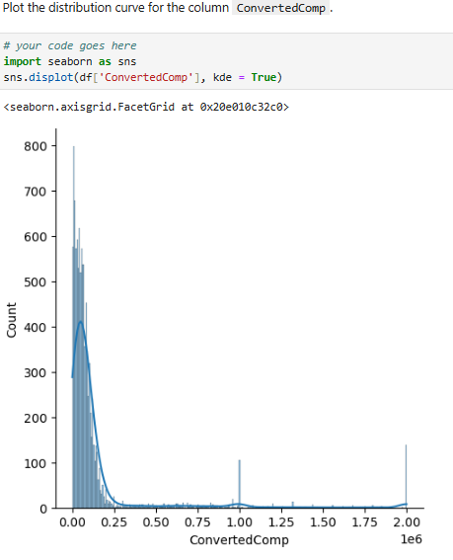
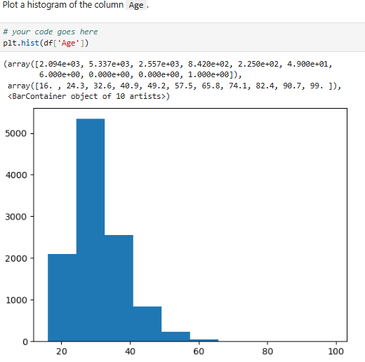
APPENDIX

Slide 19
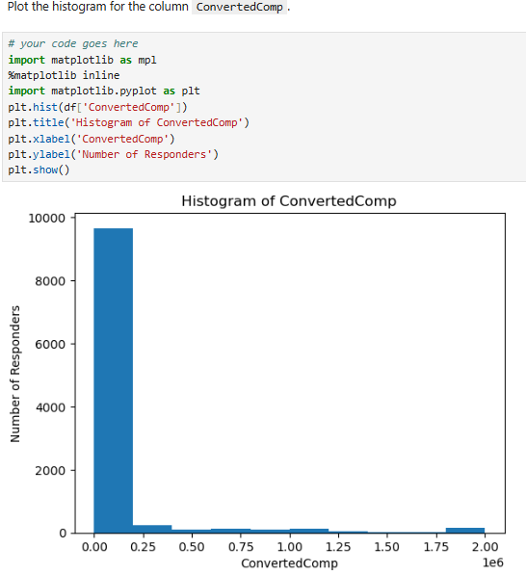
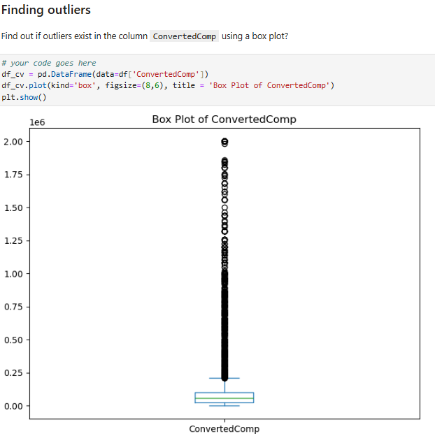
APPENDIX

Slide 20
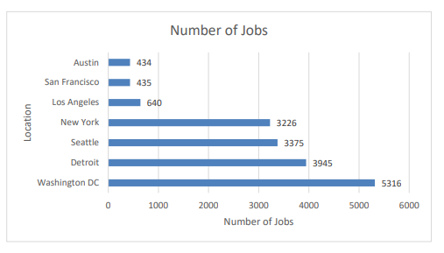
JOB POSTINGS

Slide 21
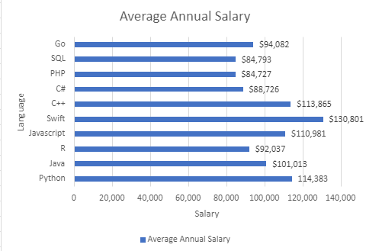
POPULAR LANGUAGES

