Slide 1
RETAIL ANALYTICS • MUC01 CAPSTONE
Retail Sales Pulse
From Analysis to Pipeline Modules
Python Libraries (EDA) & Data Engineering & Enterprise Systems
Pandas & NumPy
Matplotlib EDA
JSON Data Pipelines
Data Validation
Presented by Keerthi Priya

Slide 2
SITUATION & DATA
What the Dataset Tells Us
Six months of transaction-level retail sales data (Jan–Jun 2026) across 12 stores in Andhra Pradesh, spanning 5 product categories — used to understand store performance, category trends, and unusual sales drops.
107,836
12
5
0
Sales transactions
Stores across 6 cities
Product categories
Missing values found
Columns in the dataset
Descriptive snapshot
transaction_id, date, store_id, store_city
category, product_name
units_sold, unit_price, revenue, discount_pct
Average revenue per transaction: ₹4,264 (std. dev ₹14,243)
Average units sold per transaction: 2.6 units
Average discount applied: 7.2%
No duplicate records found in the dataset
RETAIL SALES PULSE
2

Slide 3
TASK 5.1
Load and Inspect the Data
What was checked
5.1 — Observations
Loaded the six-month retail transaction CSV (Jan–Jun 2026) into a DataFrame
Inspected shape, column names, and data types with .shape, .columns, and .dtypes
Confirmed there were zero missing values across all 10 columns with .isnull().sum()
Reviewed descriptive statistics with .describe() to understand the spread of units sold, price, and revenue
Verified there were no duplicate transaction records
The dataset contains clean, transaction-level sales data ready for analysis — no nulls, no duplicates
Descriptive statistics reveal high variability in revenue per transaction (std. dev. exceeds the mean), reflecting a wide product price range
Data types were confirmed as suitable (numeric fields for units, price, revenue and discount) before further analysis began
RETAIL SALES PULSE
3

Slide 4
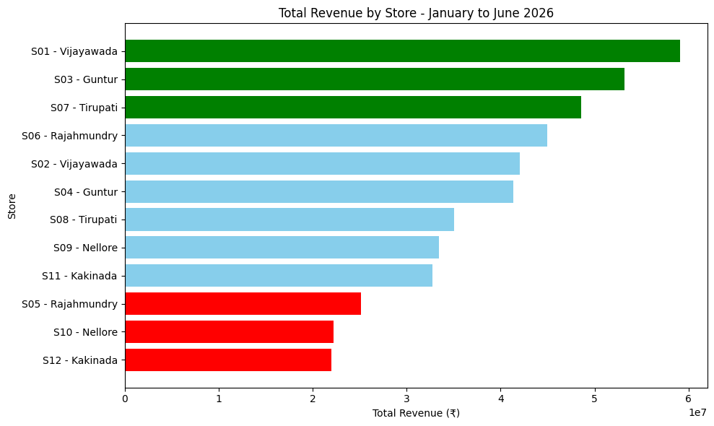
TASK 5.2
Revenue by Store
Business Interpretation
Top performers: Vijayawada (S01), Guntur (S03), and Tirupati (S07) generate the highest revenue
Bottom performers: Rajahmundry (S05), Nellore (S10), and Kakinada (S12) trail well behind
The gap may signal weaker customer demand, pricing gaps, or local competition at underperforming stores — worth investigating further
RETAIL SALES PULSE
4

Slide 5
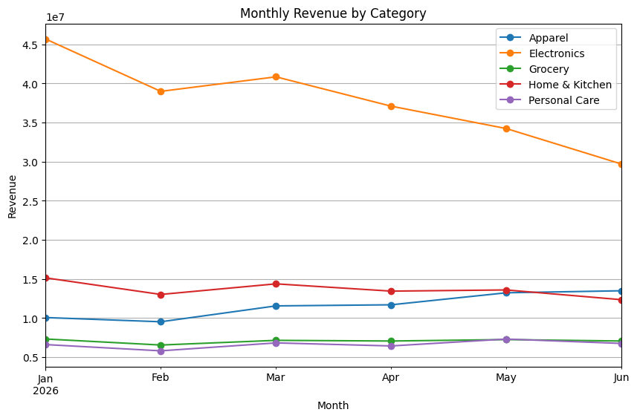
TASK 5.3
Category Performance Over Time
Business Interpretation
Electronics shows the steepest month-over-month decline — possibly fewer buyers or high price points
Grocery revenue stays remarkably consistent, reflecting steady, non-discretionary customer demand
Other categories (Apparel, Home & Kitchen, Personal Care) show comparatively stable trends across the six months
RETAIL SALES PULSE
5

Slide 6
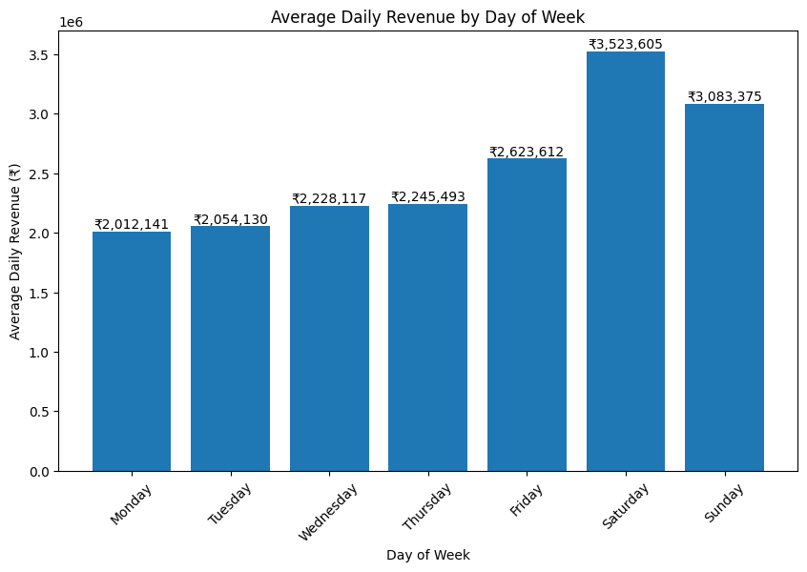
TASK 5.4
Day-of-Week Revenue Patterns
₹35.24L
Best day — Saturday (avg. revenue)
₹20.12L
Weakest day — Monday (avg. revenue)
Weekends consistently outperform weekdays — Saturday and Sunday lead average daily revenue
RETAIL SALES PULSE
6

Slide 7
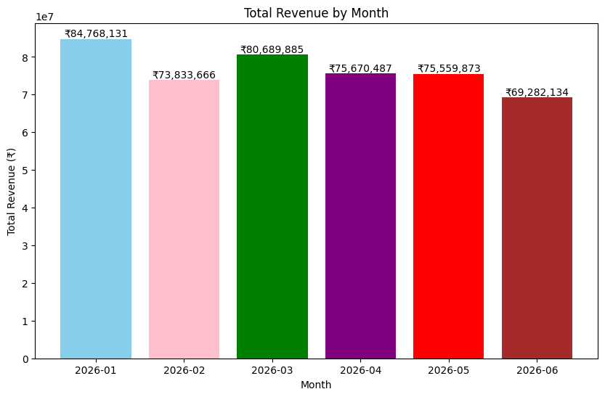
TASK 5.4
Monthly Revenue Patterns
Business Interpretation
January was the strongest month (₹8.48 Cr); June the weakest (₹6.93 Cr) — a steady downward drift
Combined with the Monday dip, this suggests a flash promotion on Mondays during weaker months could help recover lost revenue
RETAIL SALES PULSE
7

Slide 8
TASK 5.5
Anomaly Identification
Rule: a store-week is flagged when revenue falls more than 2 standard deviations below that store's own average. All 12 stores were flagged for the week of Jun 29 – Jul 5.
Store | Revenue (₹) | Likely Reason
S01 — Vijayawada | 2,73,682 | Supply disruption
S02 — Vijayawada | 3,06,102 | Local event
S03 — Guntur | 3,61,129 | Pricing issue
S04 — Guntur | 2,29,617 | Competitor activity
S05 — Rajahmundry | 1,87,376 | Supply disruption
S06 — Rajahmundry | 4,06,757 | Local event
S07 — Tirupati | 3,40,452 | Pricing issue
S08 — Tirupati | 2,61,530 | Competitor activity
S09 — Nellore | 1,87,629 | Supply disruption
S10 — Nellore | 1,15,629 | Local event
S11 — Kakinada | 2,98,689 | Pricing issue
S12 — Kakinada | 2,30,160 | Competitor activity
Business Interpretation
Every store — not just a few — was flagged in the same trailing week
That week (Jun 29–Jul 5) only overlaps the dataset through June 30, so it's a partial week with fewer transactions than a full one
This looks like an edge effect of weekly bucketing at the data boundary rather than genuine anomalies
A production pipeline should exclude incomplete trailing periods from anomaly comparisons
RETAIL SALES PULSE
8

Slide 9
TASK 5.6
Business Recommendations
01
Target the Monday dip
Saturday delivers the highest average daily revenue; Monday the lowest at ~₹20.21 lakh. Running flash promotions on Mondays can lift the weakest day.
02
Re-price Electronics
Electronics shows the steepest decline in sales — testing discounts or pricing adjustments could help recover lost demand.
03
Gather more signal
Additional data on customer demand, competitor pricing, and local events would sharpen and confirm the best course of action.
RETAIL SALES PULSE
9

Slide 10
PART 2
Automating the Pulse:
Data Pipeline & Validation
Moving from historical analysis to an automated weekly ingestion, validation, and reporting pipeline built on live API data.
RETAIL SALES PULSE
10

Slide 11
TASK 5.7 – 5.8
Understanding & Ingesting the API Response
5.7 — JSON structure
5.8 — Ingest & parse
Top level is a dictionary with keys: status, request_id, generated_at, period, record_count, data
Actual transaction records live inside the "data" key as a list of records
period = 2026-06-24 to 2026-06-30; record_count = 4,291
A real retail API would use this structure so consumers can validate metadata (period, count, status) before touching the transaction payload
Extracted the "data" list and loaded it into a pandas DataFrame; converted the date column to datetime
Confirmed DataFrame row count (4,291) matches the JSON's record_count field exactly
Why check record count: it confirms nothing was dropped in transit — a mismatch could mean incomplete data reached the pipeline, so it's checked before any reporting decision is made
RETAIL SALES PULSE
11

Slide 12
TASK 5.9
Validate the Data Before Processing
A deliberately corrupted weekly file was run through a validation function checking for nulls, non-positive revenue, and invalid store IDs.
VALIDATION SUMMARY
Design Principle
Total records checked
4,291
A well-designed production pipeline should stop completely when corrupt data is detected
Processing invalid records risks producing incorrect business results and can hide data-quality problems that need investigation
Fail-fast beats silently skipping or auto-fixing bad rows in a reporting context
Null values found
1 (row 12, units_sold)
Negative revenue found
1 (row 5, revenue: -150.0)
Invalid store IDs found
1 (row 20, store_id: S99)
STATUS: FAILED — 3 issues detected
Pipeline halted before reaching downstream reporting
RETAIL SALES PULSE
12

Slide 13
TASK 5.10
Transform & Aggregate the Weekly Feed
S03 — Guntur
S10 — Nellore
-34.2%
Top store this week (₹20.38L)
Bottom store this week (₹6.27L)
Electronics vs 6-month baseline
Category | This Week (₹) | 6-Mo. Baseline (₹) | % Diff
Apparel | 32,28,573 | 26,87,056 | +20.2%
Electronics | 57,64,694 | 87,60,741 | -34.2%
Grocery | 16,17,279 | 16,36,011 | -1.1%
Home & Kitchen | 28,47,057 | 31,65,304 | -10.1%
Personal Care | 15,57,808 | 15,33,370 | +1.6%
Category alert triggered: Electronics revenue is more than 20% below its 6-month weekly baseline — flagged for review.
RETAIL SALES PULSE
13

Slide 14
TASK 5.11
Automated Pipeline Summary Output
Output of generate_weekly_summary() — a single function producing a ready-to-read business report from the raw JSON feed.
=== RETAIL SALES PULSE — WEEKLY SUMMARY ===
Period: 2026-06-24 to 2026-06-30
Records processed: 4,291
Top store this week: S03 — Guntur (₹20,37,560.19)
Bottom store this week: S10 — Nellore (₹6,27,119.87)
Category alert: Electronics revenue down 34.20% vs 6-month baseline
No alert: Apparel, Grocery, Home & Kitchen, Personal Care
PIPELINE STATUS: COMPLETED
RETAIL SALES PULSE
14

Slide 15
KEY TAKEAWAYS
From Insight to Action
1
Store performance varies widely
2
Time patterns are actionable
Vijayawada, Guntur & Tirupati lead; Rajahmundry, Nellore & Kakinada lag behind.
Saturdays and January outperform; Mondays and June lag — a clear promo window.
3
Electronics needs attention
4
The pipeline is production-ready
Steepest category decline, now 34% below its own 6-month baseline.
Ingests JSON, validates data quality, fails safely, and reports automatically.
Thank you
RETAIL SALES PULSE
15

