Slide 1
SUPERVISED LEARNING HANDS-ON PROJECT
Customer Churn Prediction Using Supervised Learning
Predicting whether a customer will churn (Yes / No)
TECHNOLOGIES
Python
Pandas
NumPy
Scikit-learn
Matplotlib
Seaborn

Slide 2

Problem Statement
Can we predict which customers will leave?
What is customer churn?
Churn = Yes
Customer churned
Churn tells us whether a customer has churned (left) or not
Target variable: Churn
This is a classification problem
Goal: predict whether a customer will churn or not
Churn = No
Customer did not churn

Slide 3



Dataset & Features
13 columns: 7 numerical, 4 categorical, 1 identifier and the target
Numerical
Categorical
Identifier
Age
Annual_Income
Tenure_Months
Monthly_Charges
Support_Calls_Last_3M
Data_Usage_GB
Satisfaction_Score
Contract_Type
Payment_Method
Region
Plan_Type
Customer_ID
Customer_ID is only an identifier, so it is not used for prediction.
Target variable: Churn (Yes = churned, No = did not churn)

Slide 4







Data Understanding & Initial Inspection
Checks done before cleaning the data
1
2
3
4
5
6
7
8
Shape
Columns & types
First & last records
Missing values
Duplicates
Statistics
Churn split
Suspicious values
184 rows × 13 columns
6 numeric, 7 text (Annual_Income read as text)
Checked with head() and tail()
Found in 7 columns (up to 11 in Annual_Income)
4 duplicate rows
Odd min/max, e.g. Age −5 to 145
Yes 97 · No 87
Labels such as "?" and "Unknown"
Original data: 184 rows → 180 rows after removing duplicates

Slide 5


Data Cleaning
Turning messy data into model-ready data
Missing values & duplicates
Invalid numbers
Text labels
Replaced ?, NA, N/A with missing values
Removed duplicate rows (184 → 180)
Filled numerical gaps with median
Filled categorical gaps with mode
Annual_Income converted to numeric; negative or above 200,000 removed
Age below 18 or above 100
Tenure above 100 months
Monthly_Charges above 200
Support calls above 20
Data usage below 0
Satisfaction outside 1–10
Removed extra spaces
Standardized labels (e.g. "2-Year" → "2 Year", "Upi" → "UPI")
Invalid values set to missing, then filled → 0 missing values → saved as cleaned_dataset.csv

Slide 6
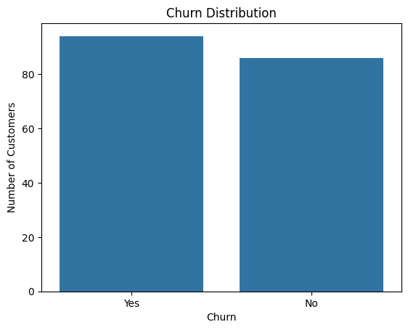
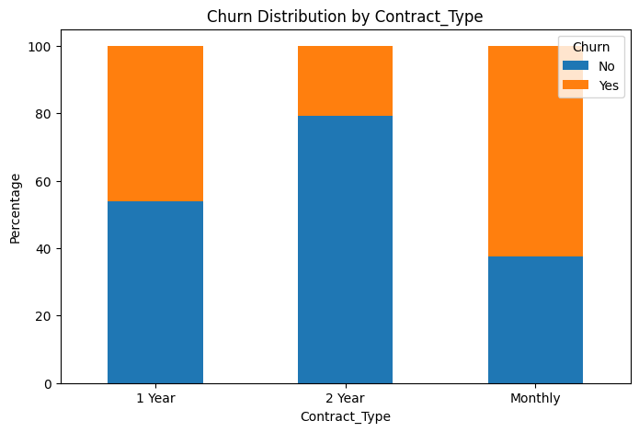
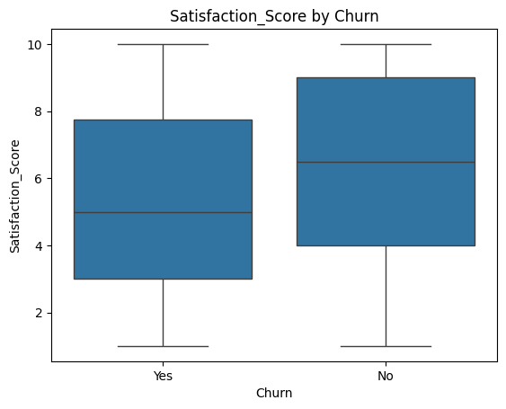
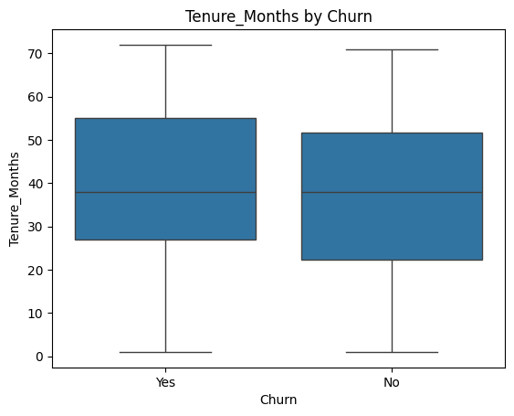
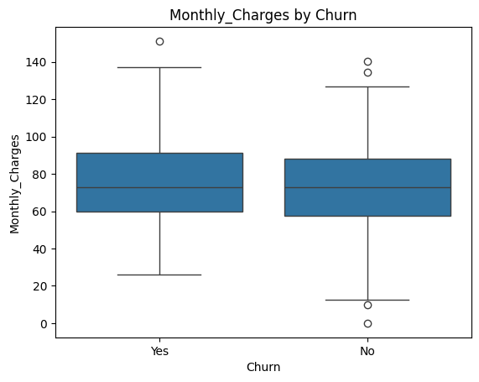
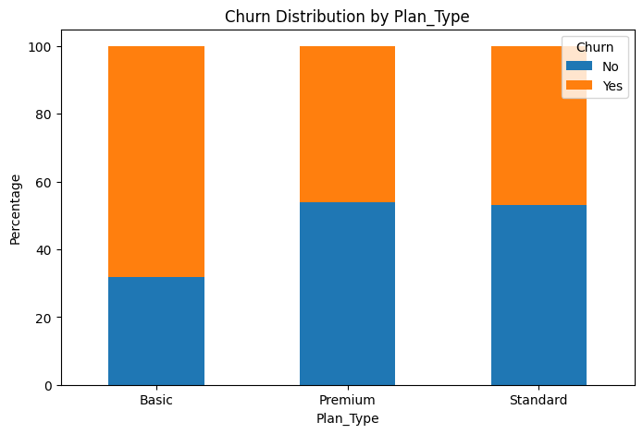
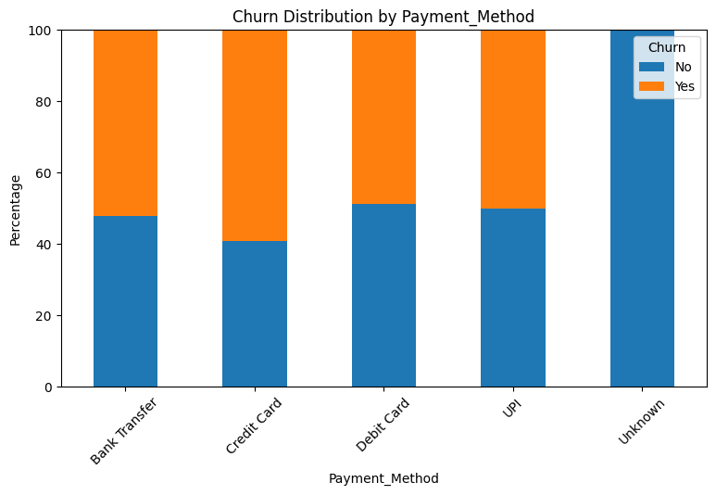
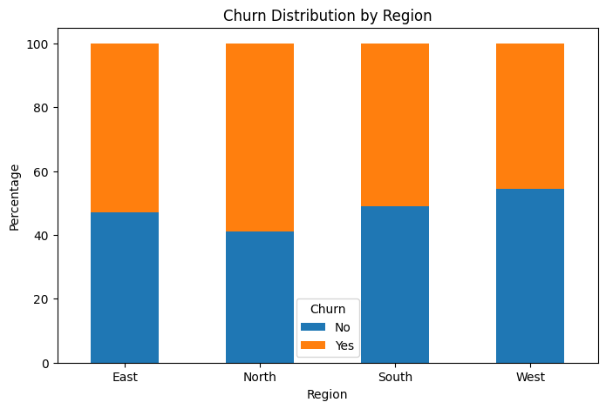
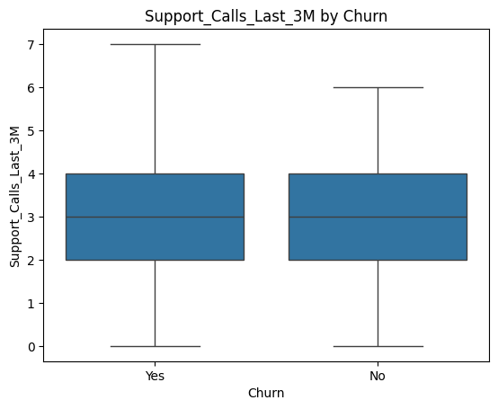
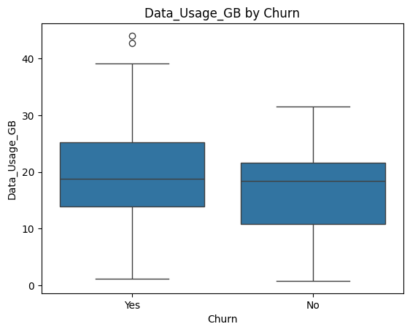
Exploratory Data Analysis
Charts from the notebook: how does churn change across customer details?
Churn distribution
Churn vs Contract_Type
Churn vs Satisfaction_Score
Churn vs Tenure_Months
Churn vs Monthly_Charges
Churn vs Plan_Type
Churn vs Payment_Method
Churn vs Region
Churn vs Support_Calls_Last_3M
Churn vs Data_Usage_GB

Slide 7
Key EDA Insights
What the notebook results show (180 customers after cleaning)
Contract_Type
Plan_Type
Satisfaction_Score
Churn rate: Monthly 62.5% · 1 Year 46.2% · 2 Year 20.8%
Churn rate: Basic 68.1% · Premium 46.2% · Standard 46.8%
Average score: churned 5.27 vs not churned 6.30
CHARACTERISTICS EXAMINED
Satisfaction_Score
Tenure_Months
Support_Calls_Last_3M
Monthly_Charges
Contract_Type
Plan_Type
Payment_Method
Region
Age
Annual_Income
Data_Usage_GB
Tenure, Support Calls and Monthly Charges had the same median for churned and non-churned customers.

Slide 8



Feature Engineering & Preprocessing
From cleaned data to model-ready data
Dataset
›
Remove Customer_ID
›
X and y
›
Train / Test Split
›
Encoding
›
Scaling
›
Model
Customer_ID removed
Churn converted: No = 0, Yes = 1
80% training, 20% testing (144 / 36 customers)
Stratified train-test split
Numerical features scaled with StandardScaler
Categorical features encoded (OneHotEncoder)

Slide 9





Supervised Learning Models
Five models were trained and compared
1
2
3
4
5
Logistic Regression
K-Nearest Neighbors (KNN)
Decision Tree
Random Forest
AdaBoost
Uses a simple formula to estimate the chance of churn.
Looks at the most similar customers and copies their outcome.
Asks a series of yes/no questions to reach a decision.
Combines many decision trees and takes the majority vote.
Builds small models one by one, each fixing earlier mistakes.
All models used the same preprocessing steps.

Slide 10


Model Evaluation
How we judge each model
Accuracy
Precision
Recall
F1 Score
Share of all predictions that are correct.
Of customers predicted to churn, how many really churned.
Of customers who really churned, how many were found.
A balance between Precision and Recall.
Confusion Matrix
ROC-AUC
Cross-validation
Why Recall matters
Missing a customer who actually churns can mean losing a retention opportunity.
Table of correct and wrong predictions.
How well the model separates churn from no churn.
Testing on different parts of the data (5 folds).

Slide 11
Model Comparison
5-fold cross-validation results from the notebook
Algorithm | CV Score | Accuracy | Precision | Recall | F1 Score
Logistic Regression | 0.594444 | 0.594444 | 0.601111 | 0.649708 | 0.622201
KNN | 0.505556 | 0.505556 | 0.532527 | 0.467836 | 0.493326
Decision Tree | 0.605556 | 0.605556 | 0.627038 | 0.616374 | 0.620060
Random Forest | 0.611111 | 0.611111 | 0.615789 | 0.681287 | 0.645405
AdaBoost | 0.583333 | 0.583333 | 0.599560 | 0.628070 | 0.611660
Best CV score
Best Recall
Best F1 Score
0.611111
0.681287
0.645405
Random Forest
Random Forest
Random Forest

Slide 12

Final Model: Random Forest
Selected using validation and testing results
CV Score
Accuracy
Precision
Recall
F1 Score
0.611111
0.611111
0.615789
0.681287
0.645405
Why Random Forest?
Business goal
Find customers who are likely to churn, so Recall matters most.
Highest CV score, Recall and F1 Score of the 5 models
Not chosen on Accuracy alone
Good balance between Precision and Recall

Slide 13
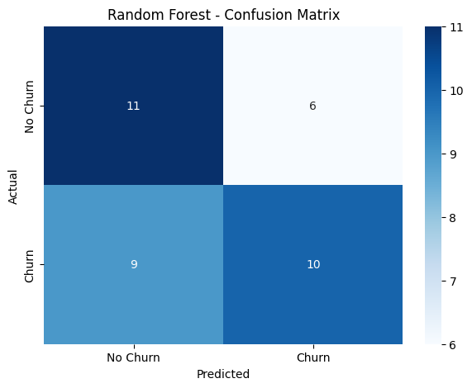
Confusion Matrix & Errors
Random Forest on the 36 test customers
11
True Negative
6
False Positive
Predicted No Churn, actually No Churn
Predicted Churn, actually No Churn
9
False Negative
10
True Positive
Predicted No Churn, actually Churn
Predicted Churn, actually Churn
False Negative: a customer who churns is predicted as No Churn, so a retention chance may be missed.
False Positive: predicted Churn but does not churn, so effort or offers may be wasted.

Slide 14




Business Recommendations
How the business can use the predictions
1
Contact predicted churners: give suitable retention support before they leave.
2
Focus on low Satisfaction_Score: improve their service experience and resolve issues quickly.
3
Monitor frequent Support_Calls_Last_3M: find the problems behind repeated support requests.
4
Support shorter Tenure_Months: give better onboarding and early support.
5
Review Monthly_Charges and Plan_Type: for customers predicted to churn, and consider suitable plans or offers.

Slide 15
Conclusion & Future Improvement
Conclusion
Limitations
The model can produce False Positives and False Negatives.
Random Forest was selected as the final model
The model can help identify customers likely to churn
Predictions can support customer retention activities
Additional data could improve it
Customer complaints
Service interaction history
Payment history
Contract renewal history
Customer feedback
Reasons for cancellation
Previous retention offers
Plan-change history

Slide 16
Thank You
Customer Churn Prediction Using Supervised Learning

