Slide 1
House Price Prediction Using Machine Learning
Machine Learning Project
Presented By : Keerthipriya

Slide 2
Project Overview
Objective
Target
Why regression?
Predict house prices from property details
Price (a continuous number)
Price is a numeric value, not a fixed label
1. Data
2. Cleaning
3. EDA
4. Preprocessing
5. Train/Test Split
6. Model Training
7. Prediction
8. Evaluation
Workflow: follow the numbered steps left to right, then next row

Slide 3
Dataset Understanding
Structure
Numerical features
Categorical features
2000 rows × 10 columns
No missing values
0 duplicate rows
Target: Price (50,005 – 999,656)
Id
Area
Bedrooms
Bathrooms
Floors
YearBuilt
Location: Downtown, Suburban, Urban, Rural
Condition: Excellent, Good, Fair, Poor
Garage: Yes, No

Slide 4
Data Preprocessing
Missing values
isnull() showed 0 missing values and 0 duplicates, so nothing was removed.
1
Numerical features
Area, Bedrooms, Bathrooms, Floors, YearBuilt are used as numeric inputs.
2
Categorical encoding
Location, Condition, Garage are converted with OneHotEncoder.
3
Feature scaling
StandardScaler for Linear/Logistic, KNN, SVC, SVR and both tree regressors; tree classifiers used passthrough.
4
Train/test split
80/20 split, random_state=42: 1600 train, 400 test (classifiers stratified).
5

Slide 5
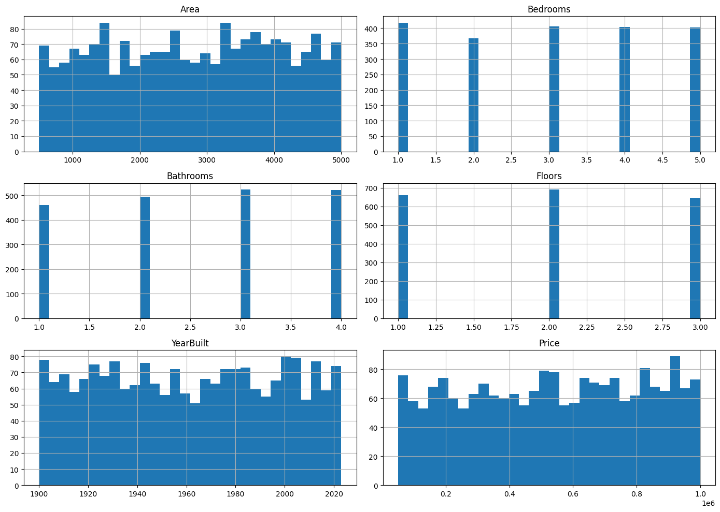
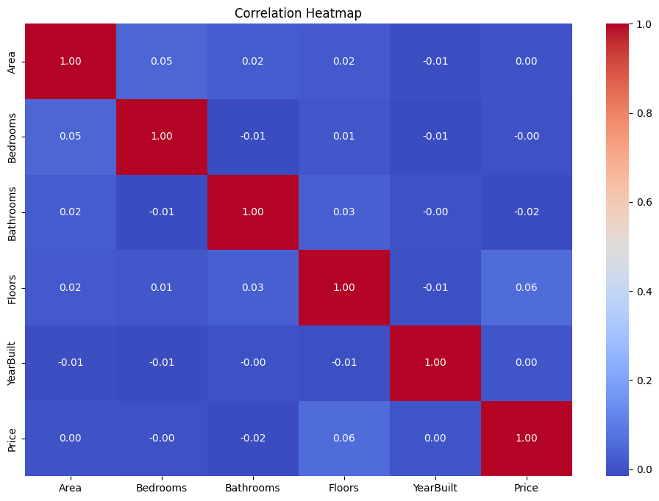
Exploratory Data Analysis
Price Distribution: Price is nearly symmetric (skew −0.06), range 50,005–999,656.
Correlation Heatmap: every feature is close to 0 with Price (highest: Floors 0.06).

Slide 6
Machine Learning Approach
Regression
Input Features
→
Model
→
Predicted Price
Target Price is a continuous number.
Classification
Input Features
→
Model
→
Price_Category
Price ≥ median 539,254 → 1 (High), else 0 (Low); 1000 rows each.
Supervised learning: models learn from rows where the answer (Price) is known.

Slide 7
Linear & Logistic Regression
Linear Regression fits a straight-line formula on the features to predict Price; Logistic Regression uses similar weights to give a Low/High probability.
CLASSIFIER: Logistic Regression
REGRESSOR: Linear Regression
max_iter=1000
LinearRegression() in a Pipeline
Accuracy
0.4750
MSE
78,279,764,121
Precision
0.4750
MAE
242,867
Recall
0.4750
RMSE
279,785
F1 Score
0.4748
R² Score
-0.0062
ROC-AUC
0.4853
Confusion matrix: [[99, 101], [109, 91]]
Scaling: StandardScaler used for both (numeric features) + OneHotEncoder.

Slide 8
Decision Tree
A tree asks yes/no questions on features (splits) until it reaches a predicted class or price.
CLASSIFIER: Decision Tree Classifier
REGRESSOR: Decision Tree Regressor
criterion=gini, max_depth=5
max_depth=5, random_state=42
Accuracy
0.4900
MSE
85,127,094,295
Precision
0.4899
MAE
249,963
Recall
0.4900
RMSE
291,765
F1 Score
0.4887
R² Score
-0.0942
ROC-AUC
0.5001
Confusion matrix: [[88, 112], [92, 108]]
Scaling: classifier used passthrough (not needed for trees); regressor pipeline used StandardScaler.

Slide 9
K-Nearest Neighbors (KNN)
KNN looks at the most similar houses (nearest neighbours) and lets them vote on the answer.
CLASSIFIER: KNN
n_neighbors=5
Accuracy
0.5175
Precision
0.5175
Recall
0.5175
F1 Score
0.5175
ROC-AUC
0.5174
Confusion matrix: [[103, 97], [96, 104]]
Scaling: StandardScaler is used because KNN depends on distances.

Slide 10
Random Forest
Many decision trees are trained; each tree contributes to the final prediction, which reduces reliance on one tree.
CLASSIFIER: Random Forest Classifier
REGRESSOR: Random Forest Regressor
n_estimators=100, max_depth=10
n_estimators=100, random_state=42
Accuracy
0.5075
MSE
86,571,527,999
Precision
0.5075
MAE
254,588
Recall
0.5075
RMSE
294,230
F1 Score
0.5075
R² Score
-0.1128
ROC-AUC
0.5063
Scaling: classifier used passthrough; regressor pipeline used StandardScaler.

Slide 11
Support Vector Machine (SVC & SVR)
SVM finds a boundary (SVC) or a fitted band (SVR) using an RBF kernel to handle non-linear patterns.
CLASSIFIER: SVC
REGRESSOR: SVR
kernel=rbf, C=1.0, gamma=scale
kernel=rbf, C=100, epsilon=0.1, gamma=scale
Accuracy
0.5225
MSE
77,908,143,776
Precision
0.5226
MAE
242,692
Recall
0.5225
R² Score
-0.0014
F1 Score
0.5221
ROC-AUC
0.4894
Confusion matrix: [[99, 101], [90, 110]]
Scaling: StandardScaler is important because SVM is sensitive to feature scale.

Slide 12
Bagging
Bagging trains many decision trees on random samples of the data and combines their votes.
CLASSIFIER: Bagging Classifier
100 trees (max_depth=5), max_samples=0.8
Accuracy
0.5050
Precision
0.5051
Recall
0.5050
F1 Score
0.5038
ROC-AUC
0.5144
Confusion matrix: [[111, 89], [109, 91]]
Scaling: passthrough (tree-based). Classifier only in the notebook.

Slide 13
Gradient Boosting
Trees are added one by one, each one trying to fix the mistakes of the previous ones.
CLASSIFIER: Gradient Boosting Classifier
n_estimators=100, learning_rate=0.1, max_depth=3
Accuracy
0.5325
Precision
0.5325
Recall
0.5325
F1 Score
0.5325
ROC-AUC
0.5446
Confusion matrix: [[105, 95], [92, 108]]
Scaling: passthrough (tree-based). Classifier only in the notebook.

Slide 14
Model Comparison
Regressors (target: Price)
Model | MSE | MAE | R² Score
Linear Regression | 78,279,764,121 | 242,867 | -0.0062
Decision Tree Regressor | 85,127,094,295 | 249,963 | -0.0942
SVR | 77,908,143,776 | 242,692 | -0.0014
Random Forest Regressor | 86,571,527,999 | 254,588 | -0.1128
Classifiers (target: Price_Category)
Model | Accuracy | Precision | Recall | F1 | ROC-AUC
Logistic Regression | 0.4750 | 0.4750 | 0.4750 | 0.4748 | 0.4853
KNN | 0.5175 | 0.5175 | 0.5175 | 0.5175 | 0.5174
Decision Tree Classifier | 0.4900 | 0.4899 | 0.4900 | 0.4887 | 0.5001
SVC | 0.5225 | 0.5226 | 0.5225 | 0.5221 | 0.4894
Bagging Classifier | 0.5050 | 0.5051 | 0.5050 | 0.5038 | 0.5144
Gradient Boosting | 0.5325 | 0.5325 | 0.5325 | 0.5325 | 0.5447
Random Forest Classifier | 0.5075 | 0.5075 | 0.5075 | 0.5075 | 0.5064

Slide 15
Model Evaluation Metrics
Used for Price (continuous)
Regression metrics
Used for Price_Category (Low/High)
Classification metrics
MSE
Accuracy
Average of squared errors; big mistakes count more.
Share of houses placed in the correct class.
Precision / Recall
MAE
Correct positive predictions / positives found.
Average size of the error, in Price units.
F1 Score
Balance of precision and recall.
R² Score
How much of Price variation the model explains (0 ≈ predicting the average).
ROC-AUC
How well the model separates Low from High.
MAE and MSE show prediction error; R² shows model fit. For classifiers, accuracy and F1 show overall correctness.

Slide 16

Key Findings
Correlation of every numeric feature with Price is near 0 (Floors 0.06, Bathrooms −0.02).
Price is nearly symmetric (skew −0.06); no missing values or duplicates.
All four regressors have R² ≤ 0 (SVR −0.0014 is the closest to 0; lowest MSE and MAE).
Classifier accuracy ranges 0.475–0.5325 on a balanced 200/200 test set.
Gradient Boosting scored highest: accuracy 0.5325, ROC-AUC 0.5447.
Tree models used depth limits (5 or 10) in the notebook.

Slide 17
Conclusion
House price prediction was treated as a regression problem (and as Low/High classification).
Data was checked and explored: histograms, correlation heatmap, boxplots.
Linear, Decision Tree, SVR and Random Forest regressors were trained, plus 7 classifiers.
Models were evaluated with MSE, MAE, R² and accuracy, F1, ROC-AUC.
Results show the given features explain very little of Price in this dataset.

Slide 18
Thank You

