Slide 1
MACHINE LEARNING / DISCOVERY
UNSUPERVISED
LEARNING
Finding structure, patterns and anomalies in unlabeled data
CLUSTERING • DIMENSIONALITY REDUCTION • ASSOCIATION RULES • ANOMALY DETECTION
Presented by Harshith Katta · Shanmukha · Keerthi Priya
Notes:
Introduce the central question: How do we gain value from data when the correct answer is not included? Set up four families of methods, each solving a different question. Avoid implying that anomaly detection is a subtype of clustering.

Slide 2
FOUNDATION
Four questions unsupervised learning can answer
A useful taxonomy organized by business question—not by a particular project.
01
Who is similar?
02
Can we simplify?
Clustering
Dimensionality reduction
Customer segments
High-dimensional embeddings
03
What occurs together?
04
What is unusual?
Association rules
Anomaly detection
Product bundles
Rare transactions
UNSUPERVISED LEARNING / TECHNICAL MASTERCLASS
02
Notes:
Clustering discovers groups, dimensionality reduction compresses representations, association analysis discovers co-occurrences, and anomaly detection isolates atypical observations. These domains overlap: DBSCAN can both cluster and mark noise, but isolation forest is an anomaly detector rather than clustering.

Slide 3
FOUNDATION
Supervised vs. unsupervised learning
The difference is the target—not whether we can ever validate results.
SUPERVISED
UNSUPERVISED
Training input: X and known target y
Learns a mapping X → y
Examples: churn prediction, house prices
Metrics: accuracy, F1, RMSE
Training input: X only
Finds structure or regularities in X
Examples: customer groups, basket affinities
Metrics depend on task and ground truth
KEY IDEA No labels for training ≠ no way to evaluate.
UNSUPERVISED LEARNING / TECHNICAL MASTERCLASS
03
Notes:
Supervised labels are the intended target during fitting. Unsupervised procedures fit only X, though some evaluation datasets may later provide labels to assess agreement. Labels can be unavailable, incomplete, expensive, or withheld by design.

Slide 4
FOUNDATION
The end-to-end unsupervised workflow
Most quality failures happen before model fitting—or during interpretation.
01
Define question
02
Audit + clean
03
Encode + scale
→
→
04
Select method
05
Fit + visualize
06
Validate + act
→
→
KEY IDEA Scale distance-based features; avoid ID leakage; interpret groups with domain experts.
UNSUPERVISED LEARNING / TECHNICAL MASTERCLASS
04
Notes:
Use a question-first workflow. Retain IDs for joining results, but exclude arbitrary IDs from numeric model features. Scaling changes the meaning of distance; standardization is often useful for K-Means and PCA, whereas more robust scaling helps heavy tails. Evaluate stability and practical meaning before deployment.

Slide 5
CLUSTERING
Five major clustering families
Different assumptions lead to different shapes, outputs and trade-offs.
Partitioning
Hierarchical
Density-based
K-Means, K-Medoids
Prototype-centred
Agglomerative, divisive
Nested groups
DBSCAN, OPTICS, HDBSCAN
Dense regions + noise
Grid-based
Model-based
STING, CLIQUE, WaveCluster
Spatial cells
Gaussian Mixture Models
Probabilistic memberships
KEY IDEA Choose a method based on cluster geometry, scale, outliers and interpretability.
UNSUPERVISED LEARNING / TECHNICAL MASTERCLASS
05
Notes:
This taxonomy is a useful survey, not a perfectly exhaustive mutually exclusive partition. Some methods can appear under more than one organizing principle. Explain prototype, hierarchy, density, grid and probabilistic methods in terms of their assumptions.

Slide 6
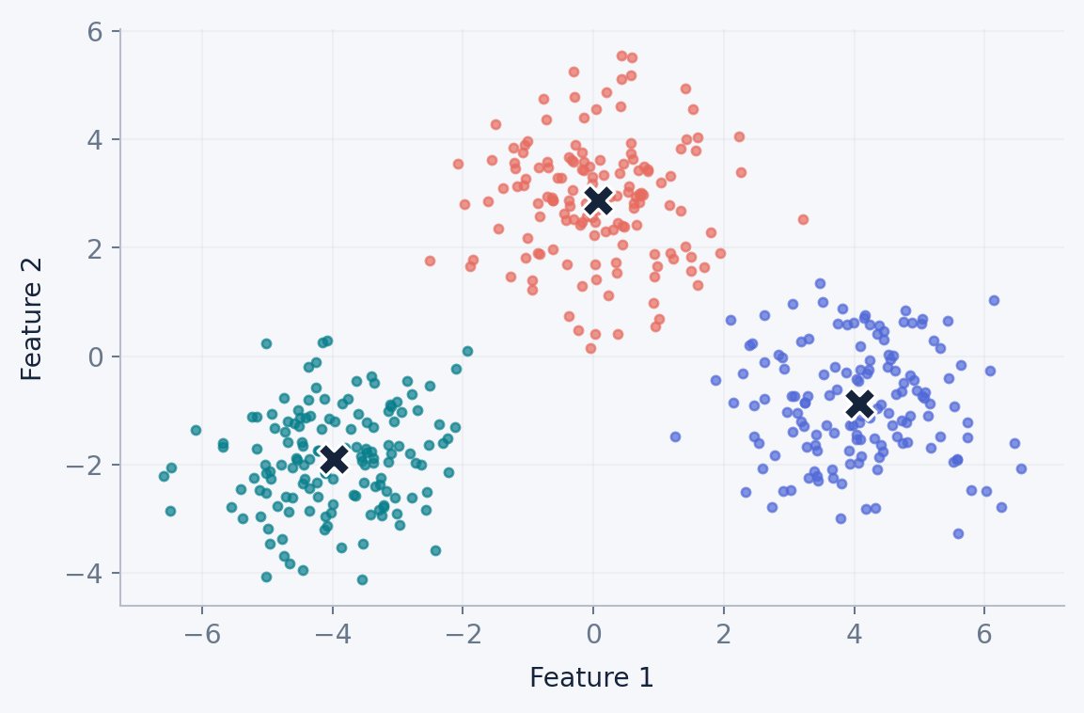
CLUSTERING
K-Means: assign → update → repeat
Minimizes within-cluster squared distance to centroids.
OBJECTIVE
J = Σₖ Σₓ∈Cₖ ||x − μₖ||²
μₖ = mean of points in Cₖ
Centroids move until assignments stabilize.
HARD MEMBERSHIP
EUCLIDEAN GEOMETRY
KEY IDEA K-Means is efficient, but sensitive to initialization, scaling and non-spherical clusters.
UNSUPERVISED LEARNING / TECHNICAL MASTERCLASS
06
Notes:
Explain that each point is assigned to its nearest centroid and centroids are updated using means, iterating until convergence. The formula sums squared Euclidean distances within each assigned cluster. K-Means minimizes a non-convex objective and can converge to local minima; use multiple initializations.

Slide 7
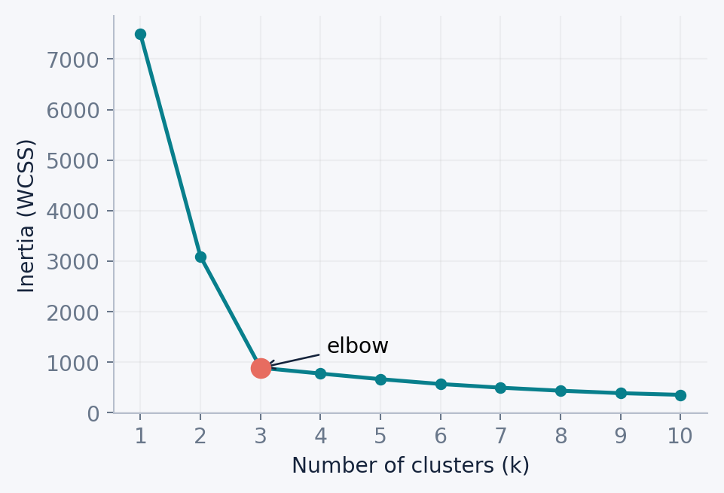
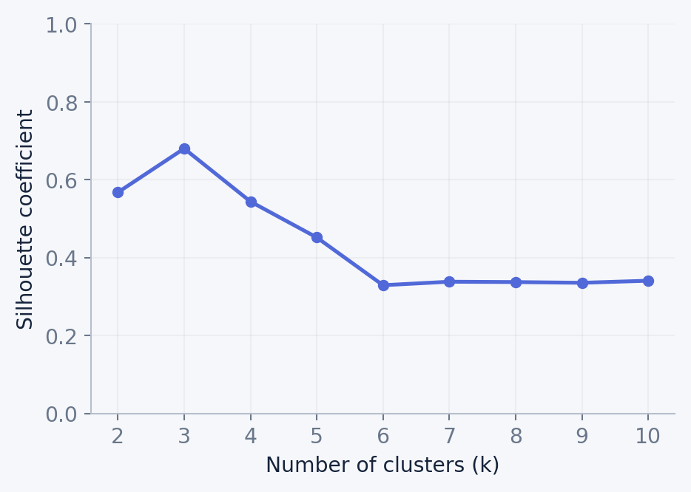
CLUSTERING
Choosing K: elbow + silhouette
Neither chart is a universal truth; both are diagnostics.
KEY IDEA Combine quantitative scores, cluster stability and business interpretability.
UNSUPERVISED LEARNING / TECHNICAL MASTERCLASS
07
Notes:
WCSS always decreases with larger K, so examine diminishing returns. The silhouette coefficient compares cohesion to separation, ranges from -1 to 1, and may prefer simple shapes. Both are imperfect when data has unequal density or non-convex structure.

Slide 8
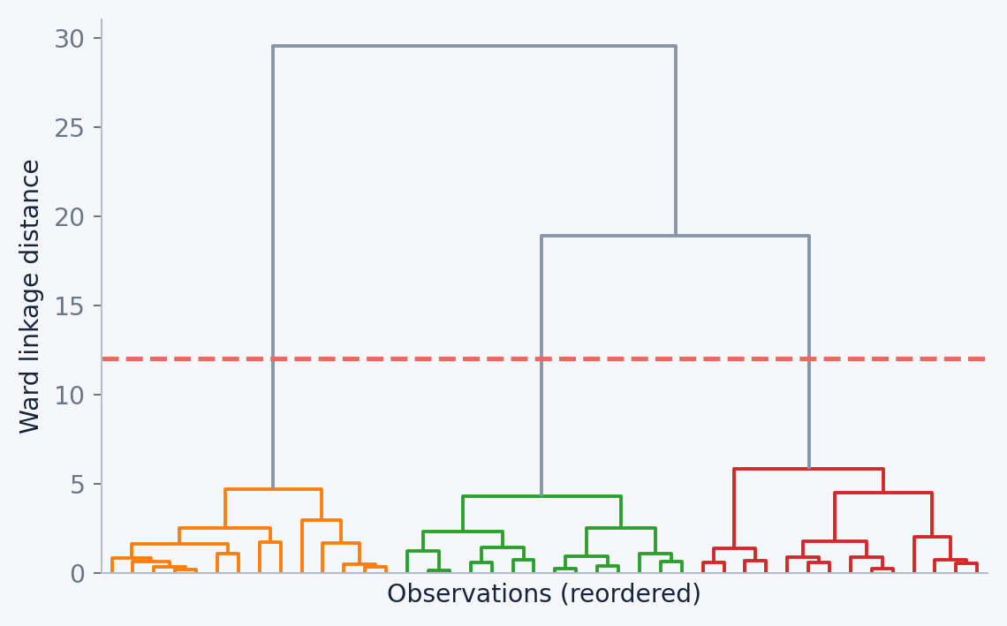
CLUSTERING
Hierarchical: merge, split, inspect
A dendrogram represents a hierarchy—not necessarily one correct K.
TWO DIRECTIONS
Agglomerative: bottom-up merges
Divisive: top-down splits
Linkage: single, complete, average, Ward
KEY IDEA A horizontal cut produces a partition at one chosen granularity.
UNSUPERVISED LEARNING / TECHNICAL MASTERCLASS
08
Notes:
The vertical axis of a dendrogram is linkage distance, not a target score. Explain parent-child groupings by different cut heights. Ward linkage approximately minimizes the increase in within-cluster variance when merging clusters and requires Euclidean geometry in common implementations.

Slide 9
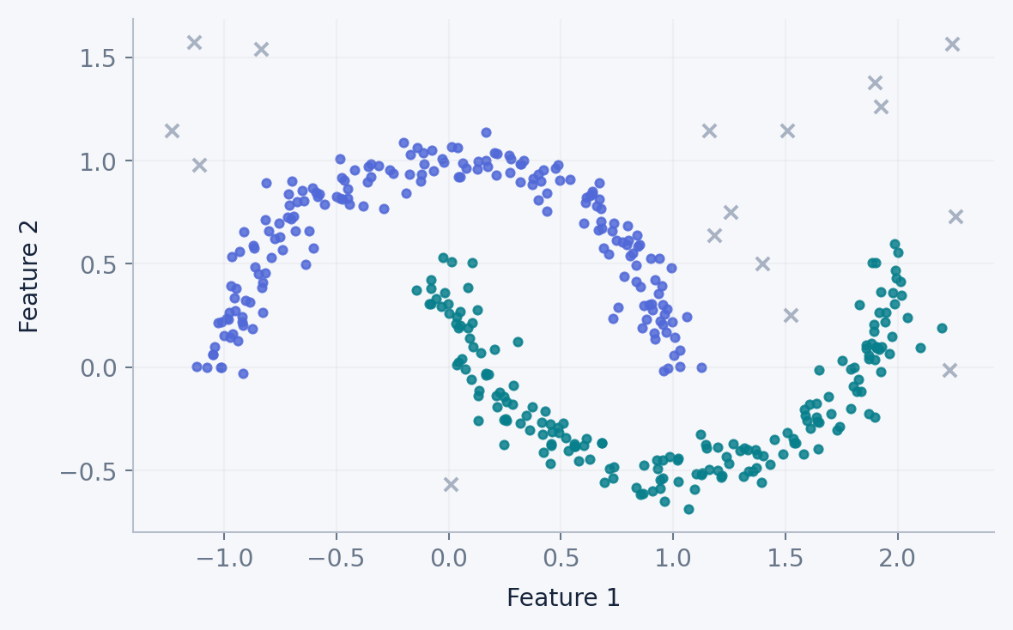
CLUSTERING
DBSCAN: density determines clusters
Dense chains form groups; sparse observations become noise.
TWO PARAMETERS
eps — neighborhood radius
min_samples — density threshold
Core • border • noise
No need to provide number of clusters
KEY IDEA Good for irregular shapes; sensitive to density variation and feature scale.
UNSUPERVISED LEARNING / TECHNICAL MASTERCLASS
09
Notes:
Explain core points as points with at least min_samples within eps including themselves (in scikit-learn). Border points are reachable from cores but are not core themselves. Noise are points not density-reachable from cores. Border points can be assigned depending on traversal order in ambiguous cases.

Slide 10
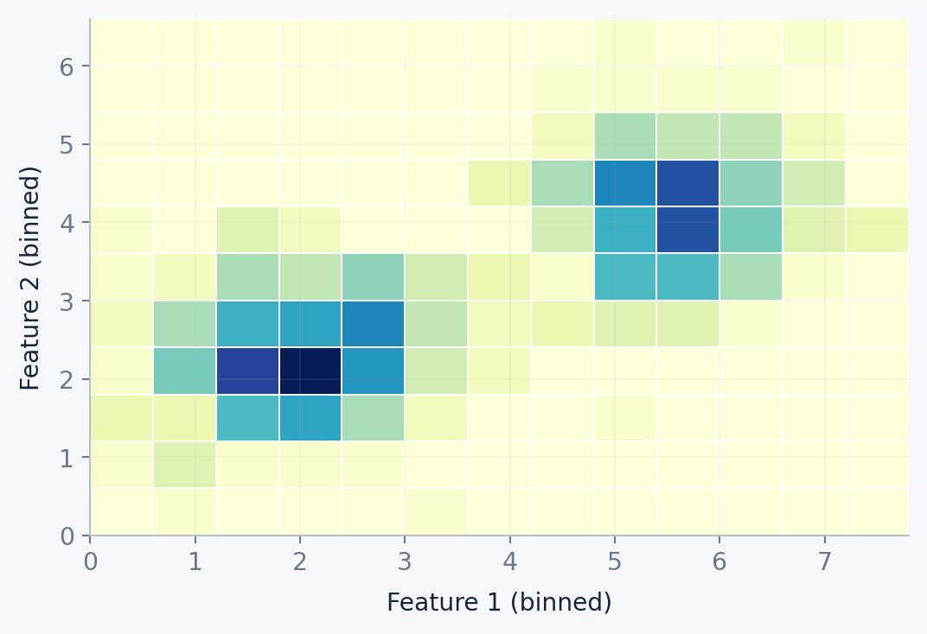
CLUSTERING
Grid-based clustering: partition space first
A data-space grid enables fast region-level reasoning.
DENSITY ON CELLS
1. Divide feature space into cells
2. Estimate occupancy or density
3. Merge neighboring dense cells
Examples: STING, CLIQUE, WaveCluster
KEY IDEA Grid resolution matters; the classic grid view differs from point-neighborhood DBSCAN.
UNSUPERVISED LEARNING / TECHNICAL MASTERCLASS
10
Notes:
Grid-based methods work on a partition of feature space rather than only pairwise point distances. STING uses statistical summaries at multiple grid resolutions; CLIQUE discovers dense units in subspaces; WaveCluster applies wavelet transformations to grid summaries. The heatmap here is an illustrative occupancy grid, not a STING/CLIQUE model result.

Slide 11
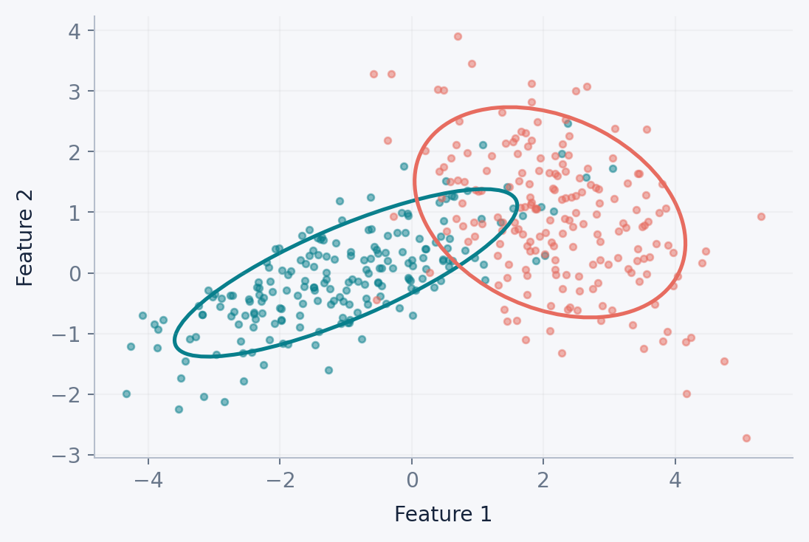
CLUSTERING
Model-based clustering: soft assignments
Gaussian mixture models estimate probabilities of belonging to each component.
GMM / EM
E-step: estimate membership responsibilities
M-step: update distribution parameters
Select complexity using BIC/AIC
Elliptical overlapping clusters
KEY IDEA Components are statistical distributions; they are not always distinct real-world segments.
UNSUPERVISED LEARNING / TECHNICAL MASTERCLASS
11
Notes:
Describe GMM as a weighted sum of Gaussian distributions. The EM algorithm alternates between expectations of component membership and parameter maximization. Compare soft probabilities with hard K-Means assignments; model-based methods can represent elliptical distributions but depend on assumptions.

Slide 12
CLUSTERING
Compare clustering families in one view
The best algorithm depends on the structure being searched for.
FAMILY
STRUCTURE
KEY CONTROL
TRADE-OFF
K-Means
Centroid
K required
Fast / scalable
Hierarchical
Nested linkage
Tree / cut
Explains relationships
DBSCAN
Point density
eps + minPts
Irregular clusters + noise
Grid-based
Cell statistics
Resolution
Spatial / subspace patterns
GMM
Probability model
Components
Overlapping groups
KEY IDEA Use scores to support decisions—not to replace understanding of the data.
UNSUPERVISED LEARNING / TECHNICAL MASTERCLASS
12
Notes:
Explain that algorithm comparisons should control preprocessing and feature representations. Selecting an algorithm based solely on silhouette can be deceptive, since silhouette tends to favor convex separated partitions and penalizes some useful irregular clusters.

Slide 13
DIMENSIONALITY REDUCTION
Why compress features?
High-dimensional distances and visualizations can become hard to interpret.
TWO PURPOSES
100 FEATURES
→
2–10
DIMENSIONS
Visualization: inspect structure in 2D / 3D
Representation: remove redundancy and noise
Trade-off: some information is lost
Keep a useful representation of the signal
KEY IDEA Dimensionality reduction does not automatically improve every downstream task.
UNSUPERVISED LEARNING / TECHNICAL MASTERCLASS
13
Notes:
Explain the curse of dimensionality as a family of challenges, including concentration of distances and sparse coverage, rather than asserting that all high-dimensional models fail. Feature selection retains original columns; feature extraction, such as PCA, constructs new coordinates.

Slide 14
DIMENSIONALITY REDUCTION
PCA: rotate toward maximum variance
Linear components are orthogonal directions ordered by explained variance.
01
02
03
04
→
→
→
Center / scale
Covariance / SVD
Eigenvectors
Project data
Explained variance ratio = λᵢ / Σⱼ λⱼ
KEY IDEA PCA preserves directions of maximum variance—not necessarily class or cluster separation.
UNSUPERVISED LEARNING / TECHNICAL MASTERCLASS
14
Notes:
PCA is linear. Standardize if original features differ greatly in units or magnitude; scaling is not mandatory in all settings. The principal axes correspond to eigenvectors of the covariance matrix (or right singular vectors in SVD). Eigenvalues quantify variance along components. The percentage captured in PC1 and PC2 must be assessed for the specific data.

Slide 15
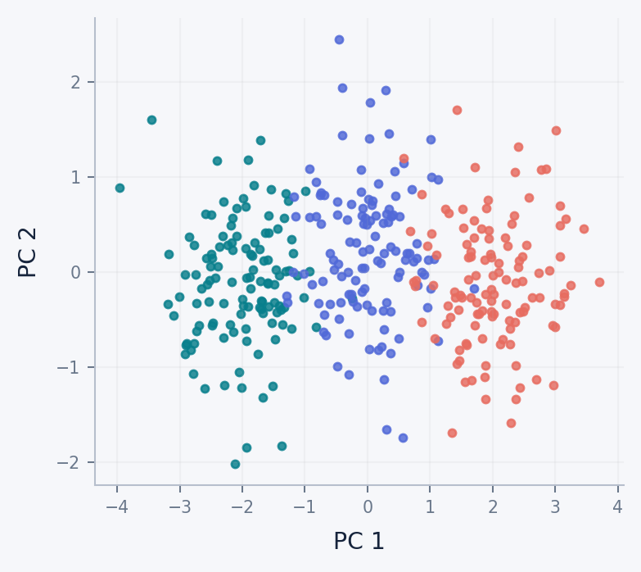
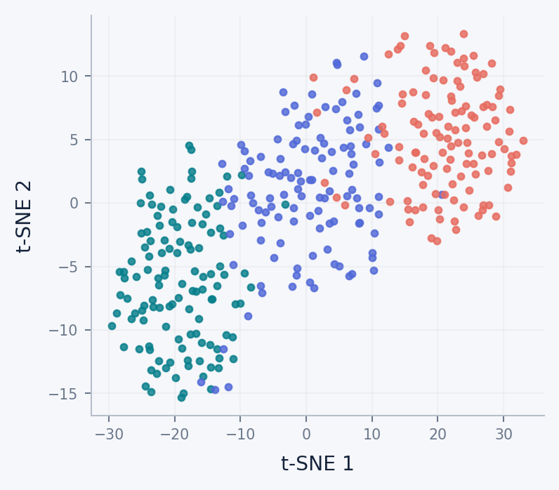
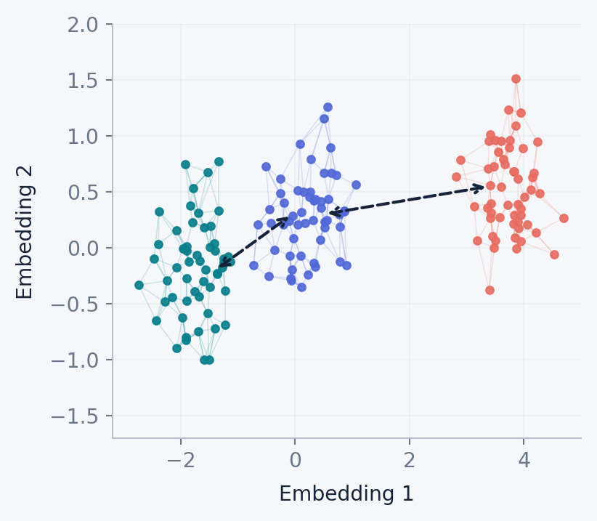
DIMENSIONALITY REDUCTION
PCA vs t-SNE vs UMAP: what each preserves
Three views of high-dimensional relationships—not interchangeable algorithms.
PCA
t-SNE
UMAP
LINEAR / GLOBAL VARIANCE
LOCAL NEIGHBORHOODS
LOCAL GRAPH + BROADER TOPOLOGY
PCA and t-SNE: computed embeddings of synthetic data. UMAP: labeled conceptual graph schematic (not a fitted embedding).
UNSUPERVISED LEARNING / TECHNICAL MASTERCLASS
15
Notes:
Read the method labels and provenance accurately. PCA emphasizes global directions of variance. t-SNE is optimized to preserve local neighbor affinities and can distort apparent distance between clusters. UMAP constructs a weighted neighbor graph and seeks a low-dimensional fuzzy-set layout, usually preserving local structure and sometimes more broad relations than t-SNE, but it does NOT guarantee global distance preservation. Its two-way links in this illustration depict neighborhood graph connectivity. Sources for preparation: van der Maaten & Hinton (2008); McInnes, Healy & Melville (2018).

Slide 16
DIMENSIONALITY REDUCTION
How to interpret UMAP responsibly
Graph structure is informative; visual distance is not a guaranteed business metric.
READ THIS VISUAL
Local links: nearest-neighbor relations
Nearby clusters: possible shared structure
Distant clusters: do not assume proportional original-space distances
n_neighbors and min_dist change the view
KEY IDEA UMAP is nonlinear and graph-based; neither topology nor global distances are perfectly preserved.
UNSUPERVISED LEARNING / TECHNICAL MASTERCLASS
16
Notes:
UMAP first builds a local fuzzy simplicial set from neighbors, then optimizes a low-dimensional representation. The graph edges are schematic and not actual UMAP fitted edge weights. Larger n_neighbors places more emphasis on broader relations, while min_dist influences how tightly points pack; avoid saying global geometry is exactly retained.

Slide 17
ASSOCIATION RULES
Market-basket analysis discovers co-occurrence
Transactions—not class labels—are the starting point.
TRANSACTION
BREAD
MILK
BUTTER
EGGS
T1
✓
✓
✓
T2
✓
✓
✓
T3
✓
✓
T4
✓
✓
✓
✓
T5
✓
✓
KEY IDEA Rules describe co-occurrence; they do not prove causation.
UNSUPERVISED LEARNING / TECHNICAL MASTERCLASS
17
Notes:
Treat each row as a transaction. A rule X ⇒ Y tests association between antecedent X and consequent Y. An item can be a product, event, action, or feature indicator; association rule learning is not restricted to commerce. In this toy data bread and milk occur together in three of five transactions.

Slide 18
ASSOCIATION RULES
Support • confidence • lift
Calculate a rule before trusting it.
SUPPORT
CONFIDENCE
LIFT
P(Bread ∩ Milk)
3 / 5 = 0.60
How often do both appear?
P(Milk | Bread)
3 / 4 = 0.75
How often is Y present given X?
0.75 / P(Milk)
0.75 / 0.80 = 0.9375
Below 1: less than chance-level association
KEY IDEA High confidence alone can be misleading when the consequent is very common.
UNSUPERVISED LEARNING / TECHNICAL MASTERCLASS
18
Notes:
Compute frequencies from the transaction table: bread appears in T1,T2,T4,T5 = 4/5; milk appears in T1,T2,T3,T4 = 4/5; both in T1,T2,T4 = 3/5. Therefore confidence bread→milk = (3/5)/(4/5)=0.75 and lift=0.75/(4/5)=0.9375. Lift is not a causal effect and high scores for rare events can be unstable.

Slide 19
ASSOCIATION RULES
Apriori vs FP-Growth
Two routes to frequent itemsets—then generate rules.
APRIORI
FP-GROWTH
Generate candidate itemsets
Prune if a subset is infrequent
Repeatedly scan transactions
Simple and intuitive; candidate explosion possible
Build compressed FP-tree
Mine frequent conditional patterns
Avoid explicit large candidate generation
Often useful for many dense transactions
KEY IDEA Set minimum support, then filter rules by confidence, lift and usefulness.
UNSUPERVISED LEARNING / TECHNICAL MASTERCLASS
19
Notes:
Apriori uses downward closure: all subsets of a frequent itemset must also be frequent; an infrequent itemset cannot have a frequent superset. FP-Growth uses a compressed transaction tree and recursive conditional mining. Both typically mine frequent itemsets, then generate rules; not every frequent itemset creates a useful actionable rule.

Slide 20
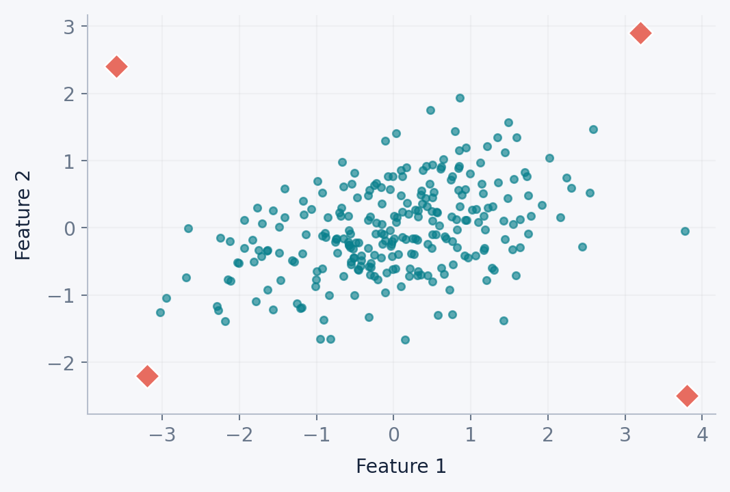
ANOMALY DETECTION
Not everything unusual forms a cluster
Anomalies may be isolated, contextual or collective.
THREE PATTERNS
Point: one unusually extreme observation
Contextual: unusual given season or user
Collective: odd sequence or group
Novelty ≠ verified fraud
KEY IDEA Anomaly detection scores suspicion; investigation establishes meaning.
UNSUPERVISED LEARNING / TECHNICAL MASTERCLASS
20
Notes:
Anomaly detection is commonly handled without labeled examples of all anomalies. Outlier detection considers deviations within the training sample. Novelty detection trains on presumed normal behavior and identifies new deviations. The graphic is synthetic and illustrates point anomalies only.

Slide 21
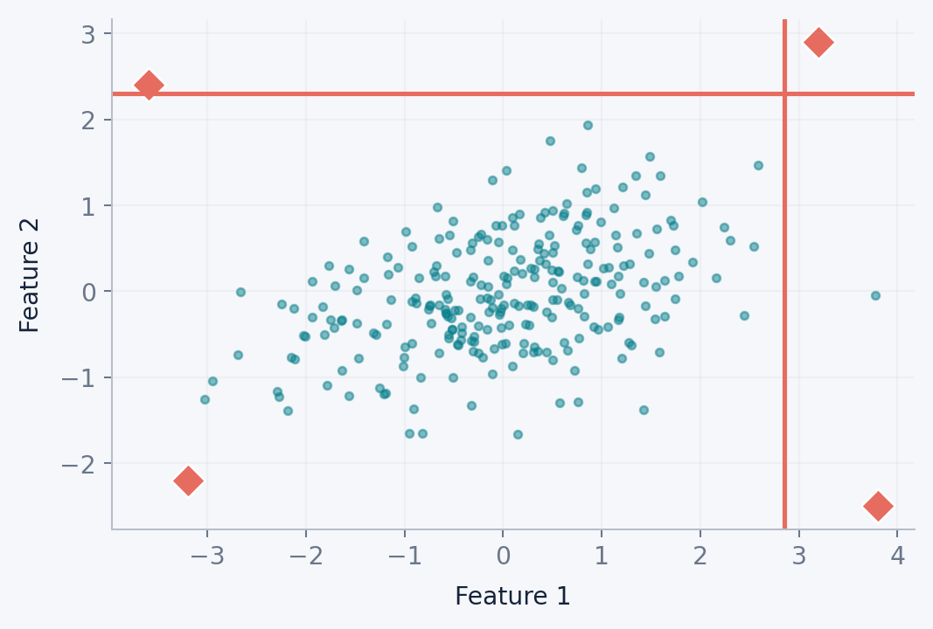
ANOMALY DETECTION
Isolation Forest, LOF, One-Class SVM
Three different definitions of unusual.
ALGORITHM INTUITION
Isolation Forest: short random split paths isolate anomalies
LOF: lower local density than neighbors
One-Class SVM: boundary around training distribution
DBSCAN noise: useful but density-dependent
KEY IDEA Scale and contamination assumptions matter; validate alerts using real outcomes.
UNSUPERVISED LEARNING / TECHNICAL MASTERCLASS
21
Notes:
Isolation Forest isolates anomalies with fewer random splits on average. LOF compares local reachability density with neighboring density. One-Class SVM learns a high-dimensional separating boundary under a kernel and hyperparameters. DBSCAN also labels noise, but is primarily a density-based clustering procedure. Original paper: Liu, Ting and Zhou, Isolation Forest, IEEE ICDM 2008.

Slide 22
EVALUATION
How to evaluate learning without target labels
Different tasks require different evidence—not a single accuracy score.
CLUSTERING
DIMENSION REDUCTION
Silhouette ↑ · Davies–Bouldin ↓
Stability, separation, interpretability
PCA explained variance / reconstruction
Neighbor trustworthiness for embeddings
ASSOCIATION RULES
ANOMALY DETECTION
Support, confidence, lift
Holdout frequency + actionable rules
Score distribution, alert burden
Precision/recall only if labeled cases exist
KEY IDEA External labels, when available, allow ARI/NMI or precision-recall—but are not required to fit.
UNSUPERVISED LEARNING / TECHNICAL MASTERCLASS
22
Notes:
Distinguish intrinsic/internal metrics from external metrics. Clustering: silhouette and Davies-Bouldin, plus domain validity and rerun stability; if ground truth labels are available, ARI or NMI compare assignments externally. PCA: explained variance and reconstruction error. t-SNE/UMAP: local trustworthiness and downstream utility. Association rules: holdout support/confidence/lift, statistical controls, action impact. Anomaly: labels enable precision, recall, PR-AUC; unlabeled deployment evaluates alert budget, stability and human review. Cross-validation as supervised stratified K-fold is not automatically appropriate for unsupervised tasks, though stability and held-out evaluation are possible.

Slide 23
PYTHON IMPLEMENTATION
Four unsupervised tasks, four Python patterns
Same discovery mindset; different input representation, model output and evaluation.
01
CLUSTERING
02
DIMENSIONALITY REDUCTION
K-Means
PCA
from sklearn.cluster import KMeans
labels = KMeans(n_clusters=4).fit_predict(X_scaled)
from sklearn.decomposition import PCA
X_2d = PCA(n_components=2).fit_transform(X_scaled)
Output: cluster membership
Output: transformed features
03
ASSOCIATION RULES
04
ANOMALY DETECTION
Apriori
Isolation Forest
from mlxtend.frequent_patterns import apriori
itemsets = apriori(basket_bool, min_support=0.1)
from sklearn.ensemble import IsolationForest
flags = IsolationForest().fit_predict(X_scaled)
Output: frequent itemsets
Output: +1 normal, −1 anomaly
Inputs are prepared separately: numeric feature matrix for K-Means / PCA / Isolation Forest; one-hot transaction basket for Apriori.
UNSUPERVISED LEARNING / TECHNICAL MASTERCLASS
23
Notes:
Explain this as a comparison of four unsupervised tasks, not a single executable script. X_scaled is a prepared numerical feature matrix; basket_bool is a transaction-by-item Boolean table. K-Means gives cluster labels; PCA transforms features; Apriori returns frequent itemsets (association rules can then be generated using mlxtend.frequent_patterns.association_rules); IsolationForest returns +1 for inliers and -1 for outliers. Different methods need different evaluation: clustering indices, explained variance and downstream stability, support/confidence/lift, and review or labeled validation for detected anomalies. The code snippets are illustrative rather than a shared runnable pipeline.

Slide 24
PRACTICAL APPLICATIONS
One learning paradigm, four business outcomes
Unlabeled data becomes useful only after patterns are validated and translated into decisions.
CLUSTER
REDUCE
Customer segmentation
Exploratory analysis
Identify behavior-based groups for tailored retention or engagement.
Compress complex feature spaces to investigate structure and redundancy.
Telecom: customer usage and support patterns
Retail: visualize multichannel customer profiles
ASSOCIATE
DETECT
Basket recommendations
Risk and quality review
Find frequently co-purchased products and relevant cross-sell opportunities.
Prioritize unusual transactions, sensor readings, or inconsistent records.
Retail: transaction-level bundles
Retail: spending anomalies for verification
Decision rule: validate patterns with domain expertise before production use.
UNSUPERVISED LEARNING / TECHNICAL MASTERCLASS
24
Notes:
Use one real-world story for each pillar. Clustering can find customer-behavior segments rather than predicting churn directly. PCA and other embeddings can help investigate many behavioral features, but a 2-D plot does not prove that clusters exist. Frequent itemsets and association rules require transaction-level basket data, not just customer aggregate features. Anomaly algorithms prioritize unusual observations for review; unusual does not automatically mean fraudulent. The telecom and omnichannel datasets are illustrative contexts only, not claimed performance benchmarks. Show that model output must be profiled, checked for stability and fairness, and tied to a decision before the business benefits.

Slide 25
EVALUATION & DECISION MAKING
Unsupervised learning: advantages and limitations
Powerful for discovery; not a substitute for validation, domain knowledge or clear objectives.
ADVANTAGES
LIMITATIONS
No labels needed
No universal accuracy
Explores large unlabeled datasets without manual target annotation.
Often lacks a single correct answer or objective ground truth.
Discovers the unexpected
Sensitive to design choices
Surfaces segments, patterns and outliers not specified in advance.
Scaling, distance, parameters and sampling change the results.
Useful representations
Interpretation is essential
Supports exploration, simplification and downstream models.
Clusters or anomalies are not automatically meaningful or causal.
Best practice: combine quantitative diagnostics, stability checks and domain review.
UNSUPERVISED LEARNING / TECHNICAL MASTERCLASS
25
Notes:
Advantages: unlabeled data can be explored even when trustworthy targets are unavailable; algorithms may reveal structure we did not explicitly hypothesize; and learned representations can assist other tasks. Limitations: there is often no unique ground truth; parameters, preprocessing, feature representation and random initialization can change outputs; apparent patterns may be artifacts; and business interpretation must avoid unjustified causal claims. Reinforce that evaluation should use task-specific internal metrics, stability testing, external evidence when available, and expert review. Transition to the final summary using the four pillars.

Slide 26
FROM RAW DATA TO DECISIONS
Discover. Validate. Act.
CLUSTER
REDUCE
Find natural groups
Make structure understandable
ASSOCIATE
DETECT
Discover recurring relationships
Investigate unusual behavior
QUESTIONS & DISCUSSION
Notes:
Close by returning to the four questions. A robust unsupervised workflow is not completed when an attractive embedding or cluster plot appears. It is completed when the discovered structure is reproducible, meaningful and operationally useful. Invite questions and be prepared to discuss scaling, metric selection, UMAP global geometry caveats and labels for evaluation.

