Slide 1
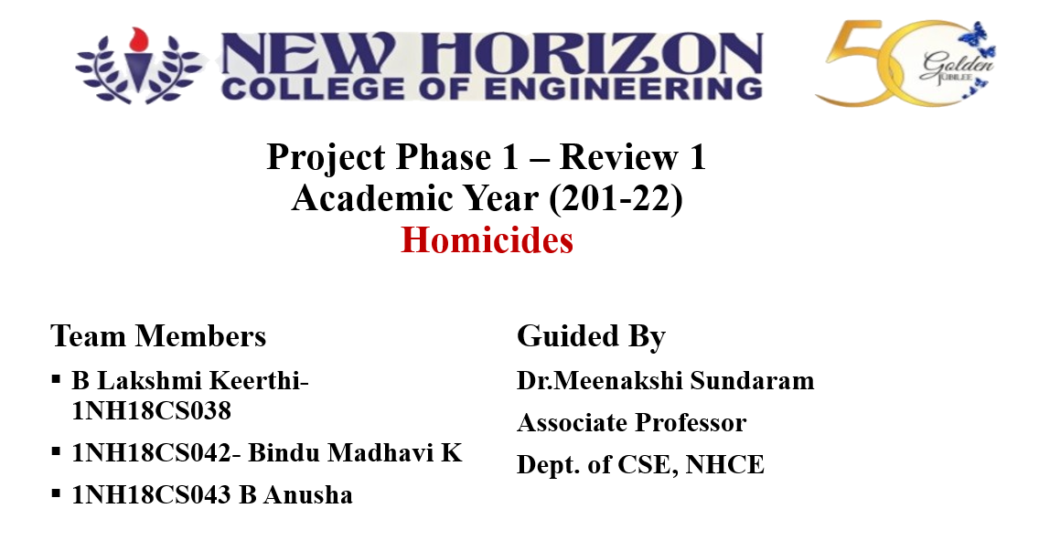

Slide 2
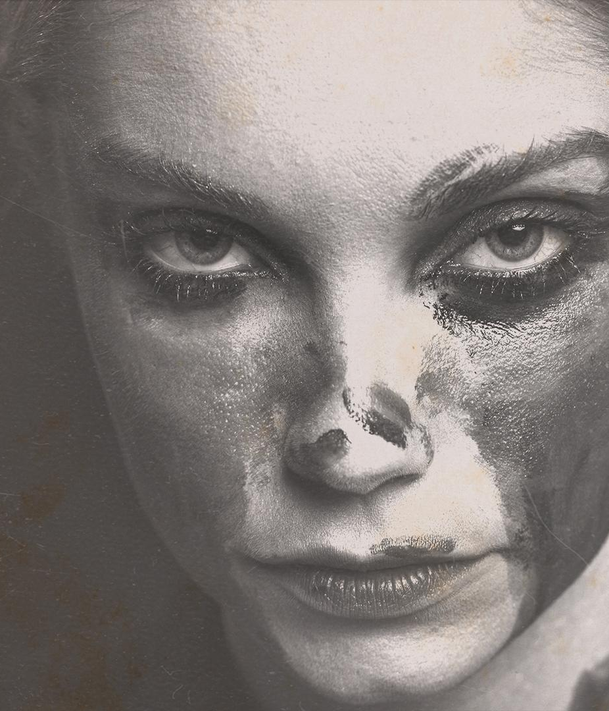
HOMICIDEs
Here is where your investigation begins

Slide 3
AGENDA
ABSTRACT
OBJECTIVES
PROBLEM STATEMENT
SYSTEM DESIGN DIAGRAM
SYSTEM REQUIRMENTS
FUTURE SCOPE
CONCLUSION

Slide 4
ABSTRACT
Crime is one of the most important associated dominating downside in our society and its statistics are important to analyze the future crime. This needs keeping track of all the crimes and maintaining an information for same which can be used needs for future reference. The current problem round-faced are maintaining of correct knowledge set of crime and analyzing this data to assist in predicting and resolution crimes in future.
The target of this project is to investigate dataset that consist of numerous crimes and predicting the style of crime which can happen in future relying upon varied conditions. The K-Nearest Neighbor (RNN & DNN) classification and varied alternative algorithms will be tested for crime prediction and one with higher accuracy will be used for training.
HOMICIDES

Slide 5
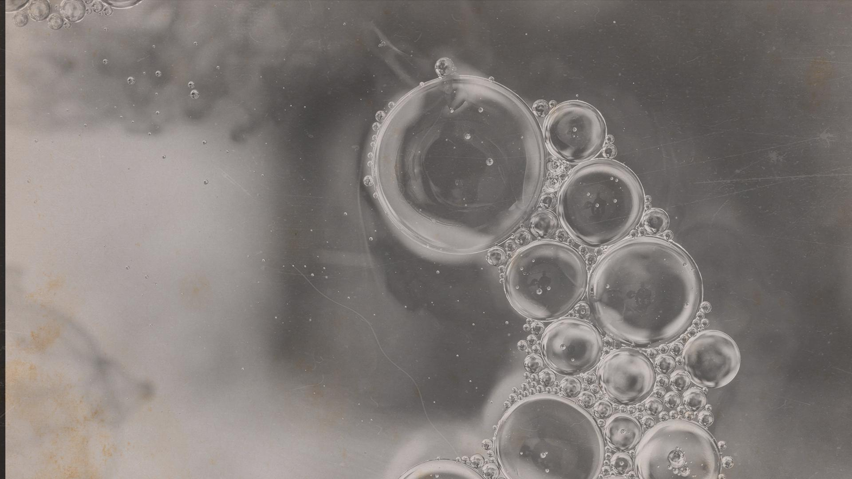
objective!
blood
The model classifies the people into Crime and Crime Free.
Proposed system gives better decisions and also improvises the business.
Proposed system makes use of data science technique “classification rules” for detecting crime among individuals.
Major objective is to identify the peoples who are in crime using data science techniques.

Slide 6
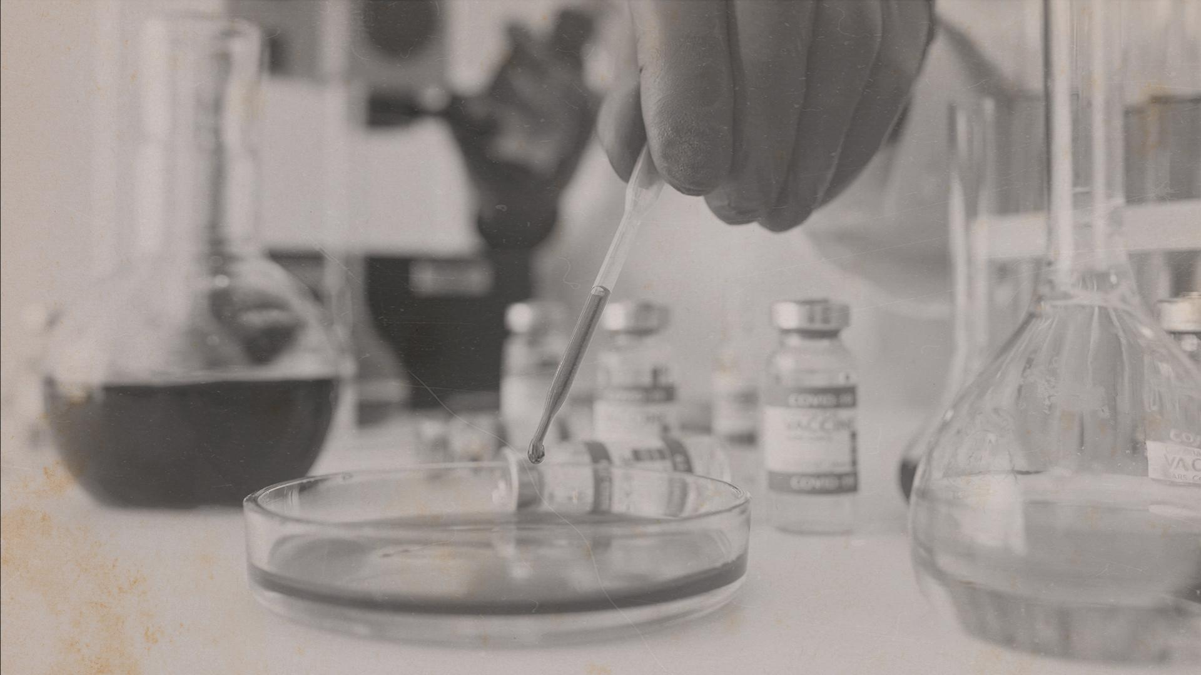
PROBLEM STATEMENT
Crime detection in every individual based on their profile and behavior is a challenging task in the current sector. Current system is a manual process where it is difficult to identify the crime in the individuals. There is no automation for this type of crime detection.
So, this project helps them, an introvert may believe that going through an experience in great detail will eventually result in figuring out what went wrong according to those suggestions will be given and help them from crimes.
CRIME

Slide 7
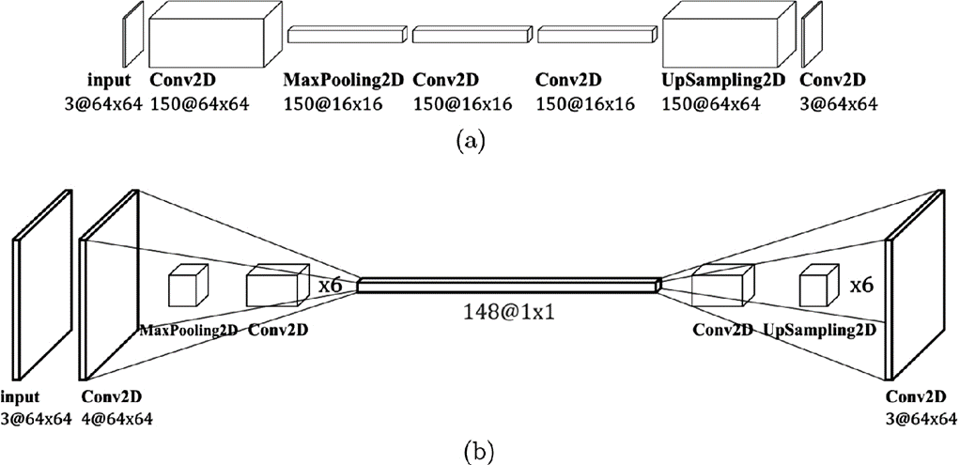
SYSTEM DESIGIN DIAGRAM

Slide 8
SYSTEM REQUIREMENT
Processor | Intel I3 onwards
Processor Speed | 2.4GHz
RAM | 2GB+
Hard Disk Space | 4GB
H/W Requirement

Slide 9
SYSTEM REQUIREMENT
Operating System | Windows
Design Tool | Pycharm
Front End | Python
Language | Python
SQL Server | SQL Server
Data Access Technology | SQL
S/W Requirement

Slide 10
FUTURE SCOPE
Additional methods like the Naive Bayes classifier can be used to test the efficiency of the model. One can implement deep learning techniques like CNN (Convoluted Neural Networks) and verify how the model performs for the given datasets.
A much more specific and vaster dataset can be used as a training model since the number of responses is limited in our case.
Machine learning is a subject to predict future based on past data. Using machine learning techniques, we predict peoples stress level and also proposed system will give suggestions based on the stress levels of peoples

Slide 11
CONCLUSION
This project helps in detecting the crime levels due to various parameters considered through a survey and it also lists whether the society is crime-free or crimeful and the range of their crime levels.
So, this project helps them, an introvert may believe that going through an experience in great detail will eventually result in figuring out what went wrong according to those suggestions will be given and help them from crime.

Slide 12
THANK YOU
CLUE!

