Slide 1

Auto-app That Helps Customers Understand Different Automobile Models

Slide 2

AGENDA
Stakeholders
Project Description
Product Vision
Goals
Increment
Product Roadmap
Conclusion

Slide 3
Stakeholders
Customers/Consumers
Automobile Manufacturers/Brands
Investors/Shareholders
Regulatory Authorities
Dealerships

Slide 4
Project Description
In today’s world, the automobile industry has various consumers which are repeatedly overwhelmed by the large number of car models, features, performance, and specifications. Where this auto-app aims to provide a user-friendly application for customers to evaluate various models based on the user preferences and requirements. The app will provide complete information about each model, such as cost, features, performance, ratings, and user reviews.

Slide 5
Product Vision
Our vision is to revolutionize the automotive research and purchasing experience by creating a mobile application that empowers consumers with unparalleled access to vehicle information and insights.
We aim to set a new industry standard for transparency, convenience, and personalization, guiding users through every stage of the vehicle ownership journey.
Ultimately, we strive to transform the way people research, compare, and purchase vehicles, putting consumers in the driver's seat and equipping them with the tools they need to navigate the automotive market with confidence.

Slide 6







Goals
User-friendly Interface
In-depth performance analysis
Facilitate Brand Comparisons
Enhance the Overall Car-Buying Experience
Continuous improvement and innovation
Differentiation
Drive Sales and Leads

Slide 7
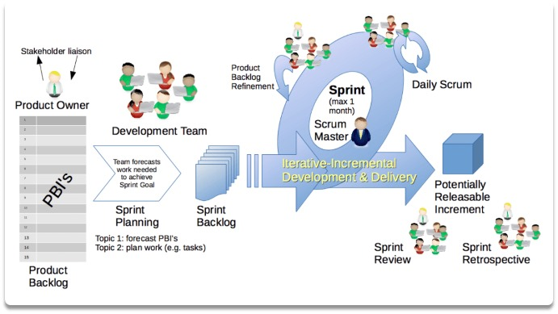
Lifecycle of Increment

Slide 8
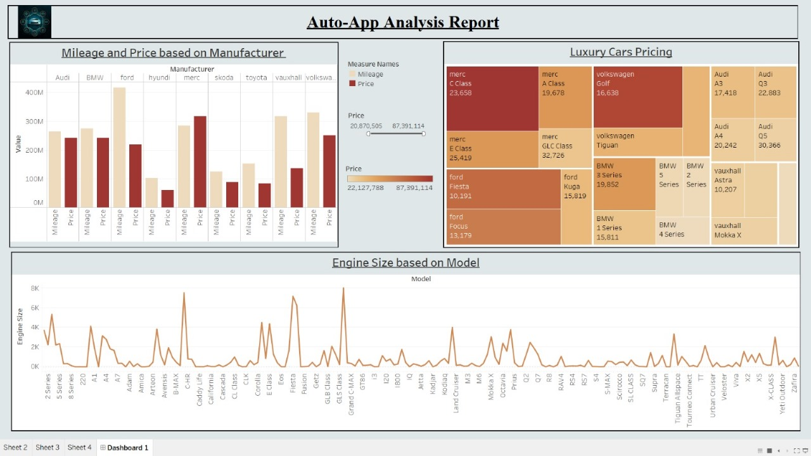
Dashboard of the Increment

Slide 9
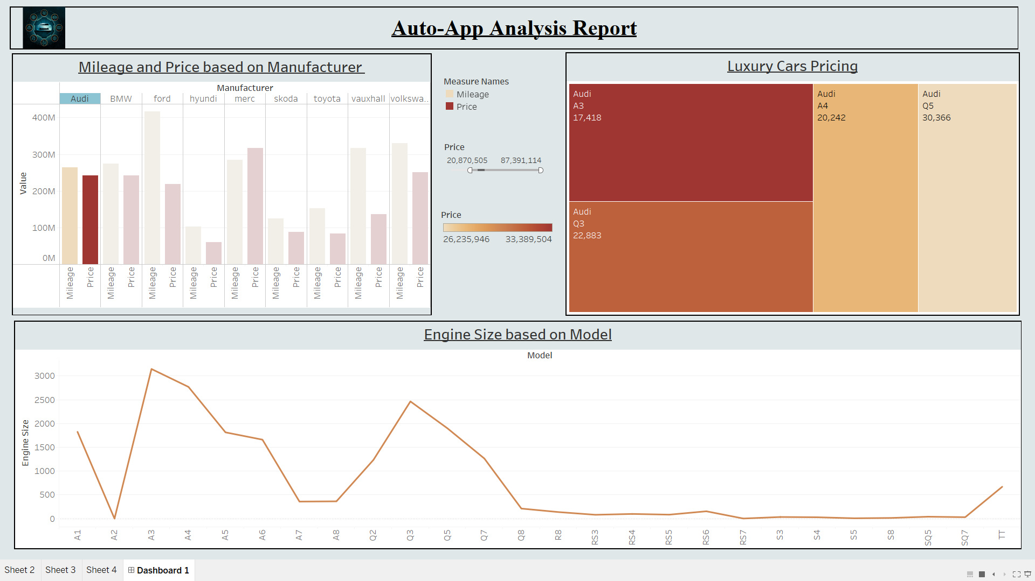

Slide 10

Product Roadmap
Q5
Q4
Q3
Q2
Q1

Slide 11
Q1:
Research and Requirements Gathering
Duration: 4 Weeks
Activities:
Market Research
User Interviews
Competitor Analysis
Requirement Documentation
Deliverables:
User Personas
Journey Maps
Market Trends Analysis
Q2:
Design and Prototyping
Duration: 6 weeks
Activities:
Wireframing
UI/UX Design
Prototyping
Usability Testing
Deliverables:
Mockups
Interactive Prototypes
Usability Test Reports

Slide 12
Q3:
Development and Testing
Duration: 12 weeks
Activities:
Frontend Development
Backend Development
Integration Testing
User Acceptance Testing
Deliverables:
Functional Features
Test Reports
Bug Fixes
Q4:
Phase 1: Deployment and Launch
Duration: 4 weeks
Activities:
App Store Submission
Marketing Campaigns
User Onboarding
Launch Events
Deliverables:
App Release
Marketing Materials
User Guides
Q4:
Phase 2: Continuous Improvement and Iterative Updates
Duration: Ongoing
Activities:
User Feedback Collection
Data Analysis
Feature Enhancements
Bug Fixes
Deliverables:
Updated Features
Performance Reports
Release Notes

Slide 13
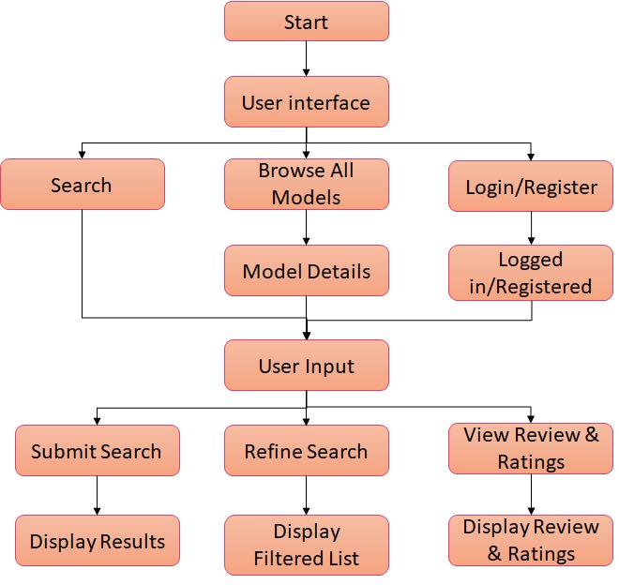
Design of Product

Slide 14
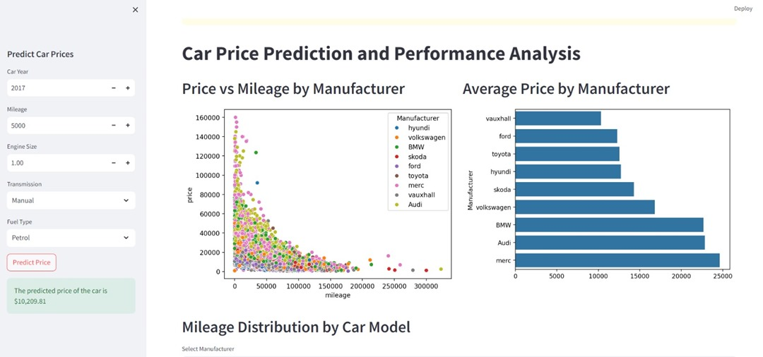

Slide 15
Conclusion
To summarize, our automobile app is the go-to tool for anyone looking to learn about different automobile types. Users may choose the best car for them based on clear information, interactive features, and comparison. It's easy to use and constantly updated, making car shopping fun. Whether you're looking for features, performance, or pricing, our app has you covered. Our goal is to make car buying simple and informative for everyone.

Slide 16
THANK YOU

