Slide 1

DENTRICKS

Slide 2
Introduction
Dentricks is a web-based dental clinic management system designed to simplify appointment booking, service management, and patient interactions. Patients can register, log in, book or cancel appointments, view services, check doctor availability, and submit feedback. The admin can manage doctors, services, and appointments while viewing patient feedback. By automating key tasks, Dentricks enhances efficiency, reduces manual workload, and improves patient experience, making it a valuable tool for modern dental clinics.

Slide 3
DATA FLOW DAIGRAM(DFD)
A Data Flow Diagram is the graphical representation of the data through an information system, modelling its process aspects. A DFD also known as bubble chart or dataflow graph are commonly used during problem analysis. DFD’S are very useful in understanding a
system and can be efficiently used during analysis. A DFD will show what kind of information will be input to and output from the system, how the data will advance through the system, and where the data will be stored it does not show information about process timing or
whether process will operate in sequence or in parallel format, a DFD is often used as the
preliminary step to create an overview of the system without going into great detail, which can later be elaborated, it can also be used for the visualization of data processing DFD shows the movement of data through different transformations or process in the system

Slide 7
USE CASE DIAGRAM
A use case diagram is a graphic depiction of the interactions among the elements of a system. It is a methodology used in system analysis to identify, clarify and organize system requirements. A use case diagram does not show the detail of the use case, it only summarizes some of the relationships between use case and the actors. In particular, the diagram does not show the order in which steps are performed to achieve the goals of each use case. It deals only with the functional requirement of the system. Use case diagrams are usually referred to as behavior diagrams, which is used to describe set of actions that systems should or can perform in collaboration with one or more external users of the system ie Actors. Each use case should provide one or more observable and valuable result to the actor

Slide 8
Login
n

Slide 9
Entity Relationship Diagram(ERD)
An Entity relationship diagram(ERD) is a data modelling technique that graphically illustrates information system’s entities and the relationship between those entities. An ERD is a conceptual and representational model of data used to represent the entity frame work infrastructure

Slide 10
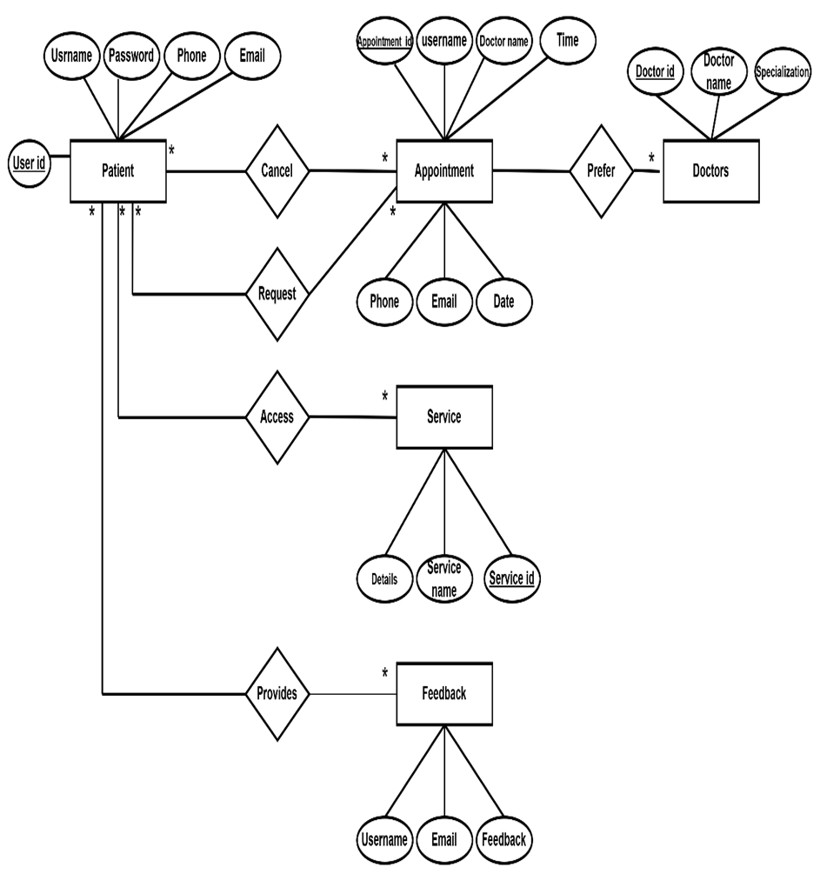

Slide 11
Table Description

Slide 12
Table name: admins
Table description: This table is used to store the details of the Admin
Column name | Type | Size | Constraints | Description
id | int | 10 | Primary key | Unique id given to the admin
Name | varchar | 50 | Not null | Username of the admin
Password | varchar | 255 | Not null | Password of the Admin

Slide 13
Table name: doctors
Table description: This table is used to store the details of doctors.
Column name | Type | Size | Constraints | Description
id | int | 11 | Foreign key | Unique id given to the user
name | varchar | 50 | Not null | Name of the doctor
specialization | varchar | 100 | Not null | Education of the doctor.
phone | varchar | 20 | Not null | Phone number of the doctor
email | varchar | 100 | Not null | Email address of the doctor
bio | text |  | Null | Details of the doctor

Slide 14
Table name: patients
Table description: This table is used to store the details of the patients.
Column name | Type | Size | Constraints | Description
id | int | 11 | Primary key | Unique id given to the patient.
full_name | varchar | 100 | Not null | Username of the patient.
Password | varchar | 255 | Not null | Password of the patient
phone | varchar | 15 | Not null | Phone number of the patient
email | varchar | 100 | Not null | Email address of the patients
address | address | 255 | Not null | Address of the pateint
gender | enum | (“male”,”f emale”,”ot her”) | Not null | Gender of the pateint
date_pf_birth | date |  | Not null | Date of birth of the patient.
registration_date | timestamp |  | Not null | Date of registration

Slide 15
Table name: appointments.
Table description: This table is used to store the details of Appointment booking
Column name | Type | Size | Constraints | Description
id | int | 11 | Primary key | Unique id given to the patient to book appointment
patient_name | varchar | 100 | Not null | Name of patient
email | varchar | 100 | Not null | Email address of the patient
appointment-time | varchar | 20 | Not null | Preferred time for the patient to consult
doctor | varchar | 50 | Not null | Name of the doctor
phone | varrchar | 12 | Not null | Phone number of the patient
apponitment_date | date | 20 | Not null | Preferred date for the patient to consult
status | enum | (“pending” ,”confirmed”,completed”,”canceled”) | Not null | Status of Appointment

Slide 16
Table name: services
Table description: This table is used to store the details of services
Column name | Type | Size | Constraints | Description
id | int | 11 | Primary key | Unique id of the service
services_name | varchar | 255 | Not null | Name of the service
description | text |  | Not null | Details of the service
photo | varchar | 255 | Not null | Related photo of the service

Slide 17
Table name: feedback
Table description: This table is used to store the details of feedback.
Column name | Type | Size | Constraints | Description
id | int | 11 | Primary key | Unique id given to the patient to send feedback
name | varchar | 255 | Not null | Name of patient
email | varchar | 255 | Not null | Email address of the patient
feedback | text |  | Not null | The feedback sent by the patient

Slide 18
TEST CASE & VALIDATION

Slide 19
Registration page
Test Case ID | Test Condition | Expected Result | Test Result
1 | field is empty | Please fill in the field. | Success
2 | Phone number less than 10 numbers | Phone number must be exactly 10 digits and only contain numbers. | Success
3 | Invalid email id | please enter a valid email id . | Success
4 | Invalid user name | User name must contain only alphabetic characters and space. | Success
5 | Below 18yr old | You must be 18 or older to register. | Success
6 | Password below 6 characters | Password must be at least 6 characters and match the confirmation. | Success
7 | Valid inputs | Registration successful | Success

Slide 20
Login page
Test Case ID | Test Condition | Expected Result | Test Result
1 | Field is empty | Please fill in the field. | Success
2 | Provide unregistered username | No user found with this user name | Success
3 | Wrong password | Invalid password | Success

Slide 21
Book appointment
Test Case ID | Test Condition | Expected Result | Test Result
1 | Field is empty | Please fill in the field. | Success
2 | Empty doctor field | Please select an item in the list | Success
3 | Empty preferred time | Please select an item in the list | Success
4 | Valid inputs | Appointment booked successfully | Success
5 | Phone number less than 10 numbers | Phone number must be exactly 10 digits and only contain numbers. | Success
6 | Invalid email id | please enter a valid email id . | Success
7 | Invalid user name | User name must contain only alphabetic characters and space. | Success

Slide 22
Update Profile
Test Case ID | Test Condition | Expected Result | Test Result
1 | field is empty | Please fill in the field. | Success
2 | Phone number less than 10 numbers | Phone number must be exactly 10 digits and only contain numbers. | Success
3 | Invalid email id | please enter a valid email id . | Success
4 | Invalid user name | User name must contain only alphabetic characters and space. | Success
5 | Below 18yr old | You must be 18 or older to register. | Success
6 | Password below 6 characters | Password must be at least 6 characters and match the confirmation. | Success
7 | Valid inputs | Updated successfully | Success

Slide 23
Feedback
Test Case ID | Test Condition | Expected Result | Test Result
1 | field is empty | Please fill in the field. | Success
2 | Invalid user name | User name must contain only alphabetic characters and space. | Success
3 | Valid inputs | Feedback submitted successfully | Success

Slide 24
Reset Password
Test Case ID | Test Condition | Expected Result | Test Result
1 | field is empty | Please fill in the field. | Success
2 | Wrong confirmation password | Password do not match | Success
3 | Password below 6 characters | New password must be at least 6 characters long | Success

Slide 25
Admin login
Test Case ID | Test Condition | Expected Result | Test Result
1 | Field is empty | Please fill in the field. | Success
2 | Provide unregistered username | No user found with this user name | Success
3 | Wrong password | Invalid credential | Success

Slide 26
Admin Setting Management
Test Case ID | Test Condition | Expected Result | Test Result
1 | field is empty | Please fill in the field. | Success
2 | Invalid user name | User name must contain only alphabetic characters and space. | Success
3 | Valid inputs | Setting updated successfully | Success
4 | Password below 6 characters | New password must be at least 6 characters long | Success
5 | Wrong confirmation password | Password do not match | Success

Slide 27
THANKYOU

