Slide 1

IBM HACKATHON PROJECT
COLLEGE ADMISSION AGENT
edunet
foundation

Slide 2
OUTLINE
■ Problem Statement
■ Technology used
■ Wow factor
■ End users
■ Result
■ Conclusion
■ Git-hub Link
■ Future scope
■ IBM Certifications
edunet
foundation

Slide 3
PROBLEM STATEMENT
■ Students seeking college admission are often overwhelmed with a vast amount of scattered and complex information regarding admission processes, eligibility criteria, application deadlines, required documents, entrance exams, and college-specific regulations. Manually browsing multiple college websites or portals is time-consuming and can lead to missed opportunities or errors in application.
edunet
foundation

Slide 4
PROBLEM STATEMENT
■ We created a College Admission Agent— a smart virtual assistant that acts like your Step-by-Step Workflow It:
■ User Query Input: Student types a question (e.g., "What is the cutoff for B.Tech in PES University?").
■ Semantic Understanding:The system converts the query into a vector (embedding) to understand its meaning.
■ Document Retrieval:The retriever searches a vector database (e.g., FAISS, Pinecone, or Chroma) to find the most relevant chunks of admission data.
edunet
foundation

Slide 5
TECHNOLOGY USED
■ We built the agent using the various technology provided by IBM Cloud Service with the Lite version.
■ IBM Watsonx AI Studio — to develop and train the AI
■ Natural Language Processing (NLP) — so it understands your queries naturally
■ Retrieval-Augmented Generation (RAG) — to find the best answers from trusted nutrition data
■ The IBM Granite Language Model — for smart, human-like responses
■ APIs to connect with health trackers or wearable devices
■ Tools - Google search, duckduckgo, Wikipedia search, webcrawler.
edunet
foundation

Slide 6
IBM CLOUD SERVICES USED
■ IBM Cloud Watsonx AI Runtime :
It provides a secure, scalable environment to deploy and run AI models in production. It makes sure your AI models run reliably and deliver fast, accurate responses to real users — whether you have 10 or 10 million requests.
■ IBM Cloud Watsonx AI Studio :
It is a collaborative environment where you can build, train, and fine-tune AI models with powerful tools and ready-made datasets. It lets developers and data scientists work together to turn ideas into AI-powered solutions — all in the cloud, with minimal setup.
■ IBM Cloud Agent Lab :
It is an interactive sandbox where you can design, test, and manage AI-powered agents — like your Nutrition Assistant! It helps you connect different AI services, fine-tune conversations, and see how your agent responds in real time before launching it live.
■ IBM Granite Foundation Model :
It is a large, pre-trained language model that understands natural language and generates human-like responses. It's AI Agent's ability to understand questions, retrieve relevant nutrition info, and give clear, conversational answers.
edunet
foundation

Slide 7
IBM CLOUD SERVICES USED
■ Lets see how the flow takes place:
Step 1: You chat with the agent — Student asks a question
Step 2: Query goes to backend -— Sent via API (hosted on IBM Code Engine).
Step 3: Query is converted to vector---Using embedding models (e.g., Watsonx Embeddings ).
Step 4: Generate answer- Sent to IBM Watsonx.ai (Granite or open model). Model gives a clear answer.
Step 5: Show answer to student --Chatbot displays reply + source link (optional).
Step 6: Log and update --Logs saved in IBM Cloud Databases.New data fetched using IBM Cloud Functions.
edunet
foundation

Slide 8
WOW FACTORS
► Students can ask questions like they talk—no need for exact keywords.
► Combines document search with smart AI-generated answers.
► Pulls information from official college websites and PDFs only.
► Adjusts answers based on course, category, marks, and location.
► Gives info for many colleges in one place—no need to search separately.
► Remembers the conversation and gives follow-up answers.
► Regularly refreshes college info using IBM Cloud Functions.
► Secure, scalable, and uses Watsonx, Code Engine, and Object Storage.
► Works with PDFs, webpages, and scraped documents.
► Can be expanded to support speech and regional languages
edunet
foundation

Slide 9
END USERS
■ Anyone who cares about eating right — from individuals and families to dietitians and wellness coaches. Empowering everyday people and professionals with smarter, tailored nutrition guidance,
> Students (Class 12 & UG Aspirants)
> Main users looking for college admission details, eligibility, cutoffs, etc.Want quick and reliable information to guide their children's career path.
> College Admission Seekers (Lateral Entry, PG, etc.)
> Students seeking admission to 2nd-year programs or postgraduate courses.
> School/College CounselorsUse the tool to assist multiple students during career guidance sessions.
> Coaching Institutes & Career CentersIntegrate the chatbot to help students choose and apply to colleges.
> College Admission Offices (as internal use) Use the bot to handle repetitive queries from students and reduce workload.
> Developers / Startups in EdTech Use this project as a base for building commercial EdTech tools.
> Government Education Portals (optional integration)
edunet
foundation

Slide 10
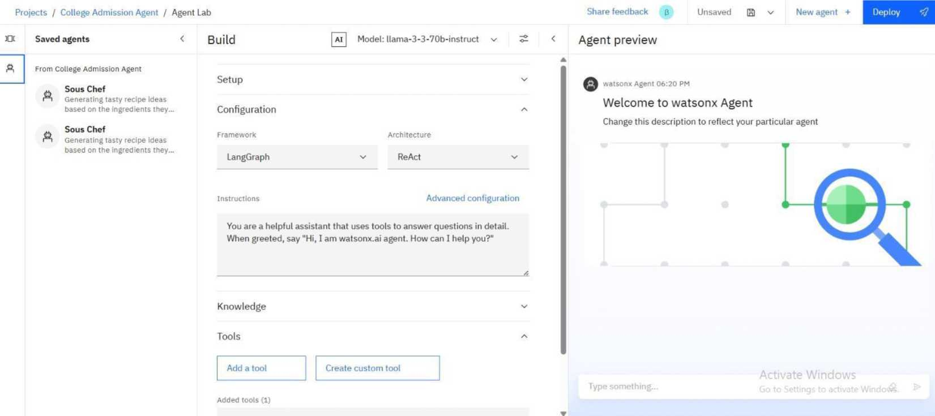
RESULTS
edunet
foundation

Slide 11
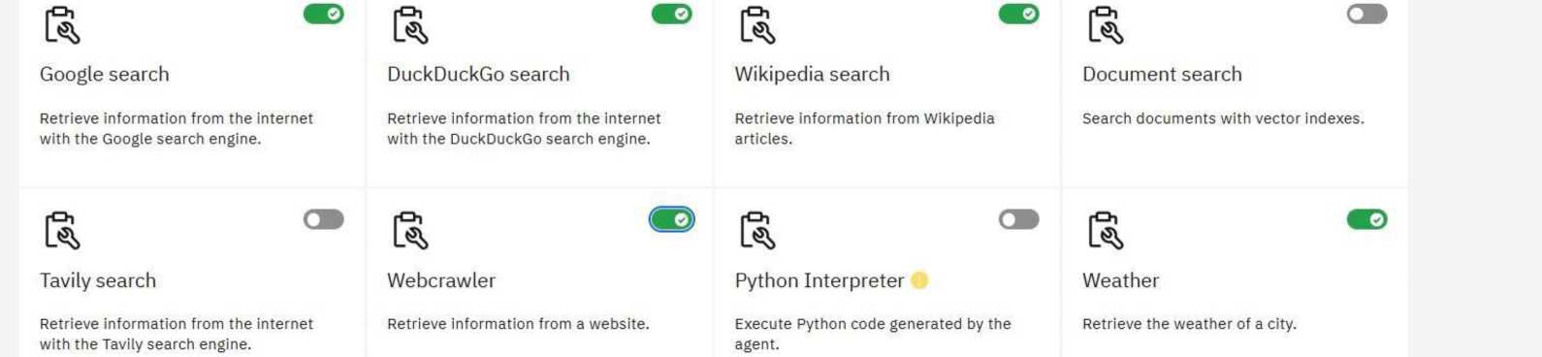
RESULTS
Select a tool
Choose a tool to add to your agent.
Q Search for a tool
Activa
Go to Se
edunet
foundation

Slide 12
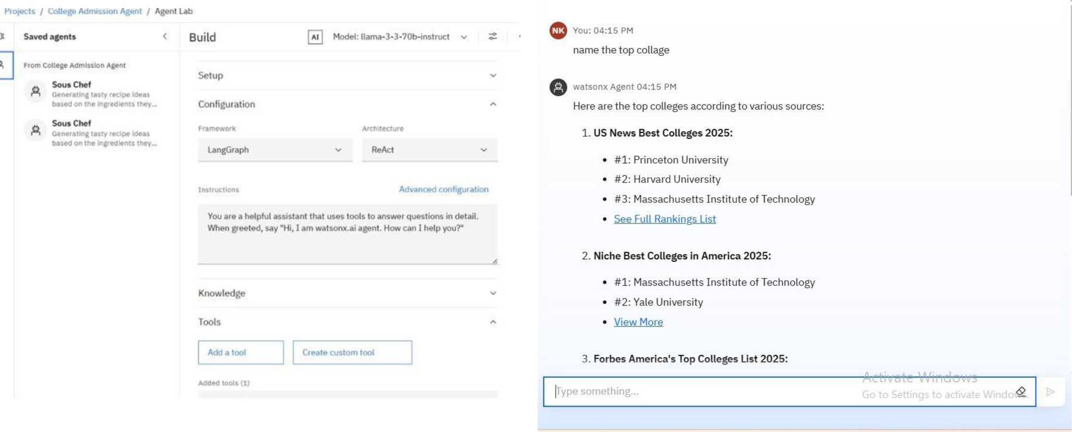
RESULTS : Final preview of my college admission Agent
edunet
foundation

Slide 13
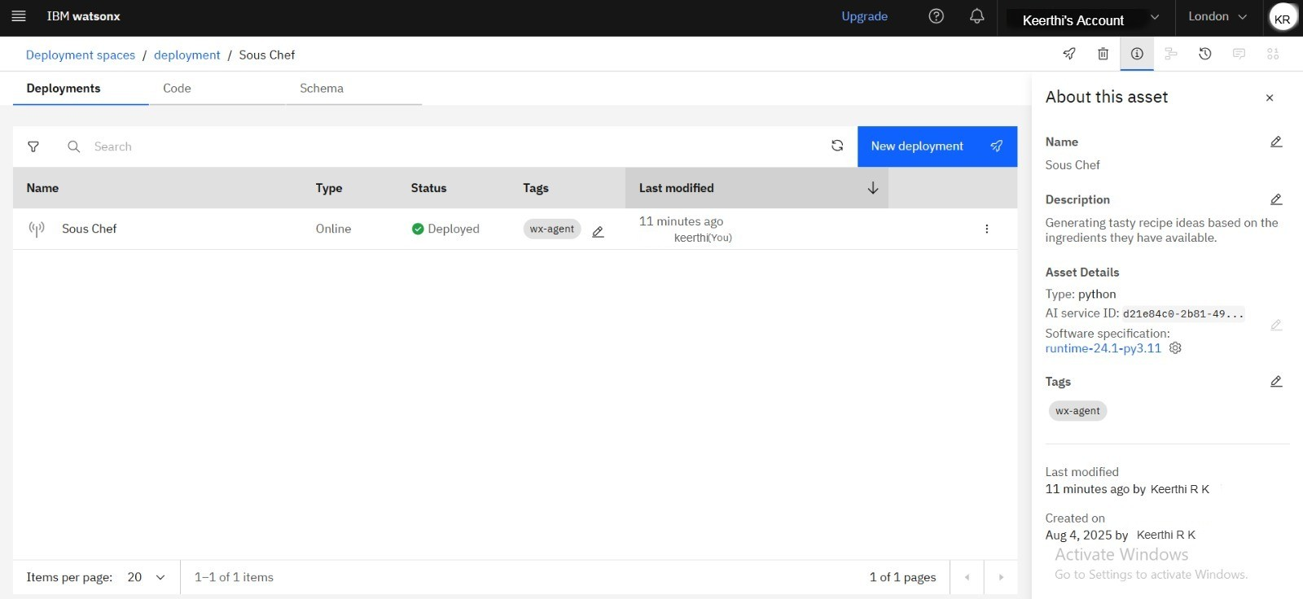
RESULTS
Deployed AI Agent

Slide 14
CONCLUSION
■ The College Admission Agent powered by Retrieval-Augmented Generation (RAG) offers an intelligent, scalable, and user-friendly solution to simplify the college admission process for students. By integrating document retrieval with powerful language models, the system delivers accurate, personalized, and up-to-date responses based on verified data sources.
■ It reduces the time and effort required to navigate multiple college websites, eliminates confusion caused by scattered information, and empowers students with clear guidance in their decision-making journey.
■ With its future-ready architecture, support for multilingual queries, and integration with IBM Cloud services, this agent sets a strong foundation for building advanced EdTech applications that can benefit students, parents, and institutions at scale.
edunet
foundation

Slide 15
FUTURE SCOPE
■ Voice and Multilingual Support
► Enable students to ask questions in regional languages or via voice input.
■ Mobile App Integration
► Develop an Android/iOS app for easy access on smartphones.
■ Personalized College Recommendations
► Suggest suitable colleges based on user profile, marks, and preferences.
■ Admission Alerts & Reminders
► Notify users about deadlines, entrance exams, and result dates.
■ WhatsApp/Telegram Bot
► Allow students to chat with the agent through popular messaging apps.
edunet
foundation

Slide 16
GITHUB LINK
■ I have completed and uploaded my project details in my Github account.
■ Github link : https://github.com/Keerthi20740/Admission-Agent-.git
■ Admission Agent imagesI have attached few snapshots of my Agent development, preview and deployment stages, ppt of my project, as well as the readmd file.
edunet
foundation

Slide 17
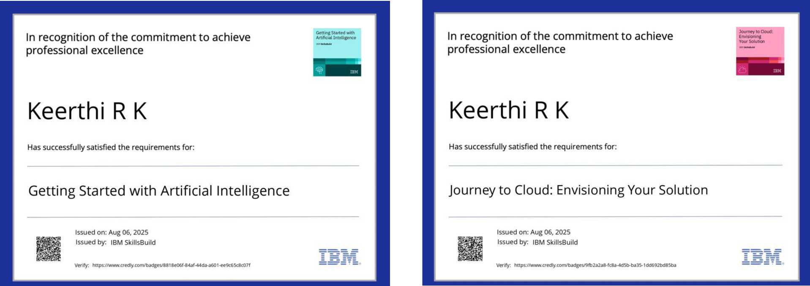
IBM CERTIFICATIONS
Here is my Getting Started with Artificial Intelligence of Credly.
edunet
foundation

Slide 18
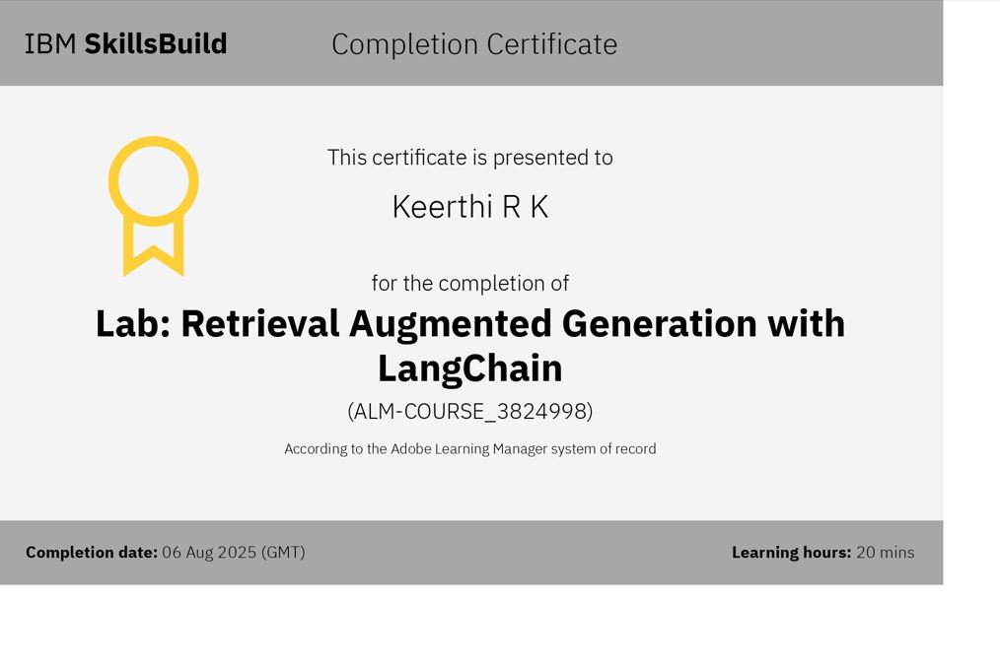
IBM CERTIFICATIONS
Here is my IBM Certificate of Retrieval Augmented Generation with LangChain
edunet
foundation

Slide 19
I I
THANK YOU
edunet
foundation

