Slide 1

Design and Analysis of Algorithms
Visual walkthroughs: sorting, greedy, dynamic programming, backtracking and branch and bound
Notes:
Introduce the topic: seven visual walkthroughs covering the main algorithm design paradigms from the DAA syllabus.
1

Slide 2
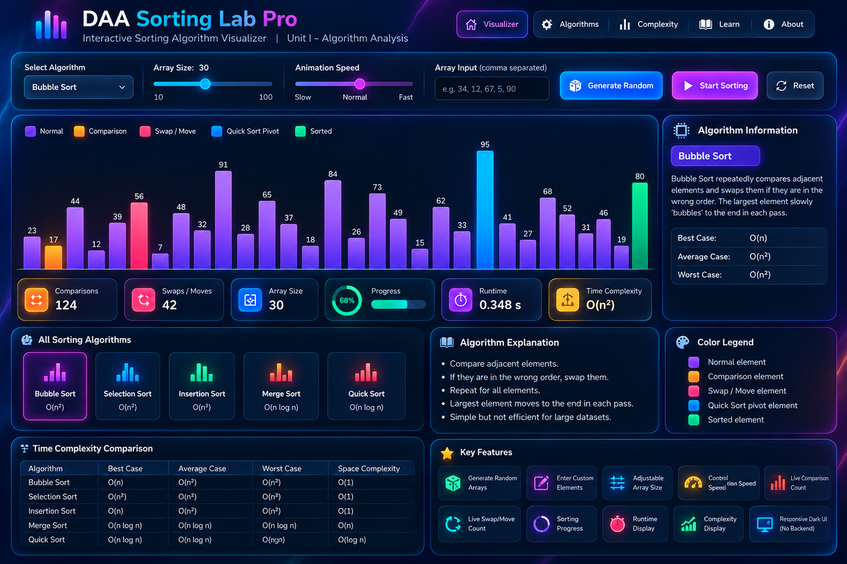
Sorting Algorithm Visualizer
5
sorting algorithms compared
  Bubble, Selection and Insertion Sort are O(n²) on average
  Merge and Quick Sort are O(n log n) on average
  Colors show comparisons, swaps, the pivot and sorted elements
  Live counters track comparisons, swaps and runtime
2
Notes:
The visualizer runs Bubble Sort on 30 elements: 124 comparisons and 42 swaps so far. The table at the bottom compares best, average and worst case plus space complexity.
2

Slide 3
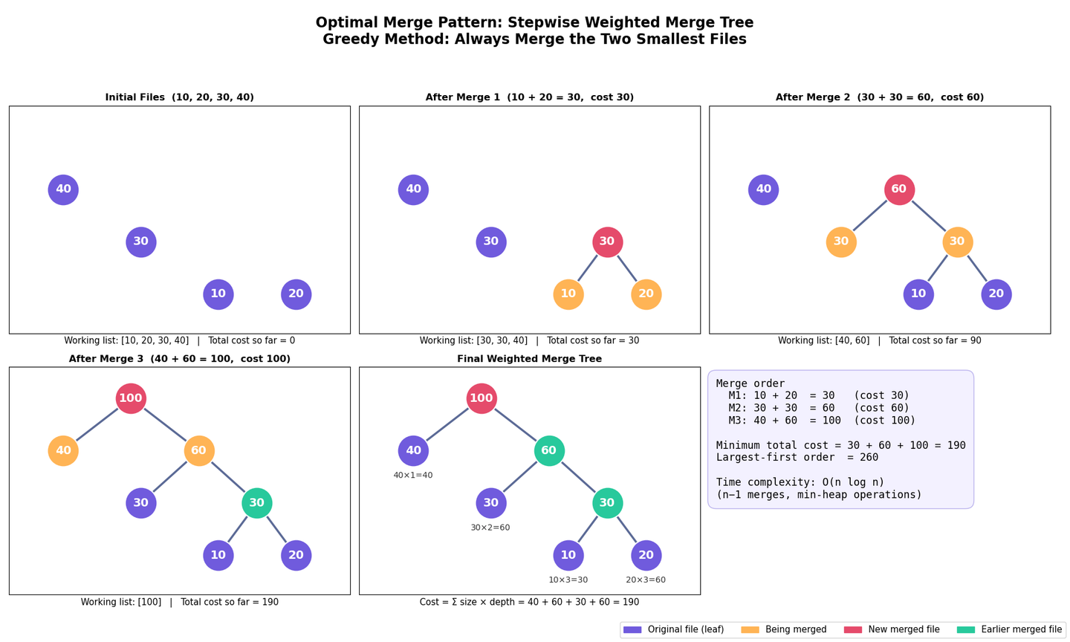
Optimal Merge Pattern
190
minimum total merge cost
  Greedy rule: always merge the two smallest files
  Files 10, 20, 30, 40 merge as 30, then 60, then 100
  Merging the largest files first would cost 260
  A min-heap gives O(n log n) time
3
Notes:
Cost = 30 + 60 + 100 = 190. Equivalent view: sum of file size times depth in the merge tree (40x1 + 30x2 + 10x3 + 20x3 = 190).
3

Slide 4
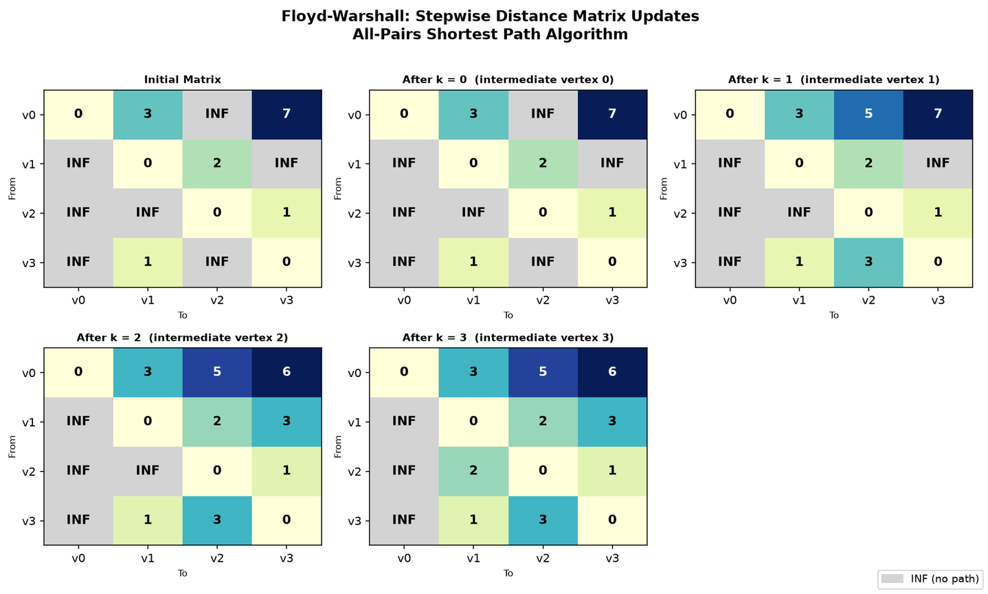
Floyd-Warshall: All-Pairs Shortest Paths
O(V³)
time, with O(V²) space
  dist[i][j] = min(dist[i][j], dist[i][k] + dist[k][j])
  Each step k allows vertex k as an intermediate stop
  Here k = 0 changes nothing; k = 1, 2 and 3 each improve entries
  Column v0 stays INF because no vertex can reach v0
4
Notes:
Walk through the matrices left to right, top to bottom. k=1 gives v0 to v2 = 5 and v3 to v2 = 3. k=2 gives v0 to v3 = 6 and v1 to v3 = 3. k=3 gives v2 to v1 = 2.
4

Slide 5
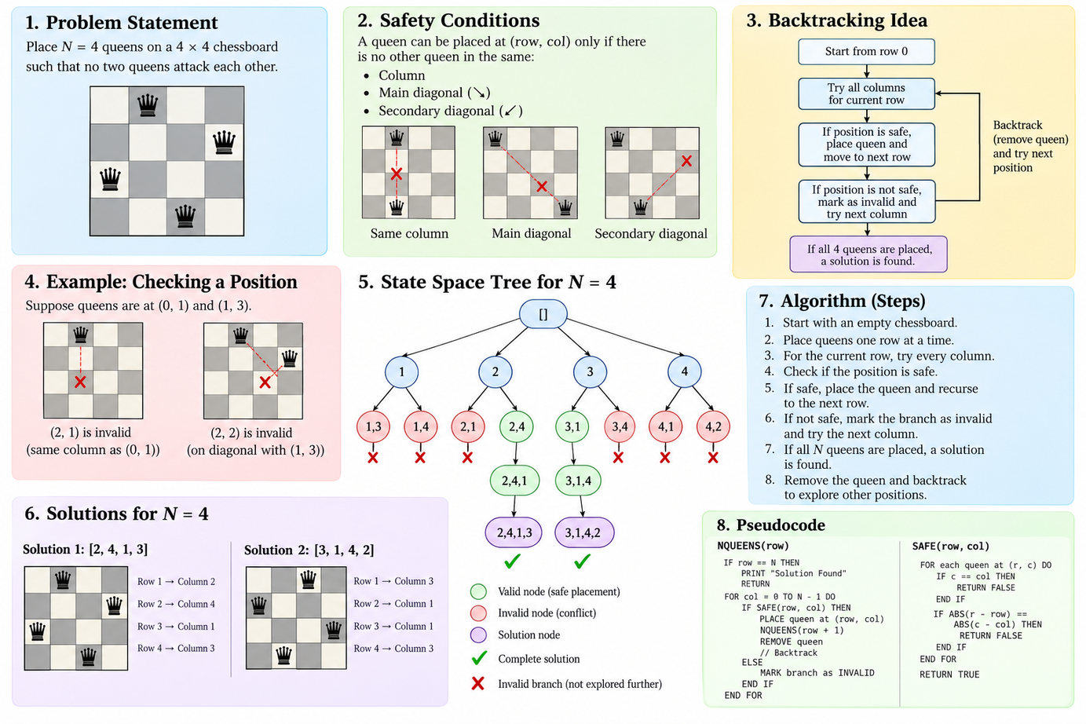
N-Queens Problem: Overview
2
solutions for N = 4
  No two queens may share a column or a diagonal
  Place one queen per row and try each column
  Skip unsafe squares; backtrack when a row has no safe square
  Solutions: [2, 4, 1, 3] and [3, 1, 4, 2]
5
Notes:
One-page summary: problem, safety conditions, backtracking idea, a position check example, the state space tree, solutions, steps and pseudocode.
5

Slide 6
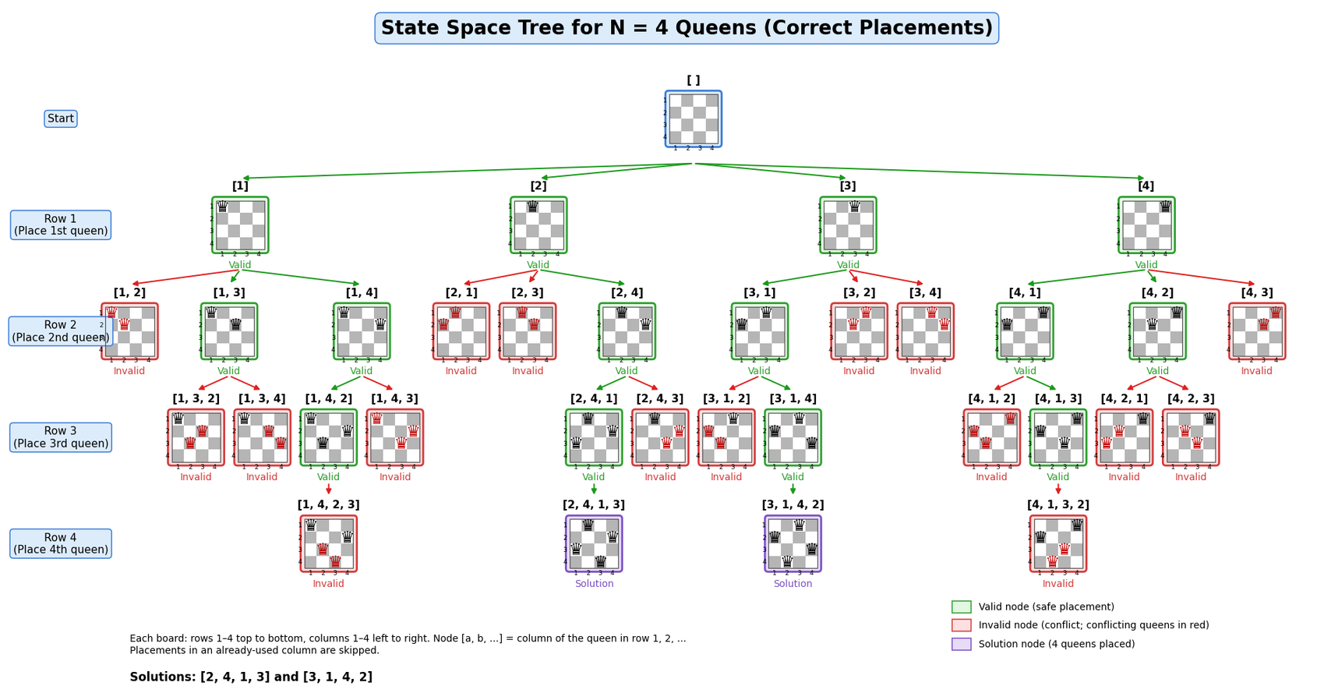
N-Queens: State Space Tree (N = 4)
Solutions found: [2, 4, 1, 3] and [3, 1, 4, 2]. Red nodes are conflicts that get pruned.
6
Notes:
Green nodes are safe placements, red nodes have a conflict, purple nodes are complete solutions. Only two of the leaf paths reach four queens.
6

Slide 7
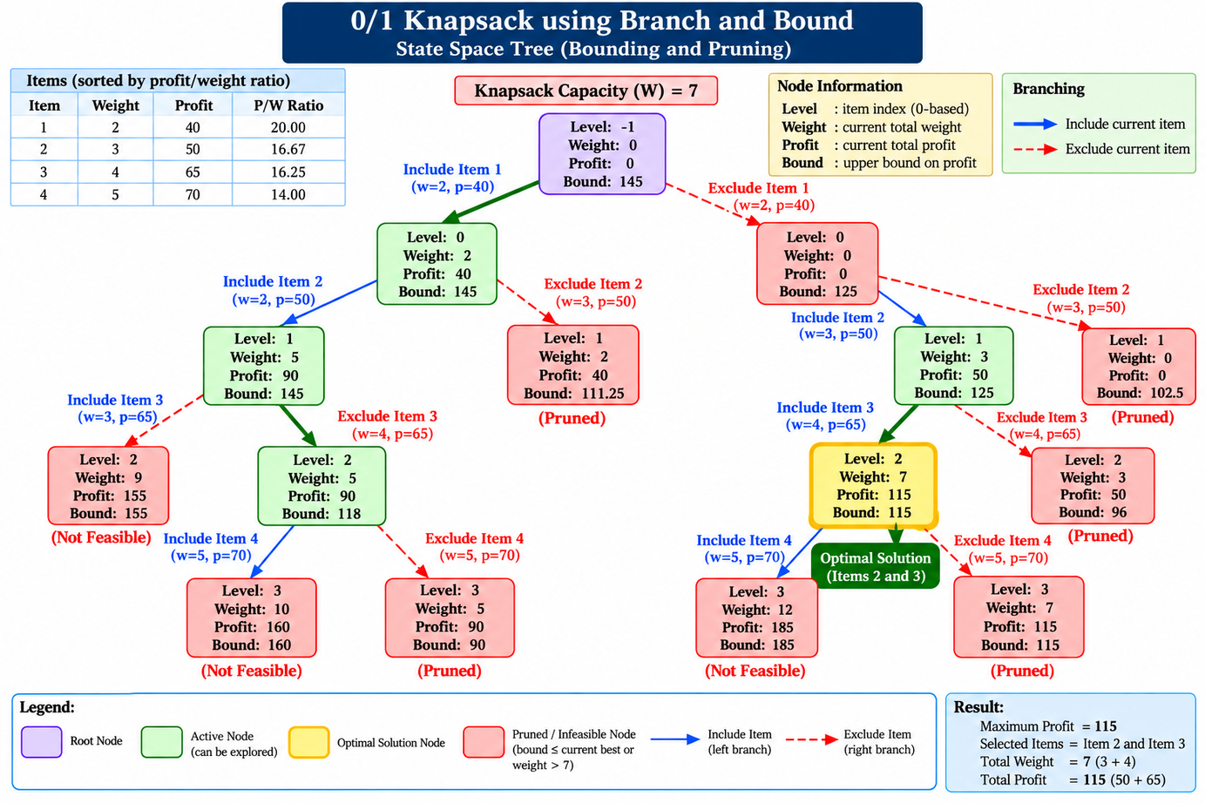
0/1 Knapsack: Branch and Bound
115
maximum profit, capacity W = 7
  Items sorted by profit/weight ratio; the bound estimates the best profit possible
  Each node branches into include or exclude
  Prune if infeasible or bound is no better than the best profit so far
  Best choice: items 2 and 3 (weight 3 + 4 = 7, profit 50 + 65)
7
Notes:
Blue arrows include an item, red dashed arrows exclude it. The highlighted yellow node is the optimal solution.
7

Slide 8
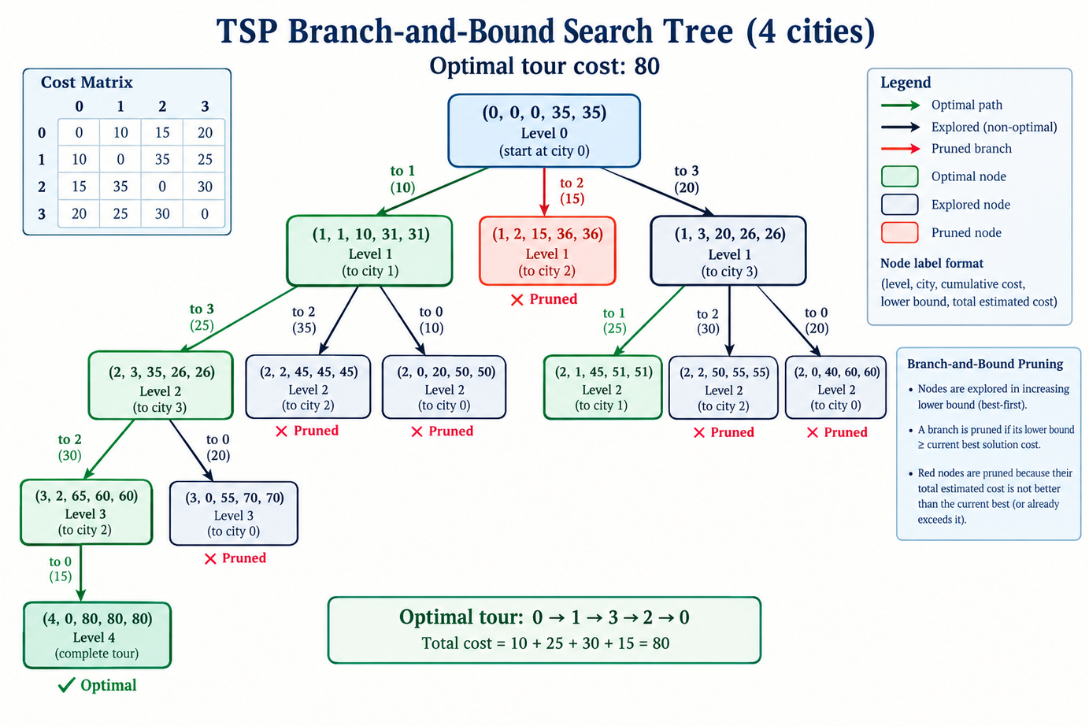
TSP: Branch and Bound Search Tree
80
optimal tour cost, 4 cities
  Nodes are expanded best-first by lower bound
  Prune a branch when its lower bound is at least the best known tour
  Optimal tour: 0 → 1 → 3 → 2 → 0
  Cost = 10 + 25 + 30 + 15 = 80
8
Notes:
Node labels are (level, city, cumulative cost, lower bound, total estimated cost). Green nodes lie on the optimal path, red nodes are pruned.
8

Slide 9
Summary: Techniques at a Glance
Problem | Technique | Core idea | Time complexity
Sorting (Bubble to Quick) | Comparison-based | Compare and rearrange elements | O(n²) to O(n log n)
Optimal Merge Pattern | Greedy | Merge the two smallest files first | O(n log n)
Floyd-Warshall | Dynamic programming | Try every vertex as an intermediate stop | O(V³)
N-Queens | Backtracking | Place row by row, undo on conflict | Exponential in N
0/1 Knapsack | Branch and bound | Prune with a profit upper bound | O(2ⁿ) worst case
Traveling Salesman | Branch and bound | Prune with a tour-cost lower bound | O(n!) worst case
9
Notes:
Wrap up: each problem maps to a design paradigm. Greedy and DP give exact polynomial algorithms here, while backtracking and branch and bound tame exponential search through pruning.
9

