Slide 1
CINEMA TICKET SALES FORECASTING
Team 1
Aakash Avinash Aundhkar(G01371754)
Sanika Suhas Dalvi(G01398375)
Keerthana Cheruvu(G01160202)
George Mason University
Dr. Duoduo Liao
AIT-614-001
November 27, 2023

Slide 2
Introduction
Forecasting cinema ticket sales - integral component of strategic planning for cinemas, distributors, and stakeholders.
By analyzing this data - accurate predictions regarding ticket sales for specific movies or timeframes can be made.
This process aids in optimizing resource allocation, refining marketing strategies, and ultimately enhancing the overall performance of cinemas in a dynamic and competitive market.

Slide 3
Building a Forecasting model – to help cinema theatres predict their total sales.
Dataset – contains information about sales history of different cinema theaters of about 8 months.
4 different types of Algorithms were used for building the forecasting model.
Objectives

Slide 4
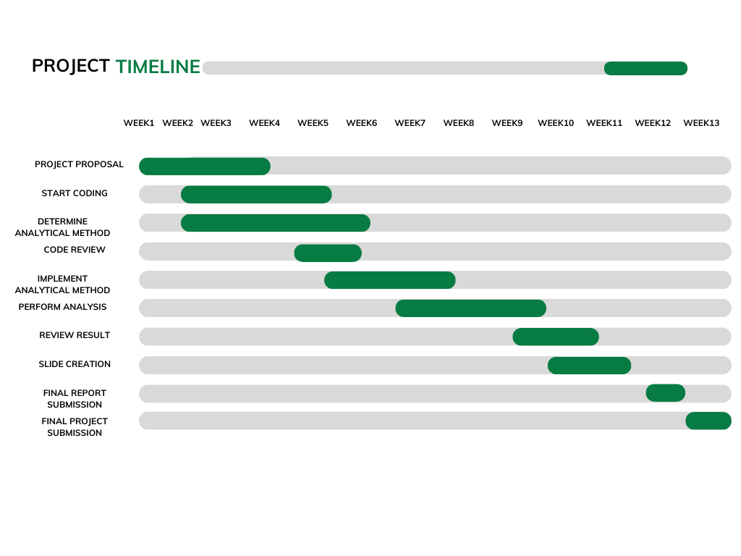
Project Timeline

Slide 5
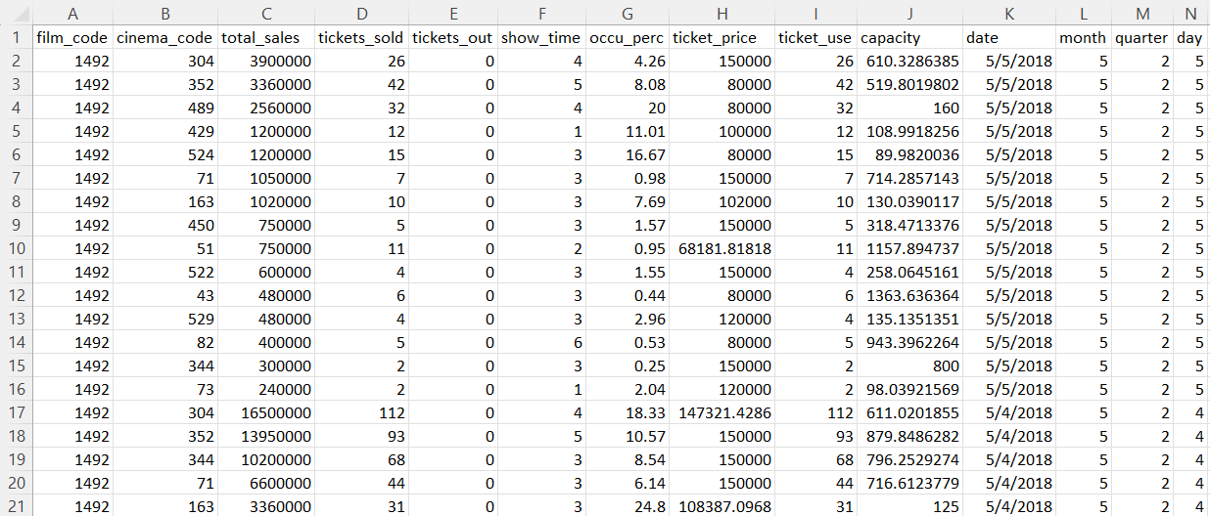
Dataset
Total records – 1,42,525
Total columns – 14
Datatypes – Integer, Date, Float

Slide 6





TECHNOLOGIES USED

Slide 7
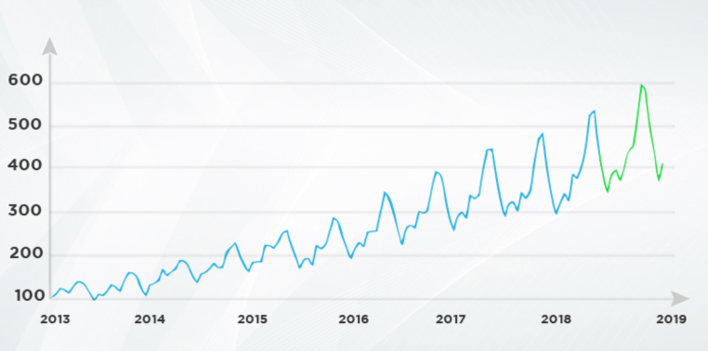
Time series forecasting is a technique used in statistics, econometrics, and machine learning to predict future values based on historical data points collected at regular intervals over time.
What is Time Series Forecasting

Slide 8
Linear regression
Decision tree
Random Forest
Gradient Boosted Regression
Machine Learning Algorithms

Slide 9





Process
Gathering Data
Ingesting Data into
Databricks DBFS
Data Cleaning &
Preprocessing
Time series
Forecasting model
Validating Results

Slide 10
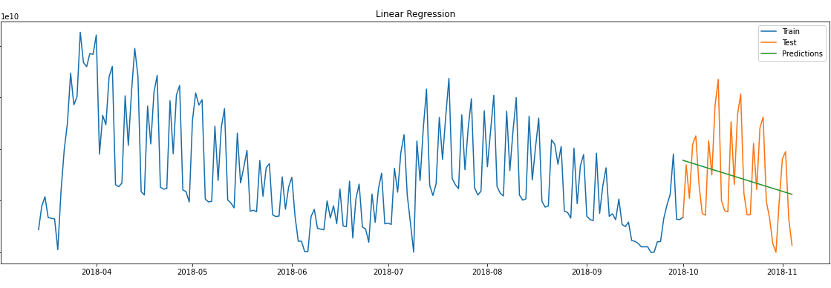
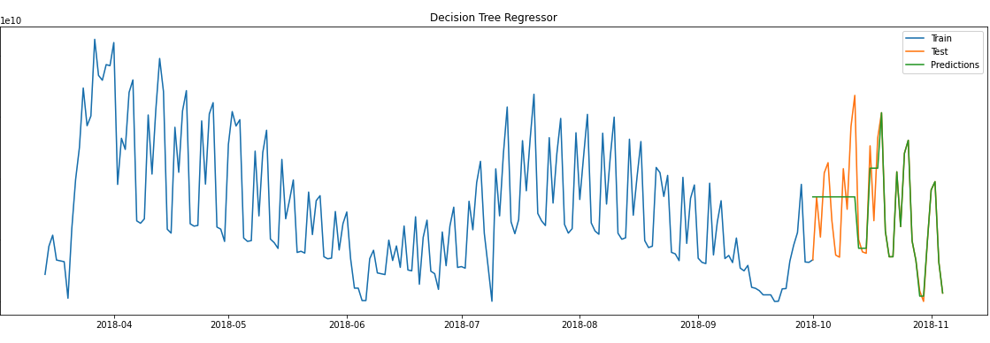
Results and Findings
Linear Regression
Accuracy : 5%
Decision Tree Regressor
Accuracy : 65%

Slide 11
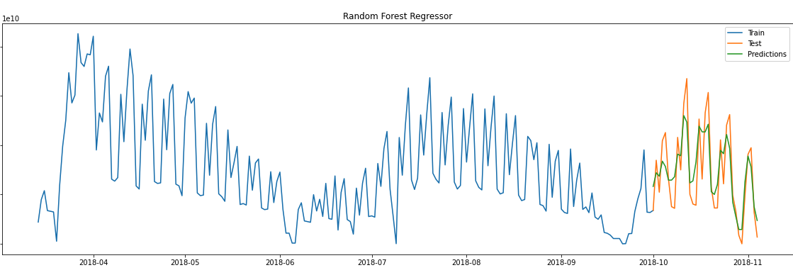
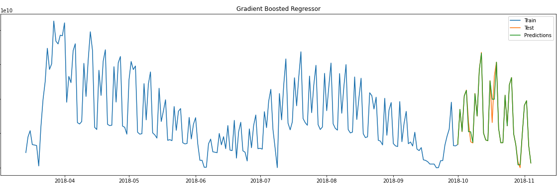
Results and Findings
Random Forest Regressor
Accuracy : 74%
Gradient Boosted Regression
Accuracy : 95%

Slide 12
Successfully cleaned and preprocessed the dataset and built a machine learning forecasting model that predicted sales for the month of October 2018 with an accuracy of 95%.
Conclusions

Slide 13
Incorporating a dataset spanning several years - would be beneficial for a more comprehensive and robust analysis, providing a broader perspective on the trends and patterns influencing total cinema sales.
Provided the dataset is huge enough – more advanced forecasting models can be implemented such as Prophet, LSTM, HMM, etc.
Further Studies and Improvements

Slide 14
Acknowledgement & References
Cinema Tickets, retrieved on November 26, 2023 from - https://www.kaggle.com/datasets/arashnic/cinema-ticket/data
Visualization and Prediction of Film Award Nominations by Using of Visual Data Mining (VDM) and Exploratory Data Analysis (EDA) Method, retrieved on November 26, 2023 from - https://www.academia.edu/43542314/Visualization_and_Prediction_of_Film_Award_No%20minations_by_Using_of_Visual_Data_Mining_VDM_and_Exploratory_Data_Analysis_EDA_Method
Dr. Liao’s Code Examples & Tutorials: Blackboard resources

Slide 15
THANK YOU

Slide 16
Questions?

