Slide 1

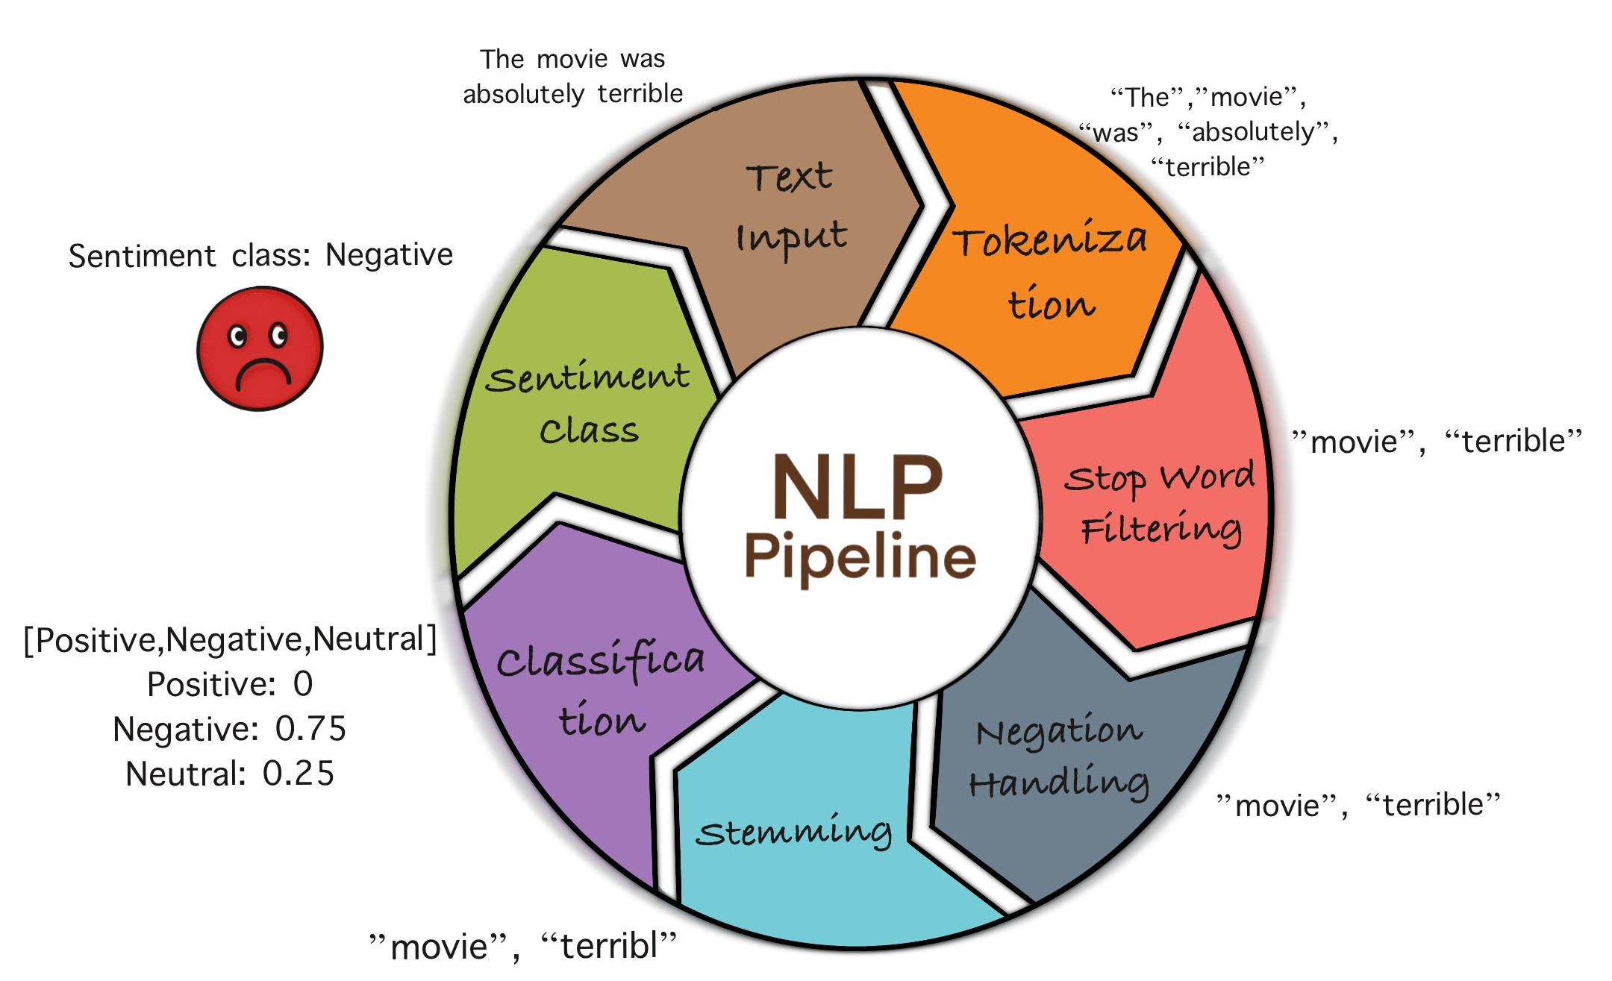
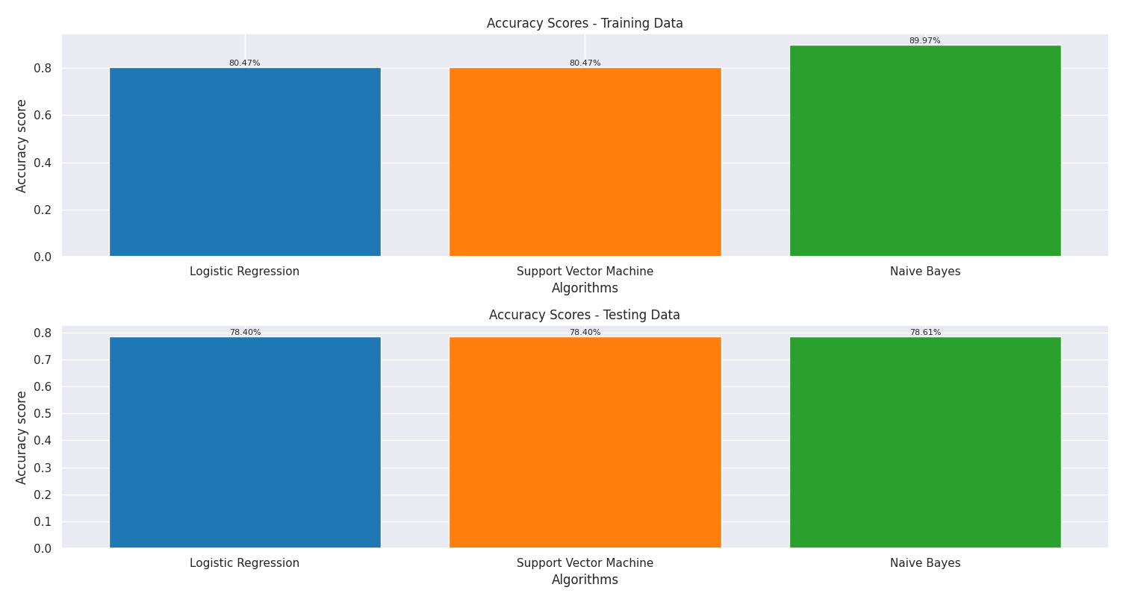
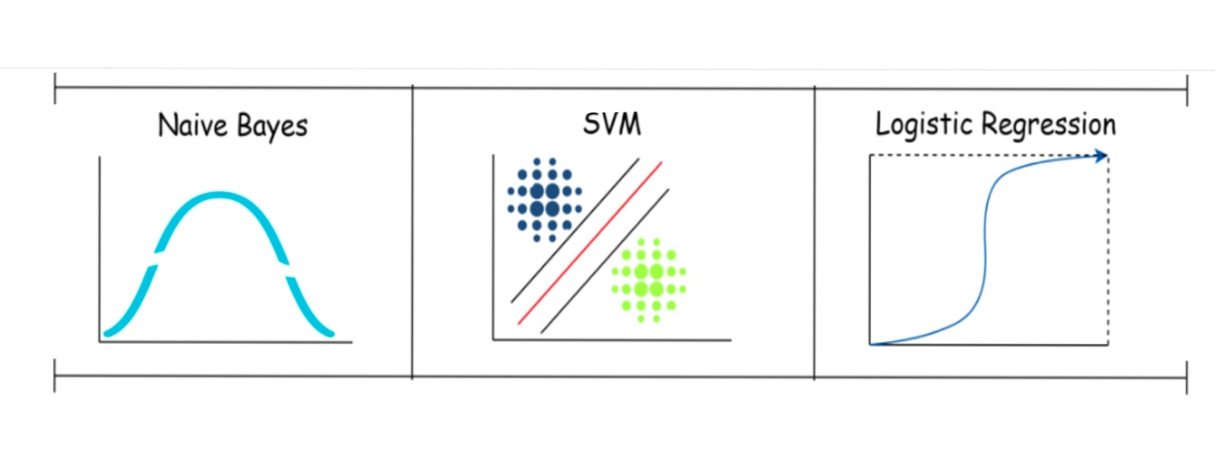
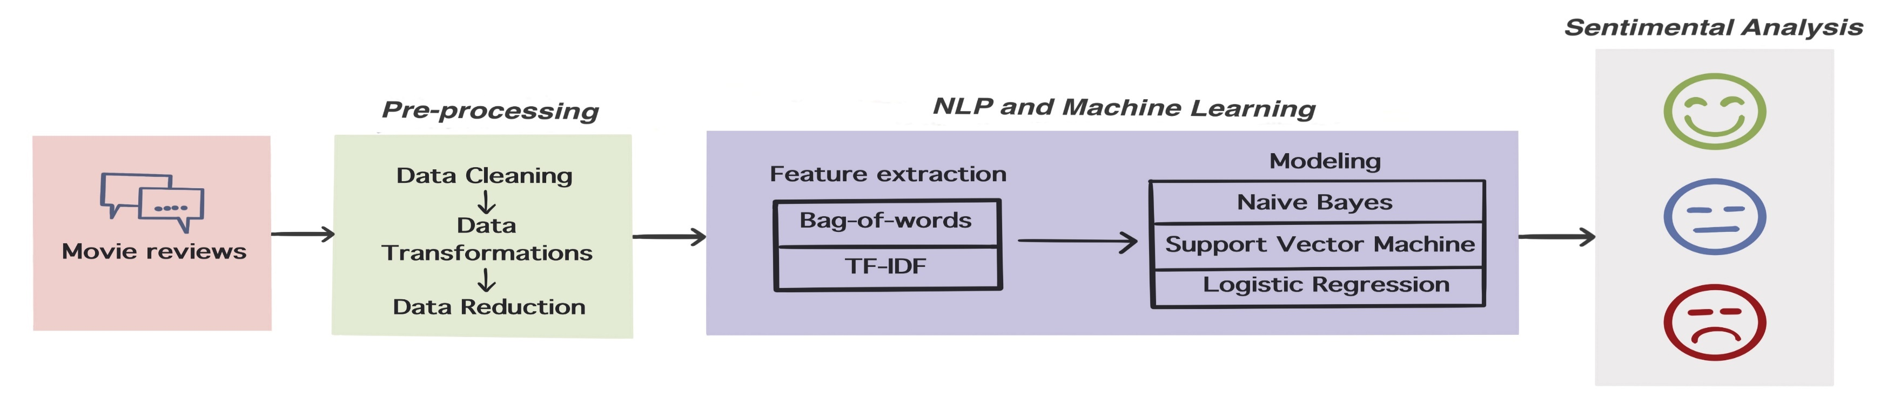
Sentimental Analysis of IMDb Movie reviews: Machine Learning and NLP Approach
Shree Raksha Sivasubramani, Keerthi Nivasshini Thangaraj and Khald Aboalayon
Data Analytics Program, School of Professional Studies
Clark University, Worcester, MA
20th Annual Multidisciplinary Conference
(MDC)
Graduate Student Council 2024
Abstract
Background: NLP & ML
Results
This research project investigates the application of Natural Language Processing (NLP) and Machine Learning (ML) in the “Sentiment Analysis of IMDb Movie Reviews”. With the exponential rise in user-generated content on online platforms, deciphering sentiments from vast movie reviews is crucial for informed decision-making within the movie industry. Automated sentiment analysis becomes a game-changer, offering an efficient solution to the time-consuming task of manual review analysis. Utilizing a dataset of 320,000 movie reviews, the study aims to classify sentiments as positive, negative, or neutral. The project utilizes an integrated methodology, encompassing conventional machine learning algorithms such as Logistic Regression (LReg), Support Vector Machine (SVM), and the distinctive Naive Bayes (NB). Notably, the Naive Bayes algorithm emerges as the top performer, achieving efficiency and speed making it particularly suitable for real-time or large-scale sentiment analysis tasks. The study contributes valuable insights into IMDb movie sentiment distribution and underscores the powerful synergy of NLP and ML in automating sentiment analysis tasks. The findings emphasize the significance of data preprocessing, feature engineering, and algorithm selection in achieving high-quality results.
NLP:
Integrates AI, machine learning, and linguistics to analyze human language and is pivotal for sentiment analysis. In our IMDb reviews project, we utilize NLP for data preprocessing and employ techniques like Bag-of-Words and TF-IDF for feature extraction, which improves model accuracy in sentiment analysis. These methods enable us to derive significant insights for applications such as customer experience and social sentiment analysis.
ML: Traditional machine learning algorithms have been widely used in sentiment analysis tasks due to their simplicity and effectiveness. In our project, we explored several traditional algorithms for sentiment analysis of IMDb movie reviews.
NB: an efficient probabilistic classifier that simplifies sentiment prediction in IMDb movie reviews by estimating the likelihood of each class based on input features.
SVM: a supervised learning algorithm that excels in classifying movie reviews by identifying the best hyperplane to distinguish sentiment classes, handling high-dimensional and nonlinear data effectively.
LReg: is a straightforward algorithm that models sentiment class probabilities from input features and delivers competitive sentiment analysis in IMDb movie reviews.
Introduction
Ref :D. Shende, "Essential Machine Learning Algorithms," June 21, 2021.
ML Algorithm | Accuracy Score (%)
 | Train | Test
Logistic Regression (LReg) | 80.47 | 78.4
Support Vector Machine (SVM) | 80.47 | 78.4
Naive Bayes(NB) | 89.97 | 78.61
In the dynamic entertainment industry, grasping audience sentiment is vital for filmmakers and marketers. Online platforms like IMDb offer vast data through movie reviews, revealing viewer preferences and reactions. Yet, the volume and complexity of this data challenge practical analysis and interpretation of audience sentiment.
Sentiment Analysis (SA), powered by AI, is crucial for decoding the complex emotions in text, such as opinions and sentiments in movie reviews. Using advanced ML and NLP techniques, it quantifies emotions from joy to anger, offering nuanced insights into audience responses.
Motivation:
There is a need to fill a knowledge gap in SA and NLP for movie reviews.
Research Question:
Can machine learning models accurately classify movie reviews by sentiment, guiding our analysis with testable hypotheses?
Methodologies
Future Work and Conclusion
Our study shows that Naive Bayes outperforms Logistic Regression and SVM in sentiment analysis, offering a more efficient and accurate tool for the movie industry's decision-making processes. These findings pave the way for further research into advanced neural networks and ensemble methods to refine accuracy. Our work demonstrates the efficacy of NLP and ML in extracting valuable insights from unstructured text and suggests potential applications across various fields.
Kaggle | EDA | NLP | ML
[1] Acquire a comprehensive 320,000-row, 16-column dataset from Kaggle and ensure data integrity through rigorous checks for null values and duplicated rows, ensuring reliability for subsequent analysis. | [3] Visualize sentiment distribution within the dataset using seaborn's countplot function, distinguishing between positive and negative sentiments. | [4] Perform preprocessing tasks tailored for sentiment analysis, including text cleaning, tokenization, stop word filtering, negation handling, and stemming. | [6] Train and evaluate machine learning models for sentiment classification to inform decision-making in the movie industry.
[2] Conduct a thorough data integrity check to ensure the reliability of the dataset by examining for null values and duplicated rows. |  | [5] Transform text data into TFIDF feature matrices using both bag of words (BOW) and Term Frequency-Inverse Document Frequency (TFIDF) models, then label the sentiment data and partition it into training and testing subsets to facilitate sentiment analysis tasks.
Challenging & Objective
References
Understanding what audiences truly think about them can be a daunting task for movie studios.
Objective:
Develop and validate machine learning models capable of performing sentiment analysis on movie reviews. We aim to process and analyze these reviews to discern the underlying sentiments, providing studios with clear, actionable insights into audience perceptions. Through the assessment of model performance and sentiment distribution, our goal is to optimize the sentiment classification process, thus enhancing the ability of movie studios to understand and react to audience feedback and improving the overall movie-watching experience.
[1] Danyal, M.M., Khan, S.S., Khan, M., Ghaffar, M.B., Khan, B. and Arshad, M., 2023. Sentiment Analysis Based on Performance of Linear Support Vector Machine and Multinomial Naïve Bayes Using Movie Reviews with Baseline Techniques. Journal on Big Data, 5.
[2] B. Pang, L. Lee, and S. Vaithyanathan, "Thumbs up? Sentiment classification using machine learning techniques," in Proceedings of the Conference on Empirical Methods in Natural Language Processing, 2002, pp. 79-86.
[3] A. Pak and P. Paroubek, "Twitter as a corpus for sentiment analysis and opinion mining," in Proceedings of the Conference on Language Resources and Evaluation, 2010, pp. 1320-1326.

