Slide 1
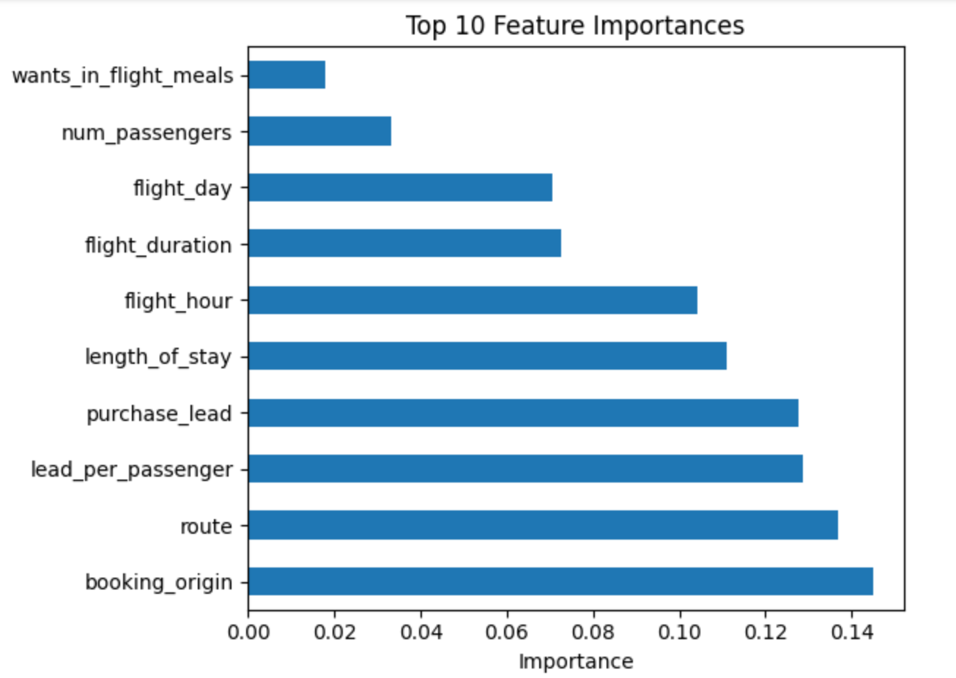
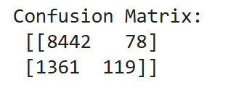
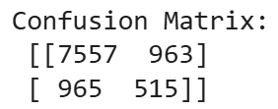
Predicting customer buying behaviour
Model: Random Forest + SMOTE
Cross‑Validation: 5‑fold
Dataset Size: 10,000
Confusion Matrix Comparison: (Before vs After SMOTE)
Summary: - booking_origin, route, lead_per_passenger are top predictors - Model performs well on Majority class, but minority class recall is low - SMOTE improved detection of class 1 to 35% recall, which can be further optimized
Metric | Score
Accuracy | 80.72%
Precision | 35%
Recall | 35%
F1 Score | 35%
Macro Avg F1 | 62%

