Slide 1

HandWritten Digit Recognition
Data Science Project Review-1
9/10/2026
 | Under the Guidance of Dr. N. Sunanda Associate Professor, Department of Computer Science and Engineering, KLH CSE Bowrampet Campus
Team Members Greeshma Sai – 2420030550 Keerthi Reddy – 2420030774 Hasini Peddi – 2420030784

Slide 2
Outline of Project Work
Focus
Introduction
Literature Survey
Challenges
Research Objectives
Conclusion & Future Work
References
Publications Details

Slide 3
Problem Statement
Handwritten digits differ in shape, size, orientation, and writing style, making automatic recognition challenging.
These variations make it difficult for computers to recognize handwritten digits accurately.
Manually identifying large numbers of handwritten digits can be time-consuming and error-prone.
There is a need for a system that can automatically recognize and classify digits from 0 to 9.
This project uses the MNIST dataset to study different handwritten digit patterns.
KNN and SVM algorithms are applied to recognize the digits and compare their performance. The models are evaluated using accuracy, precision, recall, F1-score, and confusion matrix.

Slide 4
Objectives
To develop a system that can automatically recognize handwritten digits from 0 to 9.
To use the MNIST dataset for training and testing the handwritten digit recognition models.
To preprocess and normalize the image data so that it can be effectively used by the machine learning models.
To explore the dataset using basic data analysis and visualization techniques to understand digit patterns zand class distribution.
To implement K-Nearest Neighbors (KNN) and Support Vector Machine (SVM) for digit classification.
To compare the performance of KNN and SVM using suitable evaluation metrics
To identify and understand classification errors between different digit classes using a confusion matrix.

Slide 5
Literature Survey
Authors | Title of the Paper | Methodology | Inferences | Limitation/Future work
Chunmei Zhang et al. [1] | ResNet18-ThunderSVM: Hybrid Intelligence for Handwritten Digit Recognition by Fusing Deep Spatial Features and High-Performance Classification | ResNet18 is used for automatic deep feature extraction MNIST, EMNIST, USPS and Fashion-MNIST datasets are used for evaluation | Automatic feature extraction reduces the need for manual feature engineering The model shows better generalization and robustness to noisy data. | Future work can explore model pruning and lightweight ResNet architectures Testing with more challenging datasets
Lei Guo & Zihan Wang [2] | Task-fMRI-Derived Number-Related Functional Brain Topology Constrained Spiking Neural Networks for Handwritten Digit Recognition | Task-related fMRI data is used to construct the network topology MNIST dataset is used for handwritten digit recognition | Task-fMRISNN achieved 97.27% accuracy on MNIST Demonstrates the potential of brain-inspired computing for digit recognition | The topology-to-network mapping strategy is currently fixed The study uses a relatively simple handwritten digit dataset
Raghav Sethi & Varda Pareek | Optical Handwritten Digit Recognition using Deep Learning Models on the MNIST Dataset | Uses the MNIST dataset for handwritten digit recognition. Model performance is evaluated mainly using classification accuracy. | The results show that deep learning models can achieve high accuracy for handwritten digit recognition. VGG16 achieved 98.53% accuracy. | The study focuses on the MNIST benchmark dataset, so performance on more complex

Slide 6
Problem Gap Identification
Existing Systems / Research | Gap Identified
Deep learning models such as VGG16, ResNet18 and Vision Transformer achieve high accuracy in handwritten digit recognition. | Their evaluation is mainly focused on the MNIST dataset and may not represent diverse real-world handwriting.
Image preprocessing and normalization are used to improve handwritten digit recognition. | These techniques may not completely handle variations in handwriting style, size, shape and stroke thickness.
SNN-based approaches explore brain-inspired handwritten digit recognition. | Existing approaches can rely on fixed architectures and require further validation on complex datasets.
Most existing studies focus primarily on classification accuracy. | There is a need to consider accuracy, efficiency, robustness and generalization together.
Existing research addresses different aspects of handwritten digit recognition. | A practical system combining these aspects for reliable real-world handwritten digit recognition is still needed.

Slide 7
Innovation, Creativity, and Novelty
🔹 Handwriting Variation Handling:
The system is designed to recognize handwritten digits despite differences in writing style, size, shape, stroke thickness, and alignment.
🔹 Image Preprocessing Enhancement:
Input handwritten images are preprocessed and normalized to reduce unnecessary variations and improve the quality of digit recognition.
🔹 Intelligent Digit Classification:
Machine learning/deep learning techniques are used to automatically learn digit patterns and classify handwritten inputs with high accuracy.
🔹 Similar-Digit Error Reduction:
The system focuses on improving recognition of visually similar digits such as 3 and 5 or 4 and 9, where misclassification is more likely to occur.
🔹 Real-World Application Potential:
The proposed system can be extended beyond the MNIST dataset for applications such as document digitization, banking forms, postal services, and automated data entry.

Slide 8
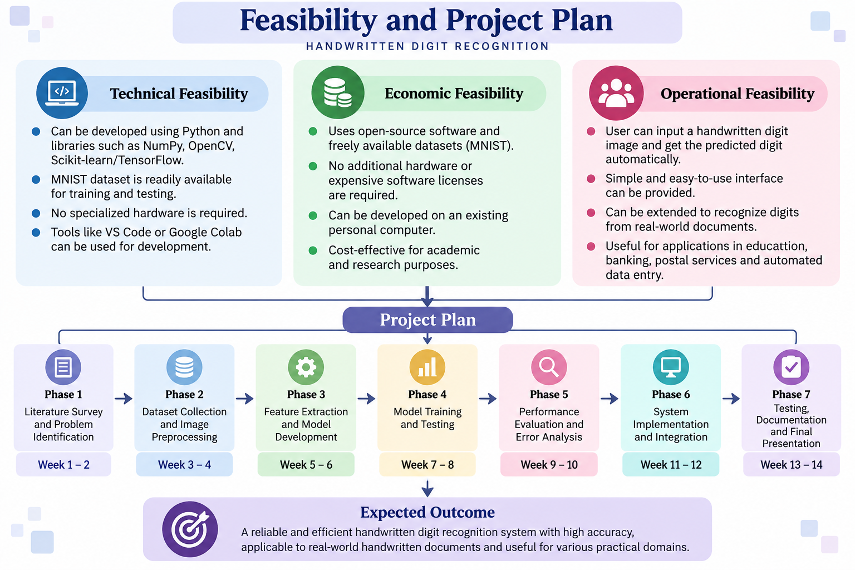
Feasibility and Project Plan

