Slide 1
Pizza Sales Analysis 🍕
SQL Project – Canva Style with Screenshots

Slide 2
🍕 Total Orders Placed

Slide 3
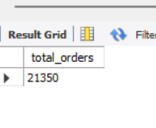
🍕 Total Revenue Generated

Slide 4
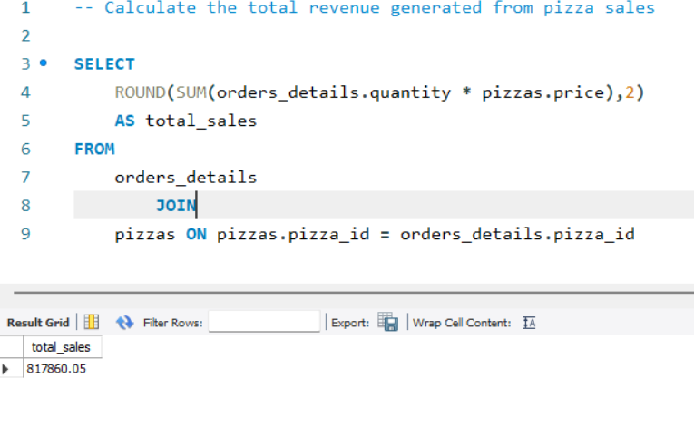
🍕 Highest Priced Pizza

Slide 5
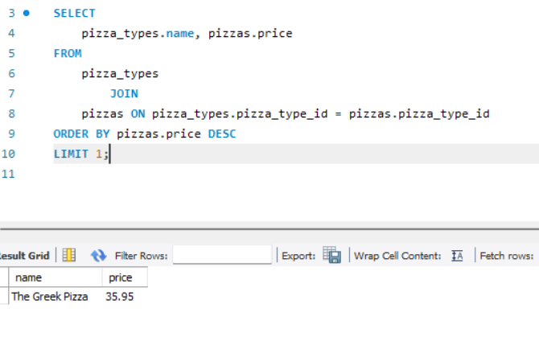
🍕 Most Common Pizza Size Ordered

Slide 6
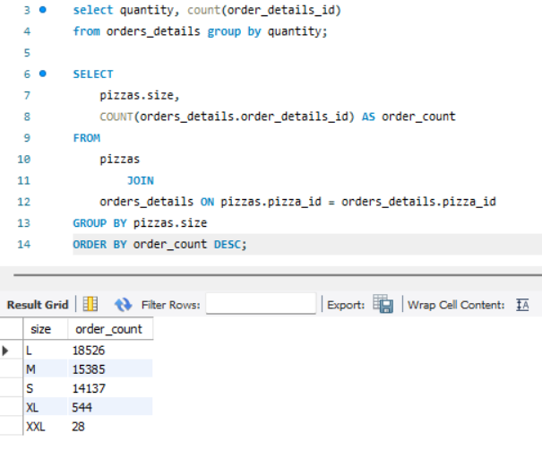
🍕 Top 5 Most Ordered Pizza Types

Slide 7
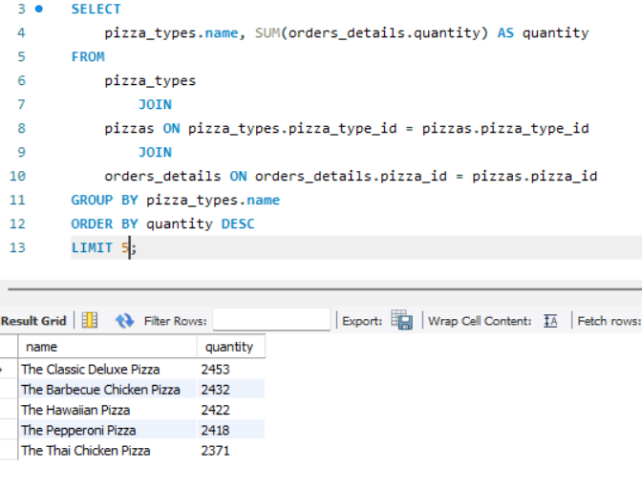
🍕 Quantity by Pizza Category

Slide 8
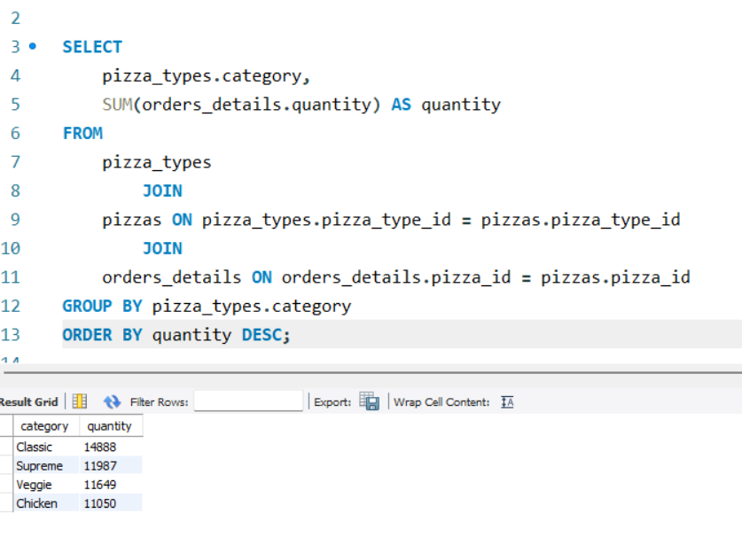
🍕 Orders by Hour of Day

Slide 9
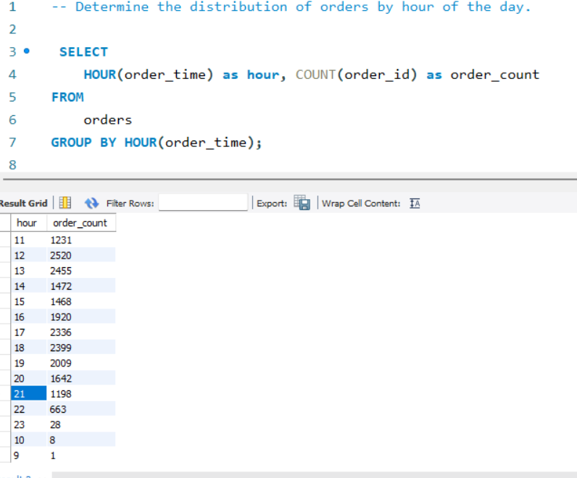
🍕 Category Distribution

Slide 10
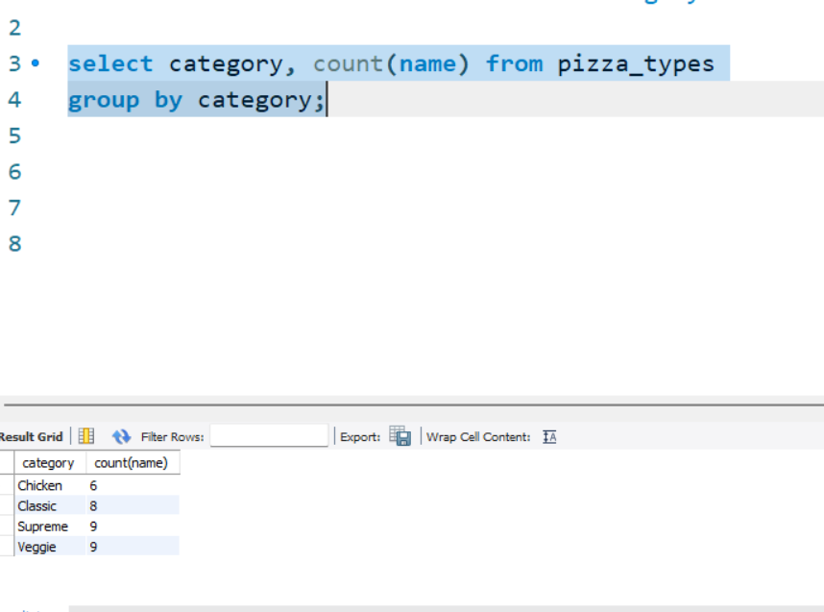
🍕 Average Pizzas Ordered Per Day

Slide 11
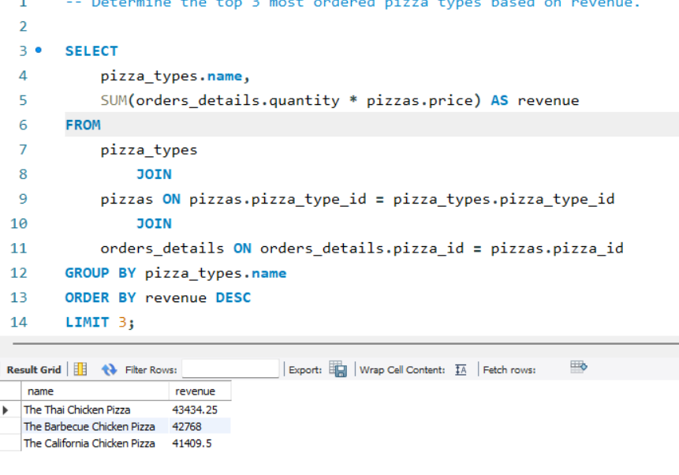
🍕 Top 3 Pizzas by Revenue

Slide 12
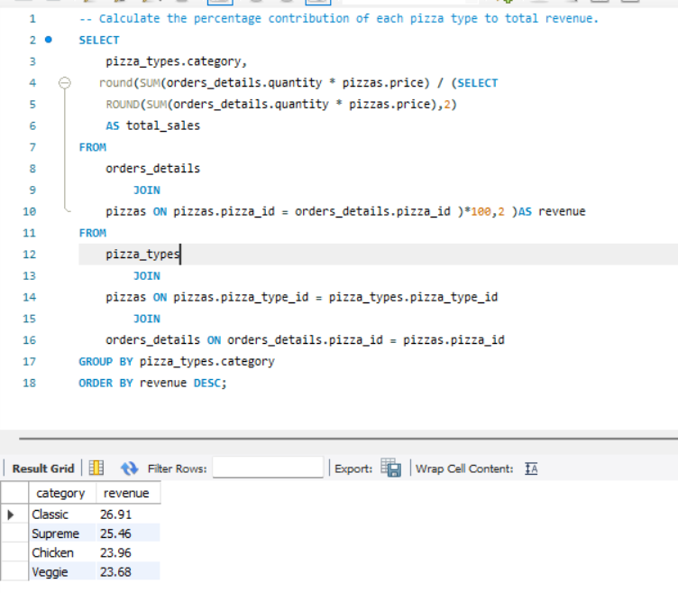
🍕 Revenue Percentage Contribution

Slide 13
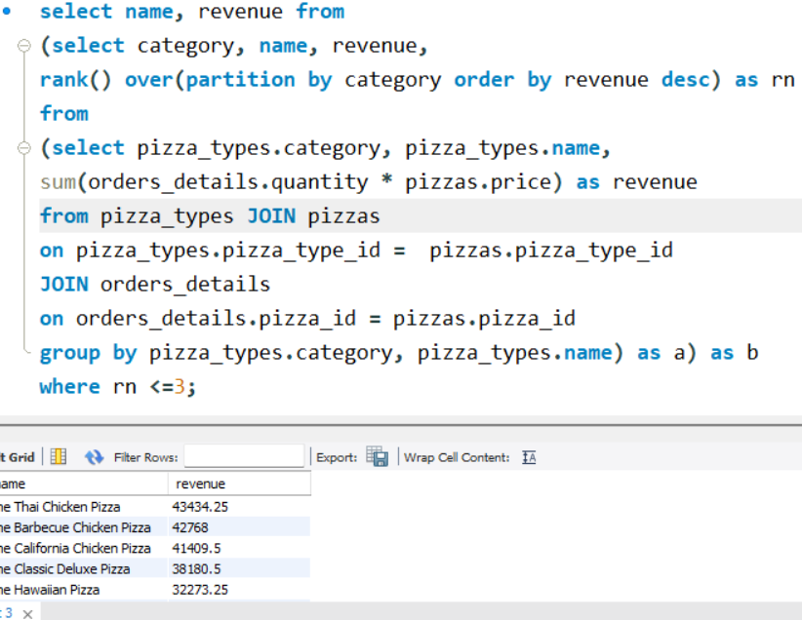
🍕 Top 3 Pizzas by Revenue per Category

