Slide 1
RATING PREDICTION BASED ON USER REVIEWS
KEERTHI PERUMAL

Slide 2
CONTENT
Introduction
Data Collection
Pre- Processing data with NLP
Model/s Development and Evaluation
Conclusion

Slide 3
INTRODUCTION
With products competing to win customers over with aggressive marketing, online reviews have become an important consideration for consumers. Over 88% of Ecommerce shoppers buy only after reading reviews of products. Product ratings and reviews secure the customer journey by giving them the confidence to complete the checkout process. User-generated content provides valuable consumer insights. It helps Ecommerce retailers understand the needs of consumers. Brands can use this information to ideate, improve and innovate products or services, foster customer loyalty, and improve their business.

Slide 4
DATA COLLECTION
We have a client who has a website where people write different reviews for technical products. Now they are adding a new feature to their website i.e. The reviewer will have to add stars(rating) as well with the review. The rating is out 5 stars and it only has 5 options available 1 star, 2 stars, 3 stars, 4 stars, 5 stars. Now they want to predict ratings for the reviews which were written in the past and they don’t have a rating.
So, we have to build an application which can predict the rating by seeing the review. On seeing the above problem definition, I have tried in building a successful machine learning model that will predict the rating based on the reviews given by the customer. But to train the model we require some data to play around. So, I have scraped some data from multiple ecommerce websites along with the ratting for the reviews. Web scraping or data collection is done with the help of Beautiful Soup and Selenium, and I have collected more than 50000 records with ratings and reviews and have stored in CSV format

Slide 5
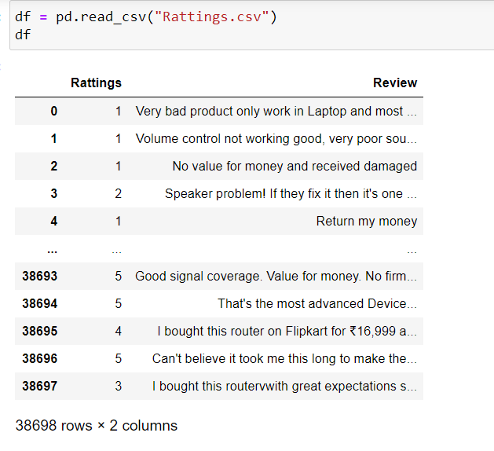
DATA COLLECTION

Slide 6
PRE – PROCESSING with NLP
Exploratory data analysis.
In statistics, exploratory data analysis is an approach of analyzing data sets to summarize their main characteristics, often using statistical graphics and other data visualization methods

Slide 7
STEPS EDA
Converting all the strings into lower case
Converting all the email address present in the reviews as “email address”.
Converting all the currency present in the reviews as “dollars”.
Converting all phone numbers present in the reviews as “phonenumber”.
Have converted all the number present in the reviews as “number”.
Removed all punctuations and stop words and lemawords from the reviews.

Slide 8
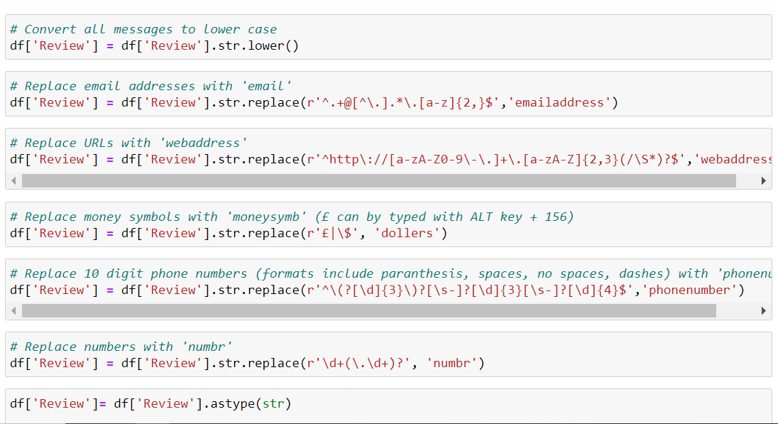
DATA CLEANSING

Slide 9
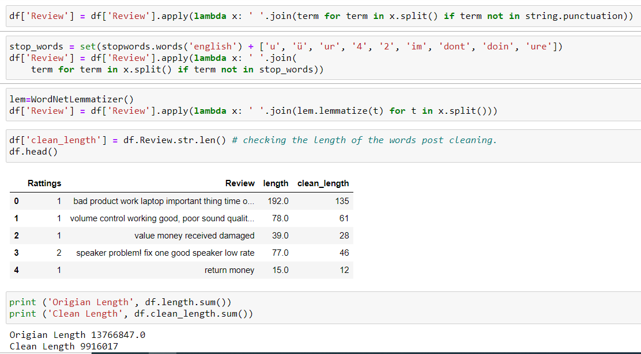
DATA CLEANSING

Slide 10
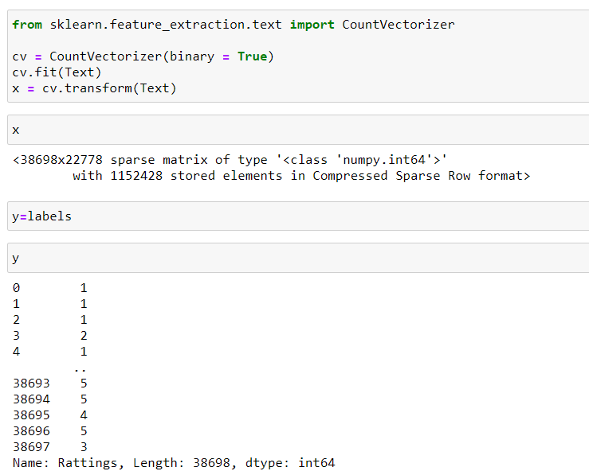
PRE - PROCESSING

Slide 11
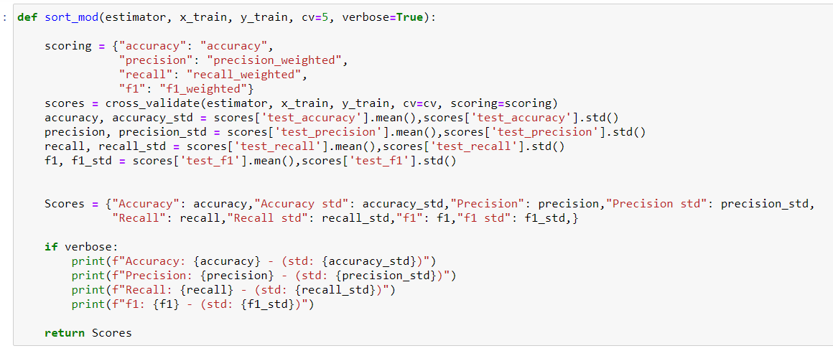
MODEL BUILDING

Slide 12
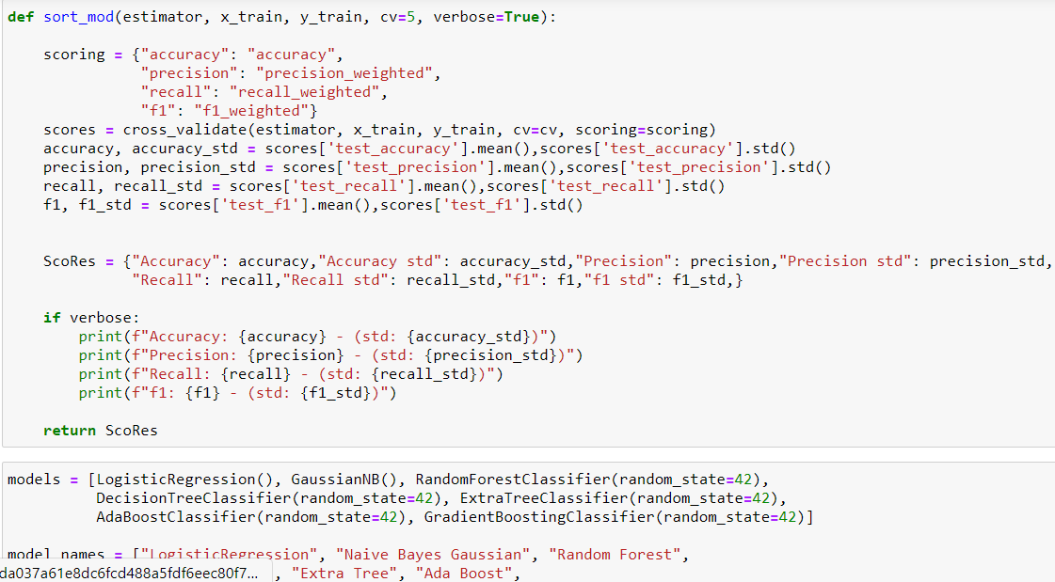
MODEL BUILDING

Slide 13
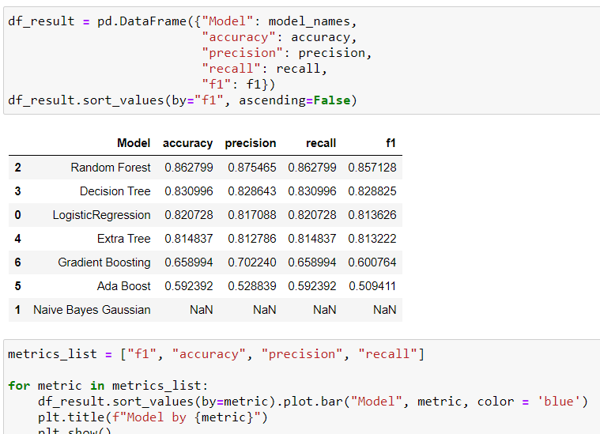
TESTING ALGORITHMS

Slide 14
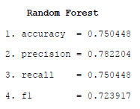
TESTING ALGORITHMS

Slide 15
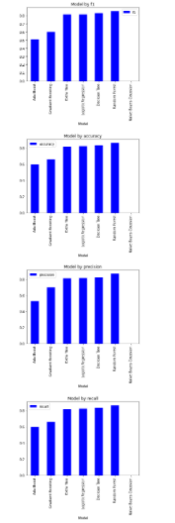
METRICS VISUALIZATION

Slide 16
CONCLUSION
Online reviews are an effective word of mouth marketing strategy in the digital age, providing outside perspectives on products and services. While positive reviews can drive revenue and build a trustworthy reputation, negative reviews or the absence of reviews can do the opposite. Understanding the importance of reviews as well as how to leverage them to boost your business can be a critical way to get ahead in the competitive ecommerce marketplace, positioning yourself miles ahead of the competition

