Slide 1
MALIGNANT COMMENTS CLASSIFIER PROJECT
KEERTHI P

Slide 2
INTRODUCTION
INTRODUCTION
The proliferation of social media enables people to express their opinions widely online. However, at the same time, this has resulted in the emergence of conflict and hate, making online environments uninviting for users. Although researchers have found that hate is a problem across multiple platforms, there is a lack of models for online hate detection.
Online hate, described as abusive language, aggression, cyberbullying, hatefulness and many others has been identified as a major threat on online social media platforms. Social media platforms are the most prominent grounds for such toxic behaviour.
There has been a remarkable increase in the cases of cyberbullying and trolls on various social media platforms. Many celebrities and influences are facing backlashes from people and have to come across hateful and offensive comments. This can take a toll on anyone and affect them mentally leading to depression, mental illness, self-hatred and suicidal thoughts.
Internet comments are bastions of hatred and vitriol. While online anonymity has provided a new outlet for aggression and hate speech, machine learning can be used to fight it. The problem we sought to solve was the tagging of internet comments that are aggressive towards other users. This means that insults to third parties such as celebrities will be tagged as unoffensive, but “u are an idiot” is clearly offensive.

Slide 3
OBJECTIVE
Internet comments are bastions of hatred and vitriol. While online anonymity has provided a new outlet for aggression and hate speech, machine learning can be used to fight it. The problem we sought to solve was the tagging of internet comments that are aggressive towards other users. This means that insults to third parties such as celebrities will be tagged as unoffensive, but “u are an idiot” is clearly offensive.
Our goal is to build a prototype of online hate and abuse comment classifier which can used to classify hate and offensive comments so that it can be controlled and restricted from spreading hatred and cyberbullying.

Slide 4
UNDERSTANDING THE DATA
The data set contains the training set, which has approximately 1,59,000 samples and the test set which contains nearly 1,53,000 samples. All the data samples contain 8 fields which includes ‘Id’, ‘Comments’, ‘Malignant’, ‘Highly malignant’, ‘Rude’, ‘Threat’, ‘Abuse’ and ‘Loathe’.
The label can be either 0 or 1, where 0 denotes a NO while 1 denotes a YES. There are various comments which have multiple labels. The first attribute is a unique ID associated with each comment.
The data set includes:
- Malignant: It is the Label column, which includes values 0 and 1, denoting if the comment is malignant or not.
- Highly Malignant: It denotes comments that are highly malignant and hurtful.
- Rude: It denotes comments that are very rude and offensive.
- Comment text: This column contains the comments extracted from various social media platforms

Slide 5
UNDERSTANDING THE DATA
- Threat: It contains indication of the comments that are giving any threat to someone.
- Abuse: It is for comments that are abusive in nature.
- Loathe: It describes the comments which are hateful and loathing in nature.
- ID: It includes unique Ids associated with each comment text given.

Slide 6
LIBRARIES

Slide 7
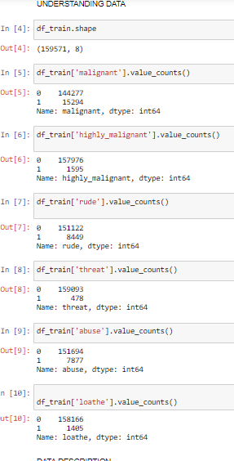
DATA PRE-PROCESSING

Slide 8
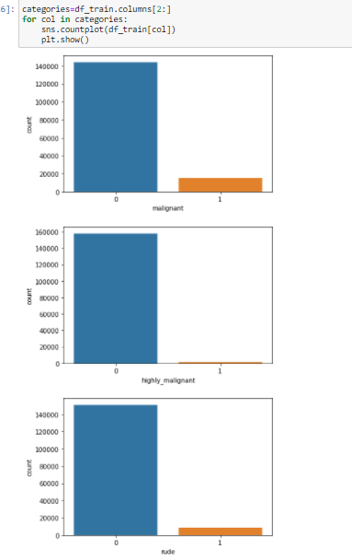
EDA

Slide 9
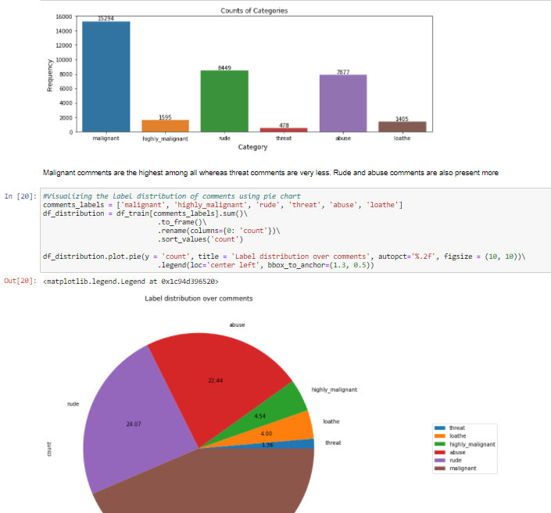
EDA

Slide 10
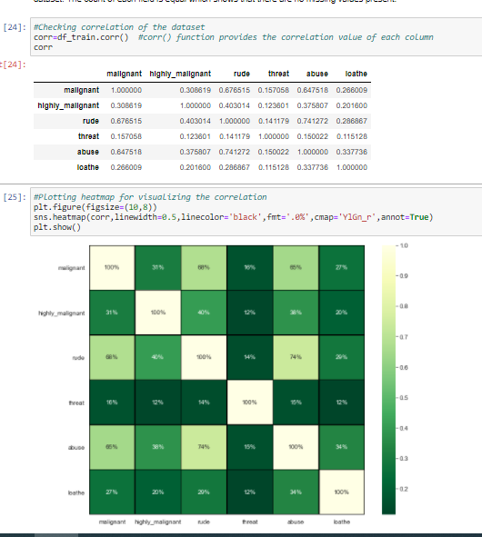
SUMMARY STATISTICS

Slide 11
SUMMARY STATISTICS
RESULTS
The highest positive correlation is seen in between fields 'rude' and 'abuse'.
Attribute 'threat' is negatively correlated with each and every other feature of this training dataset.
Overall the correlation among the attributes is not positive.

Slide 12
DATA CLEANSING
Dropping the Column
Due to the wide range of given data, it is extremely fruitful to clean, shape and set the data in the most suitable form. Dropping unnecessary columns declines the chances of producing errors. Thus, column ‘ID’ was dropped from the train dataset as every comment has its own unique id. After dropping the same, the dataset is now having 7 attributes in total including the target variables.
Cleaning the data using NLP
● Replaced the extra lines or ‘\n’ from the text.
● Transform the text into lower case.
● Replaced the email addresses with the text 'emailaddress'
● Replaced the URLs with the text 'webaddress'

Slide 13
DATA CLEANSING
● Removed the numbers
● Removed the HTML tags
● Removed the punctuations
● Removed all the non-ascii characters
● Removed the unwanted white spaces
● Removed the remaining tokens that are not alphabetic
● Removed the stop words

Slide 15
WORD CLOUD

Slide 16
MODEL BUILDING

Slide 17
MODEL BUILDING

Slide 20
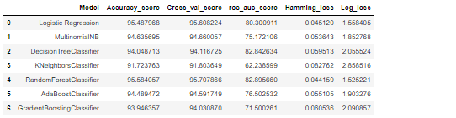
BEST FIT MODEL

Slide 21
HYPERPARAMETER TUNNING
AUC Score, f1-score and recall value is high when we use randomforest with over sampling data. So, we choose RandomForestClassifier model with over sampled data as our best model among all models.
Confusion matrix:

Slide 22
Finalizing the model
We will final the model by predicting the values and saving the model in a pickle file, which will be used for prediction of test data

Slide 23
Prediction

Slide 24
conclusion
After the completion of this project, we got an insight of how to preprocess the data, analysing the data and building a model.
First, we imported both training and testing data, which had nearly 150000+ records.
We did all the required pre-processing steps like checking null values, datatypes check, dropping unnecessary columns, etc.
We used the training data for doing Exploratory Data Analysis using various plots and recorded the observations.
While observing the results, we found that the dataset was in highly imbalanced side and we need to handle it, in order to avoid overfitting problem.
Using NLP, we pre-processed the comment text and did other steps.
As the problem was a multi-class classifier, we took a new feature known as label and combined the comment_labels output together using sum() and then stored in that feature. For a binary classification problem, we scaled the data accordingly.
After applying Tf-idf Vectoriser, we used an oversampling technique called RandomOverSampler for handling the imbalanced data. There, we took 75% of the high points data and sampled it to the low points data so that both weights could be balanced equally and we could get proper result.

Slide 25
Conclusion
Then, we split the data using train_test_split and then we started the model building process by running as many algorithms in a for loop, with difference metrics like cross_val_score, confusion matrix, auc_score, log loss, hamming loss, etc.
We found that RandomForestClassifier and XGBoostClassifier were performing well. The next step was to perform hyperparameter tuning technique to these models for finding out the best parameters and trying to improve our scores.
The major problem with this dataset occurred in this step. It took me nearly 2 hrs to run the code for finding out the best parameters itself as the dataset is large and more computational power was required. Even though we found the best algorithms, it took me 2 hrs to get the results.
Therefore, without hyperparameter tuning, we finalized RandomForest as the best performing algorithm by predicting the outputs, saving the model and storing the results in a csv file
Then, by using the model we got, another set of predictions were done by using the test data and the results were stored in a separate csv file.

Slide 26
Thank you

