Slide 1
Project
Group Number- 2
Mentor
Mrs. Shital Patil
Notes:
Add instructor notes here.

Slide 2
Objectives
Project Understanding
Approach used
Project Execution
Modules
Learning
Best Practices
Opportunity for improvement
Demo and Code Walkthrough
Q&A
Notes:
Add instructor notes here.

Slide 3
Project Understanding
This project is aimed at developing Easy Housing Solution (EHS) for administrators and Customers.
It is proposed to develop a system to provide web based Housing Solution system which will allow users to study, compare, buy, sell & then maintain his/her property details in a systematic way.
Typical operations include registering and login of the user, searching houses for buying or renting.
Owners can add their property, upload images from the Easy Housing company.
Technology Used:
ASP.NET 4.5 with MVC 5
Notes:
Add instructor notes here.

Slide 4
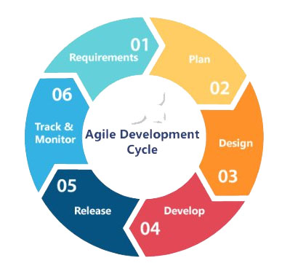
Approach used : Agile Model
The Agile methodology emphasis on four core values:
Individuals and interactions
Working software
Customer collaboration
Responding to change
Notes:
Add the notes here.
Add instructor notes here.

Slide 5
Modules
Following are the modules that we have implemented in this project :
Seller :
A seller can perform following actions using this application:
Login : Seller can login to this application using his/her credentials.
Add Property : Seller can add the property with details such as price, description, etc.
Notes:
Add the notes here.
Add instructor notes here.

Slide 6
Modules
Buyer :
A Buyer can perform following actions using this application:
Login : Buyer can login to this application using his/her credentials.
View Property : Buyer can view all the properties+

Slide 7
Modules
Admin :
An Admin can perform following actions using this
application:
Login : Admin can login to this application using his/her credentials.
View Property By Property Name : With Admin login person can sort the properties according to Property Name.
View Property By Property Type : With Admin login person can sort the properties according to Property Type.

Slide 8
Learning
Proper documentation of the project.
How to write test plan and test cases.
Proper Coding Standards.
Avoid using hard coding values.
ASP.NET 4.5 with MVC 5.
Exception handling and debugging.
Notes:
Add the notes here.
Add instructor notes here.

Slide 9
Best Practices
Proper documentation of the project.
Naming Conventions , Coding Standards should be proper.
Avoid using hard coding values.
Code review is a must.
Write proper test plan and test cases according to your project.
Readable and efficient Code.
Notes:
Add the notes here.
Add instructor notes here.

Slide 10
Opportunity for improvement
To develop for mobile based.
To be more responsive application.
To Sort the property by various filters like sort by View , cost range , area.

Slide 11
Q & A
Notes:
Add the notes here.
Add instructor notes here.

