Slide 1
User Login and Profile Management Process
Backend (Node.js + MySQL) and Frontend Integration

Slide 2
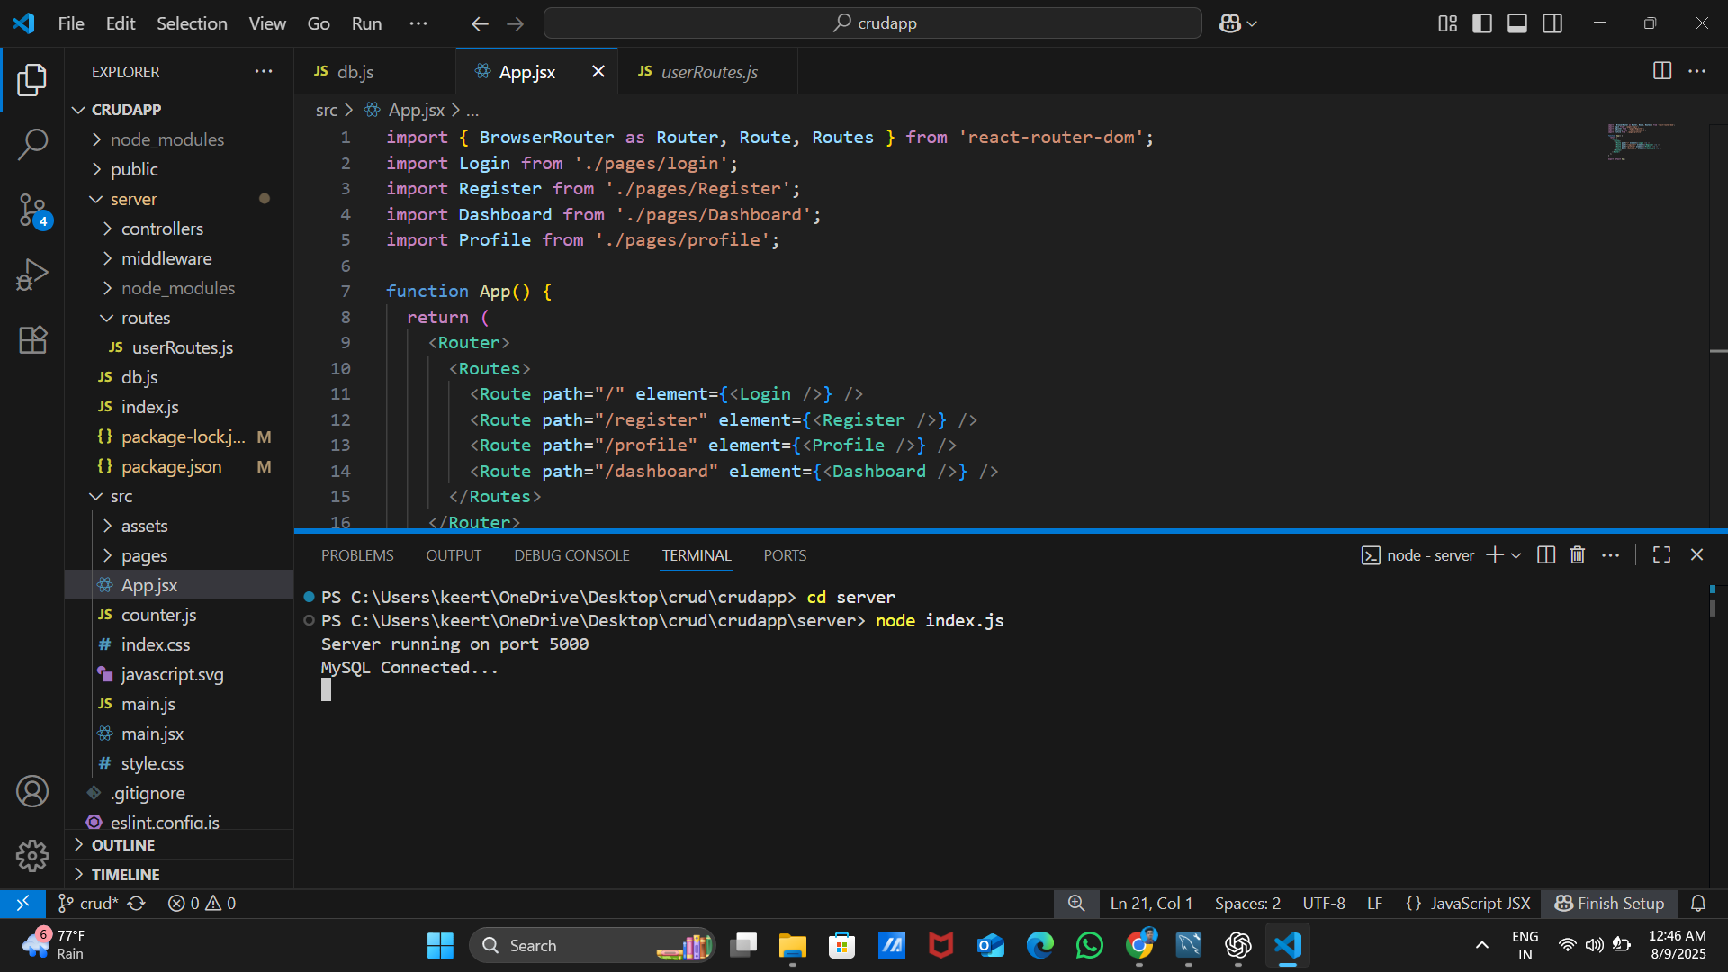
Step 1: Start Backend
Run index.js in the backend. Console shows 'MySQL connected...' indicating successful database connection.

Slide 3
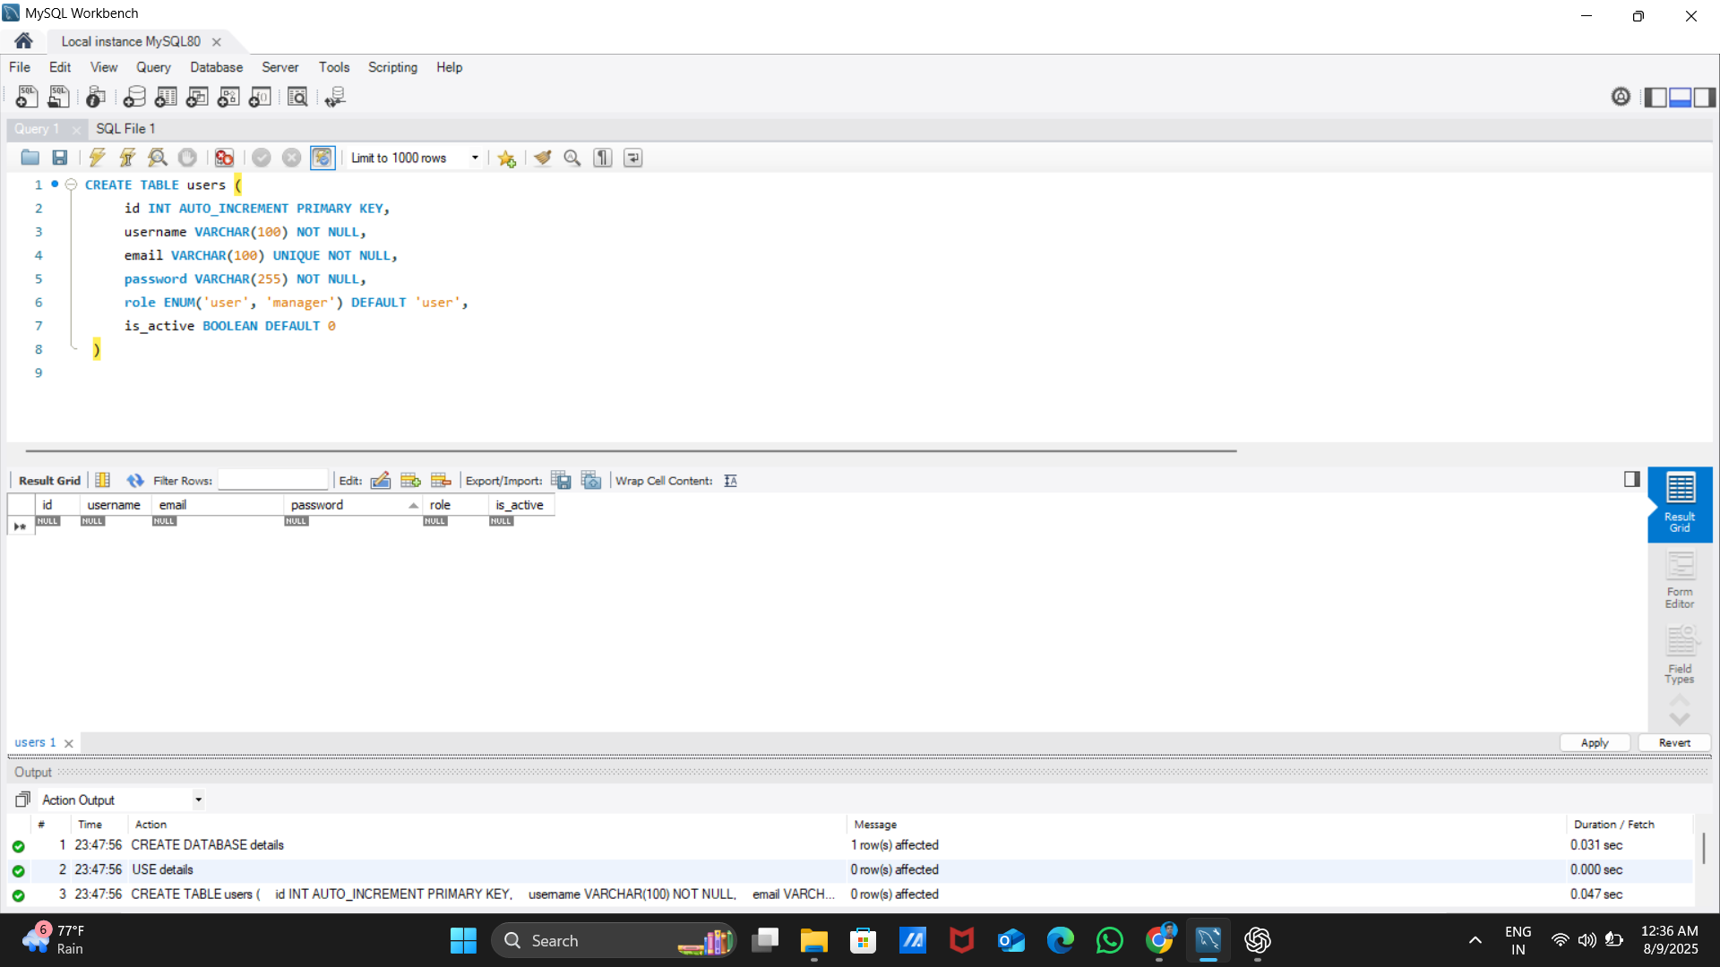
Step 2: Create MySQL Database
Open MySQL and create the required database to store user data.

Slide 4
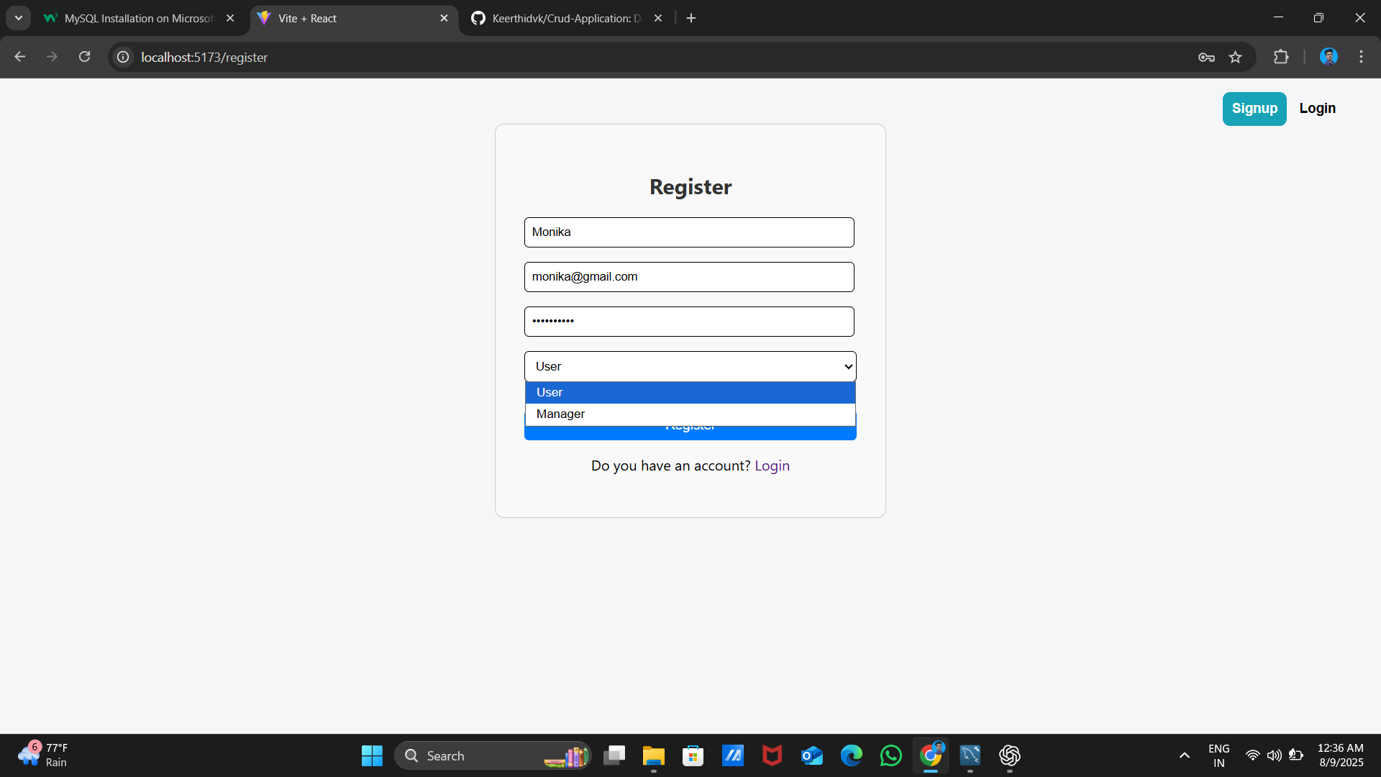
Step 3: Run Frontend
Start the frontend application to enable user interactions.

Slide 5
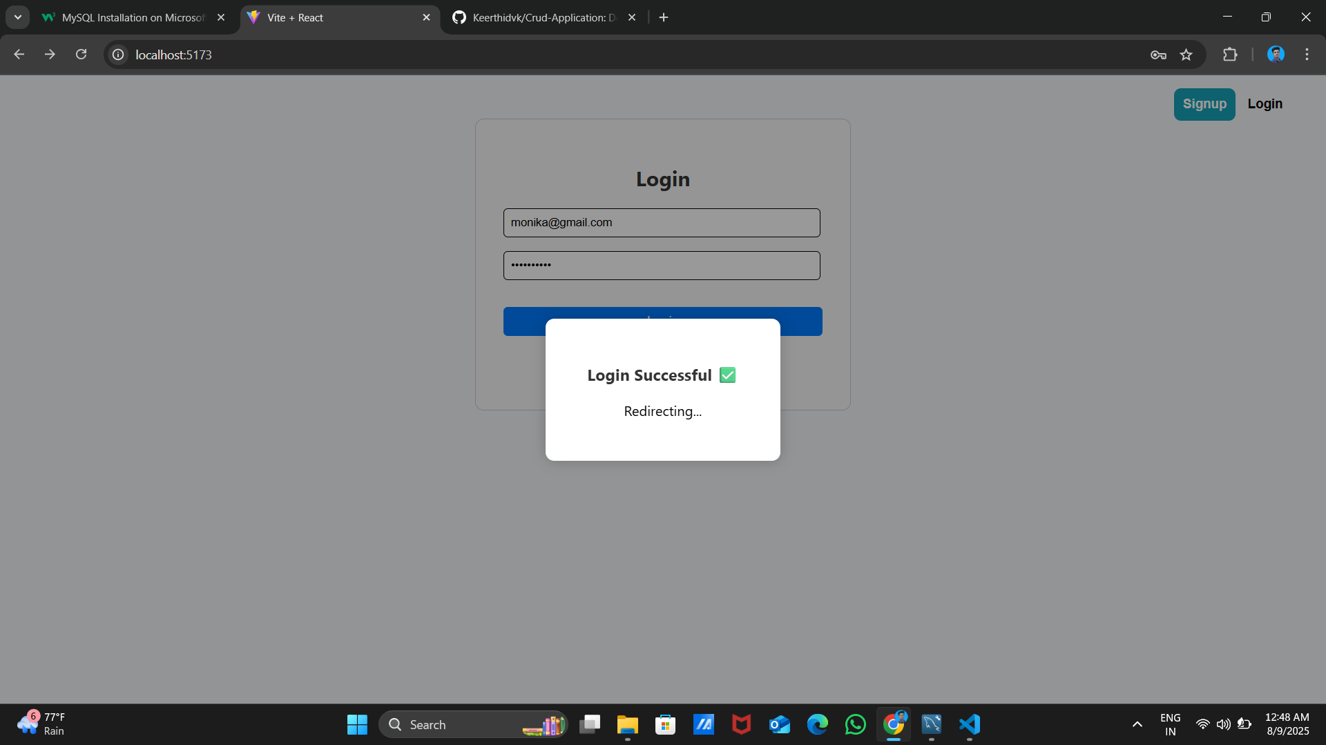
Step 4: Login as User
Login using the role of 'user'. A login popup appears to authenticate credentials.

Slide 6
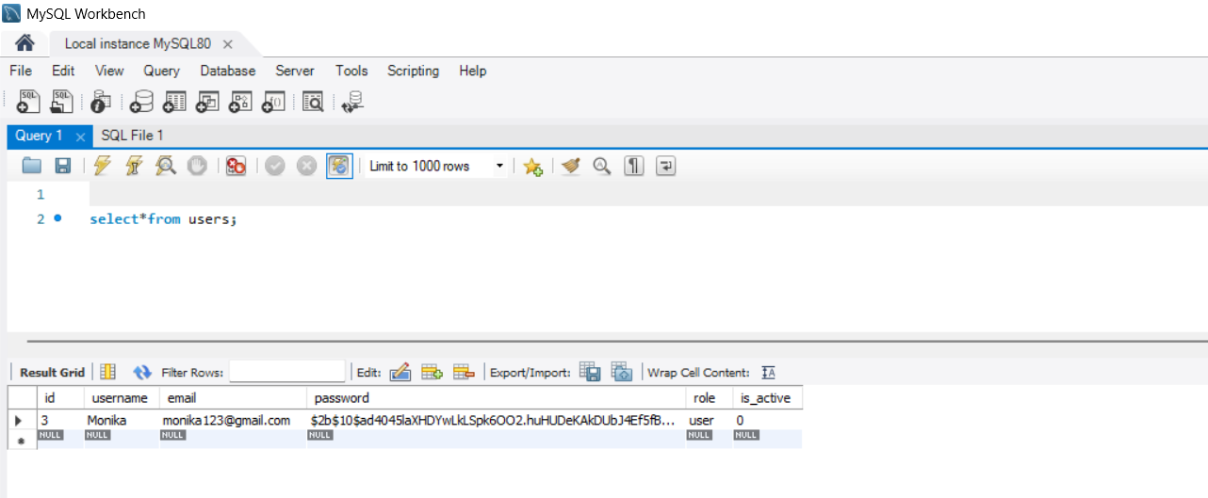
Step 5: Database Update After Login
After successful login, the database updates with 1 new row containing the user details.

Slide 7
Step 6: Password Tokenization
The password is hidden and stored securely as a token in the database.

Slide 8
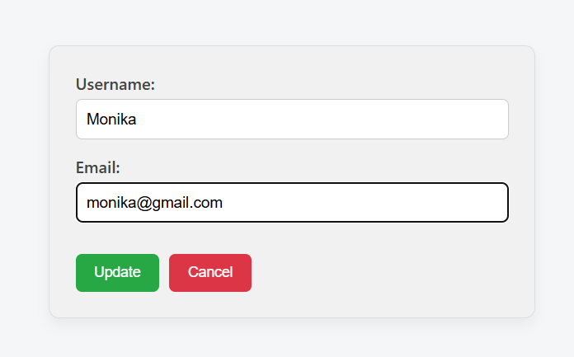
Step 7: View and Edit Profile
The user can view and edit their profile. For example, changing the email updates it in the database.
It will have updated in database.

Slide 9
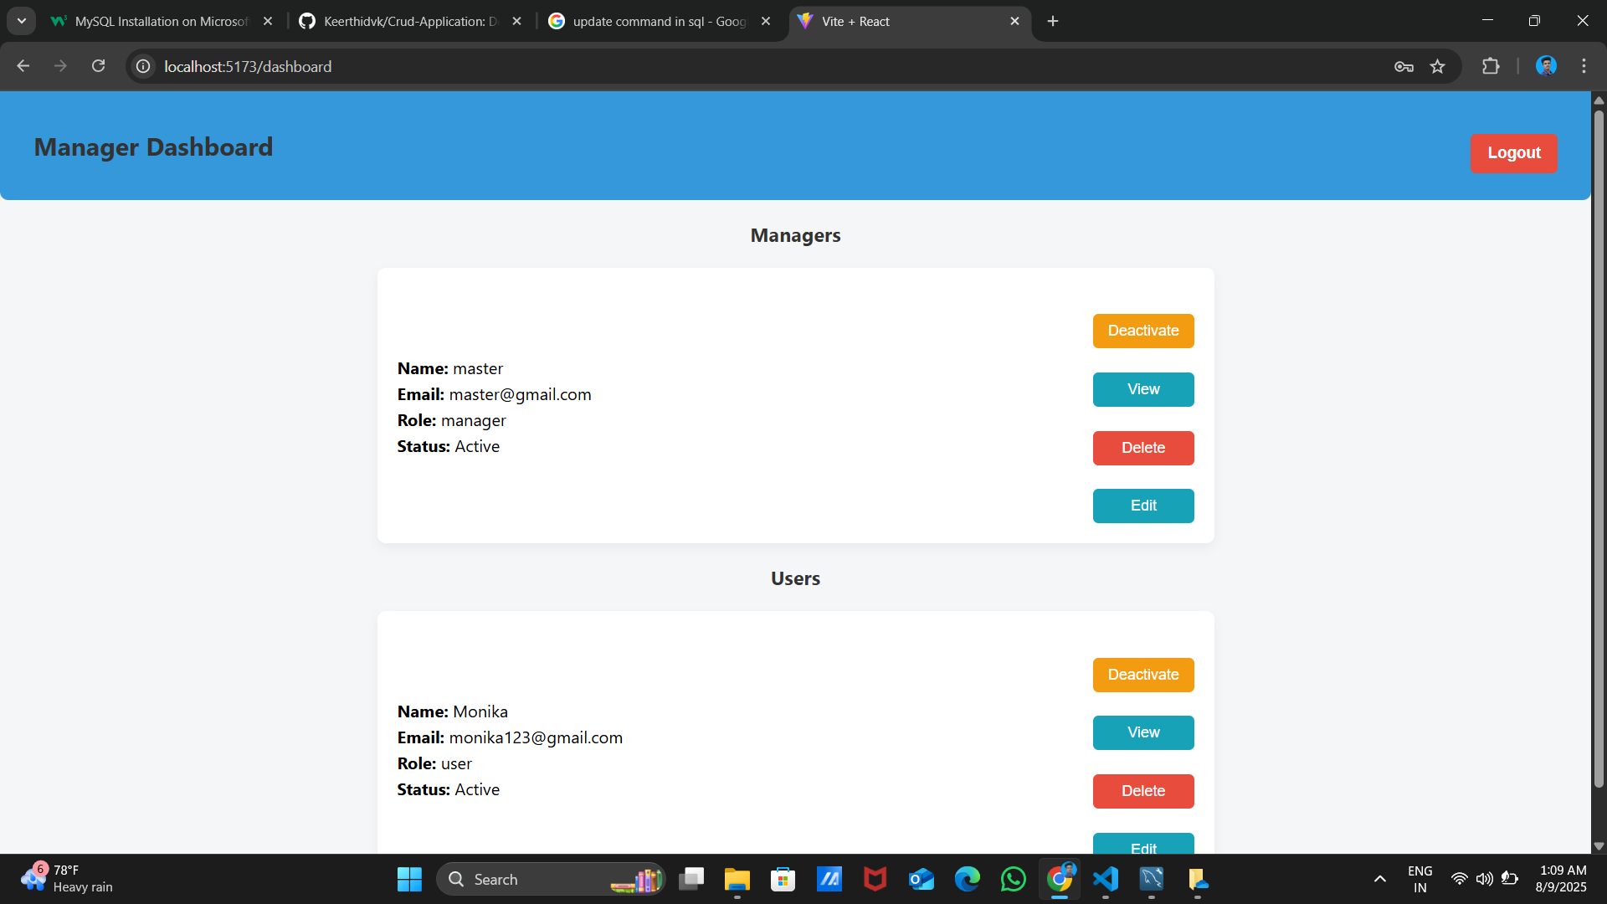
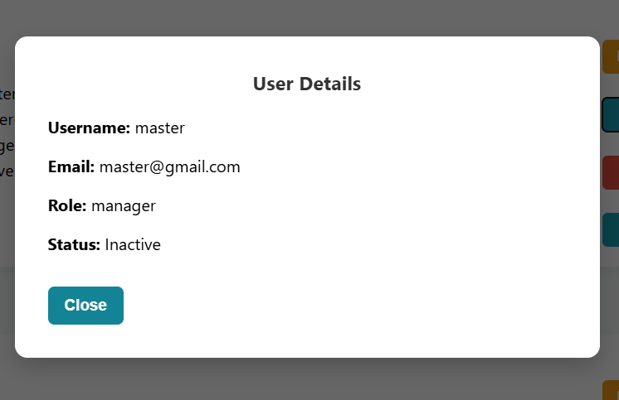
Step 8:Admin Mode
The Admin can view and edit and activate and deactivate the user profile.

