Slide 1
CUSTOMER CHURN PREDICTION CAPSTONE PROJECT
PRESENTED BY,
KEERTHIGA SEKAR

Slide 2
Business Problem
A DTH provider is facing a lot of competition in the current market and it has become a challenge to retain the existing customers in the current situation. Hence, the company wants to develop a model through which they can do churn prediction of the accounts and provide segmented offers to the potential churners. In this company, account churn is a major thing because 1 account can have multiple customers. hence by losing one account the company might be losing more than one customer.
Task:
You have been assigned to develop a churn prediction model for this company and provide business recommendations on the campaign. Your campaign suggestion should be unique and be very clear on the campaign offer.

Slide 3
Business Problem Understanding
DTH provider faces heavy competition resulting in customer churn
Loss of customers implies Loss of Revenue
Huge initial cost /customer & fixed content fee to broadcasters impacts profits
Customer acquisition cost = 5 to 6 times customer retention cost
Success rate of selling any new product or services to existing Customer is at 60-70% whereas to new customer is at 5-20%
Increasing customer retention by 5% increases profits from 25-95%
5 U.S. companies lose $136.8 billion per year due to avoidable consumer churning.

Slide 4
KEY INFORMATION ABOUT DATA
Shape
Dataset contains 11260 rows and 19 columns(5 float,2 integer,12 object )
Duplicates
No duplicate values present in the dataset
Missing Values
4361 total nulls in the dataset
2.28% of all predictor fields
Outliers
Around 2658 outliers in numeric continuous columns
Constitutes 1.4% of all predictor fields
Data clean up
Special characters such as #, &, +, $, @ present
Different representations of same category present. E.g., Male and M, Female and F
Target variable
Churn = 1 (Churned customer), Churn = 0 (Non churned customer)
16.8% churned customers in dataset

Slide 5
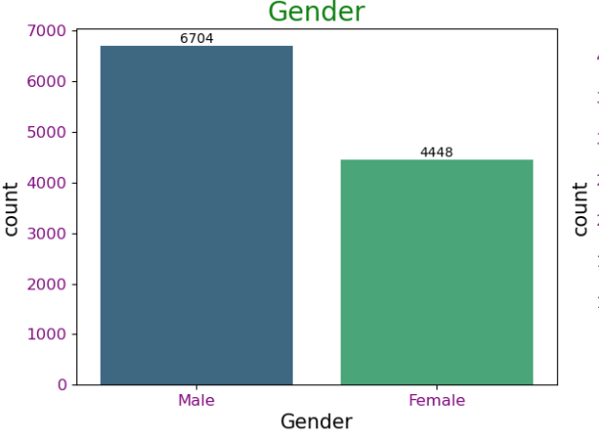
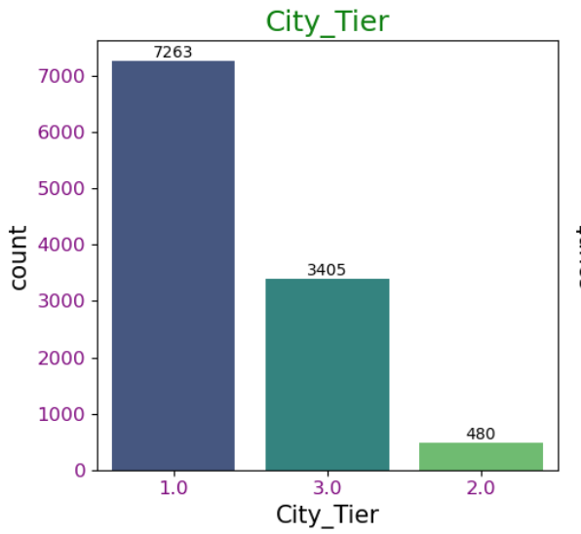
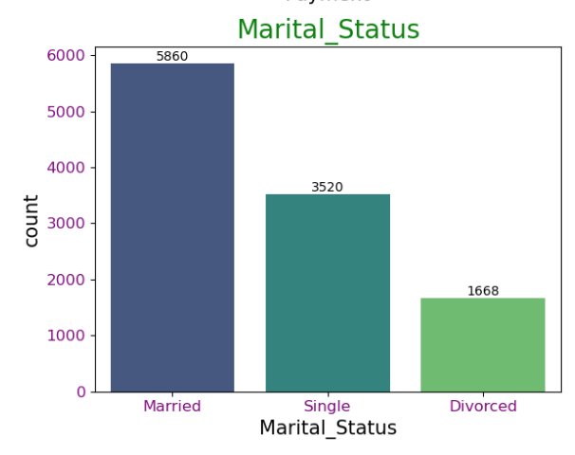
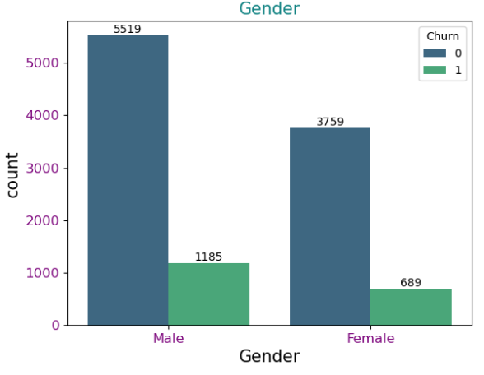
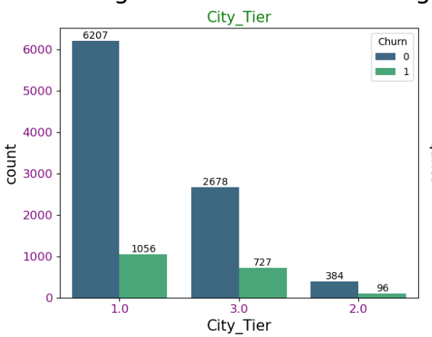
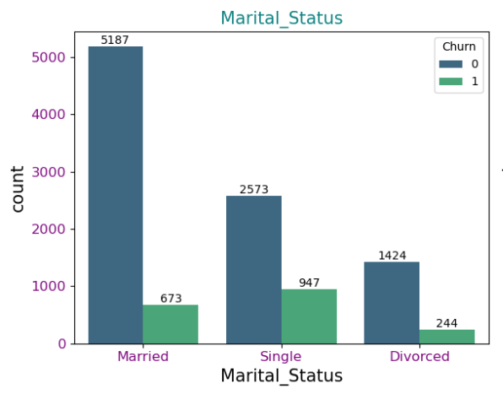
EXPLORATORY DATA ANALYSIS

Slide 6
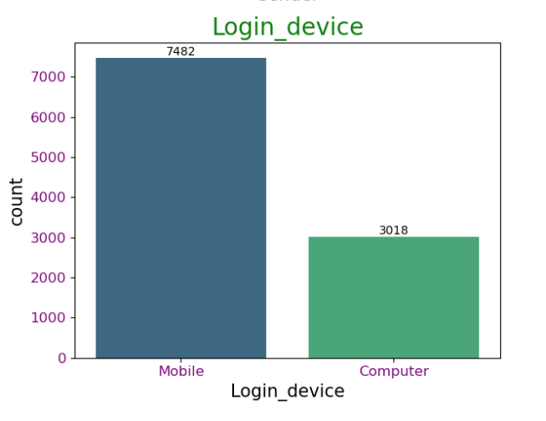
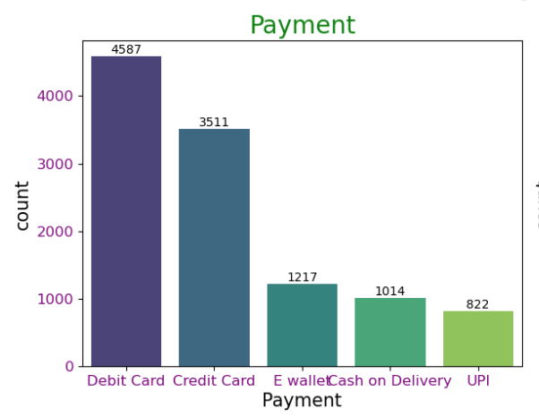
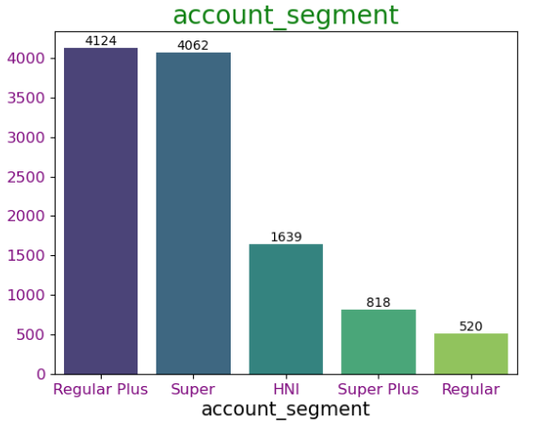
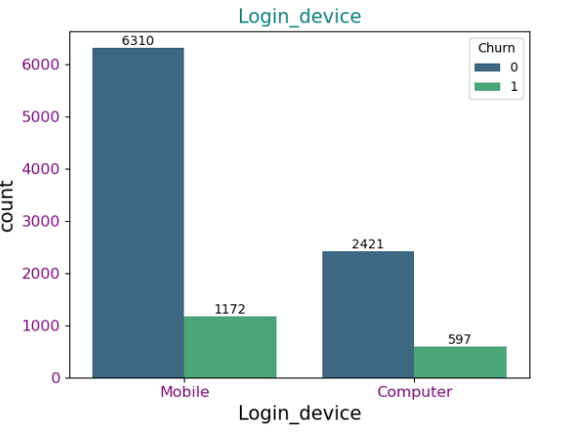
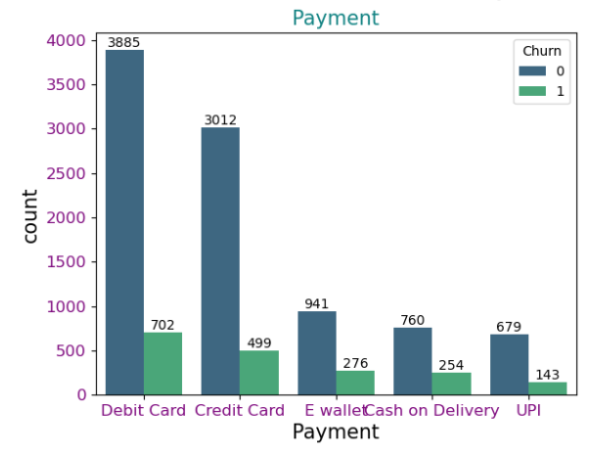
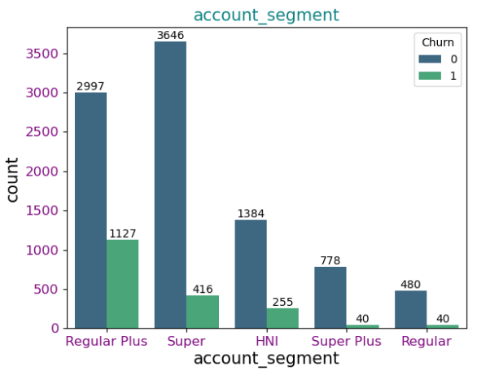
EXPLORATORY DATA ANALYSIS

Slide 7
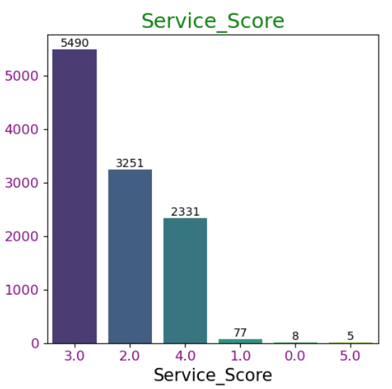
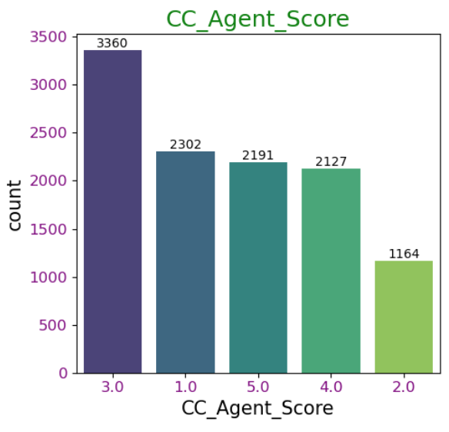
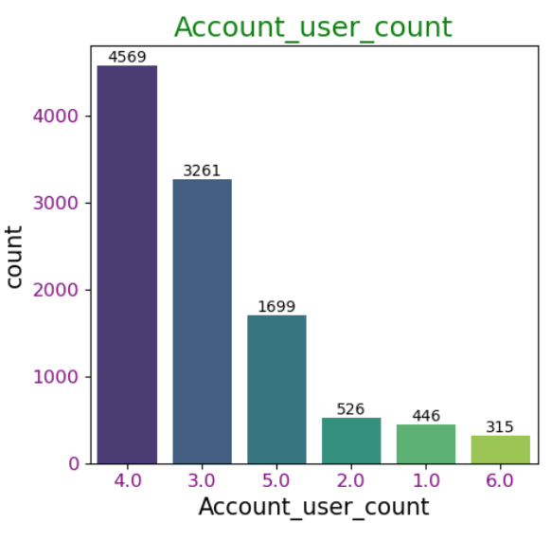
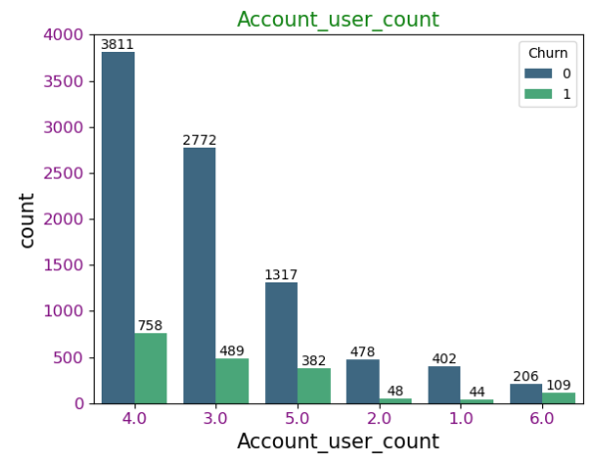
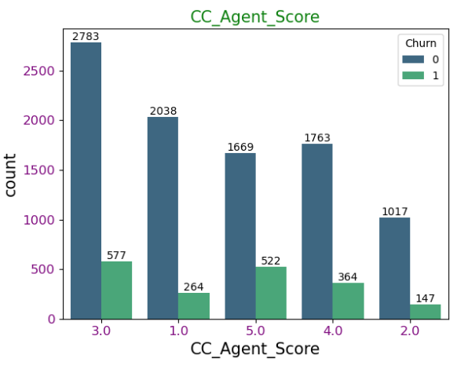
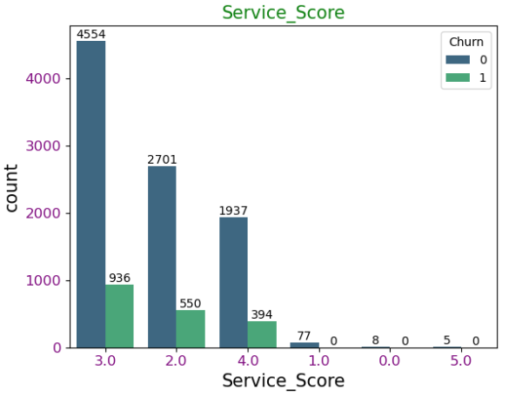
EXPLORATORY DATA ANALYSIS

Slide 8
Modelling Approach Used & Why
Data Cleaning
EDA
Pre-processing Data
Train – Test Split
Models Built
Up-Sampling
The dataset has been cleaned to address any anomalies
Appropriate methods were applied for handling null values, outlier treatment, and correcting incorrect data type mappings.
Performed univariate, bivariate and multivariate analysis
All categorical columns were encoded using a Label Encoder.
Features are scaled using MinMax Scalar.
Train – Test split is done using the 70 : 30 ratio.
Used SMOTE technique for balancing the Data.
Here, synthetically generated data points corresponding to minority class are injected into the datasets.
Built various models and checked Performance metrics against the Test data.
Done Hyper-parameter Tuning to get Better Accuracy and Generalized models.

Slide 9
Modelling Approach Used & Why
Feature Selection
Variance Inflation Factor is used to select the Important features using the VIF value.
Dropped the features with VIF > 5.
Models Built
Logistic Regression, LDA, KNN, Naïve Bayes, Random Forest, Bagging Classifier, Ada Boost,
XG Boost Classifier, Light GBM
Model evaluation criteria –Good fit, Interpretable, Recall for 1s ,F1score, Precision.
Model Selection - Best model is selected based on the Performance Metrics

Slide 10
COMPARISON OF MODEL PERFORMANCE
Models | Class | Accuracy |  | Precision |  | Recall |  | f1 Score |  | AUC
 |  | Train | Test | Train | Test | Train | Test | Train | Test | Train | Test
Logistic Regression | Churn(1) | 0.84 | 0.85 | 0.59 | 0.65 | 0.19 | 0.23 | 0.28 | 0.34 | 0.79 | 0.78
 | Not Churn(0) |  |  | 0.86 | 0.86 | 0.97 | 0.98 | 0.91 | 0.91
Logistic Regression Smote | Churn(1) | 0.74 | 0.77 | 0.71 | 0.39 | 0.67 | 0.65 | 0.69 | 0.49 | 0.8 | 0.78
 | Not Churn(0) |  |  | 0.76 | 0.92 | 0.79 | 0.8 | 0.78 | 0.85
Logistic Regression Tuned | Churn(1) | 0.84 | 0.85 | 0.59 | 0.65 | 0.18 | 0.22 | 0.28 | 0.33 | 0.79 | 0.79
 | Not Churn(0) |  |  | 0.85 | 0.86 | 0.97 | 0.98 | 0.91 | 0.91
LDA | Churn(1) | 0.85 | 0.85 | 0.62 | 0.67 | 0.23 | 0.28 | 0.33 | 0.39 | 0.78 | 0.78
 | Not Churn(0) |  |  | 0.86 | 0.87 | 0.97 | 0.97 | 0.91 | 0.92
LDA Smote | Churn(1) | 0.74 | 0.77 | 0.71 | 0.39 | 0.67 | 0.64 | 0.69 | 0.48 | 0.8 | 0.78
 | Not Churn(0) |  |  | 0.76 | 0.92 | 0.79 | 0.8 | 0.78 | 0.85
LDA Tuned | Churn(1) | 0.85 | 0.85 | 0.62 | 0.66 | 0.22 | 0.27 | 0.32 | 0.38 | 0.78 | 0.78
 | Not Churn(0) |  |  | 0.86 | 0.87 | 0.97 | 0.97 | 0.91 | 0.92
KNN_3 | Churn(1) | 0.97 | 0.95 | 0.92 | 0.76 | 0.88 | 0.75 | 0.9 | 0.75 | 0.99 | 0.93
 | Not Churn(0) |  |  | 0.98 | 0.95 | 0.98 | 0.95 | 0.98 | 0.95
KNN_1 | Churn(1) | 0.99 | 0.93 | 0.97 | 0.8 | 0.98 | 0.83 | 0.97 | 0.81 | 0.98 | 0.89
 | Not Churn(0) |  |  | 1 | 0.96 | 0.99 | 0.96 | 0.99 | 0.96
KNN_3 Smote | Churn(1) | 0.97 | 0.91 | 0.96 | 0.69 | 0.98 | 0.85 | 0.97 | 0.76 | 0.99 | 0.93
 | Not Churn(0) |  |  | 0.99 | 0.97 | 0.97 | 0.92 | 0.98 | 0.94
KNN Tuned | Churn(1) | 0.99 | 0.94 | 0.99 | 0.83 | 0.96 | 0.8 | 0.98 | 0.81 | 1 | 0.94
 | Not Churn(0) |  |  | 0.99 | 0.96 | 1 | 0.97 | 1 | 0.96
Naïve Bayes | Churn(1) | 0.86 | 0.85 | 0.58 | 0.55 | 0.56 | 0.55 | 0.57 | 0.55 | 0.82 | 0.8
 | Not Churn(0) |  |  | 0.91 | 0.91 | 0.92 | 0.91 | 0.91 | 0.91
Naïve Bayes Smote | Churn(1) | 0.73 | 0.67 | 0.64 | 0.32 | 0.83 | 0.81 | 0.72 | 0.45 | 0.83 | 0.8
 | Not Churn(0) |  |  | 0.83 | 0.94 | 0.65 | 0.64 | 0.73 | 0.77
Random Forest | Churn(1) | 0.99 | 0.95 | 0.99 | 0.89 | 0.97 | 0.79 | 0.98 | 0.84 | 1 | 0.97
 | Not Churn(0) |  |  | 0.99 | 0.96 | 1 | 0.98 | 1 | 0.97
Random Forest Smote | Churn(1) | 0.99 | 0.95 | 0.99 | 0.86 | 0.99 | 0.82 | 0.99 | 0.84 | 1 | 0.97
 | Not Churn(0) |  |  | 1 | 0.96 | 0.99 | 0.97 | 0.99 | 0.97
Random Forest Tuned | Churn(1) | 0.92 | 0.90 | 0.93 | 0.83 | 0.6 | 0.49 | 0.73 | 0.62 | 0.98 | 0.95
 | Not Churn(0) |  |  | 0.92 | 0.9 | 0.99 | 0.98 | 0.96 | 0.94

Slide 11
COMPARISON OF MODEL PERFORMANCE
Models | Class | Accuracy |  | Precision |  | Recall |  | f1 Score |  | AUC
 |  | Train | Test | Train | Test | Train | Test | Train | Test | Train | Test
Bagging Classifier | Churn(1) | 0.99 | 0.95 | 0.98 | 0.86 | 0.95 | 0.81 | 0.97 | 0.84 | 0.99 | 0.95
 | Not Churn(0) |  |  | 0.99 | 0.96 | 1 | 0.97 | 0.99 | 0.97
Bagging Classifier Smote | Churn(1) | 0.99 | 0.94 | 0.99 | 0.84 | 0.99 | 0.82 | 0.99 | 0.83 | 1 | 0.96
 | Not Churn(0) |  |  | 0.99 | 0.96 | 0.99 | 0.97 | 0.99 | 0.97
Bagging Classifier Tuned | Churn(1) | 0.99 | 0.95 | 0.99 | 0.9 | 0.95 | 0.79 | 0.97 | 0.84 | 0.99 | 0.97
 | Not Churn(0) |  |  | 0.99 | 0.96 | 1 | 0.98 | 0.99 | 0.97
Ada Boost Classifier | Churn(1) | 0.87 | 0.88 | 0.69 | 0.72 | 0.4 | 0.43 | 0.51 | 0.54 | 0.86 | 0.86
 | Not Churn(0) |  |  | 0.89 | 0.89 | 0.96 | 0.97 | 0.92 | 0.93
Ada Boost Classifier Smote | Churn(1) | 0.87 | 0.86 | 0.88 | 0.58 | 0.81 | 0.63 | 0.85 | 0.6 | 0.93 | 0.86
 | Not Churn(0) |  |  | 0.87 | 0.92 | 0.92 | 0.91 | 0.89 | 0.92
Ada Boost Classifier Tuned | Churn(1) | 0.87 | 0.88 | 0.69 | 0.72 | 0.4 | 0.43 | 0.51 | 0.54 | 0.86 | 0.86
 | Not Churn(0) |  |  | 0.89 | 0.89 | 0.96 | 0.97 | 0.92 | 0.93
XGBoost Classifier | Churn(1) | 0.98 | 0.94 | 0.97 | 0.86 | 0.91 | 0.76 | 0.94 | 0.81 | 0.99 | 0.97
 | Not Churn(0) |  |  | 0.98 | 0.95 | 0.99 | 0.98 | 0.99 | 0.96
XGBoost Classifier Smote | Churn(1) | 0.98 | 0.94 | 0.98 | 0.82 | 0.98 | 0.81 | 0.98 | 0.82 | 0.99 | 0.97
 | Not Churn(0) |  |  | 0.98 | 0.96 | 0.99 | 0.96 | 0.98 | 0.96
XGBoost Classifier Tuned | Churn(1) | 0.97 | 0.93 | 0.86 | 0.74 | 0.99 | 0.89 | 0.92 | 0.81 | 0.99 | 0.96
 | Not Churn(0) |  |  | 1 | 0.98 | 0.97 | 0.94 | 0.98 | 0.96
LightGBM | Churn(1) | 0.99 | 0.95 | 0.99 | 0.87 | 0.97 | 0.84 | 0.98 | 0.86 | 1 | 0.97
 | Not Churn(0) |  |  | 0.99 | 0.97 | 1 | 0.97 | 1 | 0.97

Slide 12
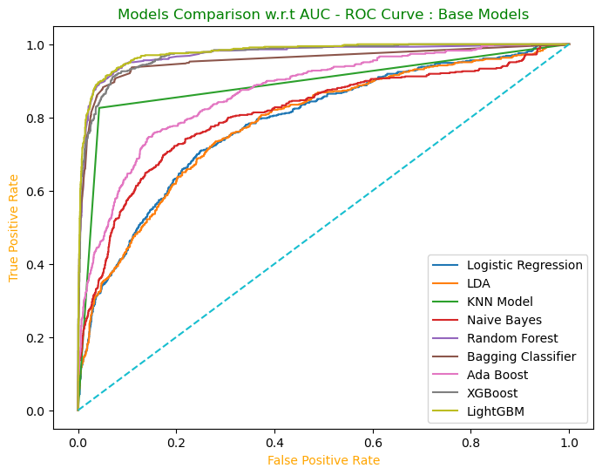
BEST MODEL
ROC curve and AUC
ROC : Performance of classification model at all classification thresholds
AUC: Signifies ability of model to differentiate between 0s and 1s
LightGBM
True positive rate/ Sensitivity/Recall = TP/ TP+FN
False positive rate= FP/FP+TN

Slide 13
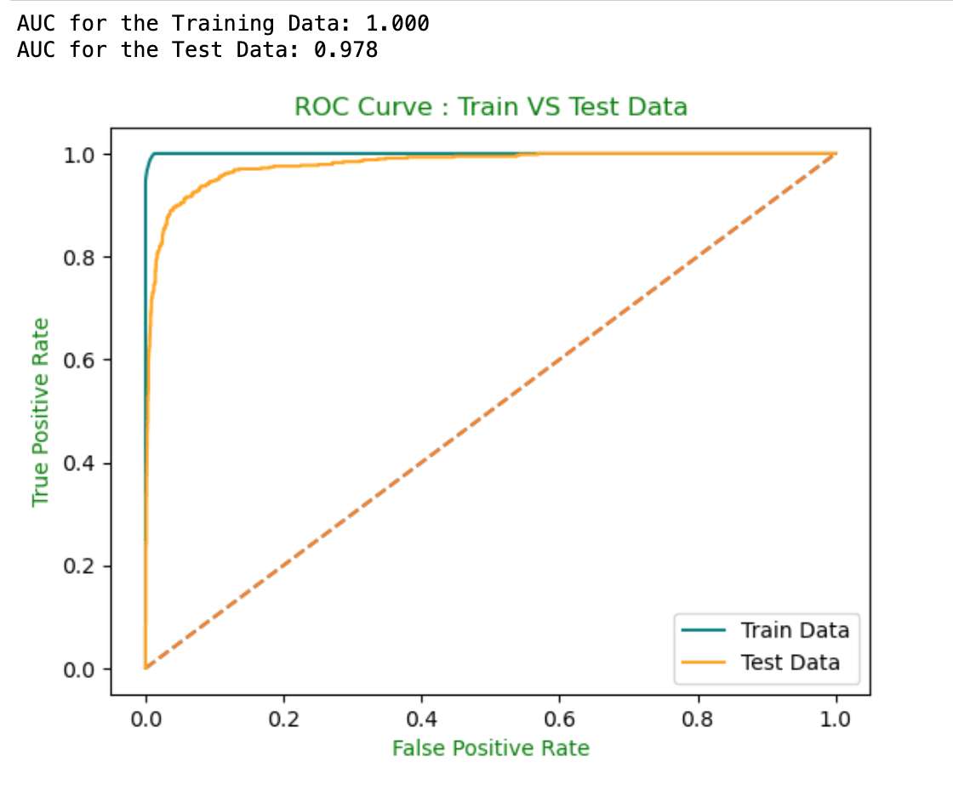
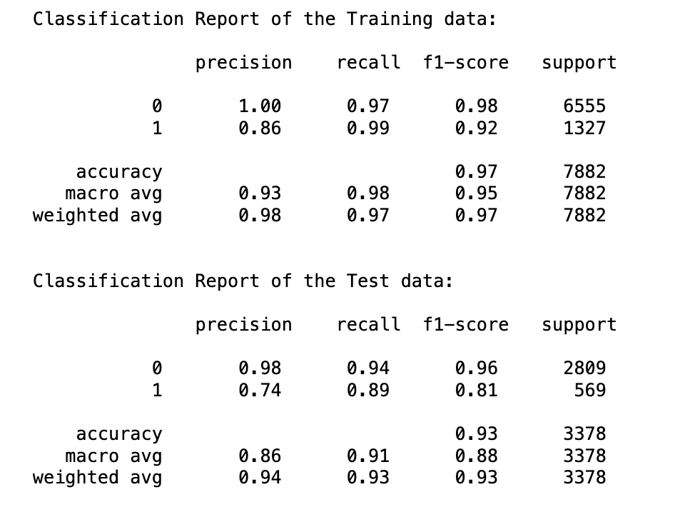
Why LightGBM?
Comparable train and test performances
Precision, Recall, F1-Score, Accuracy and AUC are high
Interpretable

Slide 14
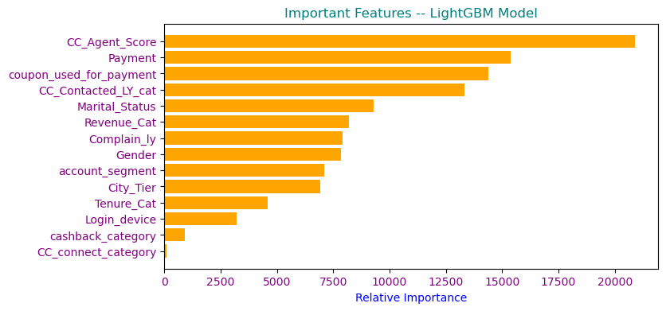
IMPORTANT FEATURES
From Model insights, CC_Agent_Score has the highest influence. It plays a significant role in the prediction task.
The second most important feature suggests that the type of payment is a critical factor.
Coupons being used for payments is a crucial factor, showing that customers’ use of coupons influences their behavior.
CC_Contacted_LY indicates that customers’ interactions with the company’s support system. It plays a significant role in influencing their behaviour.
Marital status appears to influence the outcomes in the dataset

Slide 15
Insights and Recommendation
Customer care service – Customer perspective
Recommendations
Conduct a comprehensive audit of the service to identify the root causes of customer dissatisfaction
Provide extensive training to customer care agents
Insights
78% of customers have rated service as 3 or less than 3
61% of customers have rated customer care agents a score of 3 or less than 3

Slide 16
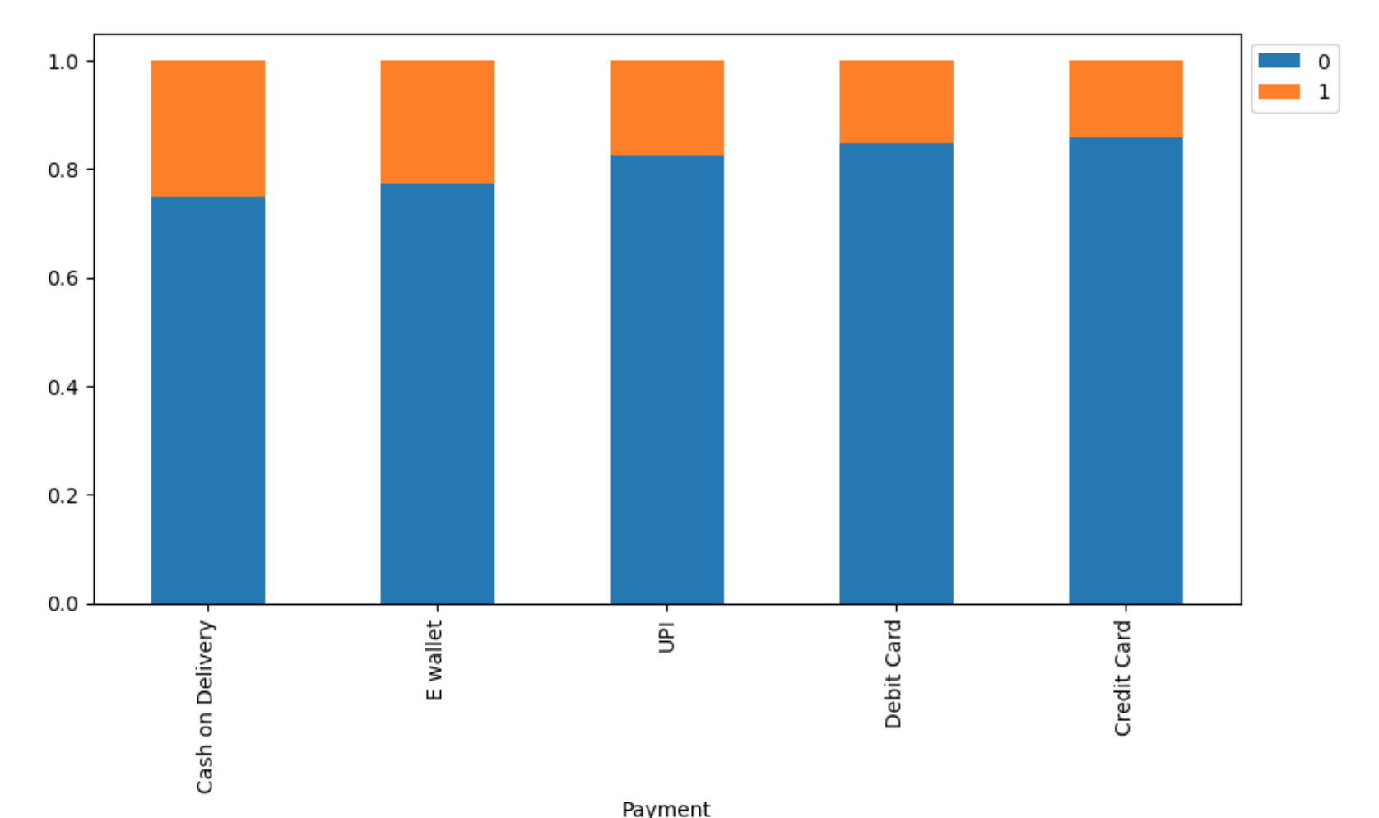
Insights and Recommendation
Recommendations
Given its popularity, businesses should ensure a smooth and efficient COD process.
Promote E-wallets and UPI as these payment methods offer convenience and security.
Insights
The proportions of 0 and 1 vary across different payment methods. Churn category 1 has a higher proportion in COD compared to other payment methods.
E-wallets, UPI, and Debit/Credit Cards have relatively similar distributions.

Slide 17
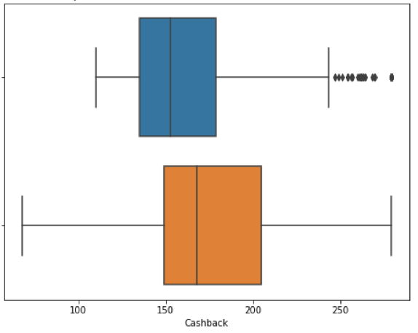
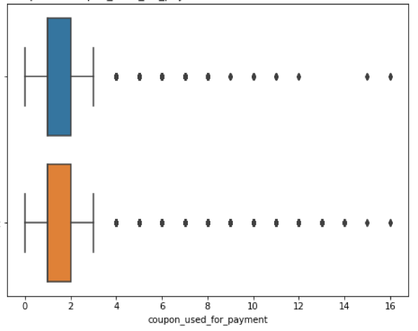
Insights and Recommendation
Cashback & Coupons
Recommendations
Create a tiered cashback system. This could increase their loyalty and engagement.
To maximize engagement, combine cashback offers with coupon usage
1
0
Insights
The churned customers as shown in first boxplot have lesser cashback
The churned and active customers have almost used the same number of coupons for payment
The current retention programs do not seem to be focusing on the customers with higher risk of churn

Slide 18
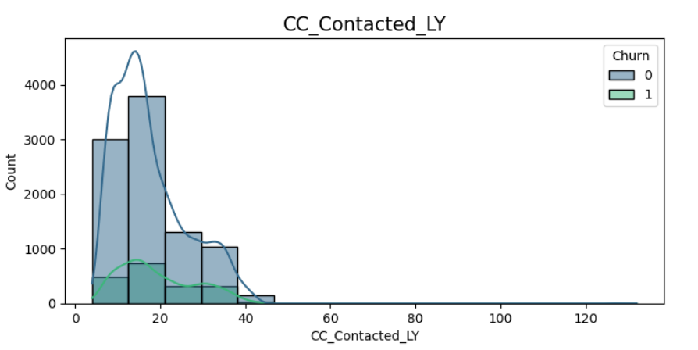
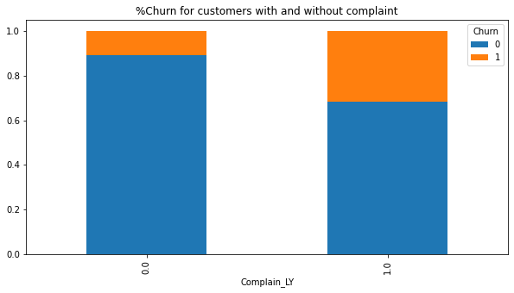
Insights and Recommendation
Churn and Customer care Service
Recommendation
Implement automated, personalized messages or reminders
Improve Response Times and Quality of Interactions
Self-Service Platforms
Retention Campaigns for At-Risk Groups.
Insights
There is a peak around the 0-10 contact range, suggesting that churned customers were either not very engaged with customer care or possibly dissatisfied with minimal contacts.
31% of customers who registered complaint churned Vs 11% of customers who have not registered complaint in last year

Slide 19
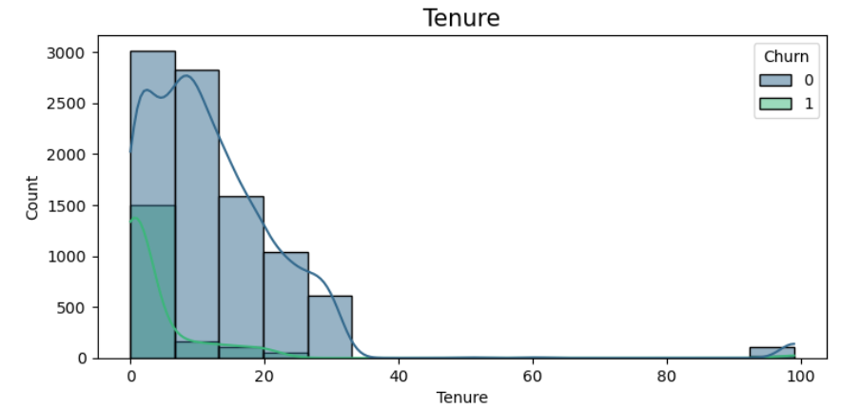
Insights and Recommendation
Recommendations
Educate and Engage early Customers by conducting Product Education Campaigns
Develop win-back campaigns that offer them exclusive deals
Implement automated check-ins
Insights
Higher proportion of customers who churn have been with the company for a shorter period. Churn is highest between the tenure period 0 to 2 months
A larger number of non-churn customers have been with the company for a longer duration.

Slide 20
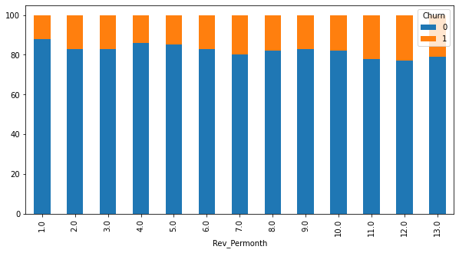
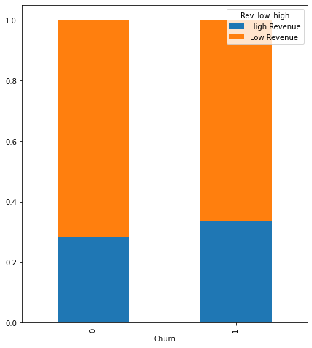
Insights and Recommendation
Revenue > = 7 : High revenue
Revenue < 7 : Low revenue
Recommendations
Identify and Address Pain Points for High-Revenue Customers
Conduct exit interviews or surveys
Insights
More proportion of high revenue customers are leaving compared to less revenue customers
The % churn of customers in higher revenue group, for revenue >=7 per month is higher than low revenue group customers

Slide 21
Thank you

