Slide 1
PROJECT INTRODUCTION
Task 4 of the Data Analyst Internship focuses on building an interactive business dashboard.
Objective: Analyze sales and profit performance using visual KPIs, trends, and filters.
Dataset Used: Superstore Sales Dataset (CSV format)
Tool: Microsoft Power BI (Free version).
This project emphasizes real-time insights for stakeholders and managers.

Slide 2
DASHBOARD OVERVIEW
The dashboard visualizes key business metrics including sales, profit, and regional performance.
Slicers enable interactive filtering by Region, Category, and Date.
Professional layout using cards, charts, and tables with consistent formatting.
Insights are clearly marked to support quick business decision-making.
Textboxes and buttons are used to enhance clarity and navigation.

Slide 3
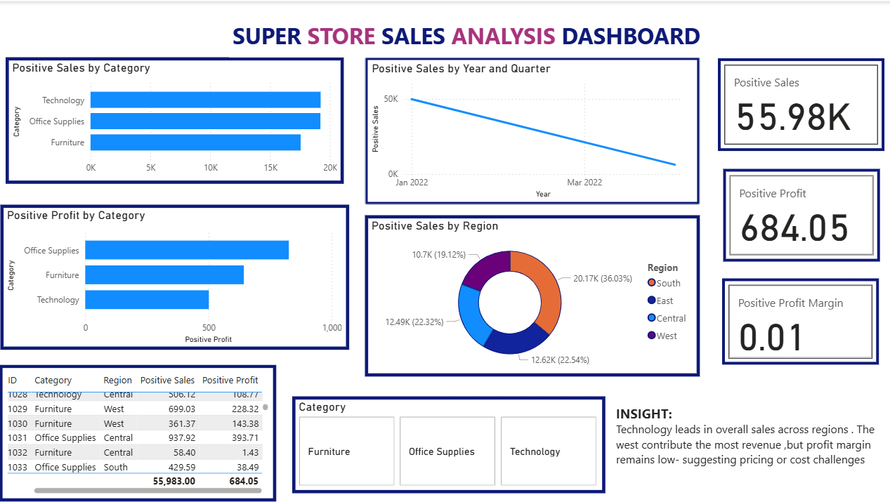

Slide 4
KPIS AND MEASURES IMPLEMENTED
1. Total Sales (Card visual using DAX):
Positive Sales = ABS(SUM('Superstore_Dataset'[Sales]))
2. Total Profit (Card visual using DAX):
Positive Profit = ABS(SUM('Superstore_Dataset'[Profit]))
3. Profit Margin (Card visual using DAX):
Positive Profit Margin =
DIVIDE(ABS(SUM('Superstore_Dataset'[Profit])), ABS(SUM('Superstore _Dataset'[Sales])))
These KPIs provide high-level summaries of financial performance.

Slide 5
VISUAL ELEMENTS ADDED
✔️ Card Visuals – For KPIs: Total Sales, Total Profit, and Profit Margin.
✔️ Line Chart – Sales trend over time (using Order Date).
✔️ Bar Chart – Sales by Product Category.
✔️ Donut Chart – Sales distribution across regions.
✔️ Table Visual – Order-level details for drill-down analysis.
✔️ Slicers – Horizontal slicers styled as buttons for better interactivity.
✔️ Insight Text Box – Added at the bottom with key business observations.

Slide 6
KEY INSIGHTS FROM DASHBOARD
📌 Technology category leads with the highest total sales.
📌 The West region has the highest revenue contribution overall.
📌 Q4 shows a significant increase in sales, suggesting seasonal trends.
📌 Despite high sales, the profit margin is low — indicating cost inefficiencies or pricing issues.
📌 Loss-making orders were identified and handled using ABS() for visual clarity in KPIs.

Slide 7
ENHANCEMENTS AND FORMATTING
APPLIED
🖼️ Consistent font sizes and colors across visuals.
📐 Visuals aligned using X-Y coordinates and uniform sizing for cards and charts.
🎛️ Button-style slicers for a clean and modern user experience.
📋 Layout divided into three key sections: KPIs (top), charts (middle), and slicers/table (bottom).
📌 Insight box formatted and positioned for immediate visibility.

Slide 8
TASK HIGHLIGHTS & COMPLETION
SUMMARY
✅ Understood and applied Power BI features such as cards, slicers, charts, and DAX.
✅ Used DAX measures to transform negative values and create custom calculations.
✅ Implemented a fully interactive dashboard with professional design.
✅ Created this presentation and README.md file for project documentation.
✅ Ready for GitHub upload and final submission per internship instructions.

