Slide 1

Department of Computer Science and Engineering
(Cyber Security)
CS23533– Foundations of Artificial Intelligence
2026-2027
AI BASED EMERGENCY RESOURCES ALLOCATIN SYSTEM— REVIEW 2
Dr. BHUVANA S,
ASSISTANT PROFESSOR SG
DHARSHINI S -241901026
KEERTHIKA K -241901046

Slide 2
Problem Statement and Motivation
Problem Statement
Manual emergency resource selection and route planning may delay response.
Suitable resources and routes must be identified quickly.
Motivation
Use knowledge-based rules to select suitable resources.
Apply A* algorithm for route finding.
Integrate allocation and map visualization in one web application.

Slide 3
Objectives
Develop a web-based emergency resource allocation system.
Select suitable resources using knowledge-based rules.
Find routes using the A* search algorithm.
Display emergency locations and routes on an interactive map.
Implement authentication, input validation, and allocation logging.
Completed So Far: Core resource allocation, A* routing, map visualization, and basic security features implemented.

Slide 4
Project Progress Since Review 1
Developed the Flask-based web application and user interface.
Implemented login authentication and role-based access control.
Developed knowledge-based emergency resource allocation.
Integrated A* algorithm for route finding.
Integrated interactive map visualization using Leaflet and OpenStreetMap.
Implemented input validation and allocation activity logging.
Current Status: Core modules integrated and basic end-to-end functionality demonstrated.

Slide 5
Literature Survey
S. No. | Author(s) & Year | Paper Title | Methodology / Algorithm | Limitations
1 | Nordin et al., 2012 | Finding Shortest Path of the Ambulance Routing: Interface of A* Algorithm Using C# Programming | A* shortest-path algorithm | Focuses on ambulance route finding rather than integrated resource allocation. researchgate.net
2 | Barrachina et al., 2014 | Reducing Emergency Services Arrival Time by Using Vehicular Communications and Evolution Strategies | Evolution strategies and vehicular communication-based rerouting | Depends on traffic and vehicular communication information.
3 | Pettet et al., 2022 | Designing Decision Support Systems for Emergency Response: Challenges and Opportunities | Emergency response decision-support and optimization approaches | Discusses broader decision-support challenges; our project implements a specific resource-selection and route-planning prototype. scopelab.ai

Slide 6
Research Gap and Project Response
1. Literature findings
A* supports shortest-path routing, while optimization and decision-support methods assist emergency response planning.
2. Limitations
Existing approaches may depend on routing information and do not always combine resource selection and route planning in one system.
3. Refined research gap
An integrated system is needed to support rule-based emergency resource allocation and map-based route planning.
4. Progress toward the solution
Implemented knowledge-based resource selection, A* routing, interactive map visualization, authentication, and allocation logging.

Slide 7
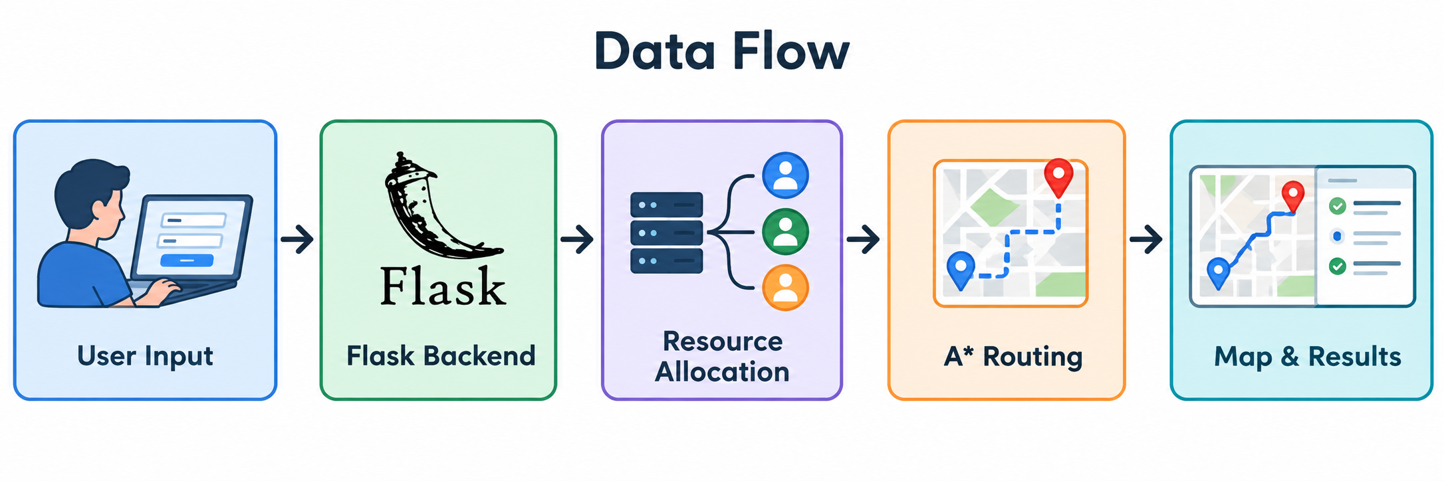
System Architecture / Proposed System
Main Components
User Interface: Enter emergency details and view results.
Flask Backend: Processes requests and coordinates modules.
Resource Allocator: Selects a suitable resource using knowledge-based rules.
A(Star) Pathfinding:Calculates a route using the road network.
Map Visualization: Displays the emergency location and route.
Security & Database: Handles authentication, access control, and allocation logs.
Improvement: Integrates resource selection, route planning, and map visualization in one web application.

Slide 8
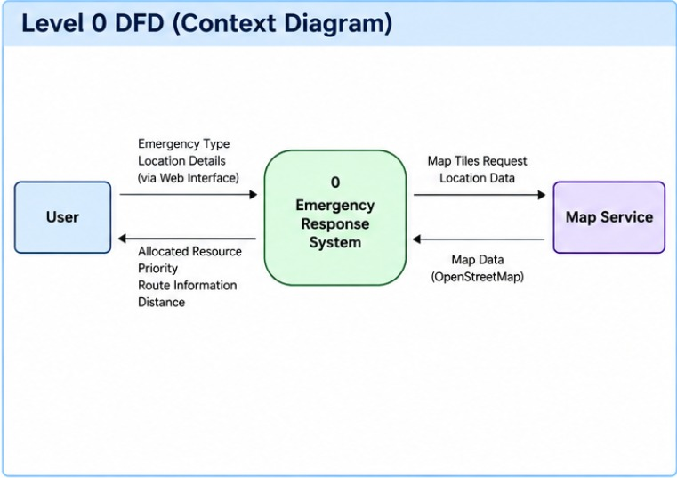
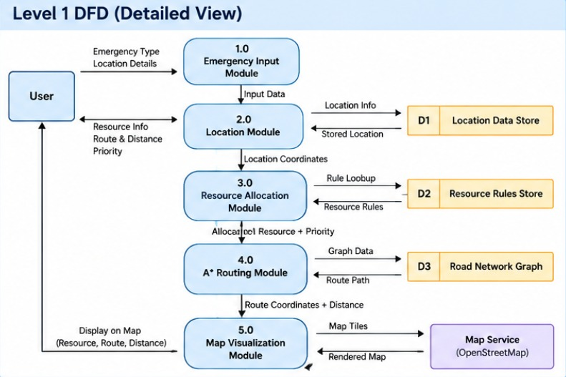
DFD Diagram

Slide 9
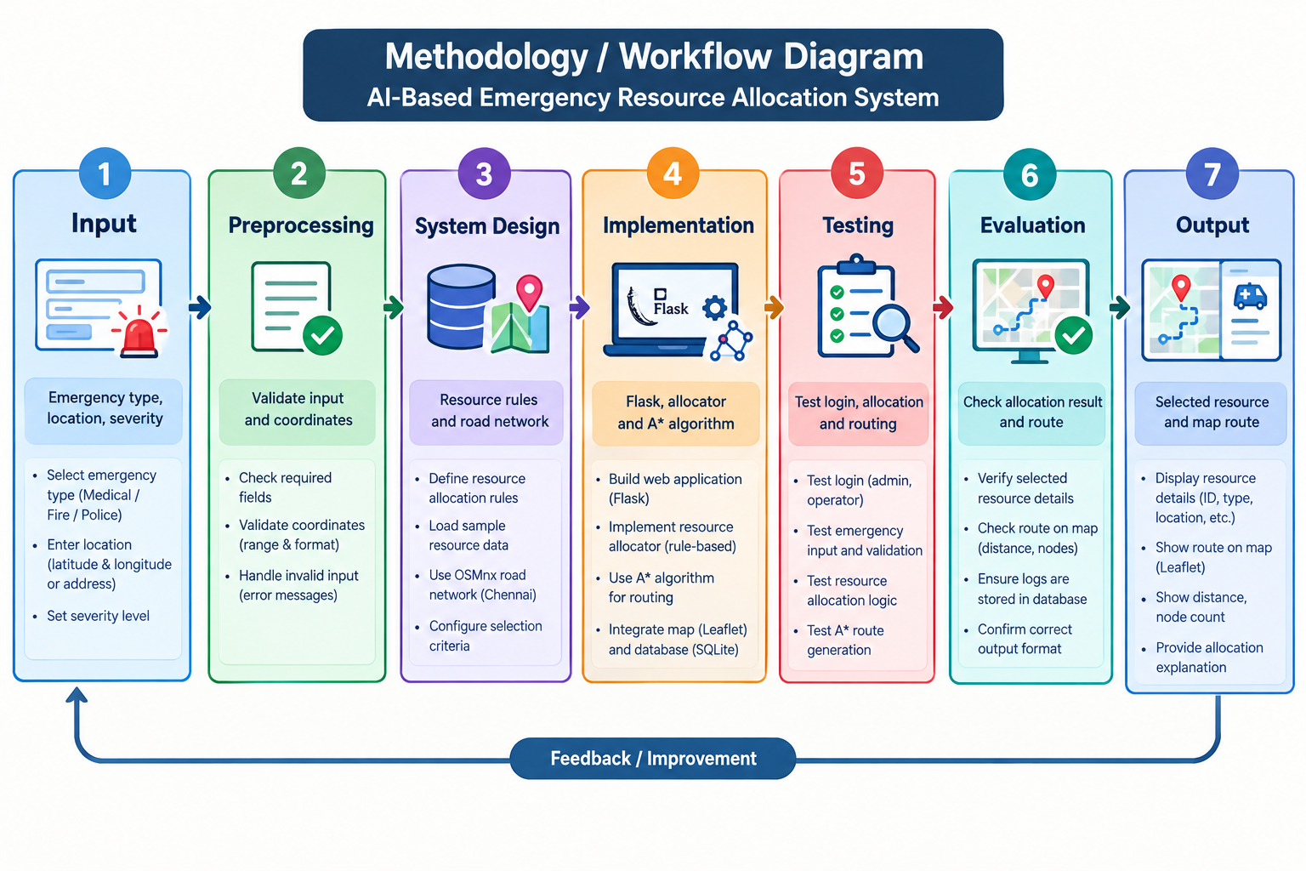
Methodology / Workflow Diagram

Slide 10
Tools and Technologies
Programming Language: Python, HTML, CSS, JavaScript
Frameworks / Libraries: Flask, NetworkX, OSMnx, Leaflet
Software / Database / Dataset:
SQLite database
OpenStreetMap road network
Python development environment
Justification:Flask handles backend requests.
NetworkX and OSMnx support A* route finding.
Leaflet displays locations and routes on a map.
SQLite stores allocation records.

Slide 11
List of Modules
Module 1 – Emergency Input & Location
index.html, map.js
Collects emergency details and location.
Module 2 – Resource Allocation
intelligent_allocator.py, resource_allocator.py
Selects a suitable resource using allocation rules.
Module 3 – A(star) Routing
astar.py, NetworkX, OSMnx
Finds a route using the A* algorithm.
Module 4 – Map Visualization
map.js, Leaflet, OpenStreetMap
Displays the location and route on the map.
Module 5 – Backend & API Integration
app.py, Flask, JSON
Connects the frontend with backend modules.

Slide 12
Module Implementation – Part 1
Module 1 – Emergency Input & Location
Purpose: Collect emergency details and location.
Input/Output: Emergency type and location → Validated emergency data.
Implementation: HTML, JavaScript and Leaflet map.
Key Functions: Location selection and input handling.
Status & Testing: Implemented; verify using emergency input and map selection.

Slide 13
Module Implementation – Part 2
Module 2 – Resource Allocation
Purpose: Select a suitable emergency resource.
Input/Output: Emergency details → Selected resource.
Implementation: Python-based knowledge rules.
Key Logic: Evaluate candidate resources and select a suitable match.
Interaction: Sends the selected resource to the A* routing module.
Status & Testing: Implemented; test output confirms resource selection.

Slide 14
Preliminary Results and Discussion
Resource Allocation: Suitable candidate resource selected.
Route Finding: A* calculates routes using the road network.
Map Visualization: Location and route displayed on the map.
Security Testing: Login and role-based access implemented.
Test Cases: Input handling, resource selection, and route generation.
Baseline Comparison: Manual selection vs. rule-based allocation.
Observation: Core modules integrated; quantitative performance evaluation is pending.

Slide 15
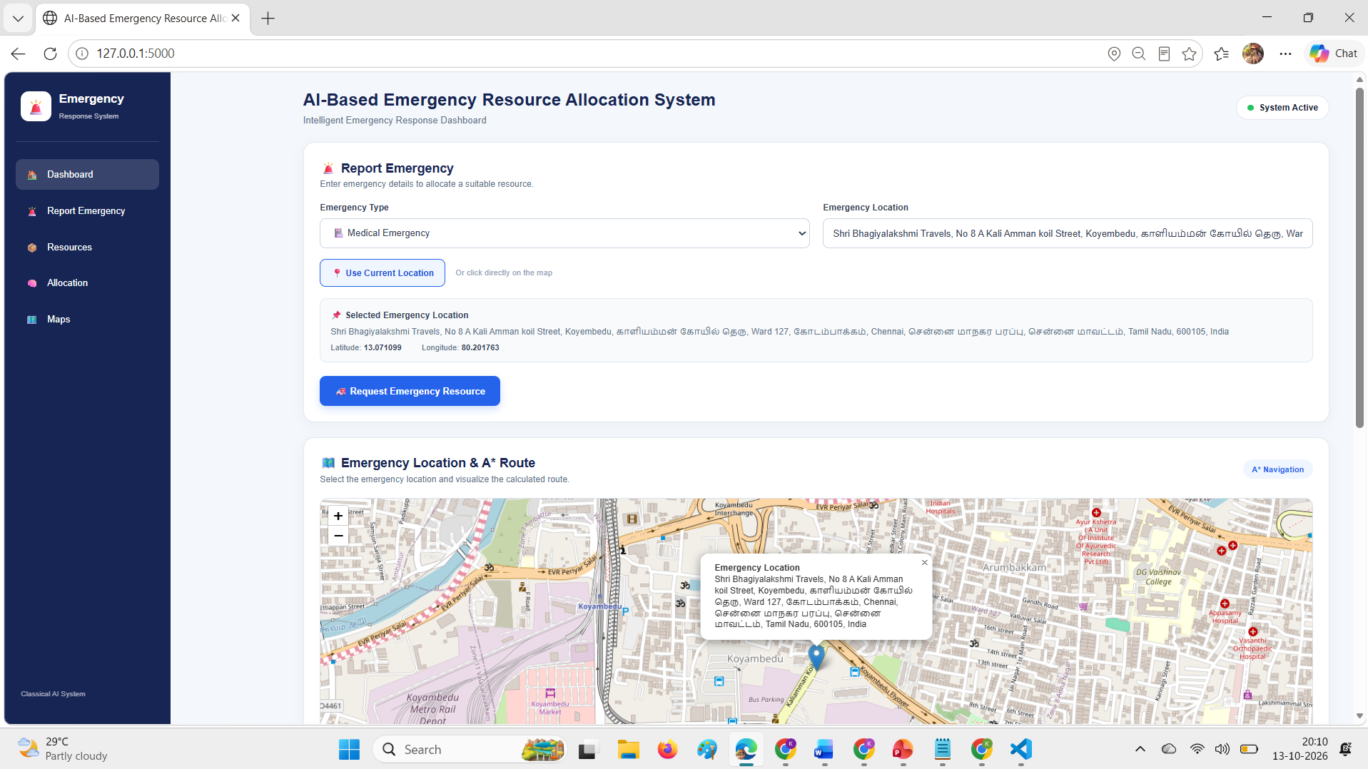
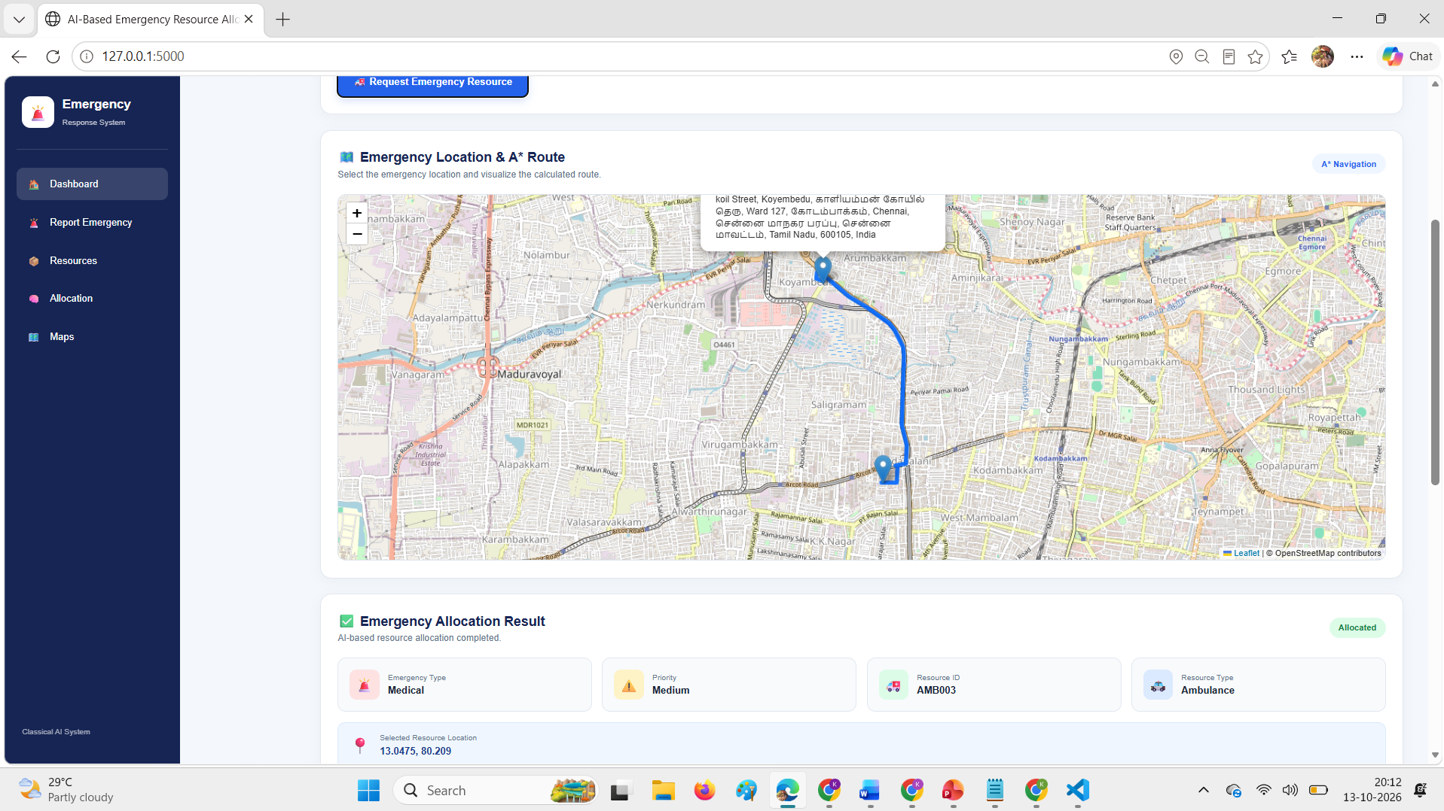
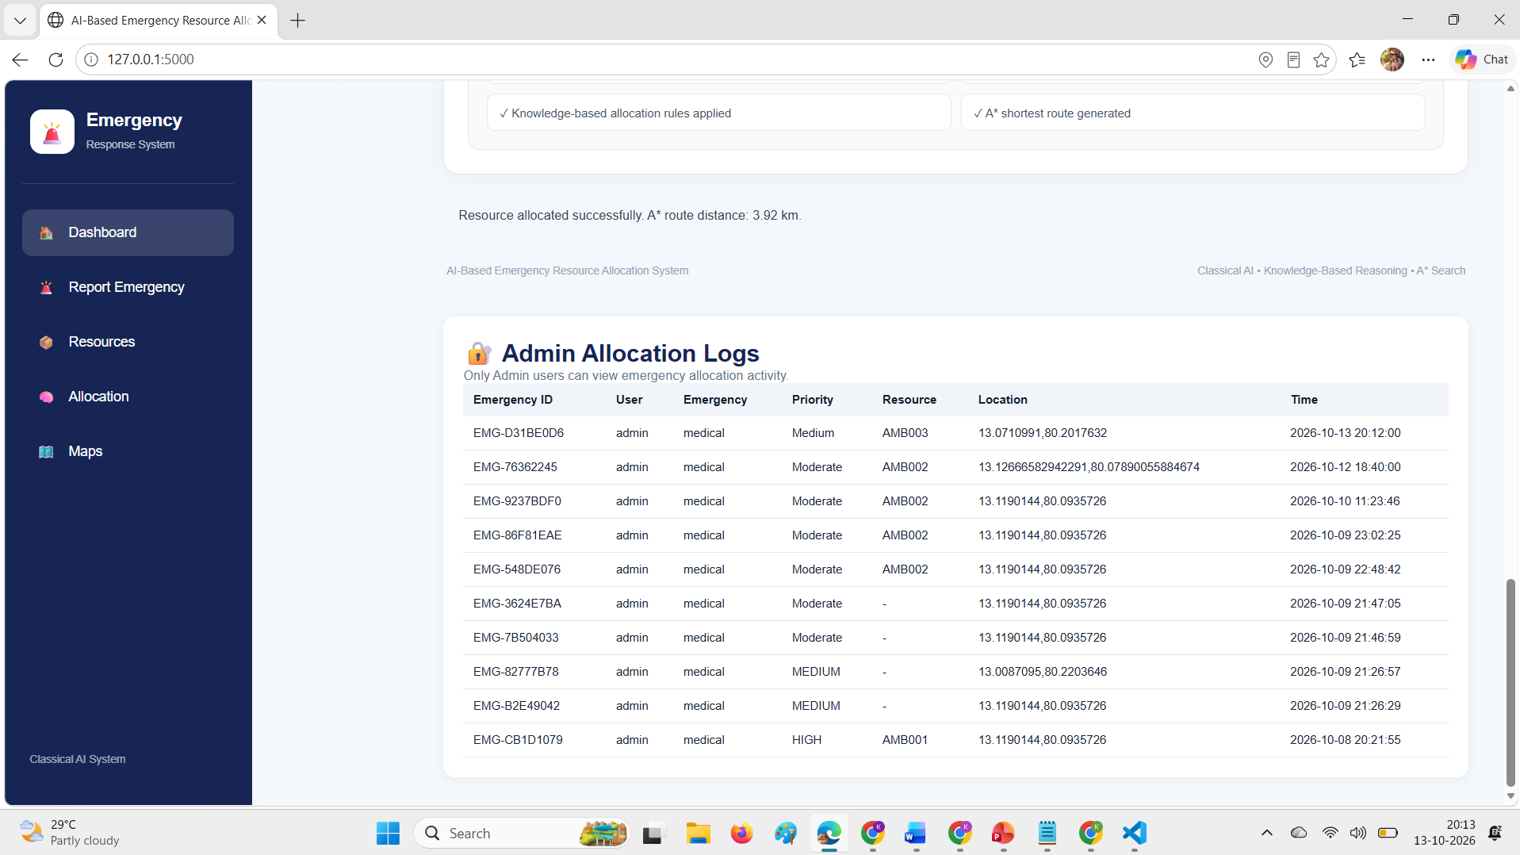
User Interface / Implementation Screenshots
Fig.1:Emergency Input Page.
Fig.2:Route Visualization
Fig.3:Allocation Logs

Slide 16
Challenges Faced and Solutions
Resource Selection: Implemented rule-based logic to select suitable resources.
Route Calculation: Used NetworkX A* with the configured road network.
Map Integration: Integrated Leaflet to display routes and locations.
Data Validation: Added input validation and authentication.
Remaining Issues: Real-time resource availability and live traffic are not integrated.

Slide 17
Work Plan Until Final Review
Week 1: Improve resource allocation and routing modules.
Week 2: Perform functional testing and fix errors.
Week 3: Evaluate results and document test observations.
Week 4: Complete project report and prepare presentation.
Final Milestone: End-to-end testing, screenshots, and final review preparation.

Slide 18
References
[1] A. Nordin et al., “Finding Shortest Path of the Ambulance Routing: Interface of A* Algorithm Using C# Programming,” 2012.
[2] J. Barrachina et al., “Reducing Emergency Services Arrival Time by Using Vehicular Communications and Evolution Strategies,” Expert Systems with Applications, vol. 41, no. 4, pp. 1206–1217, 2014.
[3] G. Pettet et al., “Designing Decision Support Systems for Emergency Response: Challenges and Opportunities,” 2022.
[4] NetworkX, “A* Shortest Path Algorithm Documentation.” https://networkx.org/documentation/stable/

Slide 19
References
[5] G. Boeing, “Modeling and Analyzing Urban Networks and Amenities with OSMnx,” Geographical Analysis, 2025.
[6] OpenStreetMap, “Map Data and Copyright.” https://www.openstreetmap.org/copyright

Slide 20
Thank You

