Slide 1

Department of Computer Science and Engineering
(Cyber Security)
CS23533– Foundations of Artificial Intelligence
2026-2027
AI BASED EMERGENCY RESOURCES ALLOCATIN SYSTEM
Dr. BHUVANA S,
ASSISTANT PROFESSOR SG
DHARSHINI S -241901026
KEERTHIKA K -241901046

Slide 2
Problem Statement and Motivation
Problem Statement
Manual emergency resource selection and route planning may delay response.
Suitable resources and routes must be identified quickly.
Motivation
Use knowledge-based rules to select suitable resources.
Apply A* algorithm for route finding.
Integrate allocation and map visualization in one web application.

Slide 3
Objectives
Develop a web-based emergency resource allocation system.
Select suitable resources using knowledge-based rules.
Find routes using the A* search algorithm.
Display emergency locations and routes on an interactive map.
Implement authentication, input validation, and allocation logging.
Completed So Far: Core resource allocation, A* routing, map visualization, and basic security features implemented.

Slide 4
Abstract
Develops an AI-based system for emergency resource allocation.
Selects suitable resources based on emergency type, priority, and location using knowledge-based rules.
Uses the A* search algorithm to find efficient routes to emergency locations.
Integrates resource allocation, route finding, and map visualization.
Applies classical AI concepts: Intelligent Agents, Heuristic Search, and Knowledge-Based Reasoning.
Aims to improve emergency response efficiency compared to manual methods.

Slide 5
Literature Survey
S. No. | Author(s) & Year | Paper Title | Methodology / Algorithm | Limitations
1 | Nordin et al., 2012 | Finding Shortest Path of the Ambulance Routing: Interface of A* Algorithm Using C# Programming | A* shortest-path algorithm | Focuses on ambulance route finding rather than integrated resource allocation. researchgate.net
2 | Barrachina et al., 2014 | Reducing Emergency Services Arrival Time by Using Vehicular Communications and Evolution Strategies | Evolution strategies and vehicular communication-based rerouting | Depends on traffic and vehicular communication information.
3 | Pettet et al., 2022 | Designing Decision Support Systems for Emergency Response: Challenges and Opportunities | Emergency response decision-support and optimization approaches | Discusses broader decision-support challenges; our project implements a specific resource-selection and route-planning prototype. scopelab.ai

Slide 6
Research Gap/Existing System
1. What existing studies do
Existing studies use A* search for emergency route planning and optimization techniques for emergency response..
2. Limitations observed
Some approaches focus mainly on routing or decision support rather than integrating resource selection and route planning..
3. Research gap
An integrated system combining knowledge-based resource allocation with A*-based routing is needed.
4. How our project responds
Our system combines rule-based resource selection, A* route finding, and map visualization in a web application.

Slide 7
Proposed System
Knowledge-Based Allocation: Selects suitable emergency resources using predefined rules.
A(star) Route Finding Calculates routes using the configured road network.
Map Visualization: Displays emergency locations and routes using Leaflet and OpenStreetMap.
Security Integration: Provides user authentication, role-based access, and allocation logging.

Slide 8
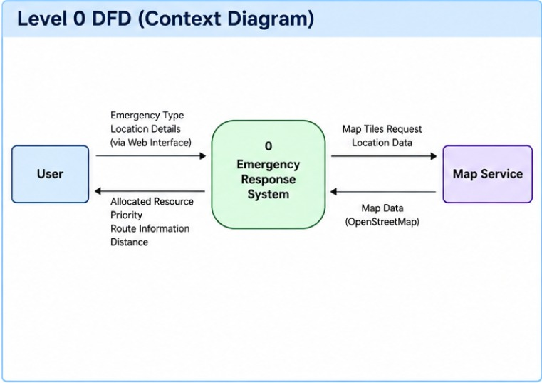
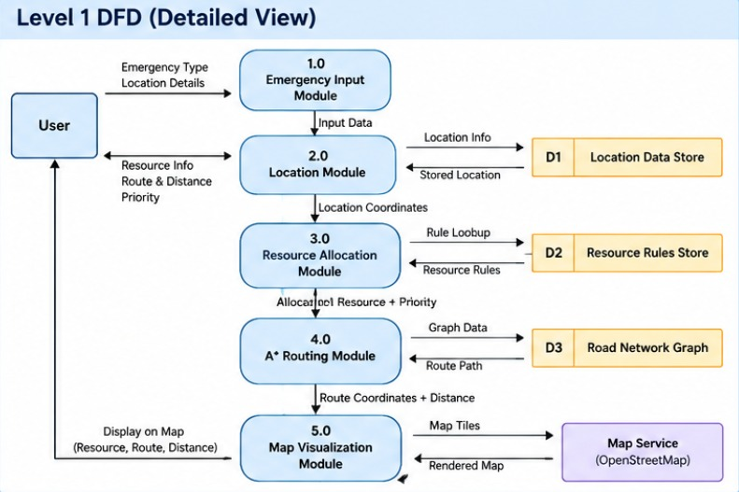
DFD Diagram

Slide 9
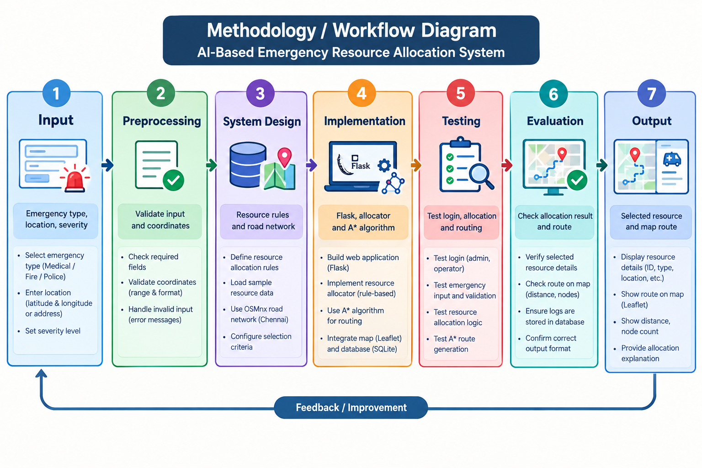
Methodology/Work Flow Diagram

Slide 10
Tools and Technologies
Programming Language: Python, HTML, CSS, JavaScript
Frameworks / Libraries: Flask, NetworkX, OSMnx, Leaflet
Software / Database / Dataset:
SQLite database
OpenStreetMap road network
Python development environment
Justification:Flask handles backend requests.
NetworkX and OSMnx support A* route finding.
Leaflet displays locations and routes on a map.
SQLite stores allocation records.

Slide 11
List of Modules
Module 1 – Emergency Input & Location
index.html, map.js
Collects emergency details and location.
Module 2 – Resource Allocation
intelligent_allocator.py, resource_allocator.py
Selects a suitable resource using allocation rules.
Module 3 – A(star) Routing
astar.py, NetworkX, OSMnx
Finds a route using the A* algorithm.
Module 4 – Map Visualization
map.js, Leaflet, OpenStreetMap
Displays the location and route on the map.
Module 5 – Backend & API Integration
app.py, Flask, JSON
Connects the frontend with backend modules.

Slide 12
Module Description(For each Module separately)
1. Emergency Input & Location
Collects emergency type, priority, and location.
Validates input using HTML and JavaScript.
2. Resource Allocation
Applies knowledge-based rules to select a suitable resource.
Sends the selected resource to the routing module.
3. A(star)Routing
Calculates a route using the road network.
Uses NetworkX and OSMnx for pathfinding.

Slide 13
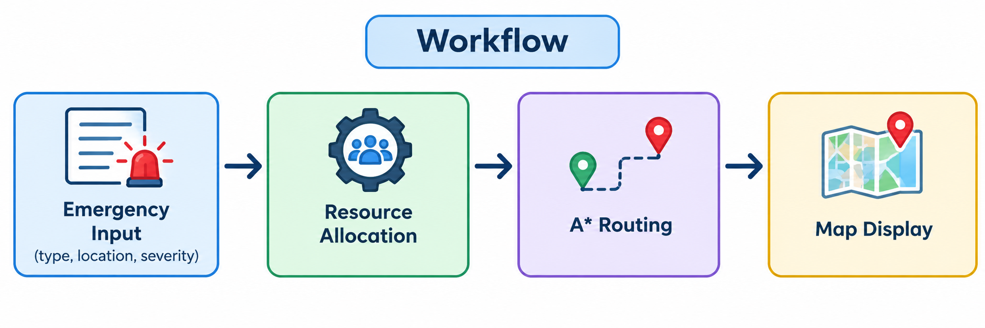
Module Description(For each Module separately)
4. Map Visualization
Displays emergency locations and routes.
Uses Leaflet and OpenStreetMap.
5. Backend & API Integration
Flask connects the frontend and AI modules.
SQLite stores allocation logs; security controls manage access.

Slide 14
Results & Discussion
Resource Allocation: Selects a suitable resource based on emergency details.
Route Finding: A* calculates a route using road-network data.
Map Visualization: Displays the emergency location and route.
System Integration: Flask connects the core modules.
Discussion: The prototype demonstrates classical AI techniques for emergency resource allocation and route planning.

Slide 15
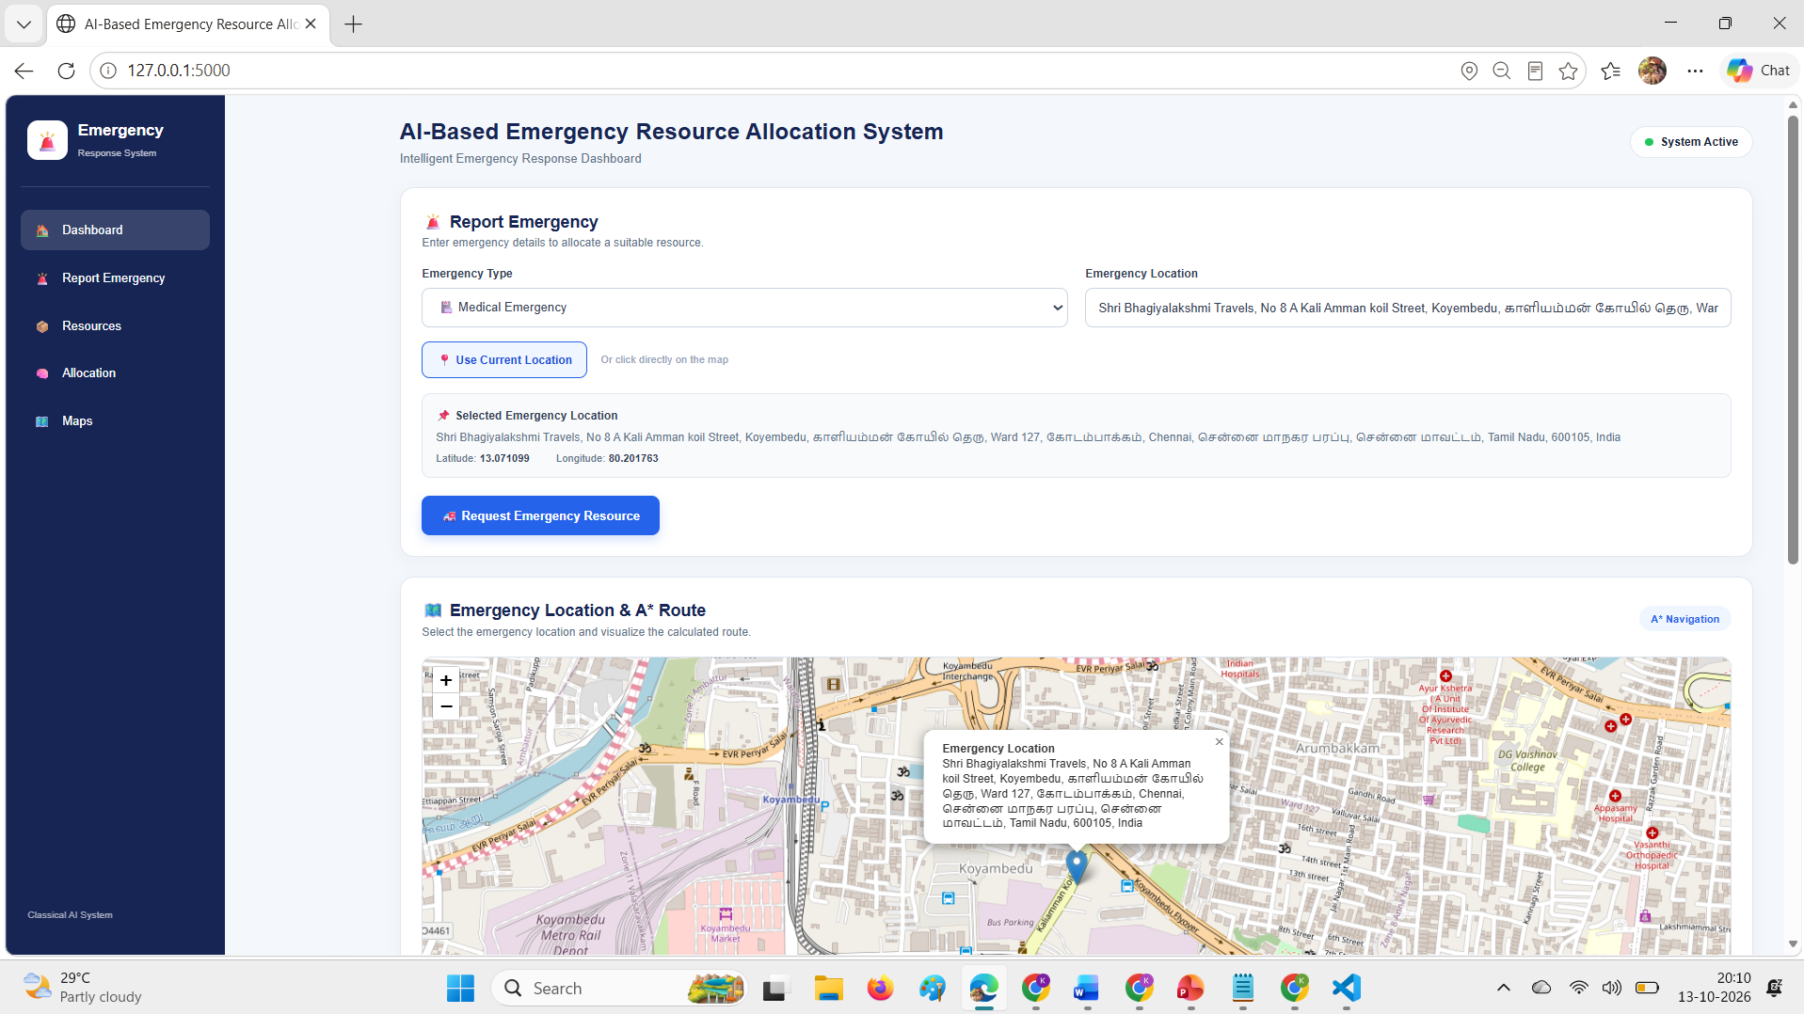
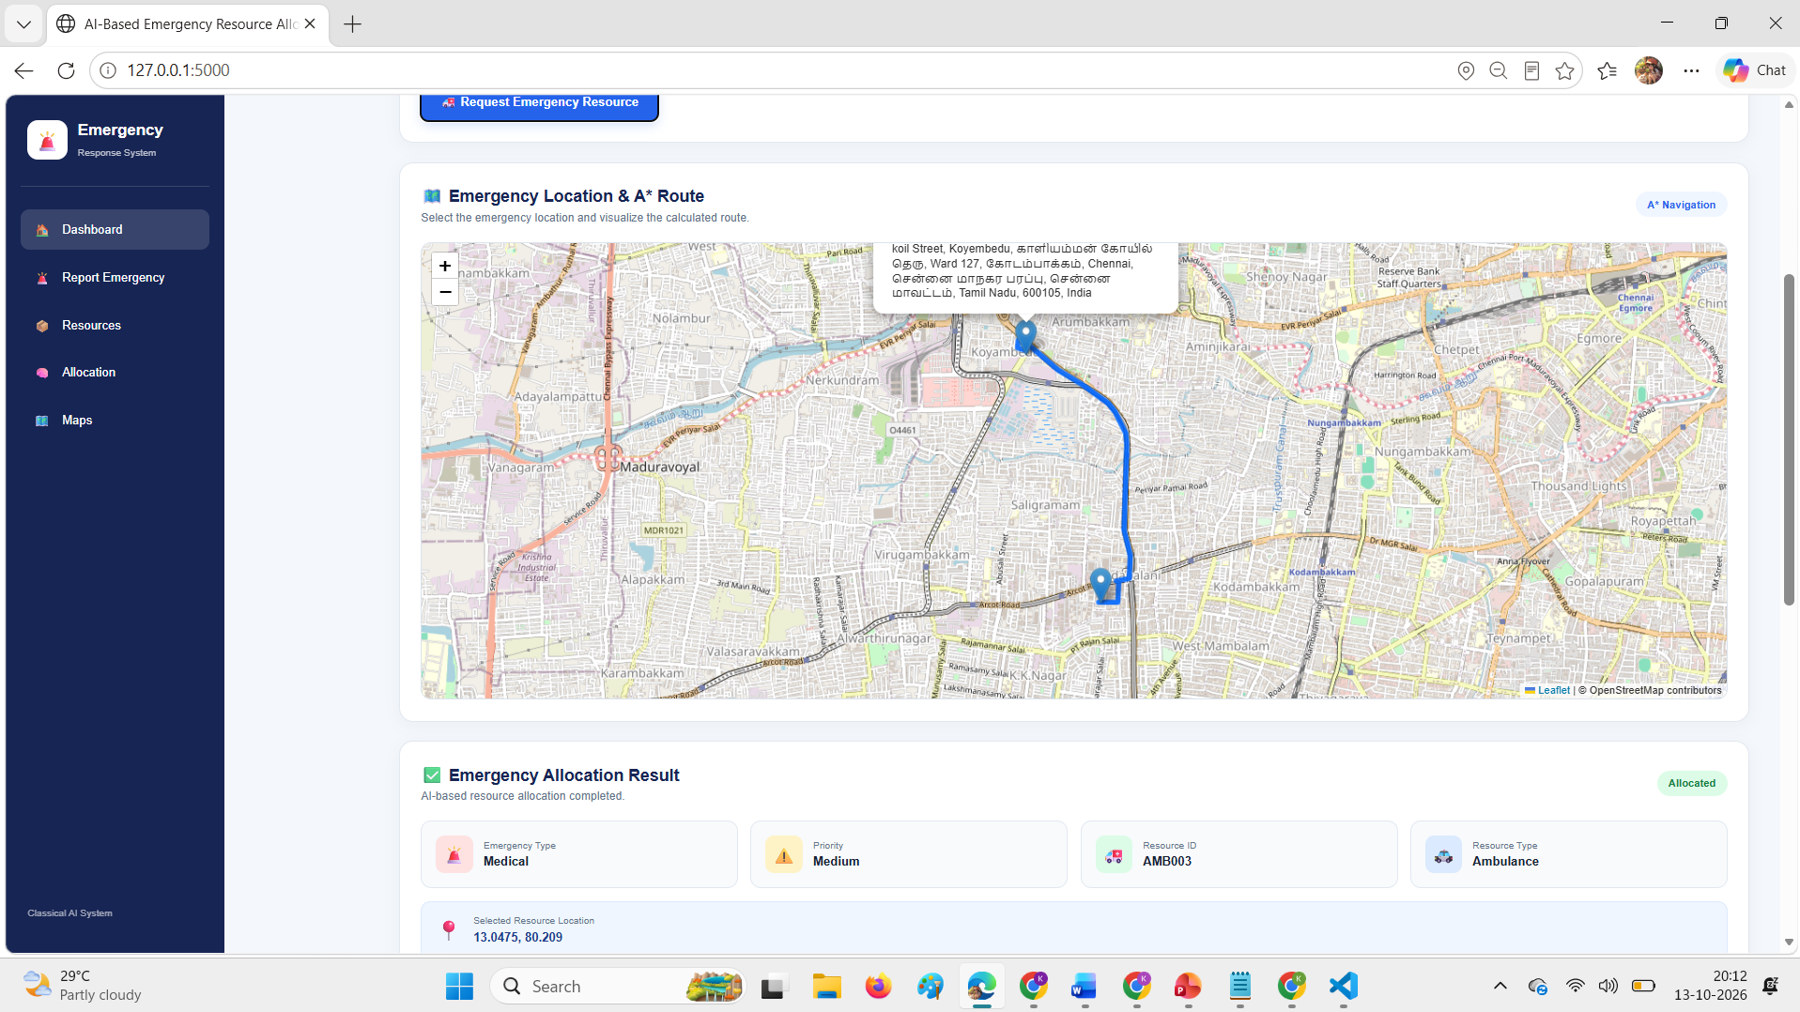
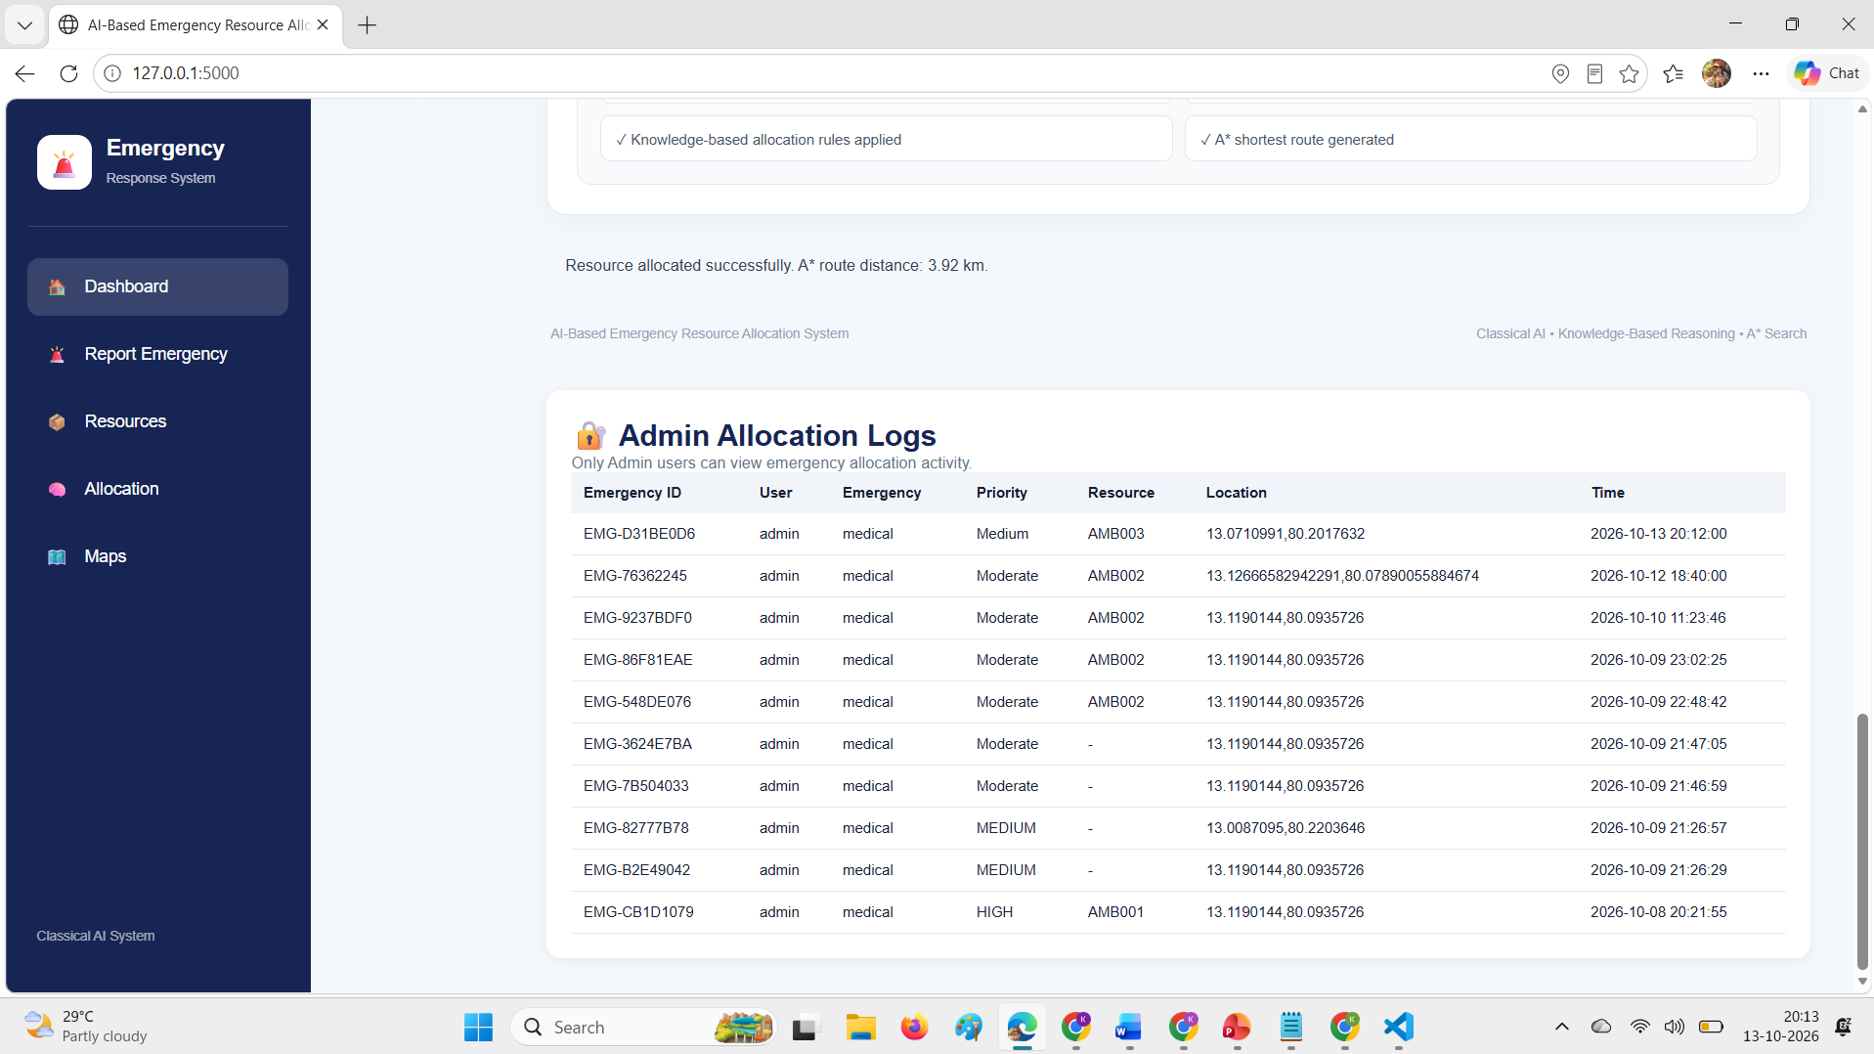
User Interface/ Screenshots

Slide 16
Conclusion
Developed an AI-based emergency resource allocation prototype.
Uses knowledge-based rules to select suitable resources.
Applies the A* algorithm for route finding.
Integrates Flask backend and interactive map visualization.
Demonstrates the practical application of classical AI techniques.
Future work includes real-time resource tracking and live traffic integration.

Slide 17
Future Work
Automatic Emergency Alerts: Receive emergency alerts automatically instead of manual input.
Real-Time Integration: Connect with emergency reporting systems to obtain incident details.
Instant Resource Allocation: Automatically select suitable resources and calculate routes.
Notifications: Alert relevant emergency personnel about new incidents.

Slide 18
References
[1] A. Nordin et al., “Finding Shortest Path of the Ambulance Routing: Interface of A* Algorithm Using C# Programming,” 2012.
[2] J. Barrachina et al., “Reducing Emergency Services Arrival Time by Using Vehicular Communications and Evolution Strategies,” Expert Systems with Applications, vol. 41, no. 4, pp. 1206–1217, 2014.
[3] G. Pettet et al., “Designing Decision Support Systems for Emergency Response: Challenges and Opportunities,” 2022.
[4] NetworkX, “A* Shortest Path Algorithm Documentation.” https://networkx.org/documentation/stable/

Slide 19
References
[5] G. Boeing, “Modeling and Analyzing Urban Networks and Amenities with OSMnx,” Geographical Analysis, 2025.
[6] OpenStreetMap, “Map Data and Copyright.” https://www.openstreetmap.org/copyright

Slide 20
Thank You

