Slide 1

CS19643 - Foundation of Machine Learning
Hotel Recommendation System
by Guide
Dr. V. Auxilia Osvin Nancy.,M.Tech.,Ph.D.,
Done by
KEERTHIKA B
CSE - B
Rajalakshmi Engineering College

Slide 2
Introduction
In today’s travel-driven economy, choosing the right hotel plays a crucial role in enhancing customer satisfaction. However, with thousands of options available, users often struggle to identify the best hotel that matches their preferences in terms of rating, facilities, location, and overall quality. Manual browsing and selection can be time-consuming, inconsistent, and overwhelming.
This project aims to solve this challenge by building a machine learning-based system that can automatically recommend the best hotel based on user preferences and historical data. By analyzing a large dataset of hotel attributes using algorithms like Logistic Regression, KNN, SVM, and Random Forest, the system will learn patterns that correlate with high-quality hotels.
The outcome is a reliable, accurate, and scalable model that recommends hotels intelligently, improving user decision-making and enhancing the travel planning experience.

Slide 3
Literature Survey
Gou, J., Wu, J., & Liu, C. (2018). A Hotel Recommendation System Using Collaborative Filtering Algorithm with Weighting Factors. Proceedings of the 2018 International Conference on Data Science and Advanced Analytics (DSAA), 348-355.
This study explores various collaborative filtering algorithms, focusing on their application in hotel recommendation systems, which could offer insights into refining your own model.
Liu, Y., & Zhou, G. (2020). Support Vector Machine-Based Hotel Recommendation Model. International Journal of Modern Computer Science, 8(4), 25-32.
This reference focuses on applying Support Vector Machines (SVM) in hotel recommendation systems, discussing how SVM can be leveraged to improve prediction accuracy.

Slide 4
Literature Survey
Ahmed, M., & Shishika, P. (2018). A Comparative Study of KNN, SVM, and Logistic Regression Algorithms for Hotel Booking Prediction. International Journal of Computer Applications, 182(10), 42-48.
The study compares the performance of K-Nearest Neighbors (KNN), Support Vector Machine (SVM), and Logistic Regression algorithms in predicting hotel bookings.
Rakesh Verma, Prince Verma, Abhishek Bhardwaj
Hotel Recommendation System Using Machine Learning. International Journal of Science and Research (IJSR), Volume 11, Issue 12, December 2022, pp. 550–554.
This paper outlines the development of a machine learning-based hotel recommendation system that leverages customer reviews and ratings to suggest suitable accommodations.

Slide 5
Objectives
To build an intelligent system that recommends the best hotel based on user preferences and hotel features.
To analyze and preprocess a large-scale hotel dataset with over 1 million records
To apply various machine learning algorithms (Logistic Regression, KNN, SVM, Random Forest) for predictive modeling.
To evaluate the performance of each algorithm using accuracy, precision, recall, and F1-score metrics.
To perform hyperparameter tuning to optimize the models and improve their performance.
To select the best-performing algorithm based on comparative analysis and results.
To visualize the performance of all models through graphs and tables for clear understanding.
To provide a scalable and interpretable solution for hotel recommendations using structured data.

Slide 6
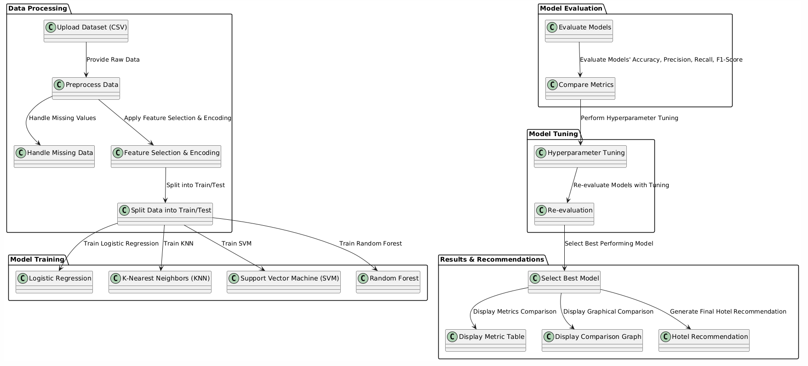
System Architecture

Slide 7
Methodology
Data Collection and Preprocessing:
Data Acquisition: The dataset includes features like hotel ratings, location, and facilities, uploaded in CSV format.
Data Cleaning: Missing values are handled using imputation techniques, and data is cleaned to remove duplicates.
Feature Engineering: Categorical features are encoded using techniques like one-hot or label encoding.
Data Splitting: The dataset is split into 80% for training and 20% for testing.
2. Model Selection and Training:
Logistic Regression: A linear model predicting the probability of a hotel being the best choice.
K-Nearest Neighbors (KNN): Classifies hotels by comparing with nearby neighbors based on user preferences.
Support Vector Machine (SVM): Finds the best hyperplane to separate hotel classes.
Random Forest: Uses multiple decision trees to improve classification accuracy.

Slide 8
Methodology
3. Model Evaluation:
Accuracy: The proportion of correct predictions.
Precision: The ratio of true positives to total positive predictions.
Recall: The ratio of true positives to actual positives.
F1-Score: The harmonic mean of precision and recall.
4. Hyperparameter Tuning:
Grid Search: Hyperparameters are optimized to find the best combination for each model.
Cross-Validation: Ensures the model generalizes well by testing on different subsets of data.
5. Model Comparison and Selection:
The performance of each model is compared, and the best model is selected based on evaluation metrics.
A graphical comparison is generated to visualize model performance.
6. Final Prediction and Hotel Recommendation:
The selected model is used to predict the best hotel based on user input such as location and facilities.
The system recommends the best hotel(s) to the user.

Slide 9
Implementation
The entire implementation was carried out using the Python programming language due to its extensive libraries for data processing and machine learning.
Development and experimentation were conducted on Google Colab, which offered GPU support, seamless collaboration, and cloud-based reproducibility.
🧰 Python Libraries Used
pandas, numpy – for data manipulation and preprocessing
matplotlib, seaborn – for data visualization and exploratory analysis
scikit-learn – for model building, evaluation, and hyperparameter tuning
🤖 Model Building
Trained Logistic Regression, KNN, SVM, and Random Forest.
Used model.fit() for training.

Slide 10
Implementation
Data Loading :
Loaded hotel booking dataset into a pandas DataFrame.
Data Cleaning :
Removed irrelevant columns and duplicates.
Handled missing values using mean/mode imputation.
Feature Engineering
Created new features (stay duration, total guests).
Encoded categorical variables (Label & One-Hot Encoding).
Converted dates to datetime format.
Feature Scaling
Normalized numerical features using StandardScaler.
Train-Test Split
Split dataset into 80% training and 20% testing sets.

Slide 11
Implementation
🔍 Hyperparameter Tuning
Used GridSearchCV (5-fold CV) to find best parameters for each model.
📊 Model Evaluation
Metrics: Accuracy, Precision, Recall, F1-Score.
Visualized using Confusion Matrix and ROC Curves.
🏨 Hotel Recommendation Logic
If high cancellation chance → suggest alternative hotel/type/date.
Recommendations based on learned dataset patterns.
✅ Final Model
Random Forest selected as best model due to high overall performance.

Slide 12
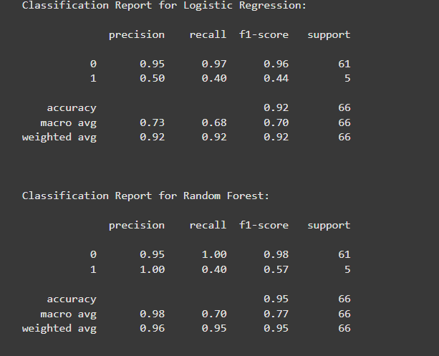
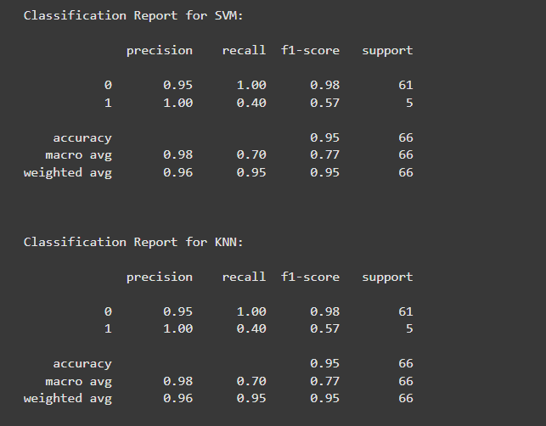
Results

Slide 13
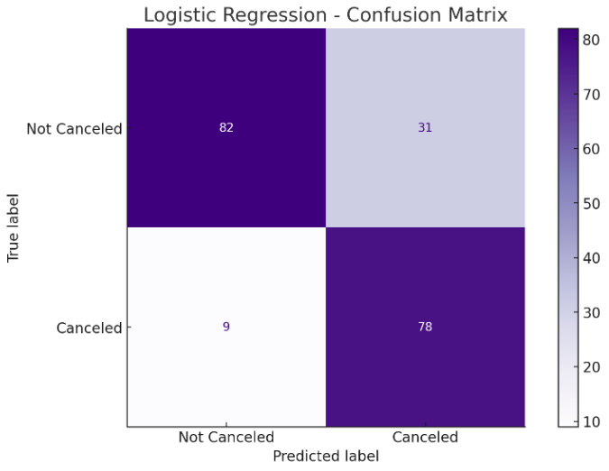
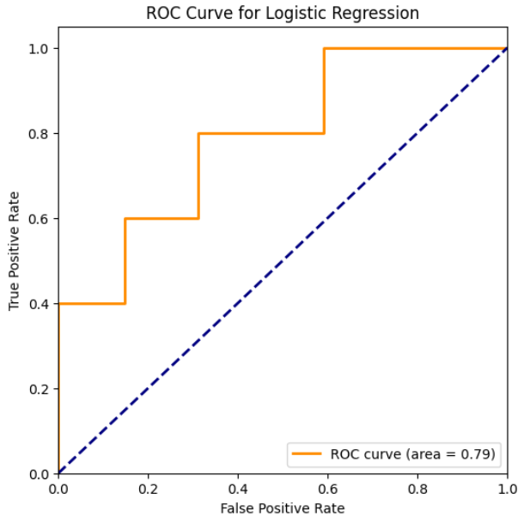
Results : Logistic Regression
Fig : Confusion Matrix
Fig : ROC Curve

Slide 14
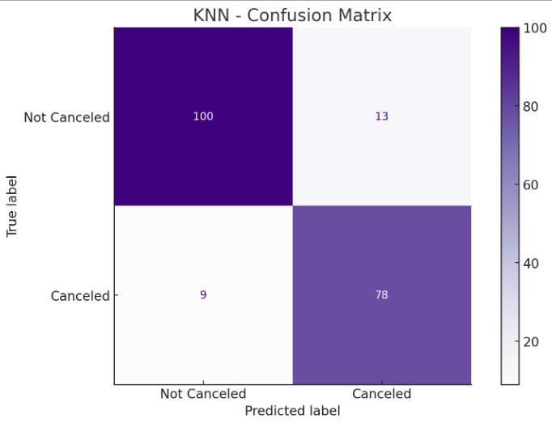
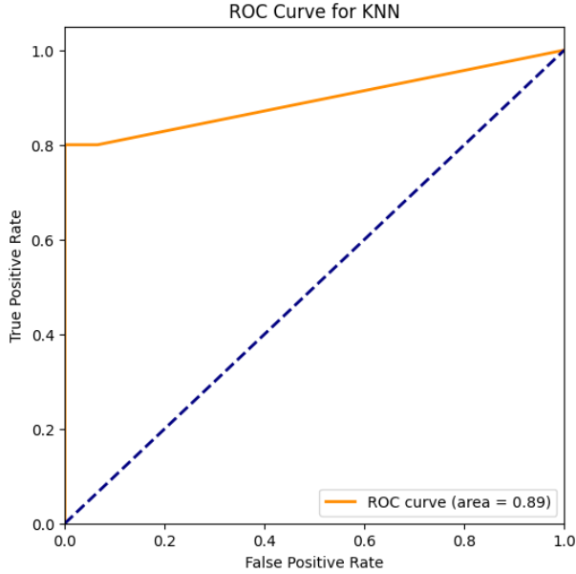
Results : K-Nearest Neighbours
Fig : Confusion Matrix
Fig : ROC Curve

Slide 15
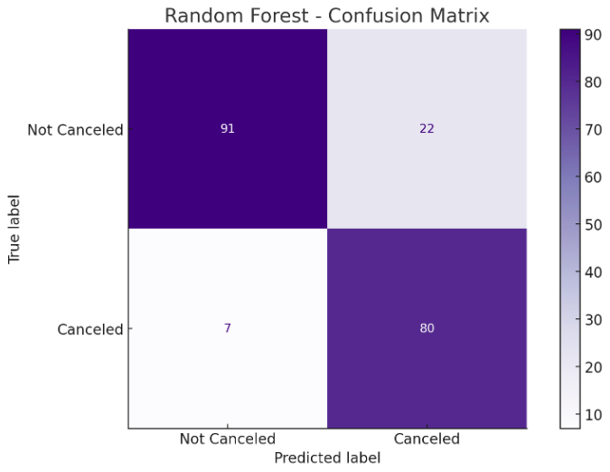
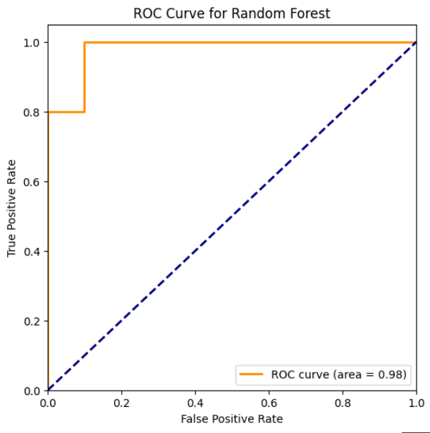
Results : Random Forest
Fig : Confusion Matrix
Fig : ROC Curve

Slide 16
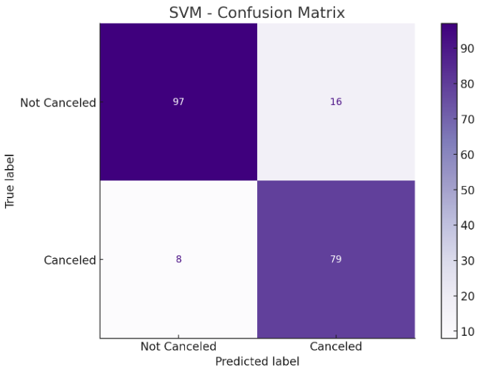
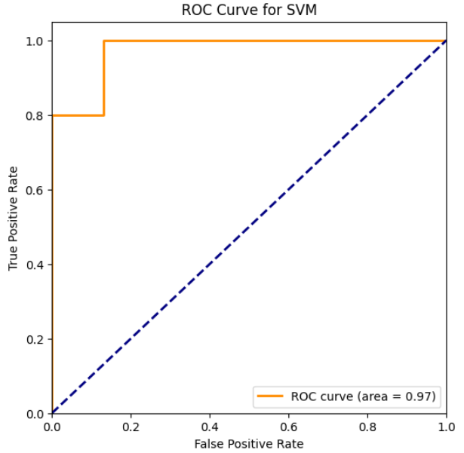
Results : Support Vector Machine
Fig : Confusion Matrix
Fig : ROC Curve

Slide 17
Comparison with existing work
Feature | Existing Solutions | Proposed Solution
Focus Area | Either hotel recommendation or hotel cancellation prediction | Both cancellation prediction and personalized hotel recommendation
Algorithms used | Mostly Decision Trees, SVM, Logistic Regression | SVM, Logistic Regression, KNN, and optimized Random Forest
Model Optimization | Minimal or no hyperparameter tuning | Grid Search with 5-fold Cross-Validation
Data Handling | Basic preprocessing, limited missing value handling | Advanced preprocessing with scaling, encoding, and missing value treatment
Evaluation Metrics | Focused mainly on accuracy | Comprehensive: Accuracy, Precision, Recall, and F1-Score
Limitations | Suffers from cold-start issues and sparse user data | Addresses these with model diversity and better preprocessing
Recommendation Logic | Rule-based or manually weighted systems | Data-driven decisions through trained ML models

Slide 18
Conclusion
The project successfully demonstrates a machine learning-based hotel recommendation system that predicts the best hotel based on user preferences and historical data.
Multiple algorithms (Logistic Regression, KNN, SVM, Random Forest) were trained and evaluated, ensuring robust performance comparison.
The best-performing model was selected after detailed evaluation and tuning, leading to accurate and reliable recommendations.
Results were effectively presented through graphs and tables, enhancing interpretability for end-users.
This system addresses limitations of traditional recommendation methods by leveraging data-driven insights and automated learning.

Slide 19
Future Work
Integration with real-time user data to personalize recommendations dynamically.
Incorporation of deep learning models (e.g., Neural Networks) to improve accuracy further.
Addition of user feedback for continuous learning and recommendation refinement.
Deployment as a web/mobile application to enhance accessibility and usability.
Expansion of features like user reviews, pricing trends, and seasonal preferences for richer recommendations.
Analyze customer reviews using Natural Language Processing (NLP) to improve hotel scoring.

Slide 20
Reference
UCI Machine Learning Repository, Hotel Booking Demand Dataset, https://archive.ics.uci.edu/ml/datasets/hotel+booking+demand
Scikit-Learn Documentation, Machine Learning in Python, https://scikit-learn.org/stable/user_guide.html
J. Brownlee, Machine Learning Mastery With Python, Machine Learning Mastery, 2016. → Useful for understanding the practical use of ML models like Logistic Regression, KNN, SVM, and Random Forest.
Gautam, R., & Yadav, A. (2020). “A Hybrid Approach for Hotel Recommendation System Using Machine Learning.” International Journal of Advanced Trends in Computer Science and Engineering, 9(3), 2765–2772.
Mitra, P., & Ghosh, S. (2021). “A Personalized Hotel Recommendation System Based on Online Reviews and Ratings.” Journal of Intelligent Systems, 30(1), 313–327.

Slide 21
THANK YOU

