Slide 1
Door Locking Security System
Created By:
Keerthinath R Aadarsh Ritul K
126015044 126003001

Slide 2
Contents
Objective
Hardware Used
Circuit
Working
Future enhancements
Conclusion

Slide 3
Objective
The objective of this project is to design and implement an efficient and secure door locking system using IoT technology. This system aims to enhance security measures by providing remote access control, real-time monitoring and intelligent authentication methods and safety measures incase of an intruder and emergency situation

Slide 4
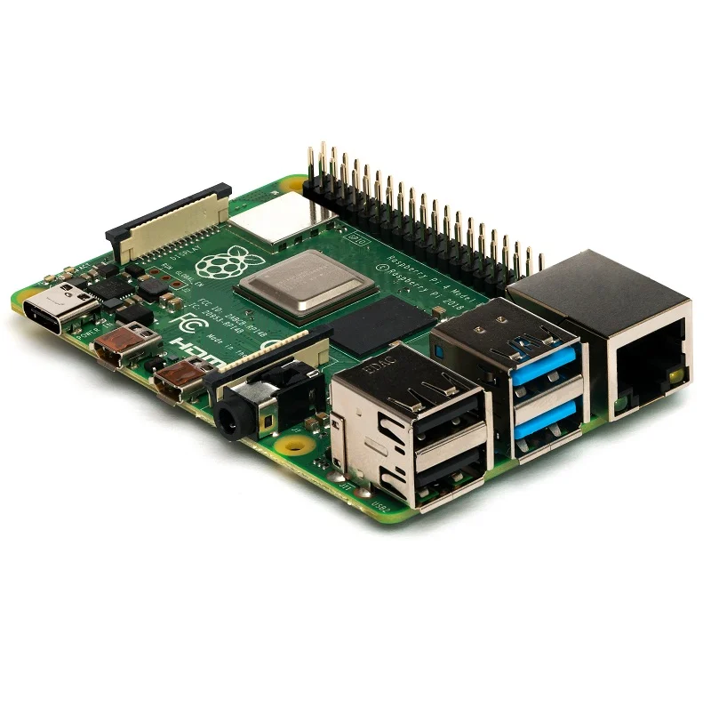
Hardware Used
Rasberry Pi – 4 Model B

Slide 5
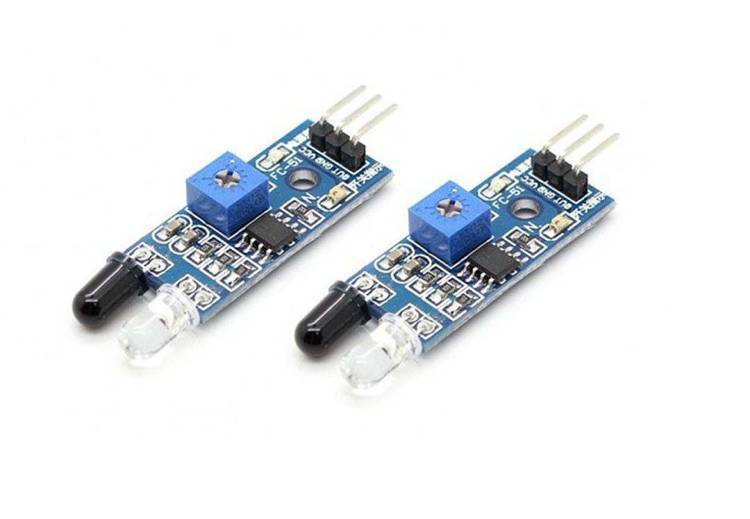
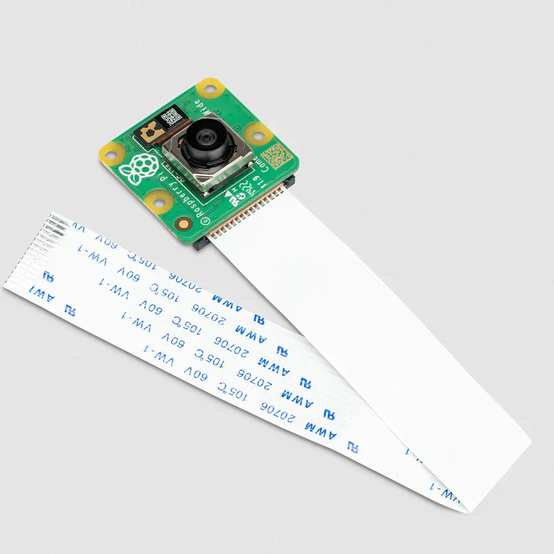
Hardware Used
IR Sensors
Pi Camera

Slide 6
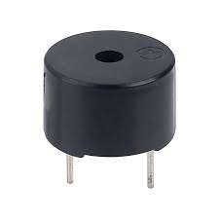
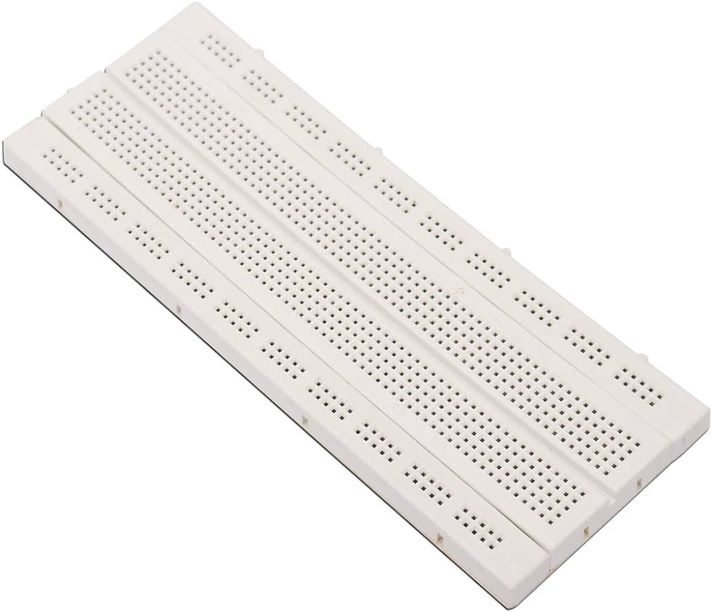
Hardware Used
Buzzer
Breadboard

Slide 7
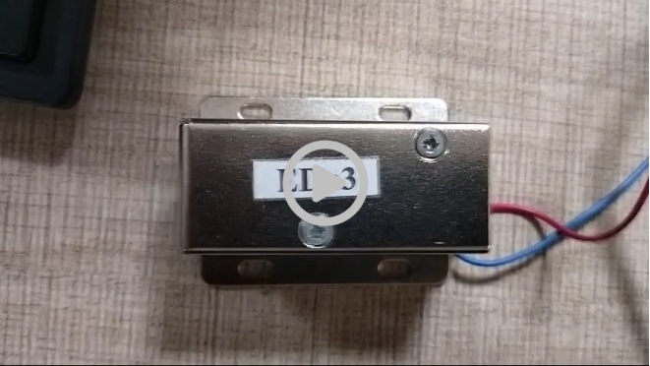
Hardware Used
Electromagnetic Lock

Slide 8
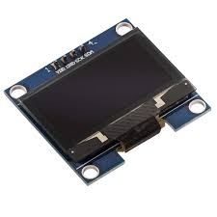
Hardware Used
OLED

Slide 9
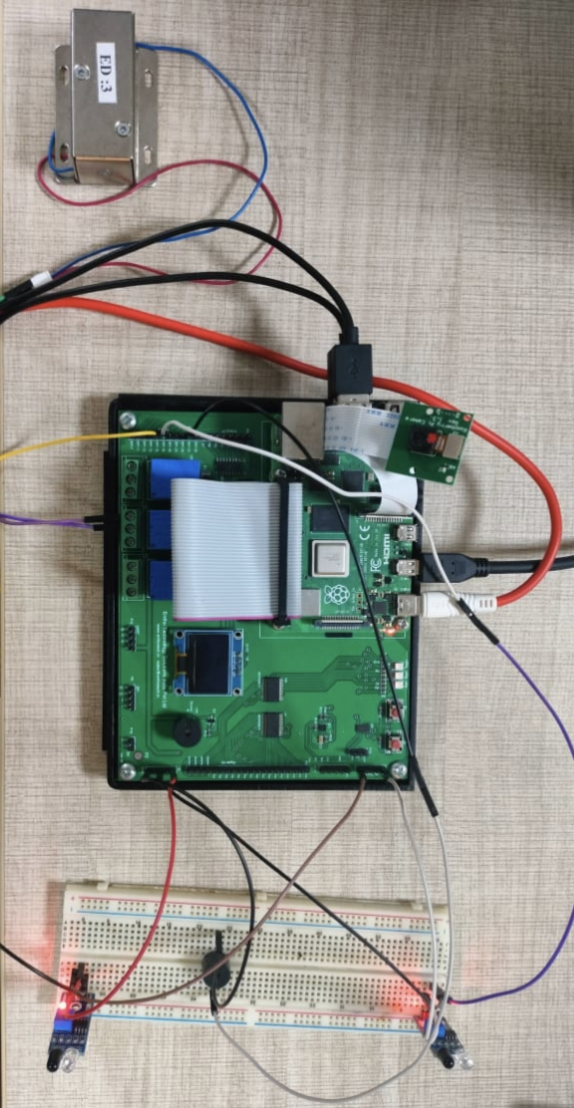
Circuit

Slide 10
Different methods to manage door locking system
Utilizing Cloud Technology
By integrating with ThingSpeak Cloud Platform we can open and
close the lock by typing the password.
With the help of this, users can remotely open and close the door
lock using ThingSpeak's web or mobile application interface from
anywhere with internet access.

Slide 11
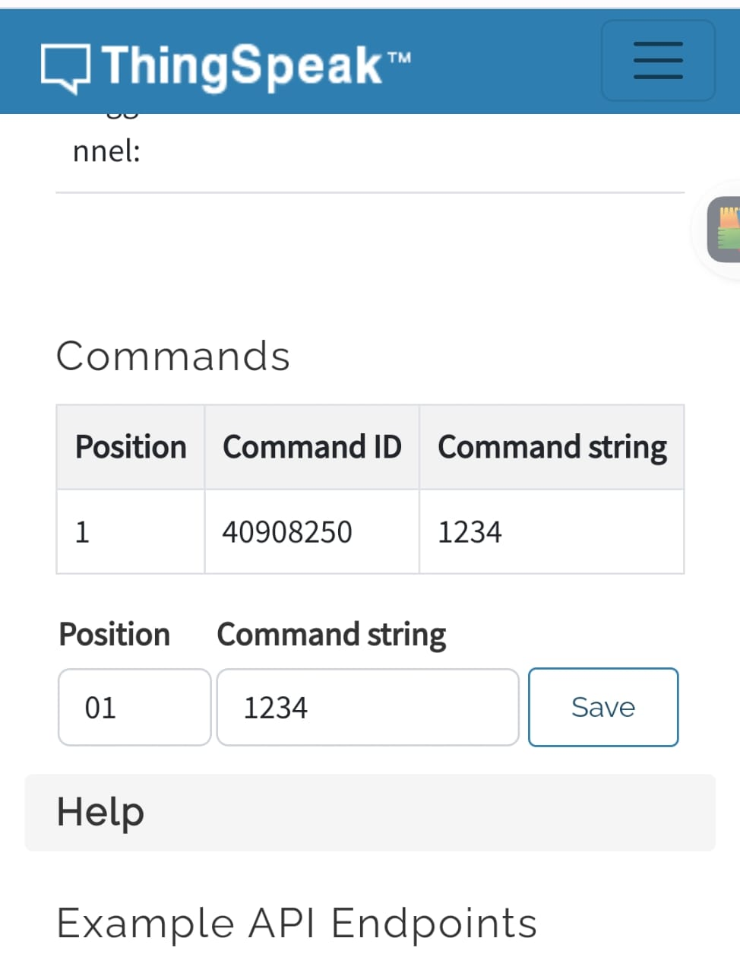
Working:
1.Enter option 1.
2.Enter the password through the Talkback ThingSpeak account(timeout of 8
secs) and the person should be in front of the Entry IR Sensor.

Slide 12
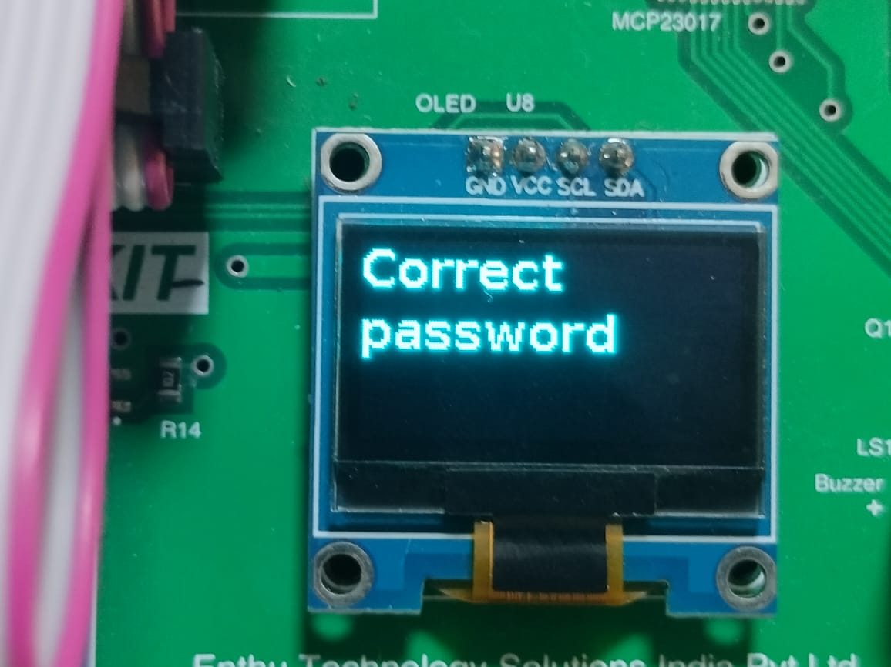
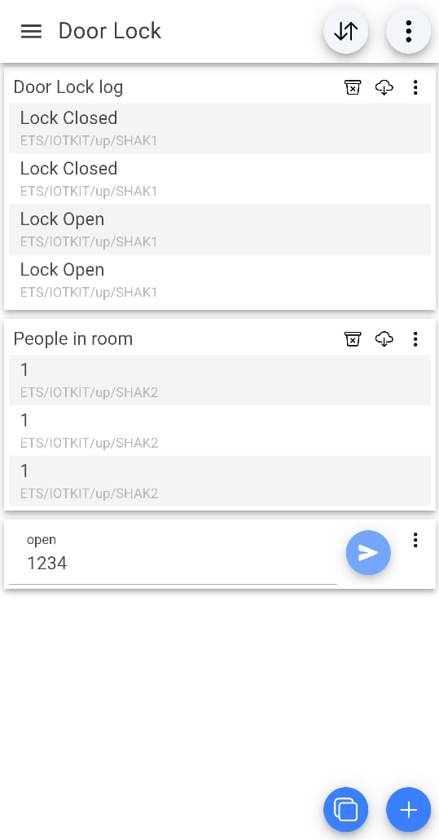
3.If password is correct, the door lock opens(for 5 seconds).
4.The OLED displays whether the password is correct or not along with the number of attempts.
5.The status of the lock ( i.e when it is opened and closed) and the number
of people in room is sent to the user using MQTT app.

Slide 13
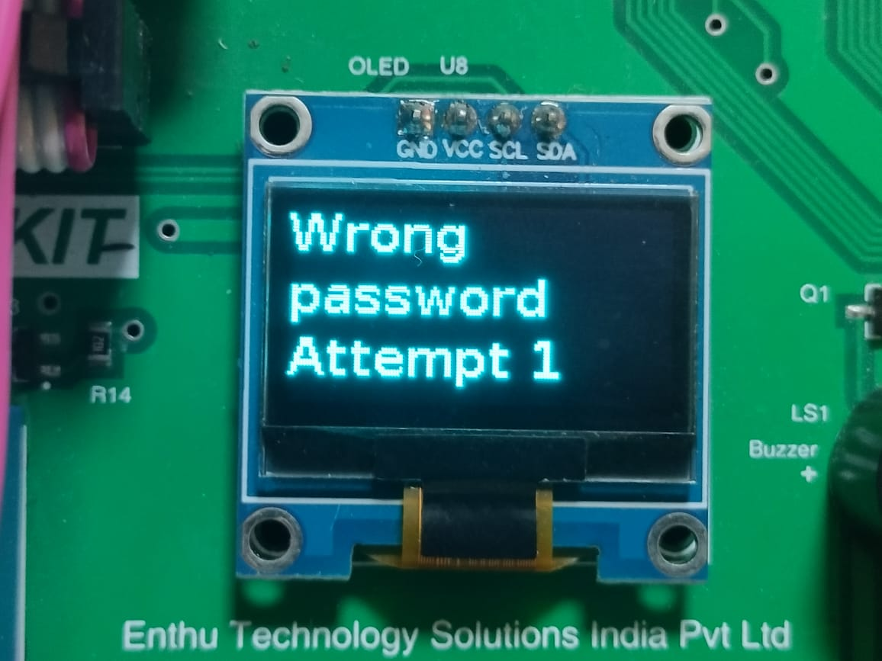
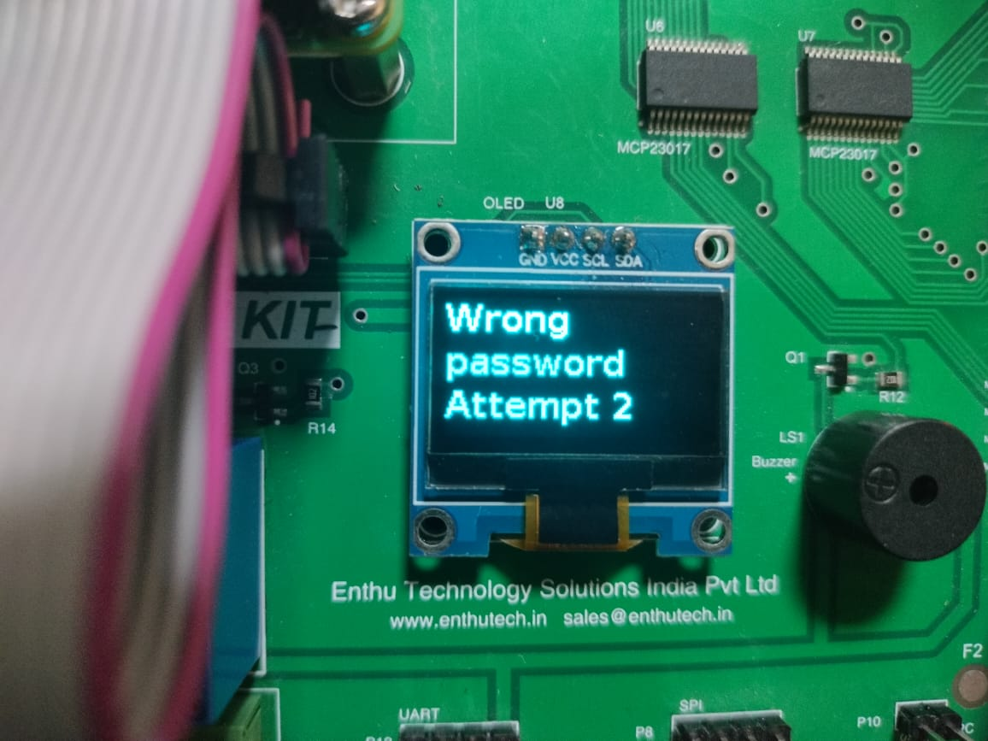
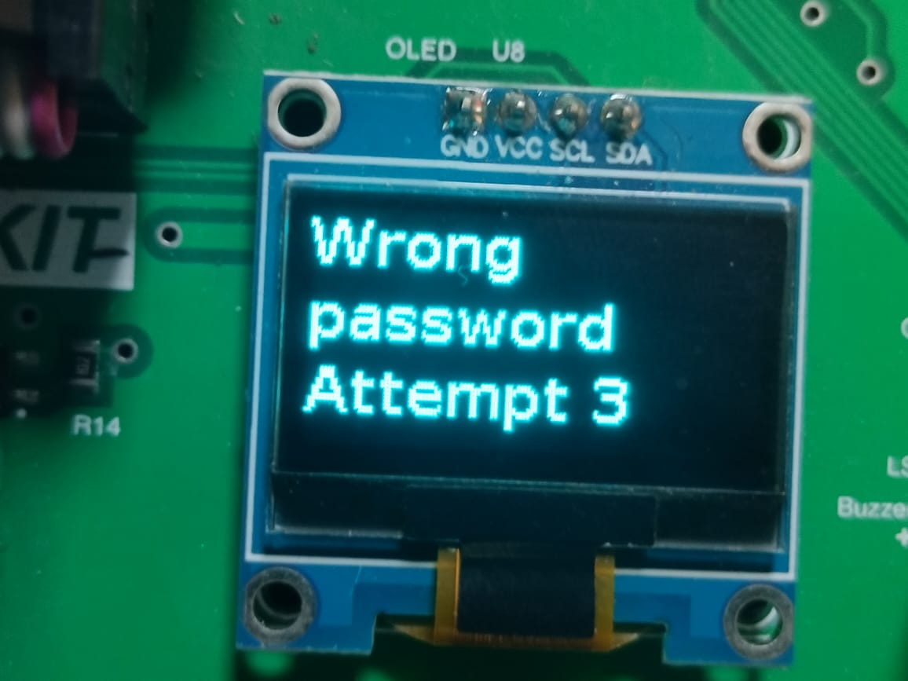
6.If the number of people in the room is full, further entry to the room is denied.
7.If a person leaves the room, he/she is sensed by the Exit IR Sensor and the number of people in the room is decremented and sent to
MQTT.
8.If password is incorrect you can try four more times.

Slide 14
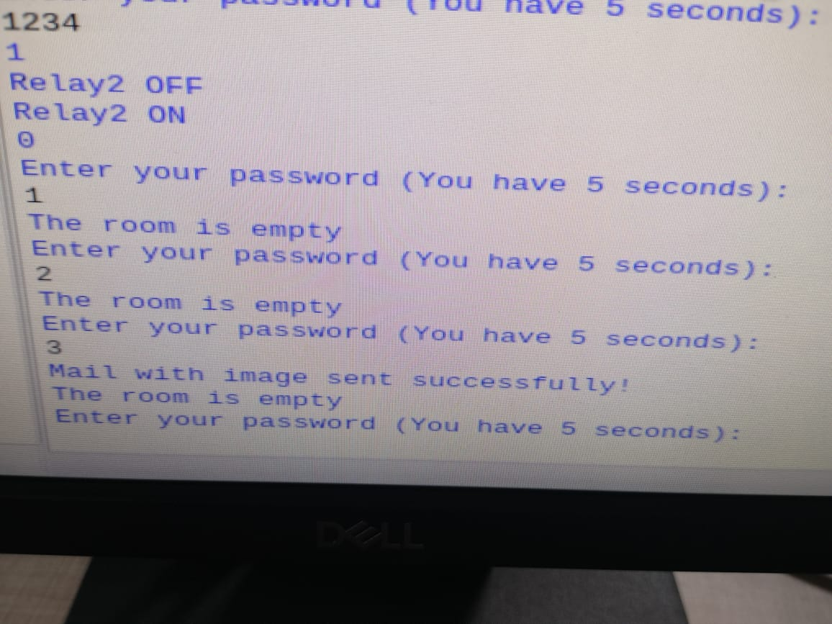
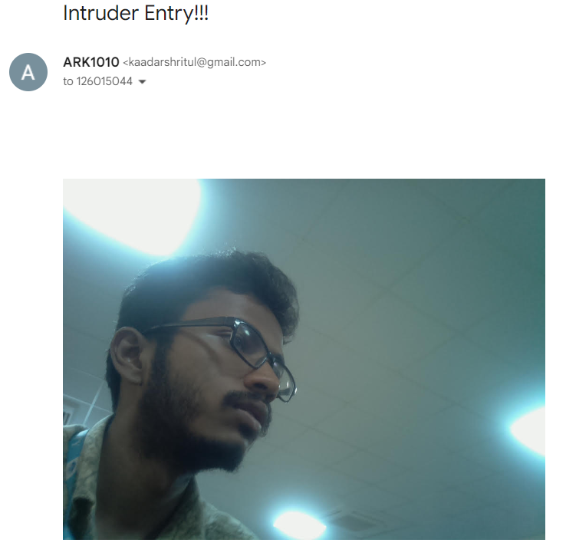
9.If password is entered incorrectly three times, the Pi Camera captures
an image of the person and sends the image of the person through email to the owner.

Slide 15
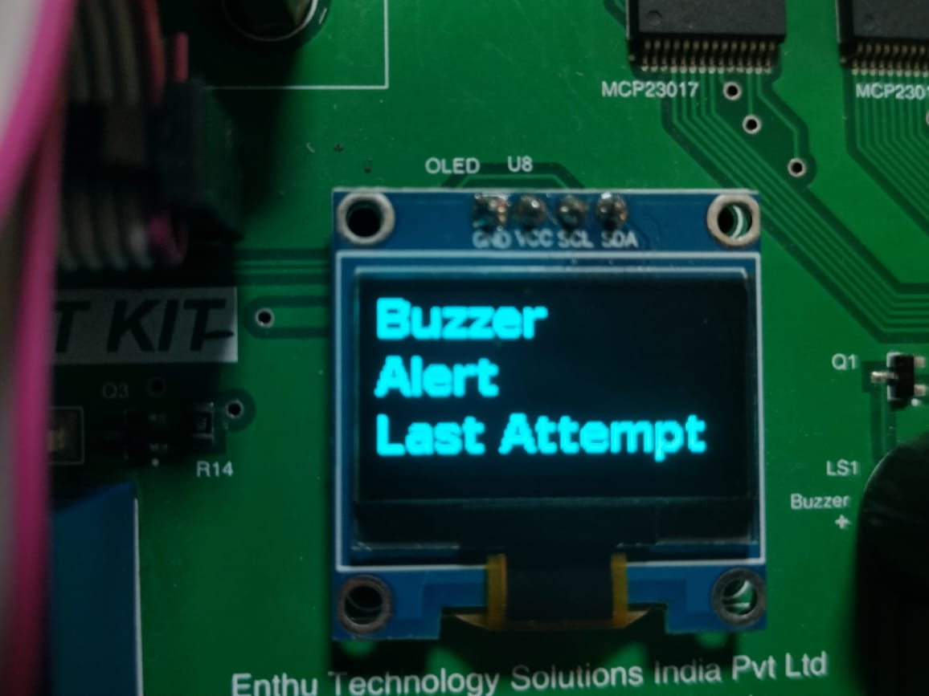
10.When the password is entered incorrectly four times, a warning is displayed on the OLED that the buzzer will be turned on for the last attempt (fifth attempt).
11.When the wrong password is entered for the fifth time, the buzzer is turned on, and there is a lockout.

Slide 16
Different methods to manage door locking system
||. Manual Typing
The person(s) who want to enter the door can simply type the
password and enter the door.

Slide 17
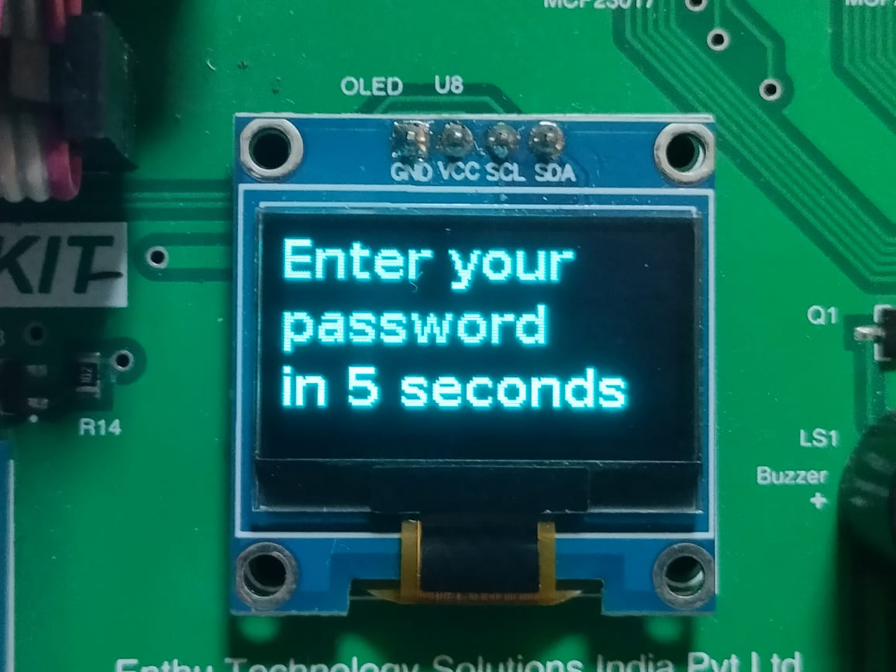
Working
1.Enter option 2.
2.The password is entered manually by the person who wants to enter.
The working is similar as to when Cloud technology is used.
Except, the timeout for entering password is 5 seconds.

Slide 18
Different methods to manage door locking system
|||.Utilizing MQTT(Message Queuing Telemetry Transport)
This method is only used for emergency purposes. With the the
help of Iot MQTT Panel app available in Google Play Store, the user
can open the lock. The lock stays open and does not close.

Slide 19
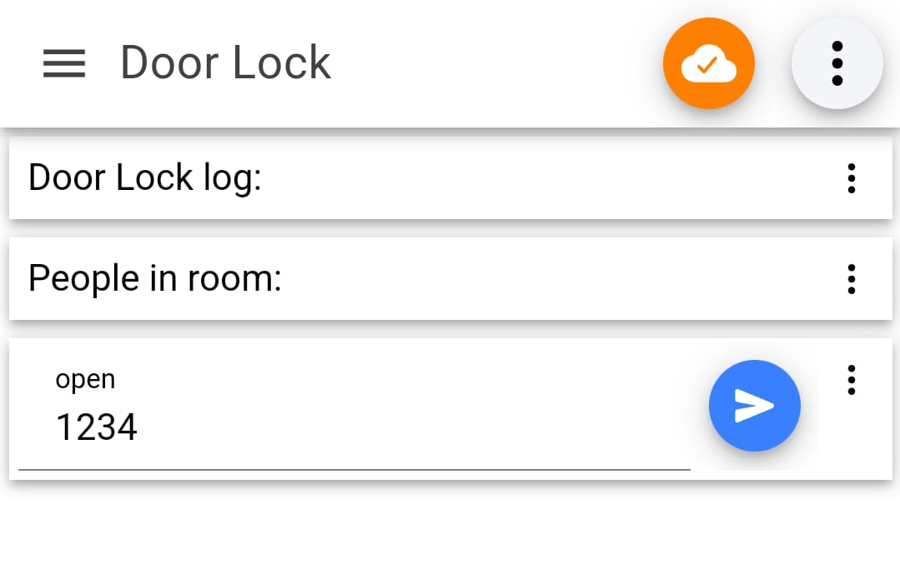
Working
1.Enter option 3.
2.Enter the password through MQTT app in your mobile.
The rest of the working is same as the previous methods..

Slide 20
Future Enhancements
1.Biometric Authentication.
Integrate biometric authentication such as fingerprint, face recognition etc
2.Voice Recognition.
Implement voice technology to allow users to verbally input passwords.
3.Keypad
Integrating keypad in order to enter the password.

Slide 21
Conclusion
The analysis and evaluation of the security system for door locking indicate its effectiveness in enhancing security measures for buildings and properties.
Continued research and development in this area hold promise for the future advancement of even more secure door locking systems.

