Slide 1
WELCOME EVERYONE…
PRESENTED BY,
KEERTHI SHREE
KAMALI
HIRUTHIK PRASANTH
ARUN
KABILAN
JOTHIVASAN

Slide 2
STRING
String is a array of characters . That is a collection of characters it includes letters(both upper and lower case),special characters(like +,=,<,>,?,@,#).
Syntax: datatype(char) name(variable)[size]=“value”.
String should be enclosed within a double quote “ ”.
The format specifier is %s but it don’t have a special datatype, it is indicated by char datatype itself.
<string.h> is the header file which includes few inbuilt functions like strlen , strcat , strupper ,strlower and etc ..,

Slide 3
WRITE A PROGRAM IN C TO COUNT THE TOTAL NUMBER OF WORDS IN A SENTENCE
PROGRAM:
#include <stdio.h>
#include<string.h>
int main()
{
char sent[80];
int wordCount = 0,i;
printf("Enter a sentence: ");
scanf("%[^\n]",sent);

Slide 4
for (i = 0; sent[i] != '\0'; i++)
{
if (sent[i] == ‘ ')
{
wordCount++;
}
}
printf("Number of words: %d\n", wordCount+1);
}

Slide 5
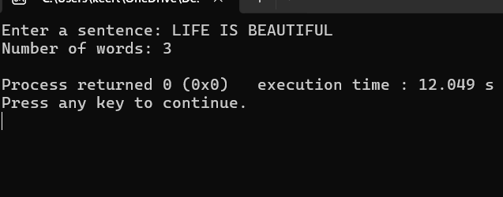
OUTPUT:

Slide 6
WRITE A PROGRAM IN C TO CHECK WHETHER TWO STRINGS ARE AN ANAGRAM USING FUNCTIONS.
#include<stdio.h>
#include<string.h>
int anagram(char word1[],char word2[])
{
int len1,len2,i,j,count=0;
len1=strlen(word1);
len2=strlen(word2);
for(i=0;i<len1;i++)
{
for(j=0;j<len2;j++)
{
if(word1[i]==word2[j])
{
word2[j]='*';
count++;
break;}}}

Slide 7
return (count==len1);
}
int main()
{
char word1[50],word2[50];
printf("Enter 2 words:\n");
scanf("%s %s",word1,word2);
if(anagram(word1,word2))
{
printf("Yes,the words are anagram.\n");
}
else{
printf("No,the words are not anagram.");
}
}

Slide 8
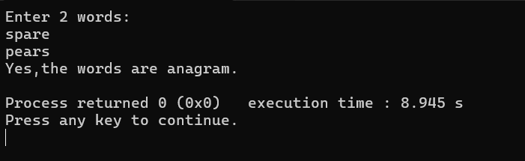
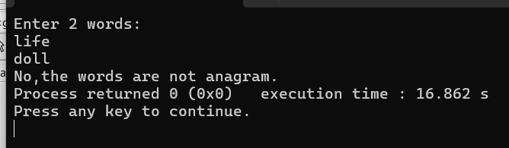
OUTPUT:

Slide 9


