Slide 1
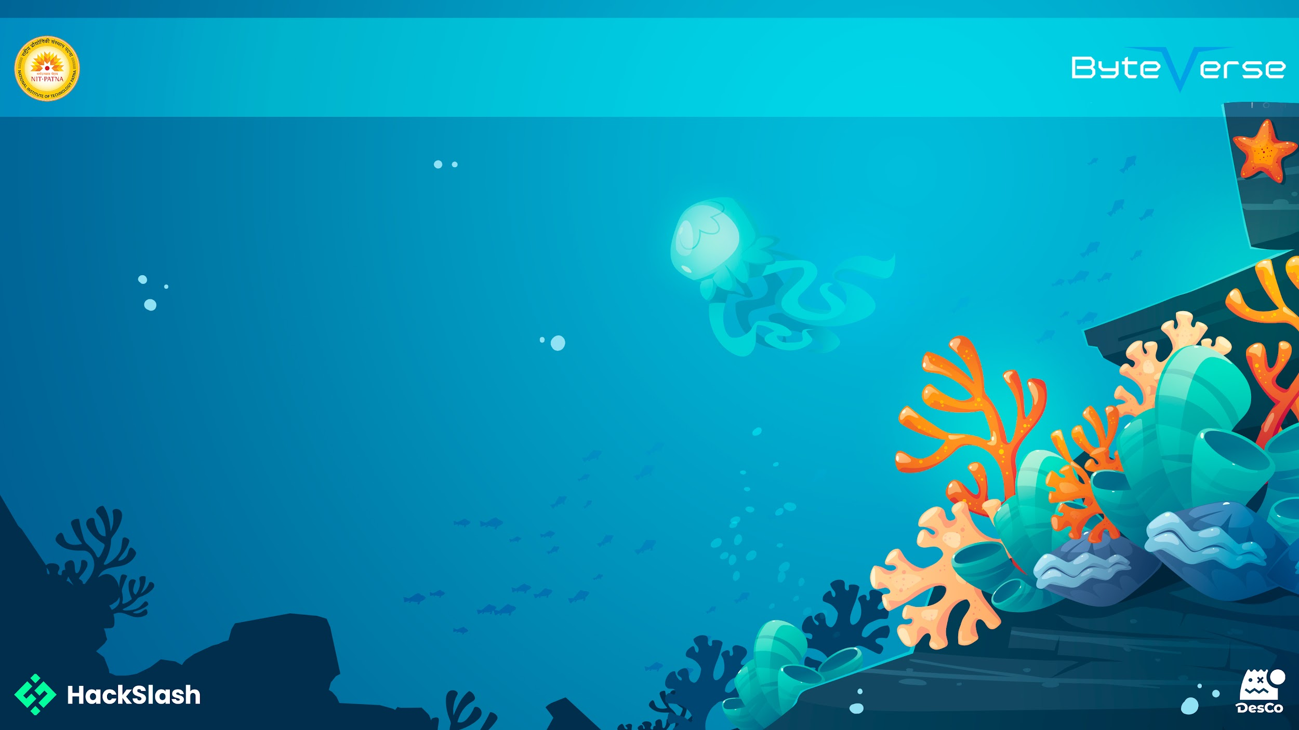
Basic Details of the Team
and Problem Statement
Problem Statement:
Many people struggle to access quick and reliable healthcare information. This assistant helps users check symptoms, receive mental health support—making healthcare more accessible and user-friendly.
Team Name: <Tag Team>
Institute Name: AMRITA VISHWA VIDYAPEETHAM
Theme Name: HELATHCARE AND MEDICAL

Slide 2

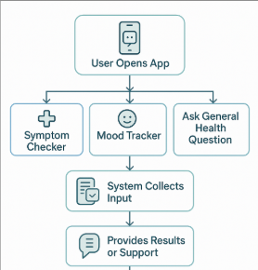
Idea/Approach Details
Describe your idea/Solution/Prototype here:
Our solution is an AI-powered Healthcare Assistant App designed to provide quick, reliable, and user-friendly access to essential health services and information. The core goal is to empower users with immediate support and guidance.
KEY FEATURES:
1.Symptom Checker:Instantly analyzes user-reported symptoms to suggest possible conditions and next steps.
2.Mental Health Support:Offers emotional check-ins, relaxation exercises, and AI-driven chat for mental well-being.
3. Virtual Assistant:Provides round-the-clock answers to health queries, reminders, and first aid guidance.
Add process flow chart or image of prototype or any relevant image related to your idea
Describe your Technology stack here:
Frontend: Streamlit (UI), HTML/CSS (via Markdown)
Backend: Python (logic & chat handling)
AI Integration: Groq API (LLaMA3 model)
Vector Search: Pinecone + multilingual-e5-large embeddings
Session Management: Streamlit session_state
Planned Integration: External medical APIs (symptom info, etc.)

Slide 3
Idea/Approach Details
Describe your Use Cases here:
Symptom Checker & Health Q&A Users can chat naturally to describe symptoms or ask health-related questions, and receive AI-powered responses that are informative, friendly, and contextually relevant.
Mental Health Support The assistant responds with empathy and warmth, offering calming messages and encouraging users to take care of their mental well-being.
Mood Tracker Users can select their daily mood using emojis, optionally add personal notes, and save their emotional state in a private log, helping track mental health over time.
Mood-Lifting Games Suggestion If a user logs a sad or low mood, the assistant gently recommends simple games (like trivia or riddles) to help lift their spirits.
Describe your Dependencies/ Show Stopper here:
API Access & Rate Limits The system depends on valid and active API keys for Groq (AI model) and Pinecone (vector DB). Expiry or rate limits of these APIs can break functionality.
Internet Connectivity MediChat requires stable internet access for real-time API calls, embedding generation, and database querying. Offline use is not supported.
Pinecone Index Availability If the Pinecone index (quickstart) is not properly initialized or populated with relevant embeddings, symptom-related queries may return poor or no results.
Session State Volatility All user chats and mood logs are stored in Streamlit's session state, which resets on page refresh or browser closure, leading to data loss unless persistent storage is implemented.

Slide 4
Team Member Details
Team Leader Name: KEERTHI SREE J
Branch (Btech/BCA etc): Btech Stream (ECE, CSE etc): CSE Year (I,II,III,IV): II
Team Member 1 Name: JAHNAVI A
Branch (Btech/BCA etc): Btech Stream (ECE, CSE etc): CSE Year (I,II,III,IV): II
Team Member 2 Name: HARINI A K
Branch (Btech/BCA etc): Btech Stream (ECE, CSE etc):CSE Year (I,II,III,IV): II

Slide 5
Important Pointers
Please ensure below pointers are met while
Kindly keep the maximum slides limit to 4 pages.
All the topics should be utilized for description of your idea.
Try to avoid paragraphs and post your idea in points.
Keep your explanation precisely and easy to understand.
Idea should be unique and novel. If it has a business potential more weightage will be given.
Apart from this PPT abstract of your idea will be asked separately while presenting.
You need to save the file in PDF and upload the same on Google Form provided. No PPT, Word Doc or any other format will be supported.
You can delete this slide (Important Pointers) when you upload the PPT.

