Slide 1
Insect Pest identification
PRESENTED By :
Kavitha.S(22AI021)
Keerthivarsan.D(22AI022)
Kodisumith.R(22AI024)
Madhan.V(22AI025)
22AIC13 – Deep Learning
TEAM NO:6

Slide 2
Abstract:
Agricultural productivity is often hindered by insect pests, which cause significant crop damage. This project presents an automated Insect Pest Identification system utilizing deep learning to aid farmers and agronomists in identifying harmful pests and minimizing pesticide application. Through a Convolutional Neural Network (CNN) approach, the system classifies insect images, enabling rapid and accurate pest identification. The model is deployed in a mobile or web application, offering farmers real-time pest identification and control recommendations to promote sustainable farming practices.

Slide 3
Project Idea:
Mobile Pest Identifier: Farmers can use in the field to identify pests and get control recommendations.
Web Dashboard for Farmers: Create a dashboard where farmers can upload photos, track identified pests, and access control suggestions.

Slide 4
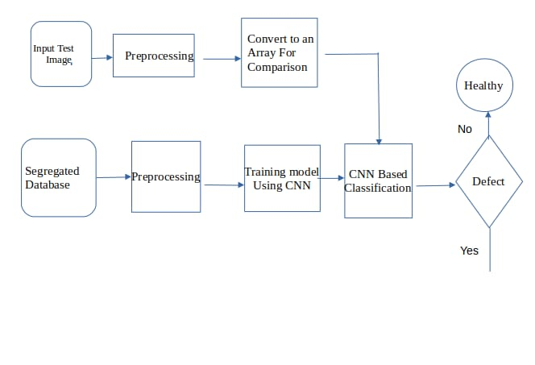
Project Life Cycle:
Affected

Slide 5
Languages used:
Backend development : PYTHON for model training
Frontend design : HTML & CSS
Frameworks and libraries : Tensorflow / Keras for model training, Flask for backend API
Development Environment :Visual Studio Code

Slide 6
Implementation:
Project setup: Environment Preparation , Install Flask
Create the Flask Application
Implement Image Processing Logic: Implement Image Processing Logic
Create the User Interface: HTML Template , CSS Styling
Run the Application : Start the Flask Server , Access the Web Application
Testing and Iteration : Test the Upload Feature, Verify the Prediction Output

Slide 7
Application of the Project:
Gardening: Helps hobbyist gardeners quickly identify pest issues to take preventive measures.
Agriculture: Assists farmers in managing crop health, reducing potential losses from pest infestations.
Education: Serves as a learning tool for students and enthusiasts interested in plant care and pest management.
Research: Provides data collection opportunities for researchers studying pest behaviors and plant responses.

Slide 8
References:
https://www.kaggle.com/datasets/drravirsaxena/pest-identification
Kamilaris, A., & Prenafeta-Boldú, F. X. (2018). Deep learning in agriculture: A survey. Computers and Electronics in Agriculture, 147, 70-90.
Xing, Y., Meng, H., Zhang, Z., & Chen, W. (2020). A novel hybrid model for insect pest recognition based on DCNN and SVM. Computers and Electronics in Agriculture, 169, 105222.
Mohanty, S. P., Hughes, D. P., & Salathé, M. (2016). Using deep learning for image-based plant disease detection. Frontiers in Plant Science, 7, 1419.
Ferentinos, K. P. (2018). Deep learning models for plant disease detection and diagnosis. Computers and Electronics in Agriculture, 145, 311-318.
https://www.researchgate.net/publication/350330823_Insect_Pest_Detection_and_Identification_Method_Based_on_Deep_Learning_for_Realizing_a_Pest_Control_System

Slide 9
Conclusion:
The Insect Pest Identification project leverages technology to provide a practical solution for plant health management. By combining web development with potential machine learning advancements, the application addresses a critical need among gardeners and farmers, promoting better pest management practices.

Slide 10
Future Work:
Model Enhancement: Replace the mock prediction logic with a trained deep learning model capable of accurately identifying specific pests and diseases.
User Authentication: Implement user accounts to allow personalized experiences, such as saving previous queries and managing a personal garden.
Data Visualization: Add charts and graphs to visualize pest occurrences and health trends over time based on user submissions.
Community Features: Create forums or chat functionalities where users can discuss pest management strategies and share experiences.
Offline Functionality: Develop a mobile app version that can function without internet connectivity, ideal for users in remote areas.

Slide 11
Thank You
Kavitha.S(22AI021)
Keerthivarsan.D(22AI022)
Kodisumith.R(22AI024)
Madhan.V(22AI025)

