Slide 1


AUTOFIXER: LLM-GUIDED PROGRAM REPAIR FOR JAVA USING NEURO-SYMBOLIC AND MULTIMODAL CODE REASONING
Supervisor
Ms.M.Shamini, M.E.,
Professor,
Department of CSE
Panimalar Engineering College Chennai City Campus
Head of the Department
Dr. I.Thamarai, M.E., Ph.D.,
Professor,
Department of CSE
Panimalar Engineering College Chennai City Campus
Student Name ELANTHIRAIYAN SB
(313522104033)
KEERTHIVASAN G
(313522104075)
MANISH MOHAN
(313522104093)
MOHAMMAD AMMAR
(313522104099)

Slide 2
ABSTRACT
Solves the "plausible but incorrect" patch issue by verifying AI-generated code against formal logic.
Combines the generative power of the Qwen2.5-coder LLM with the Z3 theorem prover for verification.
Uses multimodal analysis by integrating AST, CFG, and compiler diagnostics into the repair process.
Features a symbolic validation layer to eliminate hallucinations and ensure program semantic integrity.
CS3811- PROJECT WORK

Slide 3
INTRODUCTION
The increasing complexity of modern software makes manual debugging an expensive and time-consuming task for Java developers.
Automated Program Repair (APR) seeks to automate bug fixing, but existing tools often produce "plausible but incorrect" patches.
While Large Language Models (LLMs) offer generative power, they can introduce hallucinations that compromise software reliability.
AutoFixer addresses these issues by combining LLM-based code generation with formal verification using the Z3 theorem prover.

Slide 4
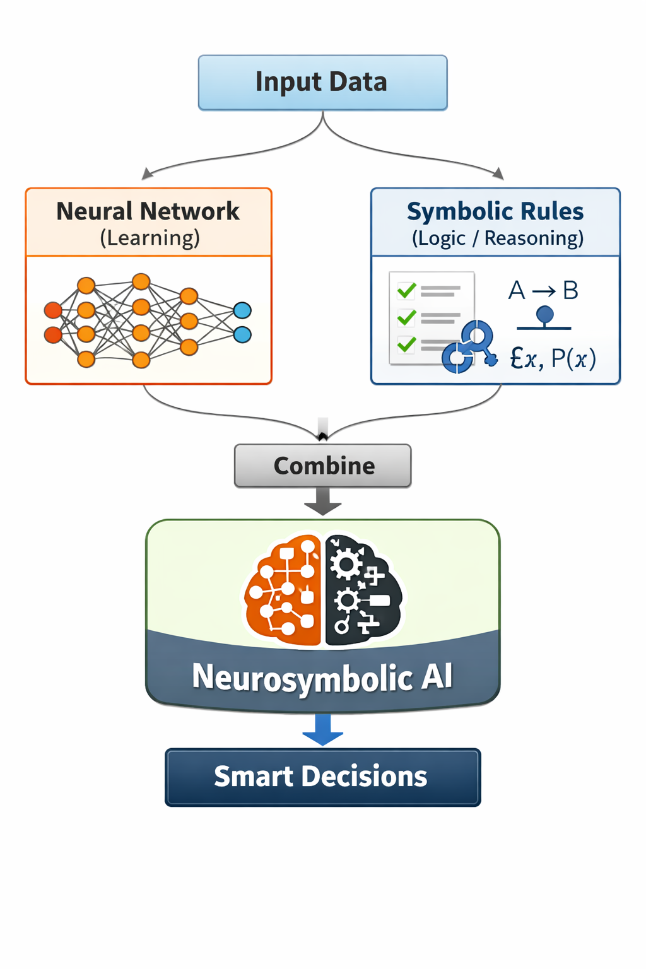
WHAT IS NEUROSYMBOLIC?
Neurosymbolic AI combines neural networks (which learn patterns from data) with symbolic AI to create systems that can both learn and think.
.

Slide 5
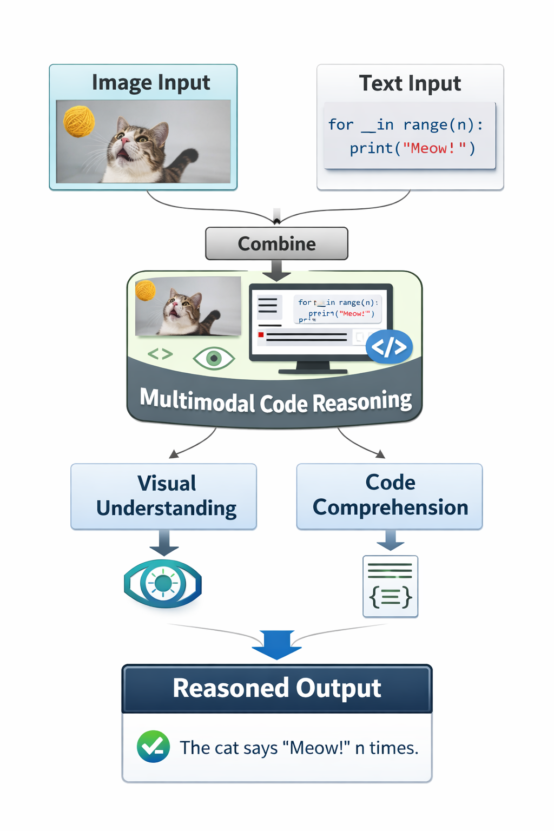
WHAT IS MULTIMODAL CODE REASONING?
Multimodal Reasoning is an AI approach that understands and reasons using multiple data types such as text, images, audio, and video together.

Slide 6
EXISTING SYSTEM
Traditional generate-and-validate systems like GenProg and ARJA often produce "plausible but incorrect" patches that pass tests but fail in execution.
Existing LLM-based methods such as CodeT5 and PLBART view repair as sequence problems but fail to provide any formal verification of the code.
Constraint-based techniques like SemFix and DirectFix offer semantic correctness through SMT solvers but scale poorly to large or complex programs..
Purely neural models operate as "black-box" systems, providing no explanation for repair decisions, which reduces developer trust.

Slide 7
DRAWBACKS
Frequent generation of "plausible but incorrect" patches that pass test suites while failing logical requirements.
Lack of formal semantic verification to ensure that generated code preserves the original program invariants.
Vulnerability to neural hallucinations where models produce syntactically valid but logically flawed code.
Insufficient integration of structural information like Abstract Syntax Trees, leading to shallow code analysis.

Slide 8
LITERATURE SURVEY
Title: Automatically finding patches using genetic programming
Authors: W. Weimer, T. Nguyen, C. Le Goues, and S. Forrest
This foundational paper introduced GenProg, the pioneering tool that used genetic programming to automatically repair defects in C programs. While it successfully proved that automated program repair was a viable concept, it relied heavily on a generate-and-validate approach. As your report notes, this method had a significant weakness: it frequently produced "plausible but incorrect" patches that could pass the existing test suites.

Slide 9
LITERATURE SURVEY
Title: SemFix: Program repair via semantic analysis
Authors: H. D. T. Nguyen, D. Qi, A. Roychoudhury, and S. Chandra
This paper introduced SemFix, a systematic approach that generates semantically correct program repairs by utilizing symbolic execution and constraint solving. Instead of relying on random code mutations, it represents the desired behavior of a program as logical constraints and uses an SMT solver to mathematically discover patches that satisfy them. This method significantly increased the validity of generated patches compared to earlier generate-and-validate techniques.

Slide 10
PROPOSED SYSTEM
Implements a dedicated symbolic validation layer to formally verify the semantic correctness of every generated patch.
Utilizes a local inference engine to ensure data privacy and reduce the cost associated with commercial API dependencies.
Introduces a neuro-symbolic framework that integrates the Qwen2.5-coder LLM with the Z3 theorem prover.
Features an automated feedback loop where Z3 counter-examples are fed back to the LLM to refine incorrect fixes.

Slide 11
ADVANTAGES
Significantly reduces the "plausible but incorrect" patch rate by enforcing formal logical constraints on AI output.
Eliminates neural hallucinations by grounding the LLM’s generative capabilities in mathematical rigor and truth.
Provides deeper code understanding through multimodal analysis of program structure rather than just raw text.
Ensures high reliability with a 95% fix success rate compared to the 50% success rate of standard neural models.

Slide 12
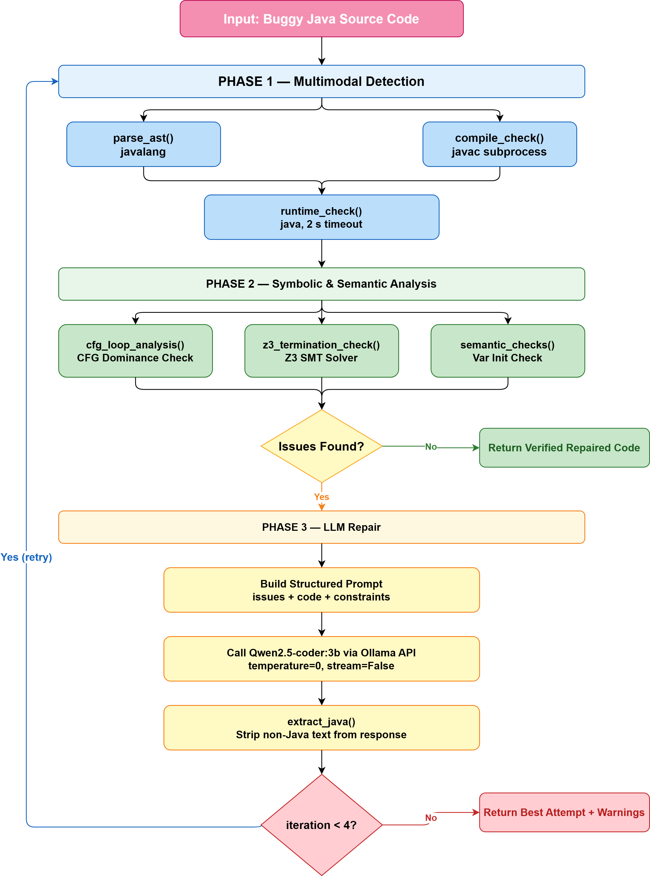
METHODOLOGY

Slide 13
METHODOLOGY
Input Buggy Java Source Code The process starts by taking faulty Java code as input for analysis and repair.
Phase 1 – Multimodal Detection The code is checked using parsing (parse_ast()), compilation (compile_check()), and runtime verification (runtime_check()) to detect syntax, compile-time, and execution errors.
Phase 2 – Symbolic & Semantic Analysis Advanced analysis is performed using control flow graph (CFG) loop analysis, Z3 termination checking, and semantic checks to identify logical and variable-related issues.
Issue Detection and Decision Making If no issues are found, verified repaired code is returned; otherwise, the system proceeds to automated repair.
Phase 3 – LLM-Based Repair A structured prompt containing detected issues and constraints is sent to the Qwen2.5-coder model to generate repaired Java code.
Iterative Refinement and Output The repair process repeats up to 4 iterations until verified repaired code is produced, otherwise the best repair attempt is returned with warnings.

Slide 14
SOFTWARE AND HARDWARE REQUIREMENTS
OS: Windows
Processor : minimum i5
GPU: Nvidia RTX 2060
RAM: 6GB
Software requirements:
Python
TensorFlow
Flask
VS Code
HTML,CSS,JavaScript

Slide 15
Modules
Programming language : python
=====================================================
Module 1: (OS Configuration)
System environment setup
Module 2: (Software configuration)
Python, Tensor Flow, Anaconda, Deep learning libraries and other libraries
Module 3:( Dataset collection and configuration )
Collect Text (Test-20% and Train-80%), config hypermeters.
Module 4: (Train the model )
Training on Ollama model (depending on how powerful your CPU and GPU)
.

Slide 16
Modules
Programming language : python
=====================================================
Module 5: (Add NeuroSymbolic and Multimodal)
Apply Neurosymbolic and multimodal code reasoning
Module 6: ( Accuracy )
Run Accuracy and Validate the test and validatation dataset.
Module 7: (Deploy model)
Save (.pth file )
Module 8: (Final)
Use the trained model to make predictions using API frameworks

Slide 17
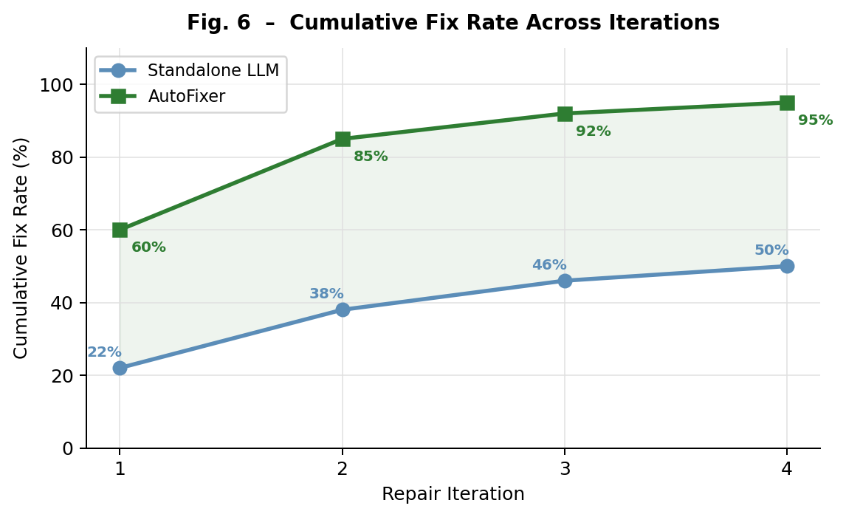
RESULT
CP

Slide 18
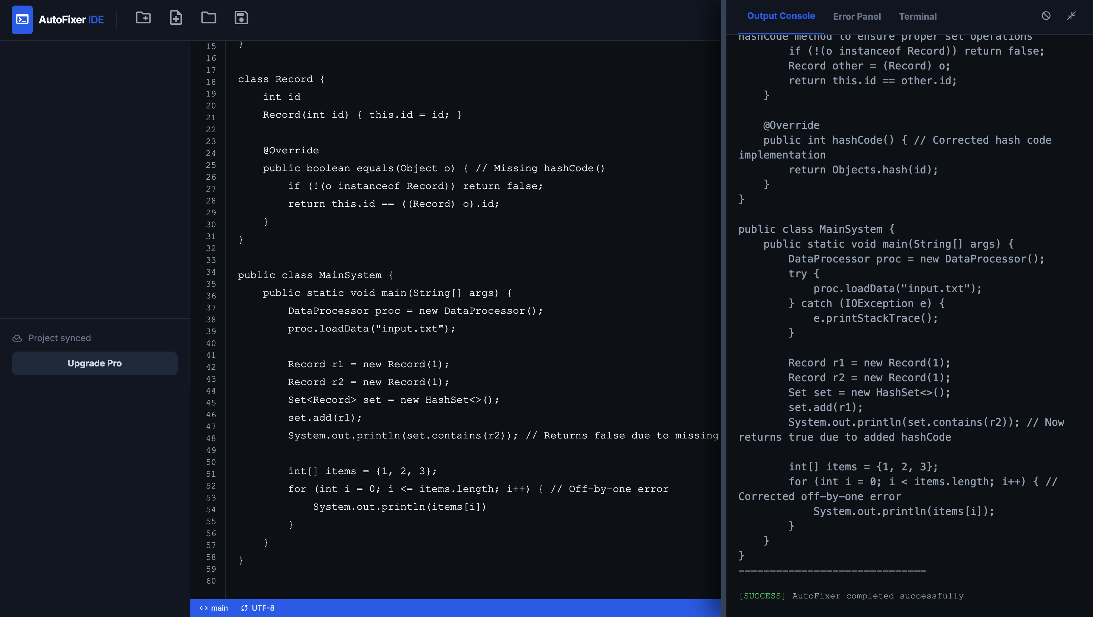
OUTPUT

Slide 19
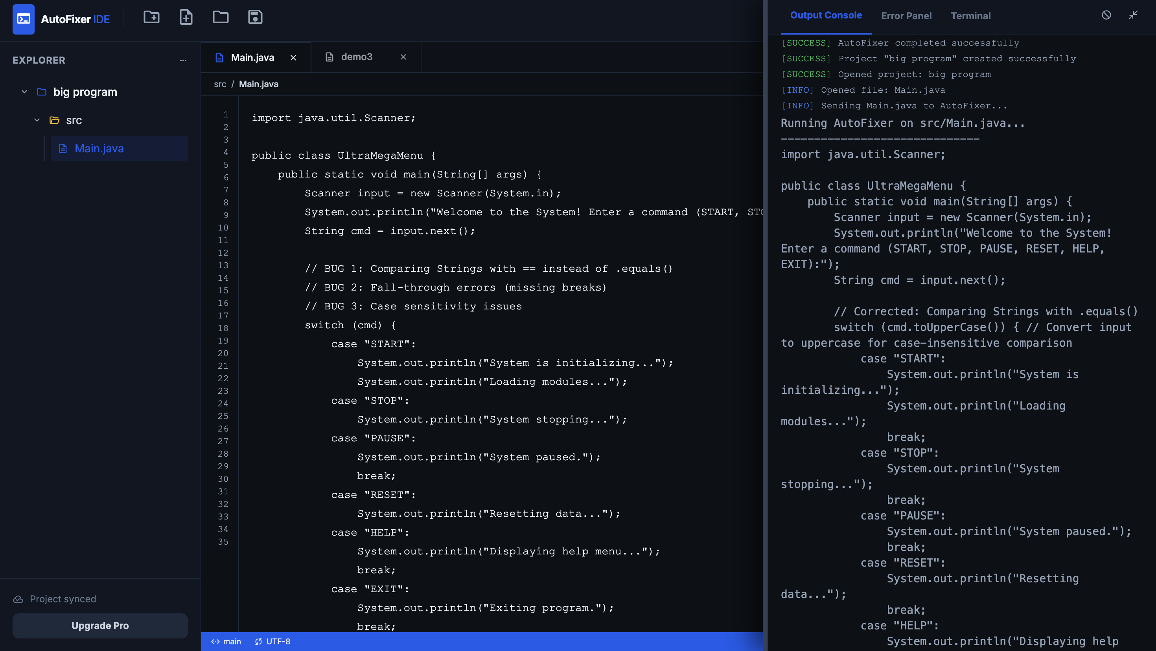
OUTPUT

Slide 20
Thank You

