Slide 1
PREDICTING MAINTENANCE NEEDS AND TRAFFIC ANOMALIES IN NETWORK DEVICES USING MACHINE LEARNING
Group 4
V. Divya Madhuri CB.SC.U4AIE23024
Keerthivasan S V CB.SC.U4AIE23037
Mopuru Sai Bavesh Reddy CB.SC.U4AIE23044
V. Bhavya Kruthi CB.SC.U4AIE23073

Slide 2
CONTENTS
Introduction
Dataset Overview
Methodology
Implementation
Results
Conclusion

Slide 3
Introduction
Predictive maintenance uses machine learning to predict when network devices might fail or need maintenance. By analyzing data like CPU and memory usage, and network traffic, it helps identify potential issues before they cause disruptions. The goal is to reduce downtime, improve performance, and optimize resources by detecting patterns in device health that are hard for humans to spot.
The goal is to:
Detect Problems Early: Identify high CPU/memory usage or unusual network traffic before they cause failures.
Save Costs: Perform maintenance only when needed, avoiding unnecessary downtime.
Ensure Reliability: Keep devices running smoothly by addressing issues proactively.
This project applies machine learning to monitor device health, detect anomalies, and generate alerts to help maintain network devices efficiently
This project applies machine learning to monitor device health, detect anomalies, and generate alerts to help maintain network devices efficiently

Slide 4
Dataset Overview
The dataset seems to reflect a network scenario where a small number of devices (represented by the IPs) are communicating with a constrained set of services (destination ports), but using a wide range of temporary source ports for these interactions. This pattern could indicate:
Monitoring or testing in a controlled network.
Focused traffic between specific servers or services.
Potential for further analysis of service usage or port-based anomalies.
Shape: 54,768 rows × 30 columns.
Key Features:
Network Info: Date, Source_IP, Destination_IP, Source_Port, Destination_Port
Traffic Stats: Flow_Duration, Packet_Size, Flow_Bytes_per_s, Flow_Packets_per_s
Protocol & Security: Protocol_Type, Attack_Vector, Anomaly_Score
Labels: Label (Normal/Attack), Anomaly_Severity_Index

Slide 5
METHODOLOGY
Data Collection and Preprocessing
To clean and prepare the dataset for effective model training and ensure the data is suitable for analysis.
Traffic Anomaly Detection
To detect traffic anomalies that may indicate security threats or issues requiring attention
Generating Alerts
To notify stakeholders of critical issues that require attention, based on detected anomalies and system performance.
Model Training and Evaluation
Generating Alerts for Critical Issues
To create detailed, personalized alerts for devices with critical issues requiring immediate attention.
The goal is to use machine learning to predict devices needing maintenance and flag those with high maintenance needs and traffic anomalies as critical issues.

Slide 6
IMPLEMENTATION
1.Data Collection and Preprocessing:
Data Loading: The dataset is loaded from a CSV file containing network traffic, device health, and system performance attributes. It is important to clean and preprocess the data to ensure it is ready for machine learning models.
Feature Engineering:
Maintenance Need Criteria: A target variable Maintenance_Needed is defined based on CPU utilization, memory utilization, and system patch status. If CPU or memory utilization exceeds a threshold (80% CPU, 85% Memory) or the device is outdated, it is flagged for maintenance.
Spike Detection: Sudden changes in CPU and memory utilization are detected using the diff() function, which calculates the difference between consecutive data points.
Why: This step ensures that the dataset is cleaned and transformed into meaningful features, such as Maintenance_Needed and spike detection, which are crucial for the model to understand when maintenance is required based on system performance.

Slide 7
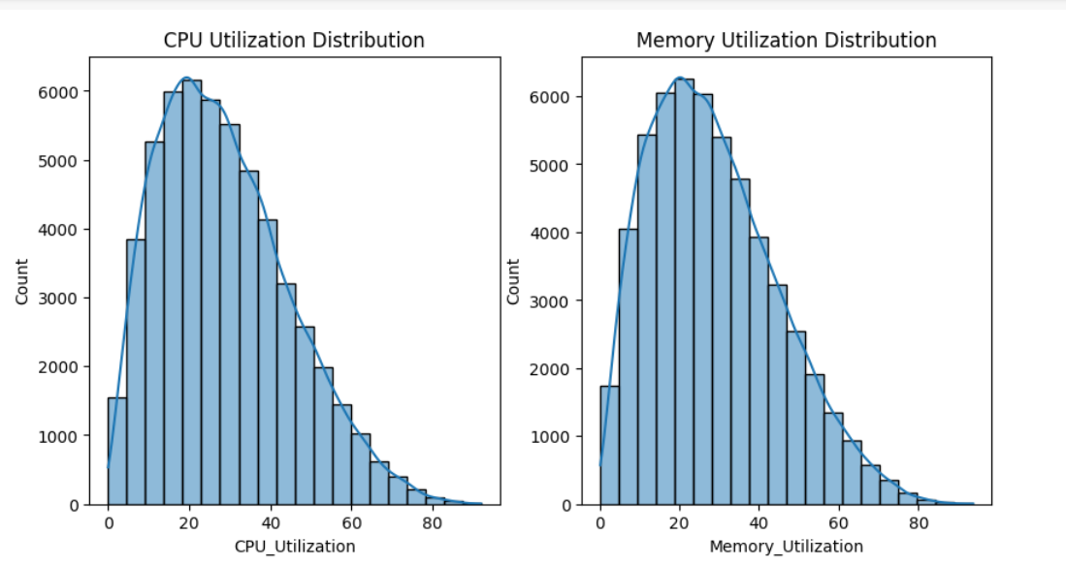
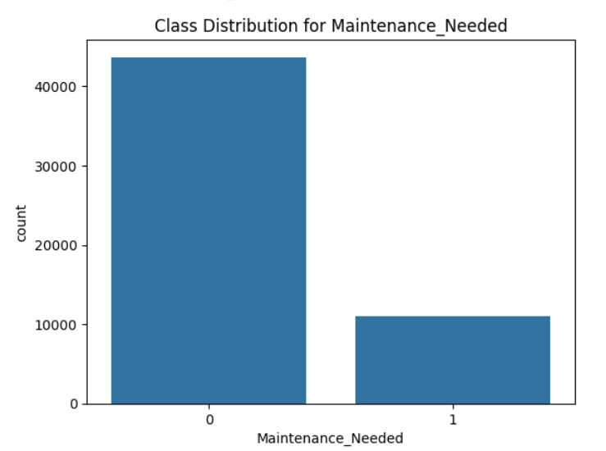

Slide 8
2.Traffic Anomaly Detection
Anomaly Detection with Isolation Forest: Isolation Forest is applied using network traffic features such as Flow_Bytes_per_s and Flow_Packets_per_s to detect anomalies. Anomalies are flagged as outliers by Isolation Forest.
Label Conversion: Anomalies are re-labeled from -1 (outlier) to 1 (anomaly) and 1 (normal) to 0.
Anomaly Severity: The severity of the anomaly is labeled as "High" if the anomaly is detected.
Why: Traffic anomalies can indicate security issues, network inefficiencies, or potential device failures. Detecting these anomalies helps proactively manage device health and network security.

Slide 9
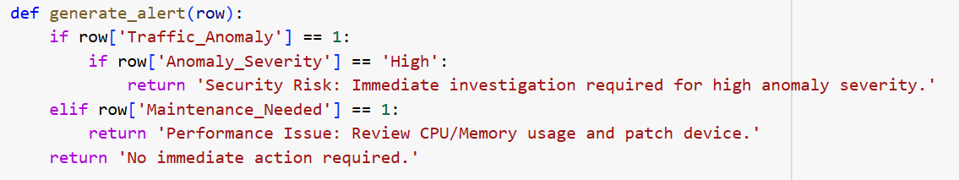
3. Generating Alerts
Alert Generation Logic: A function is created to generate alerts based on traffic anomalies and maintenance needs. If both high traffic anomalies and maintenance needs are detected, a critical issue alert is generated.
Why: Alerts serve as actionable insights, helping IT teams prioritize responses to devices showing potential issues. These alerts ensure prompt action to reduce downtime and mitigate security risks.

Slide 10
4. Model Training and Evaluation: Predicting Maintenance Needs
Model Training (Random Forest & XGBoost): Two classifiers, Random Forest and XGBoost, are used to predict the maintenance needs based on system utilization and traffic data.
Hyperparameter Tuning: GridSearchCV is applied for hyperparameter optimization to find the best-performing model. Evaluation Metrics: Models are evaluated using metrics like accuracy, precision, recall, and F1 score.
Why: Machine learning models are used to predict when maintenance is needed based on historical data. This proactive approach minimizes downtime and optimizes device performance by anticipating failure.

Slide 11
Model Training and Evaluation: Detecting Critical Issues
Critical Issue Detection: A new target variable, Critical_Issue, is defined where a device is flagged if both maintenance is needed and a traffic anomaly is detected.
Random Forest Classifier for Critical Issues: A Random Forest model is trained on relevant features to predict critical issues.
Why: Identifying critical issues allows for timely intervention, preventing both performance degradation and security vulnerabilities by addressing the most urgent cases.

Slide 12
5. Generating Alerts for Critical Issues
Alert Generation for Critical Devices: Devices flagged with critical issues receive detailed alerts, including CPU utilization, memory usage, traffic anomalies, and recommended actions for resolution.
Why: Detailed alerts ensure the IT team can quickly address critical issues, minimizing downtime and preventing potential damage by acting on urgent cases.

Slide 13
6. Insights and Results
Data Insights: The data is analyzed to provide insights on average CPU and memory utilization for devices needing maintenance versus those that don’t.
Critical Issue Statistics: The number of critical issues detected is analyzed, and a breakdown is provided to show devices that need immediate attention.
Why: Analyzing the results helps evaluate model performance and gain valuable insights into network device health, aiding in better decision-making and resource allocation.

Slide 14
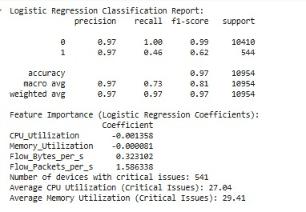
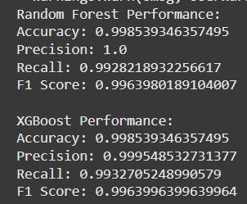
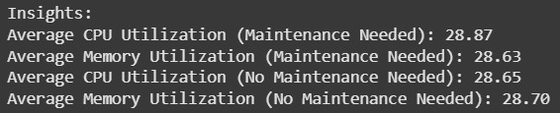
Results

Slide 15
CONCLUSION
This project demonstrates a proactive approach to maintaining network devices and ensuring network security using machine learning. By leveraging Random Forest and XGBoost models, we effectively predicted maintenance needs based on CPU utilization, memory usage, and patch status, helping to prevent unexpected failures and reduce downtime.
For traffic anomaly detection, the Isolation Forest model was used to identify unusual network behavior, highlighting potential security threats and performance issues. Combining maintenance predictions and traffic anomalies allowed us to flag critical devices for immediate attention, ensuring prioritized resolution of serious problems.
Alerts with recommended actions were generated to assist IT teams in addressing issues promptly, improving system reliability and security. Evaluation using metrics such as accuracy, precision, recall, and F1 score confirmed the effectiveness of our approach.
In summary, this project provides a robust, machine learning-driven solution to predict and address network issues before they escalate, ensuring smoother operations and enhanced network safety.

Slide 16
FUTURE INSIGHTS
Predictive Maintenance with IoT Integration
Integrate IoT sensor data (if applicable) for holistic insights into system health, including environmental factors such as temperature and humidity.
Visualization and Reporting
Dynamic Dashboards: Create dashboards in tools like Tableau or Power BI to provide stakeholders with real-time insights into anomalies, maintenance needs, and system health.
Critical Issue Management
Priority Scoring: Develop a scoring mechanism to prioritize critical issues based on the severity of anomalies and their impact on system performance
Integration with Security Analysis
Threat Intelligence: Combine traffic anomalies with external threat intelligence feeds to classify anomalies as potential cyber threats.

Slide 17
Thank you

