Slide 1
Remote Sensing And Machine Learning Techniques to Assess to Quantify and Predict Natural Disasters
GROUP 4
V. Divya Madhuri CB.SC.U4AIE23024
Keerthivasan S V CB.SC.U4AIE23037
Mopuru Sai Bavesh Reddy CB.SC.U4AIE23044
V. Bhavya Kruthi CB.SC.U4AIE23073

Slide 2
Introduction
Overview of Natural Disasters:
Floods and wildfires are increasingly affecting regions like Texas (flooding) and Arizona (wildfires).
These disasters cause significant damage to lives, property, and ecosystems.
Early detection and prediction are essential for disaster management and mitigation.
Importance:
This project aims to integrate image enhancement techniques and prediction models to better predict and manage these disasters.
By using satellite imagery and machine learning models, we can improve early warning systems and reduce disaster impact.
TEAM 4 - FAI

Slide 3
Primary Goal:
Enhance satellite images for flood and fire detection.
Develop predictive models for flood and fire management.
Specific Aims:
Flood prediction using Normalized Difference Water Index (NDWI), historical data, and machine learning.
Fire detection using Normalized Difference Vegetation Index (NDVI), Wavelet Transforms, and HSV enhancements.
Enhance image quality to detect flood and fire-affected areas effectively.
Project Objective
TEAM 4 - FAI​

Slide 4
Flood Estimation Dataset (Texas):
Landsat imagery with Near-Infrared (NIR) and Mid-Infrared (MIR) bands.
Geographical data including elevation and rainfall.
Historical flood records and data on past flood events.
Fire Detection Dataset (Arizona):
Landsat imagery with spectral bands used to detect fire-prone vegetation.
NDVI (vegetation health) and NMDI (Normalized Multi-Band Drought Index) for assessing fire risk.
Weather conditions such as temperature and humidity.
Data Frequency: Satellite images are collected on a monthly basis, with historical data from past floods and fires.
DATASET OVERVIEW

Slide 5
ESTIMATE FLOOD AREAS IN TEXAS
Loading and Preprocessing:
Align Bands: Manually align the bands for August and September since they are not pre-aligned.
Remove Black Bands: Remove sensor fault lines (black bands) using a mask and inpainting to clean images.
Band Combination for Visualization: Combine Bands 1-3 to create RGB images for visual comparison between August and September.
Manual Pixel Shift for Alignment: Apply manual pixel shifting on August bands to match with September’s for accurate comparison.
Thresholding and Mask Creation: Create a mask using thresholding to highlight areas affected by sensor faults.
Inpainting Process: Use different inpainting algorithms (e.g., Fast Marching Method) to reconstruct areas masked due to sensor faults.
NDWI Calculation for Flood Detection:
Calculate NDWI (Normalized Difference Water Index) to identify flooded areas based on water pixel values.
Threshold NDWI results to isolate flooded water pixels.
Flooded Area Calculation:
Convert identified water pixels to area using satellite resolution (30m x 30m per pixel).
Calculate total flooded area in km² based on pixel count and pixel size.

Slide 6
DETECTING FIRE HOTSPOTS IN ARIZONA
Processing of different spectral bands to generate a false-color image and calculate vegetation indices such as NDVI and NMDI to identify areas affected by fire. 1. Loading Bands (Satellite Data) 2. Creating a False-Color Image The false-color image allows the visualization of fire hotspots (e.g., burned areas often appear in specific colors). A false-color image is generated by combining different bands to visually highlight fire-affected areas.
Bands Used: The code uses:
Band 7 (NIR - Near Infrared) for the red channel.
Band 5 (MIR - Mid Infrared) for the green channel.
Band 4 (Red) for the blue channel.
The cv2.merge function is used to combine these bands into a 3-channel RGB image, resulting in a false-color image.

Slide 7
3. Alternative Method 1: NDVI Calculation
NDVI (Normalized Difference Vegetation Index) is used to measure vegetation health by comparing the reflectance in the NIR and RED bands.
Formula:
Steps:
Convert RED (Band 3) and NIR (Band 4) to float32 for accurate calculations.
Calculate NDVI using the formula.
Handle NaN values by setting them to 0.
Normalize the NDVI between 0 and 255 using cv2.normalize.
Convert NDVI back to uint8 for display.
Mask Creation: The calculate_mask function creates a binary mask for areas affected by fire based on NDVI values. A threshold of 0.30 is used to define affected areas.
NDVI = NIR – Red / NIR + Red

Slide 8
4. Alternative Method 2: Using the False-Color Image
HSV Color Space: The false-color image is converted to HSV for easier detection of specific color ranges (e.g., red, yellow, orange).
Color Masking: The code uses cv2.inRange to create masks for specific color ranges:
Red Range: Identifies areas with fire.
Yellow and Orange Ranges: Identifies potential hotspots.
Masks Combination: Masks are combined using the cv2.bitwise_or operation to identify areas affected by fire and hotspots.
Results: The affected areas and fire hotspots are visualized, showing better results than the NDVI-based method for detecting fire locations.
5. Fire Area Calculation
The number of affected pixels (those with values of 255 in the mask) is counted using np.sum.
This count is then converted into a real-world area (km²) using the function calculate_km_affected. This is where a formula is used, but it’s abstract in the provided code.
6. NMDI Calculation
NMDI (Normalized Multi-Band Drought Index) is introduced as an alternative to NDVI for detecting fire-affected areas using additional bands.

Slide 9

Formula for NMDI:
Where:
NIR corresponds to the Near-Infrared band (Band 4).
MIR1 and MIR2 are two different Mid-Infrared bands (Bands 5 and 7).
Steps:
Convert NIR, MIR1, and MIR2 bands to float32.
Calculate NMDI using the formula.
Handle NaN and infinite values by setting them to -1.
Normalize NMDI between 0 and 1 using cv2.normalize.
Create masks for vegetation and soil based on NMDI values, where lower values indicate fire-affected vegetation.
Percentile Calculation: Percentiles (e.g., 40th percentile for NDVI) are used to differentiate between soil and vegetation.
7. Fire Detection with NMDI
A mask is created for areas with low NMDI values, indicating fire-affected vegetation.
The results are visualized to show the NMDI-based detection of fire-affected areas, compared to the NDVI and false-color methods.

Slide 10
ENHANCING ADRA IMAGE
Alternative 1: HSV Luminance Replacement
Convert RGB to HSV:
Convert the RGB image to the HSV (Hue, Saturation, Value) color space. The HSV color space separates color information (Hue and Saturation) from brightness (Value or Luminance), making it easy to adjust brightness without affecting color.
Formula for HSV Conversion:
The formula and conversion involve calculating hue, saturation, and value based on the RGB values.
Resize Panchromatic Band:
Resize the panchromatic band to match the dimensions of the RGB image to ensure compatibility when replacing the luminance channel.
Replace Luminance with Panchromatic Band:
Substitute the Value (V) channel in the HSV image with the high-resolution panchromatic band. This allows us to bring in more detailed brightness information without altering the RGB image's color content.
Convert HSV back to RGB:
Convert the modified HSV image back to RGB. The result is a higher-resolution color image where the details from the panchromatic band enhance the brightness while retaining the color of the original RGB image.

Slide 11
Alternative 2: Wavelet Transform of the Panchromatic Image
Set Up Bands:
Identify the bands for Red, Green, and Blue (R, G, B) from the grayscale images, representing the initial colors to be processed.
Resize Panchromatic Band:
Resize the panchromatic band to match the dimensions of the other RGB bands for compatibility with wavelet decomposition.
Apply Wavelet Transform:
Perform a 2D Discrete Wavelet Transform (DWT) on both the panchromatic image and each color band (R, G, B) using the biorthogonal wavelet ('bior3.7').
Formula for Wavelet Decomposition: DWT(image)=(LL,(HL,LH,HH))
Here, LL is the low-frequency approximation component, while HL, LH, and HH are high-frequency components that capture different directional details.

Slide 12
4. Replace Low-Frequency Coefficients:
Substitute the low-frequency approximation coefficients (LL) of the color bands (R, G, B) with those from the panchromatic band. This step infuses the RGB channels with higher detail from the panchromatic image.
5. Reconstruct Image with Inverse DWT:
Perform the Inverse Discrete Wavelet Transform (IDWT) to reconstruct each modified color band (R, G, B) with the enhanced details from the panchromatic band.
6. Merge Reconstructed Bands:
Combine the three reconstructed bands (R, G, B) into a single high-resolution RGB image using cv2.merge.
7. Visualize the Result:
Display the original RGB image and the enhanced image side-by-side for comparison.

Slide 13
FLOOD PREDICTION MODEL
1. Data Loading, Cleaning, feature,label seperation and EDA plots
Check for Missing Values: Use apply() to identify any empty columns.
Convert Labels: Replace values in the FLOODS column from YES/NO to 1/0 for numerical analysis.
Separate Features (x): Select predictor columns (columns 1 to 13).
Separate Target (y): Select the FLOODS column as the target variable.
2. Feature Scaling
Scale Data: Normalize features between 0 and 1 using MinMaxScaler for uniform distribution across model inputs.
3. Train-Test Split
Split Dataset: Divide data into training and testing sets (80% train, 20% test) to validate model performance.
4. K-Nearest Neighbors (KNN) Classification
Train KNN Model: Use KNeighborsClassifier to train on x_train and y_train.
Prediction and Evaluation: Predict flood chances, compare with actual values, and evaluate accuracy using cross_val_score.

Slide 14
5. Logistic Regression​
Standardize Data: Rescale training and testing data using MinMaxScaler.​
Train and Evaluate: Train LogisticRegression, predict flood chances, and evaluate with metrics (accuracy_score, recall_score, roc_auc_score).​
6. Decision Tree Classifier​
Train Model: Train DecisionTreeClassifier on training data.​
Predict and Evaluate: Make predictions, compare with actual flood values, and evaluate with standard metrics.​
7. Random Forest Classifier​
Train Random Forest Model: Use RandomForestClassifier to train with a max depth of 3.​
Evaluation: Use cross_val_score for accuracy and compare predictions against actual data.​
8. Ensemble Learning​
Voting Classifier Setup: Combine LogisticRegression, RandomForestClassifier, and KNeighborsClassifier in a VotingClassifier.​
Prediction and Evaluation: Predict flood chances, compare individual classifiers' accuracy, and evaluate ensemble performance.​

Slide 15
FIRE PREDICTION MODEL
Setup: Import necessary libraries (numpy, pandas, matplotlib, seaborn) and load the dataset.
Data Cleaning: Convert Portuguese month names to English.
Initial Analysis: Examine basic statistics of the 'number' column, noting high variability in fire counts.
Max Fire Analysis: Identify the highest fire count, including the month, year, and state.
Monthly Analysis: Group data by month, calculate total fires, and identify peak fire months based on mean and standard deviation.
State and Yearly Analysis: Summarize fire counts by state and year, identifying peak states and years with visualizations.
Prediction Modeling:
Third-degree Polynomial: Fit a cubic model to predict future fires (2019-2023).
Linear Model (Post-2006 Data): Fit a simpler linear model for a refined, less aggressive prediction for future fires

Slide 16
Flood-Prone Areas: Visualize the predicted flood regions in Texas based on NDWI and model outputs.
Map Visualization: Display the predicted flood zones and compare them with actual flood occurrences.
Model Performance: accuracy Logistic Regression: 91.6% KNN: 83.3% Decision Tree:75% Random Tree:91.6% Ensemble:91.6%
Flood Prediction Results
TEAM 4 - FAI

Slide 17
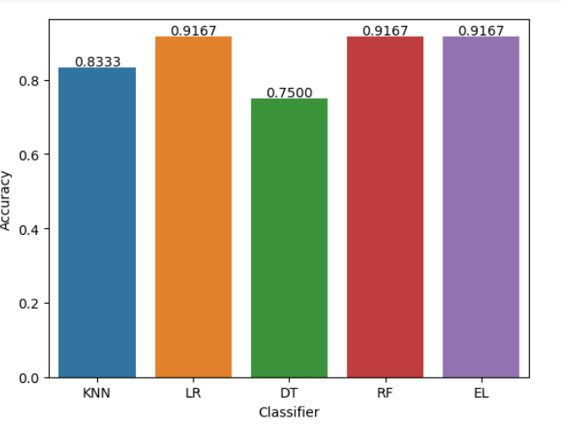

Slide 18
Fire-Affected Areas: Show the fire-affected regions in Arizona identified using NDVI and HSV-enhanced maps.
Map Visualization: Display the fire zones predicted using the model and compare with actual fire data.
Fire Prediction Results
TEAM 4 - FAI

Slide 19
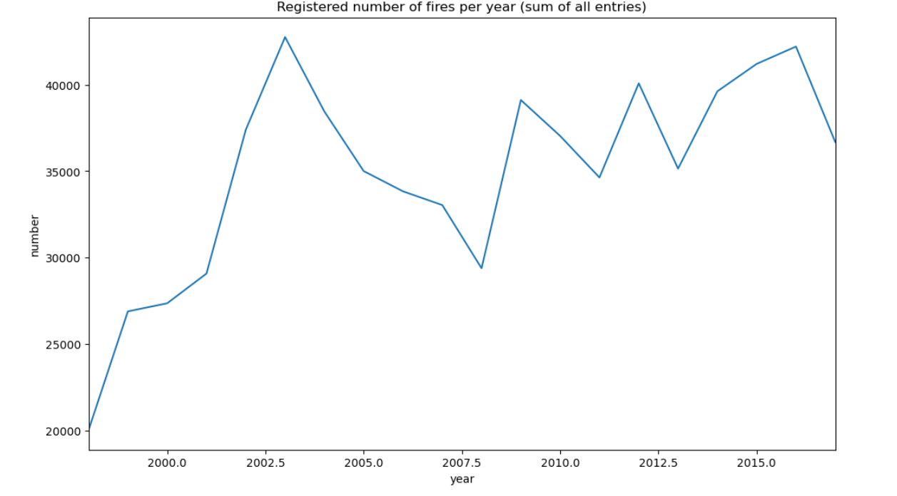
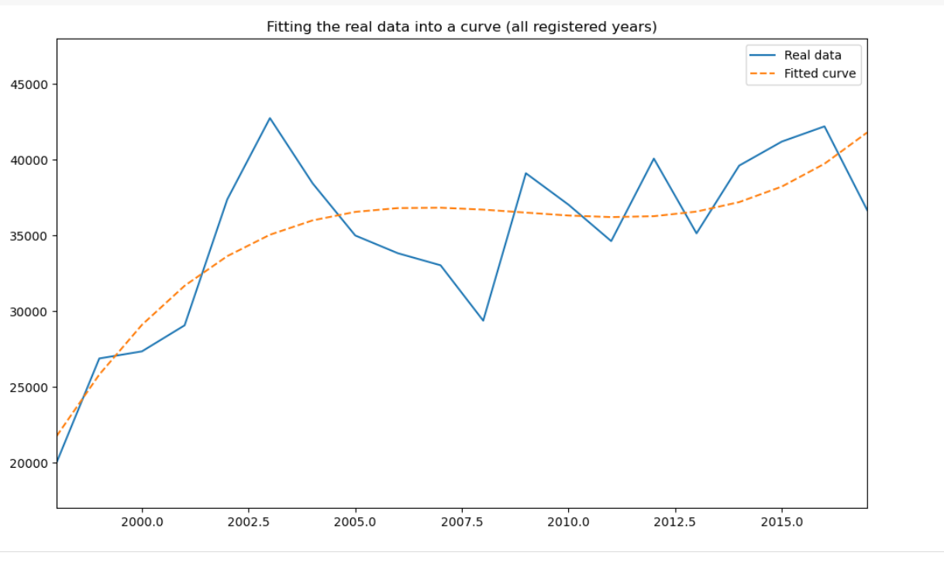
TEAM 4 - FAI

Slide 20
Summary:
The project combines image enhancement techniques and machine learning models to predict floods and fires.
These methods improve disaster management, helping authorities take proactive actions.
Impact:
Real-time predictions of floods and fires can guide disaster relief efforts and reduce damage.
Next Steps:
Expand the geographic scope of the prediction models.
Improve real-time monitoring and response mechanisms.
CONCLUSION

Slide 21
Thank you

